Slide 1
[그림 3-1]
you
say
goodbye
and
I
you
Win
hello
say
.
(7x3)
goodbye
Wout
and
(3x7)
I
you
Win
hello
say
은닉층
.
goodbye
(7x3)
and
출력층
I
hello
.
입력층

Slide 2
[그림 3-2]
you
say
goodbye
Win
and
I
(7x3)
hello
.
은닉층
입력층

Slide 3
[그림 3-2]
(1x7)
입력층
은닉층
Win
(7x3)
[ 1
0
0
0
0
0
0 ]
(1x7)
입력층
은닉층
Win
(7x3)
[ 0
0
1
0
0
0
0 ]

Slide 4
[그림 3-3]
you
say
goodbye
and
I
Win
hello
.
(7x3)
Wout
Softmax
LOSS
(3x7)
you
Win
say
은닉층
goodbye
(7x3)
and
출력층
확률
정답 레이블
I
hello
.
입력층

Slide 5
[그림 3-5-2]
Softmax
you
Wout
say
은닉층
goodbye
Win
출력층
확률
정답 레이블
LOSS
and
I
hello
Wout
.
Softmax
입력층
확률
정답 레이블

Slide 6
you
say
goodbye
and
I
Win
hello
.
(7x3)
Wout
(3x7)
you
Win
say
goodbye
(7x3)
and
I
hello
.

Slide 7

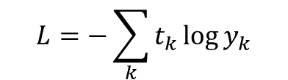
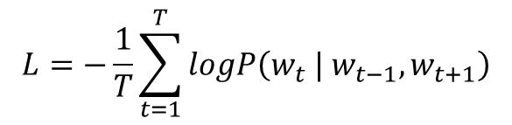


[수식 3-5-1]
$$w_{1}{ w}_{2}…w_{t−1}{ w}_{t}{ w}_{t+1}⋯w_{T−1}{ w}_{T}$$
$$P\left(w_{t} | w_{t−1},w_{t+1}\right)$$
$$L=−\sum_{k}{t_{k}\log{y_{k}}}$$
$$L=−logP\left(w_{t} | w_{t−1},w_{t+1}\right)$$
$$L=−\frac{1}{T}\sum_{t=1}^{T}{logP\left(w_{t} | w_{t−1},w_{t+1}\right)}$$
P$\left(w_{t} | w_{t−1},w_{t+1}\right)$

Slide 8
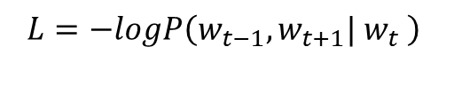



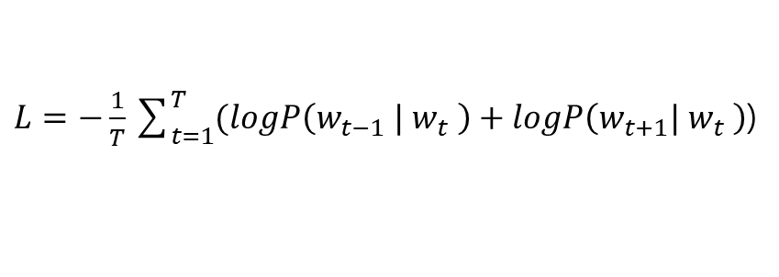
[수식 3-5-2]
$$w_{1}{ w}_{2}…w_{t−1}{ w}_{t}{ w}_{t+1}⋯w_{T−1}{ w}_{T}$$
$P\left(w_{t−1},w_{t+1}| w_{t} \right)$ =$P\left(w_{t−1} | w_{t} \right)P\left(w_{t+1}| w_{t} \right)$
$$L=−logP\left(w_{t−1},w_{t+1}| w_{t} \right)$$
$=$ $−logP\left(w_{t−1} | w_{t} \right)P\left(w_{t+1}| w_{t} \right)$
$=$ $−(logP\left(w_{t−1} | w_{t} \right)+logP\left(w_{t+1}| w_{t} \right)$)
$L=−\frac{1}{T}\sum_{t=1}^{T}{(logP\left(w_{t−1} | w_{t} \right)+logP\left(w_{t+1}| w_{t} \right)}$)

