Slide 1




Building a QR code and barcode scanner
DONE BY: NYAMANDE VANESSA
TAFADZWA TRACEY
MANDEYA TAFADZWA

Slide 2



What is a qr code
It is two-dimensional version of the Barcode which is able to convey a wide range of information instantly with the scan of a mobile device
It can take up to 30% damages of the Code

Slide 3





Structure of a qr code
Position detectors
Alignment markers
Timing pattern
Version Information
Formation Information
Data and error correction keys
Quiet zone

Slide 4
What is a bar code
•it is a machine readable representation of numerals and characters and it consist of bars and spaces
•Mainly used in supermarkets ,convenience stores and other ubiquitous

Slide 5
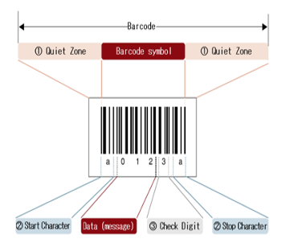



Structure of a barcode
•Consist of
•
-Quiet Zone
-Start / Stop character
-Check Digit

Slide 6
How a barcode /qr code scanner works
1 .Decoding function
•Barcode/Qr code recognition on camera
•Recognised stored information is added as text on the qr/bar code
•the information is exportedstored as a text document

Slide 7

How a barcode /qr code scanner works
2.Main function
Turn on the video camera on the computer
Call the decoding function.
Read the decoded text
Load a website for the qr code

Slide 8

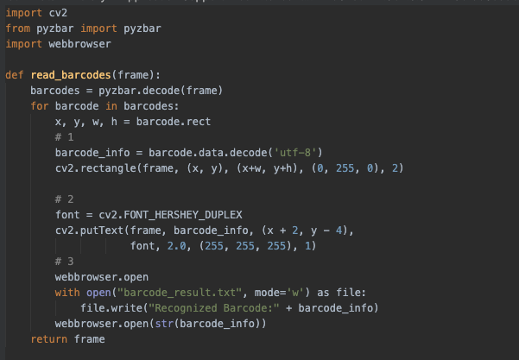


Slide 9
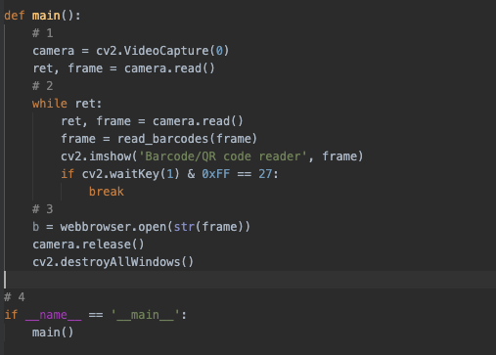

Slide 10
The code results are shown below!
THANK YOU FOR WATCHING

Slide 11

Video

