Slide 1
Build a qr code/barcode scanner

Slide 2
What is a qr code
It is two-dimensional version of the Barcode which is able to convey a wide range of information instantly with the scan of a mobile device
It can take up to 30% damages of the Code

Slide 3
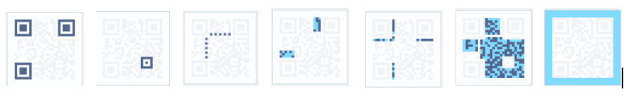
Structure of a qr code
Position detectors
Alignment markers
Timing pattern
Version Information
Formation Information
Data and error correction keys
Quiet zone

Slide 4
What is a bar code
it is a machine readable representation of numerals and characters and it consist of bars and spaces
Mainly used in supermarkets ,convenience stores and other ubiquitous

Slide 5
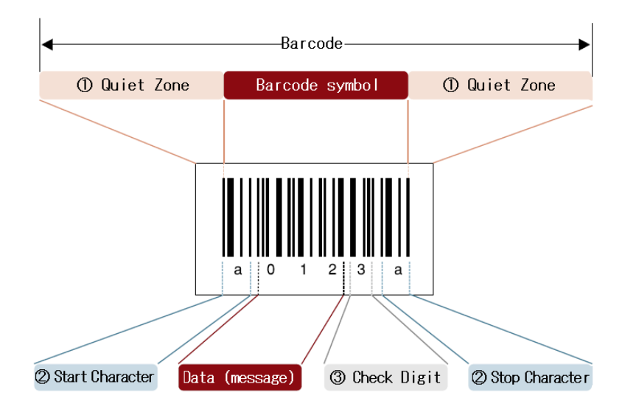
Structure of a barcode
Consist of
-Quiet Zone
-Start / Stop character
-Check Digit

Slide 6
How a barcode /qr code scanner works
1 .Decoding function
Barcode/Qr code recognition on camera
Recognised stored information is added as text on the qr/bar code
the information is exportedstored as a text document

Slide 7
How a barcode /qr code scanner works
2.Main function
Turn on the video camera on the computer
Call the decoding function.
Read the decoded text
Load a website for the qr code.

Slide 8

Video

