Slide 1


Factors Affecting Performance in Swimming
Presented by: NazriFC
Objective: To analyze which factors influence performance in swimming using exploratory data analysis and hypothesis testing.

Slide 2
Sections:
Tafara Kanyemba: 3-15,29,34-37
Unathi Manana: 20-28,30-31
Neo Zandamela: 16-19,32-33

Slide 3

    But reduces to just 200 observations
2000 observations (originally)
33 variables
Focused on swimming athletes

Slide 4
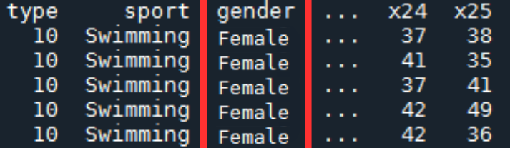

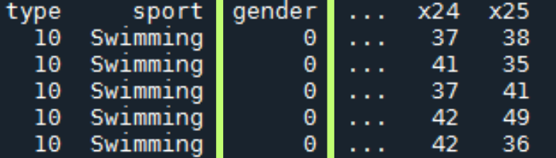
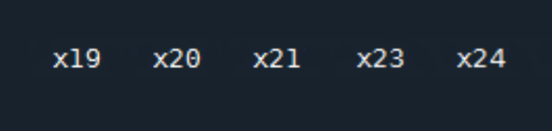

Phase 1 – Exploratory Data Analysis (EDA) Overview
BEFORE
BEFORE
AFTER
AFTER
Converted gender to binary (1 for Male, 0 for Female).
Removed redundant variable x22 (Physical Fitness) which was identical to x13 (Fitness)

Slide 5
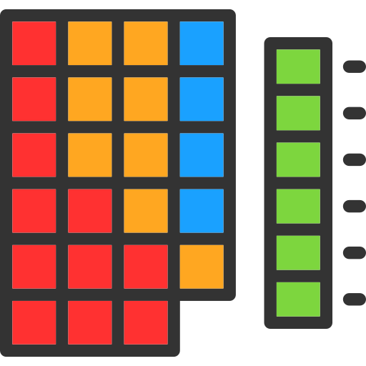
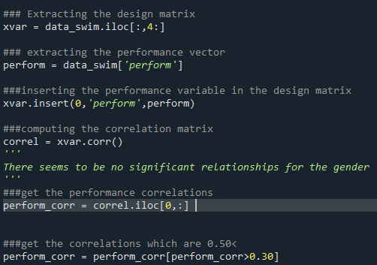
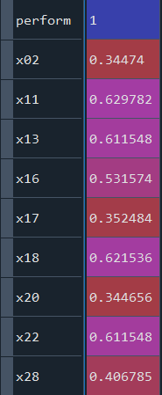
Phase 1 – Correlation Analysis
Variables arm strength, endurance, fitness, lactate threshold, maximal oxygen uptake, muscle strength, physical fitness and technical skills show high correlations with performance.

Slide 6
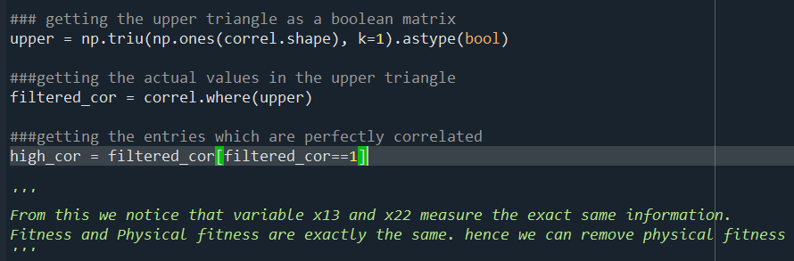
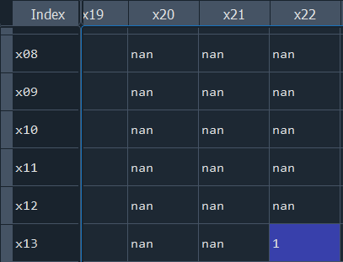
Phase 1 – Correlation Analysis
X22 (physical fitness) and x13 (fitness)
Have the exact same information!

Slide 7
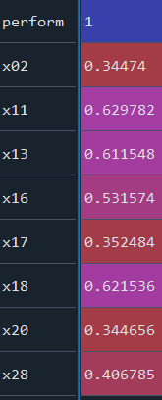
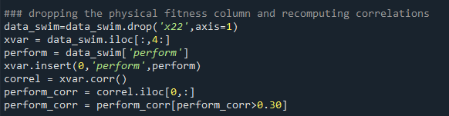
Phase 1 – Correlation Analysis
Variables arm strength, endurance, fitness, lactate threshold, maximal oxygen uptake, muscle strength and technical skills show high correlations with performance.

Slide 8
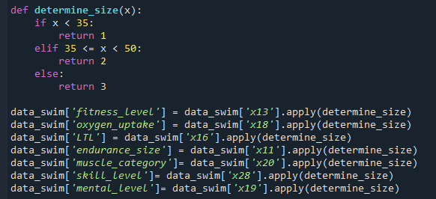
Phase 1- Categorical Variables
We felt it necessary to create an extra set of categorical variables

Slide 9
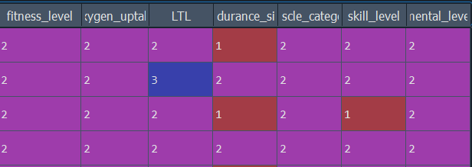
Phase 1- Categorical variables
The additional categorical variables.

Slide 10
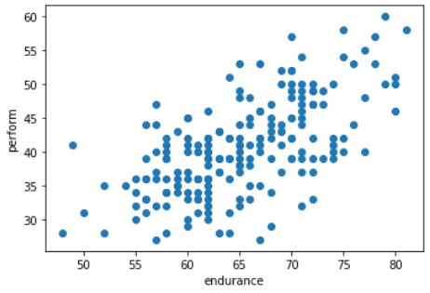
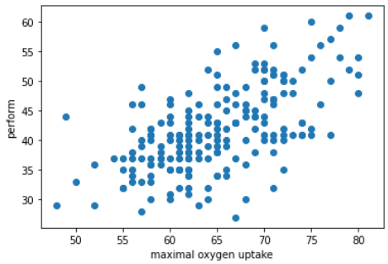
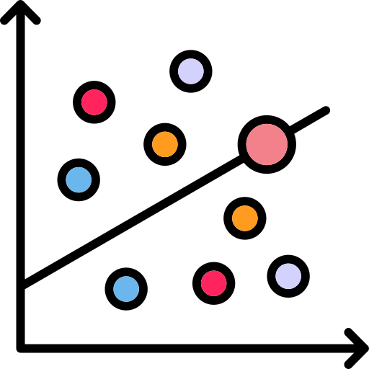
Phase 1 – Scatterplots
perform vs oxygen uptake
perform vs endurance
Positive correlations with endurance, fitness, lactate threshold and oxygen uptake.

Slide 11
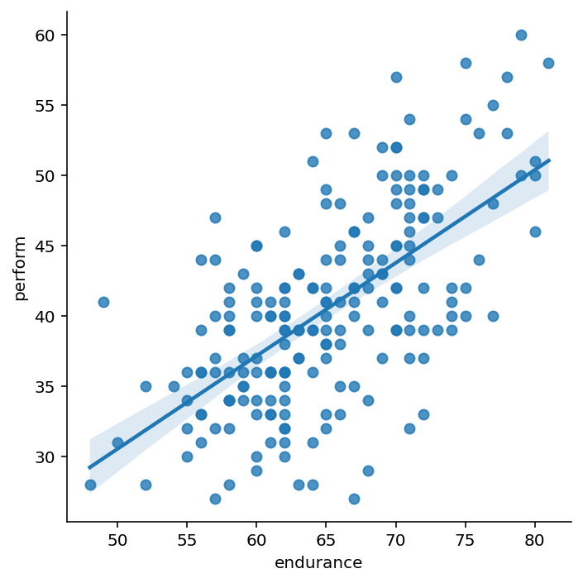
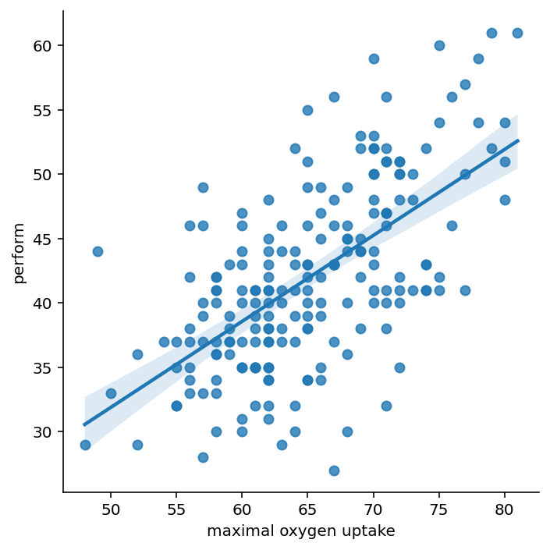
Phase 1 – Scatterplots
perform vs oxygen uptake
perform vs endurance
Positive correlations with endurance, fitness, lactate threshold and oxygen uptake.

Slide 12
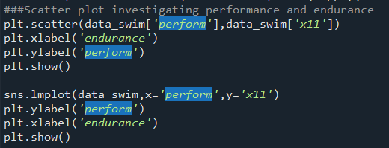
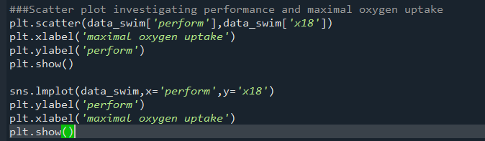
Phase 1- Scatterplots

Slide 13
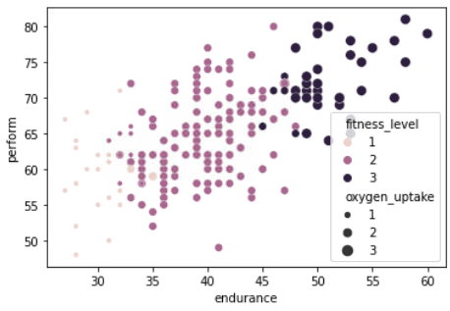
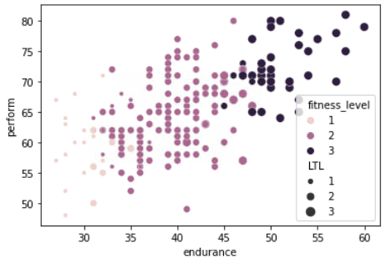
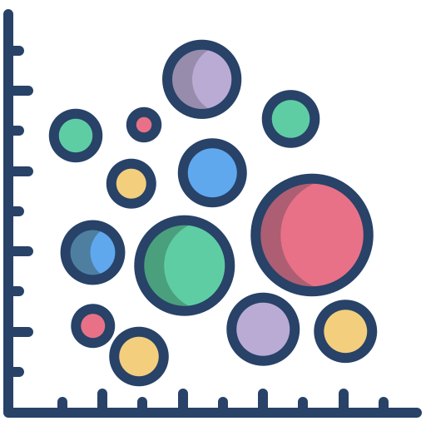
Phase 1 – Multi-dimensional Analysis
Higher endurance and fitness, along with better oxygen uptake, are associated with higher performance.

Slide 14
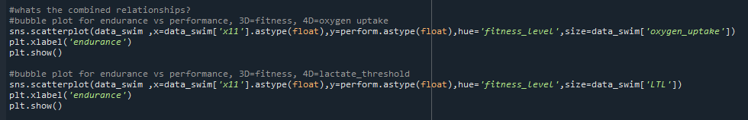
Phase 1- Bubbleplots

Slide 15
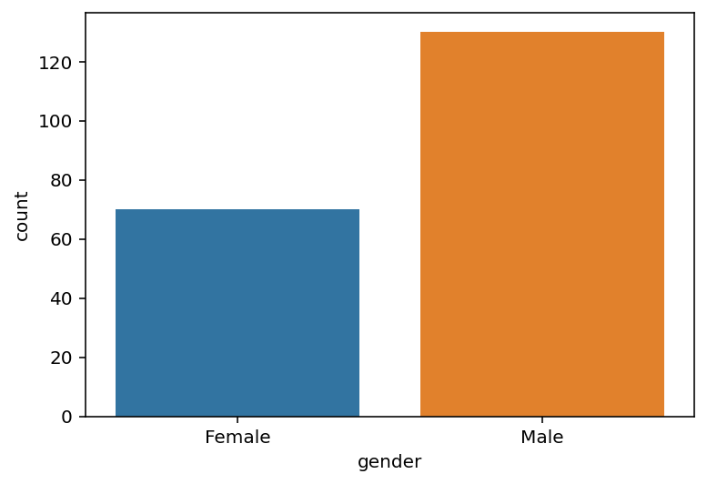

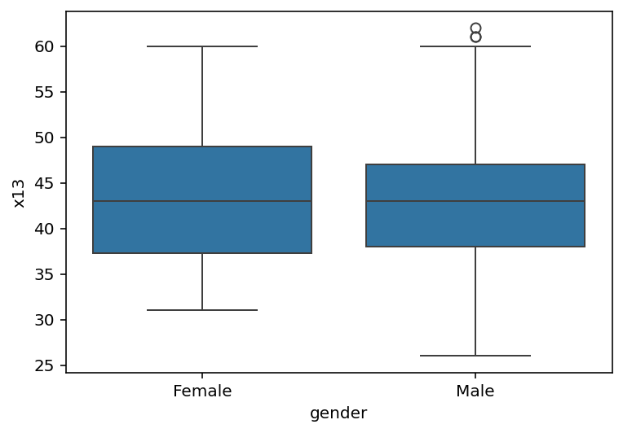

Phase 1-Gender Gap
There appears to be a large
Gender gap in the swimming competition
But there is very strong competition

Slide 16
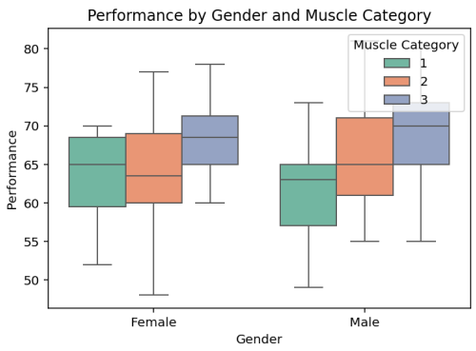
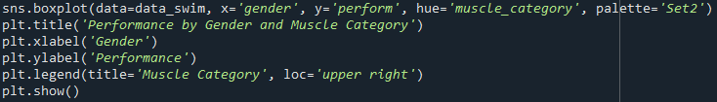
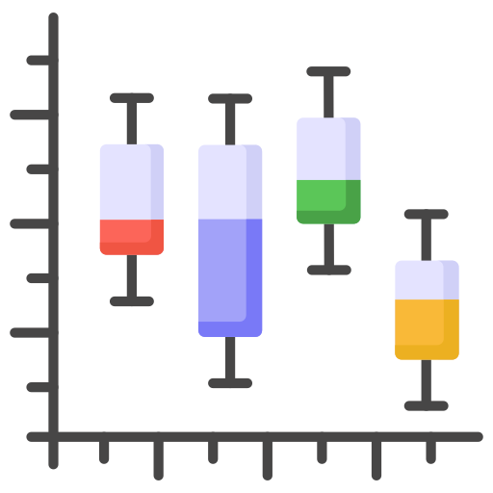
Phase 1: Visualization of Performance, Muscle Strength, and Mental Factors in Swim Data
Although there appears to be a lot of variance, for the different muscle strength categories the performance appears to be centred between 60-70.
The mean performance between males and females appears to be insignificant for different muscle strength categories since both graphs overlap.

Slide 17
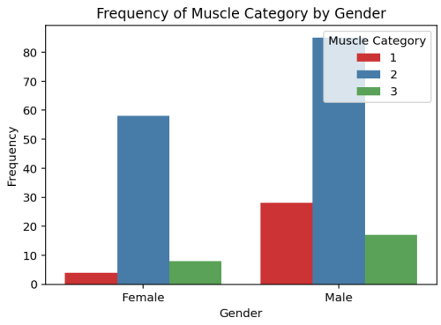
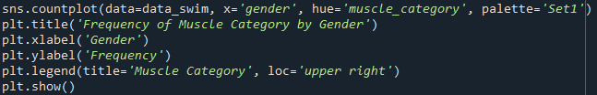
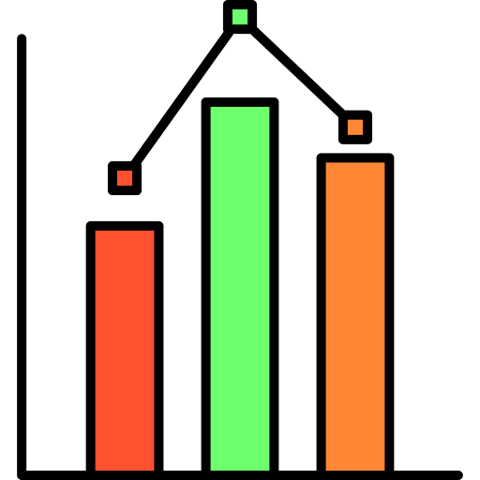
Phase 1: Visualization of Performance, Muscle Strength, and Mental Factors in Swim Data
The distribution of muscle strength categories across the two genders appears to be normally distributed.
With muscle category #2 being dominant for both genders, indicating that both genders have a specialization in that category.

Slide 18
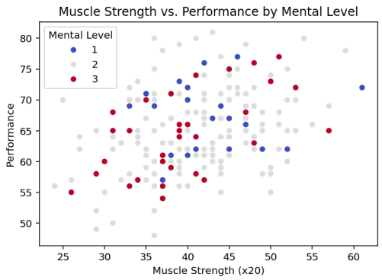
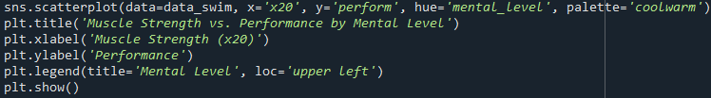
Phase 1: Visualization of Performance, Muscle Strength, and Mental Factors in Swim Data
If muscle strength was significant, we’d expect that people with a higher muscle strength would have a higher performance.
We observed that there is no visible general pattern

Slide 19
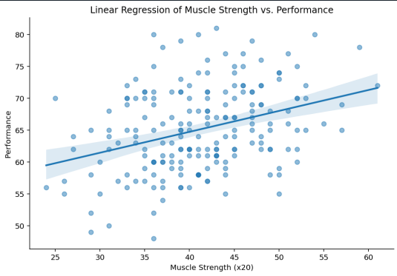

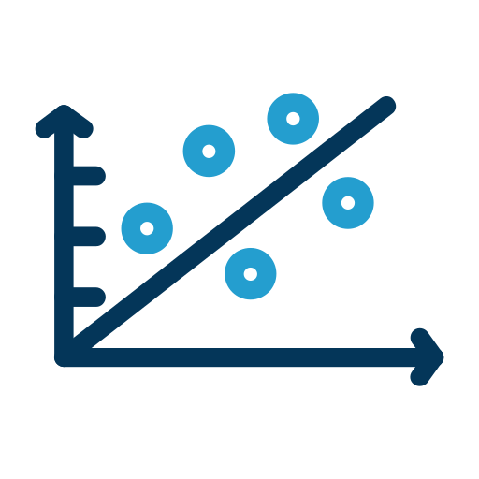
Phase 1: Visualization of Performance, Muscle Strength, and Mental Factors in Swim Data
We observed a positive slope which could indicates that higher strength is associated with better performance.
Thus, when muscle strength increases performance has a gradual increase.

Slide 20
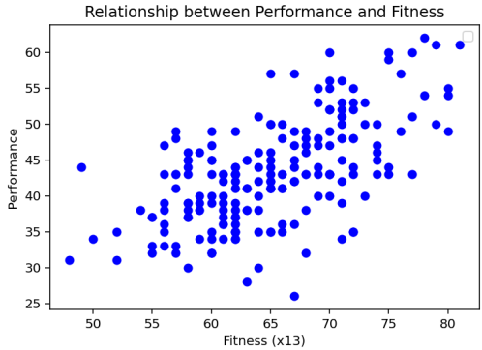
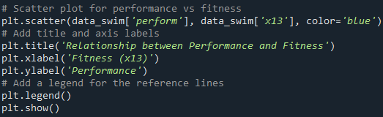
Phase 1: Analyzing Performance, Fitness, and Endurance Metrics in Swimmers
F From this graph we can clearly see that there is a positive correlation between
fitness and performance. If an individual has a high fitness level,chances are his
/her performances are higher

Slide 21
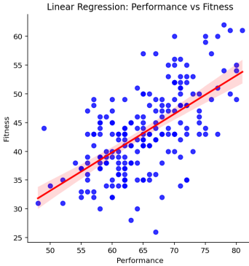
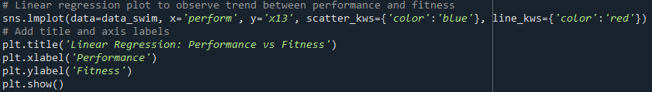
Phase 1: Analyzing Performance, Fitness, and Endurance Metrics in Swimmers
The linear model plot shows a positive relationship.The slope of the regression
line indicates a strong relationship..

Slide 22
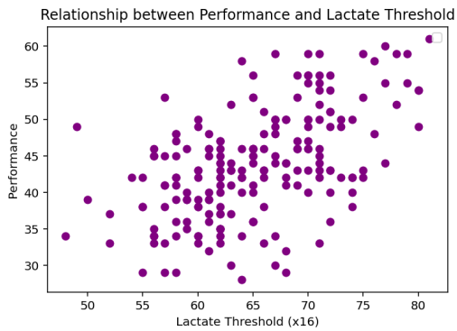
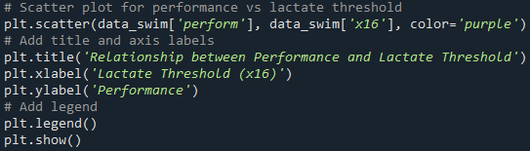
Phase 1: Analyzing Performance, Fitness, and Endurance Metrics in Swimmers
An upward trend in this scatter plot suggests that higher lactate thresholds
are beneficial in improving performance,as there is a strong relatiosnhip

Slide 23
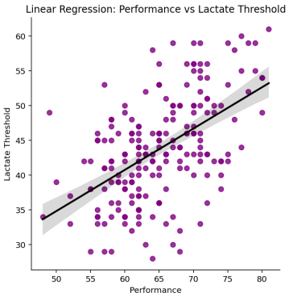
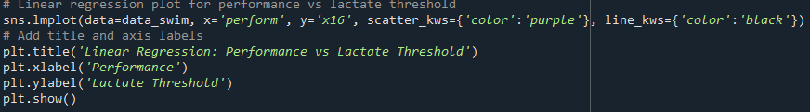
Phase 1: Analyzing Performance, Fitness, and Endurance Metrics in Swimmers
The regression line’s slope will indicate how performance is expected to change with varying lactate thresholds
As performance increases ,lactate threshold increases too

Slide 24
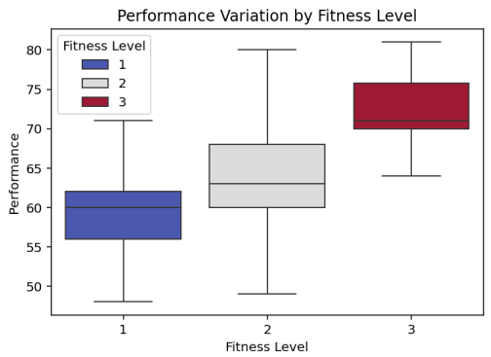
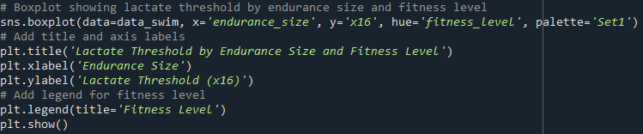
Phase 1: Analyzing Performance, Fitness, and Endurance Metrics in Swimmers
The spread of each boxplot indicates the variability in performance at each
fitness levels,while the median shows central tendency
We can see that group 3 displays higher fitness levels in correlation to
performance

Slide 25
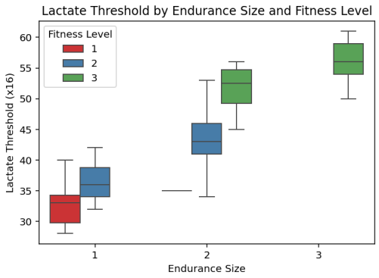
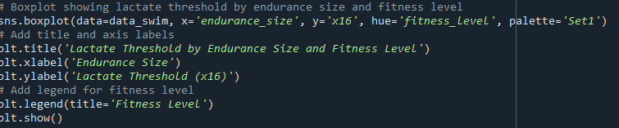
Phase 1: Analyzing Performance, Fitness, and Endurance Metrics in Swimmers
This boxplot highlights differences in lactate threshold based on both
endurance and fitness level
The fitness levels also increase as the endurance level increases

Slide 26
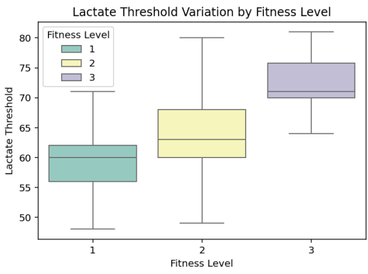
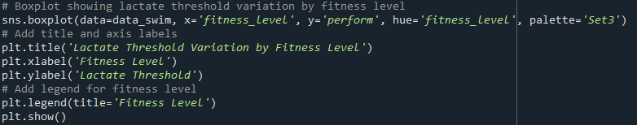
Phase 1: Analyzing Performance, Fitness, and Endurance Metrics in Swimmers
This boxplot shows a summarised version of the graph above as it depicts that
the fitness level increases as lactate threshold increases as well

Slide 27
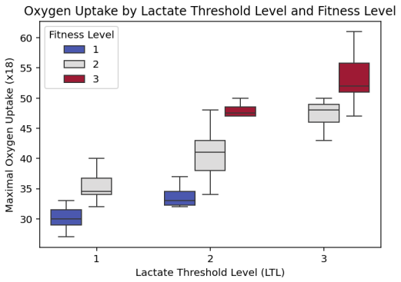

Phase 1: Analyzing Performance, Fitness, and Endurance Metrics in Swimmers
Lactate is produced by the body to remove carbon dioxide from the blood
The more oxygen a person can inhale,the more carbon dioxide is replaced..
When the breathing rate cant replace co2 fast enough ,lactate starts to forn,
hence a higher oxygen intake dicates a higher lactate threshold ..

Slide 28



Phase 2 – Hypothesis Testing: Psychological Factors and Performance
Hypothesis:
Null Hypothesis (H₀): Psychological factors have no significant effect on performance.
Alternative Hypothesis (H₁): Psychological factors affect performance.
Test: Chi-square test for dependency.
Results: No significant relationship between psychological factors and performance (p-value = 0.502).
graphs:
The graph shows that there is a weak correlation between performance and psychological factors..
From the barplot we can deduce that there is no significant difference between the different performance levels.

Slide 29

Phase 2- Hypothesis Testing: Psychological Factors and Performance

Slide 30


Phase 2- Hypothesis Testing: Psychological Factors and Performance
There is no significant difference in performance levesl between the different psychological levels..
As can be observed by the overlapping boxplot..

Slide 31


Phase 2- Hypothesis Testing: Psychological Factors and Performance

Slide 32


Phase 2- Hypothesis Testing: Psychological Factors and Performance
No significant difference can be assumed from observing the graph. There is a high correlation amongst the different Psychological Levels.

Slide 33


Phase 2 – Hypothesis Testing: Gender and Performance
Hypothesis:
Null Hypothesis (H₀): There is no significant difference in performance between male and female athletes..
Alternative Hypothesis (H₁): There is a significant difference in performance between male and female athletes.
Tests: Shapiro-Wilk Test: Tested for normal distribution.
Levene’s Test: Tested for equality of variances.
t-test: Compared the means of male and female performance.
Results: Shapiro-Wilk Test: Data is normally distributed (p = 0.122).
Levene’s Test: No significant difference in variances (p = 0.843).
t-test: No significant difference in performance between male and female athletes (p = 0.485).
graphs:
Performance levels as observed are about the same for both genders.
The boxes are overlapping which indicates there are similar performance levels among both genders

Slide 34


Phase 2 – Hypothesis Testing: Gender and Performance

Slide 35

Phase 2 – Hypothesis Testing: Gender and Performance

Slide 36

Phase 2 – Hypothesis Testing: Gender and Performance

Slide 37
Phase 2 – Conclusion
Test | Variable Tested | Test Type | p-value | Conclusion
Psychological Factors Test | Psychological Factors (x23) | Chi-Square Test | 0.502 | No significant relationship between psychological factors and performance.
Gender Test | Gender (Male vs. Female) | t-test (Two-Sample) | 0.485 | No significant difference in performance between male and female athletes.
Normality Test (Gender) | Gender (Male & Female Data) | Shapiro-Wilk Test | 0.122 | The performance data is normally distributed.
Variance Test (Gender) | Gender (Male vs. Female) | Levene's Test | 0.843 | Variances are equal (homoskedastic).

Slide 38
Phase 3-4
Sections
Unathi Manana: 43-46
Neo Zandamela: 47-53
Tafara Kanyemba: 40-42, 54-62
Everyone : 63-64

Slide 39

Phase 3
Regression Model For Swimming
Exploring how to model the performance of swimmers on various factors

Slide 40

Phase 3: Preparing the model
Start by joining all the columns (explanatory variables) together.

Slide 41

Phase 3: Model selection
Gender
x07 (Body align.)
X09 (decision-making)
X11 (endurance)
X16 (lactate threshold)
X20 (Muscle strength)
X21 (pattern recognition)
X28 (technical skills)

Slide 42

Phase 3: Model Selection
Why are these the variables which are most significant?

Slide 43

Phase 3: MULTICOLLINEARITY (VIF)
Variable | VIF
Gender | 1.0215222801418362
Body alignment and posture | 1.0259303428608404
Endurance | 1.0339099082436223
Lactate threshold | 8.128892586549428
Muscle strength | 8.211090221402822
Pattern recognition | 1.0490855853156578
Technical skills | 1.0332784347093886
None of the VIF values are greater than 100 indicating that there is NO MULTICOLLINEARITY problem.

Slide 44

Phase 3: NORMALITY TESTS (graphical)
Observation: Very few observations lie on the straight line.
Interpretation: We can’t fully deduce if Normal or Not.

Slide 45

Phase 3: NORMALITY TESTS (graphical)
Deviations from Normality can be observed, but it overall the residuals appear to be approximately Normally Distributed.
Closely observe the KDE and Normal Distribution curve !

Slide 46
Phase 3: NORMALITY TESTS (formal)
Test if the errors are normal at the 5% level of significance:
H0 : errors are normal
HA : errors are non-normal
Reject H0 if p < 0.05 p = 0.446 > 0.05, therefore don’t reject H0 .
It cannot be proved that the errors are non-normal, i.e. they can be assumed to be normal.
Test Statistic: 0.9928886294364929

Slide 47

Phase 3: Diagnostic Measures
Table summarizes diagnostic statistics for various observations from our regression analysis, showing influential statistics

Slide 48

Phase 3: Diagnostic Measures
This table shows influential observations.
The influential observations highlighted in this table indicate points in the dataset that have a significant impact on the model's predictions.
These observations may affect the model's estimates disproportionately

Slide 49

Phase 3: Heteroskedasticity Test (graphical)
Random scatter of points around the horizontal line, indicates that the residuals are evenly distributed across all levels of the independent variable, suggesting homoscedasticity.

Slide 50

Phase 3: Heteroskedasticity Test (graphical)
Random scatter around the horizontal line at zero.

Slide 51
Phase 3: Heteroskedasticity Test (formal)
Test if the errors are homoscedastic at the 5% level of significance:
H0 : errors are homoskedastic
HA : errors are heteroskedastic
Reject H0 if p < 0.05 p = 0.519 > 0.05, therefore don’t reject H0 .
It cannot be proved that the errors are heteroskedastic, i.e. they can be assumed to be homoskedastic.

Slide 52

Phase 3: FINAL MODEL

Slide 53

Phase 3: Example Prediction
What does the low performance tell us ?

Slide 54


Phase 4: Gender
Females boast a slimmer build, possibly making it easier to glide through water. There could be less resistance due to a lower surface area. Possibly have a higher affinity for technical skills.
Males boast a higher muscle mass, possibly making it easier to propel themselves through water. They have a higher power output. Possibly have a higher affinity for endurance.

Slide 55
Phase 4: Gender
Possible influences that Gender could have
Males | Females
Higher muscle strength | More technical skills
Higher endurance | Better pattern recognition
Higher lactate threshold | Better body alignment

Slide 56




Phase 4: Gender
Strictly modelling males and females

Slide 57



Phase 4: body alignment and posture
It’s no coincidence that evolution decided that the optimum shape for any fish should be one with a lower surface area slim figure

Slide 58



Phase 4: Body Alignment and Posture
Posture when swimming proves to be very important as it limits the amount of “drag” on the body.
Can you see the similarity?

Slide 59
Phase 4: Decision Making, Technical skills and Pattern Recognition
These 3 factors could be heavily tied to each other. The element of time is involved when maneuvering under water.
When to maneuver?
How to maneuver?
How often to maneuver?

Slide 60
Phase 4: Decision Making
What type of decisions do swimmers even make?
They have to pace themselves and adjust their speed at the right moments.
All this is important in order to not exhaust themselves.
What pace should you use?
How fast should you breathe
When to adjust speed?

Slide 61


Phase 4: Technical Skills
Athletes also have to decide among the plethora of techniques available. These techniques engage different muscle groups and choosing the right one is up to the athlete’s preference

Slide 62


Phase 4: Endurance, Lactate Threshold and Muscle Strength
As discussed in Phase 1, We have already identified how strongly tied endurance, lactate threshold and muscle strength is.

Slide 63
Phase 4: Summary of Evidence on Significant Variables Affecting Swimming Performance
Lactate Threshold: A higher lactate threshold allows swimmers to maintain higher intensities longer, contributing to improved performance (Snyder et al., 2015).
Body Composition and Muscle Strength: Optimal body composition and strength enhance swimming efficiency, with studies showing that greater muscle power correlates with better sprint performance (Haff et al., 2015).
Training Variables:
Training Volume and Intensity: Customized training regimens that balance endurance and speed work lead to optimal performance gains.
Technique Development: Efficient stroke technique is critical for reducing drag and improving speed, emphasizing the need for technical training alongside physical conditioning (Maglischo, 2003).
Technical Skills: Technical proficiency allows swimmers to better handle changes in pace or respons to the physical demands of turns and starts (Springer et al. ,2002).
Gender: Greater buoyancy due to higher body fat percentage and greater muscle mass in males (Seifert et al., 2010)

Slide 64
Phase 4: Summary of Evidence on Significant Variables Affecting Swimming Performance
SOURCES
Mujika, I., et al. (2000). "Physiological responses to training."
: Snyder, B.J., et al. (2015). "Lactate threshold and its relationship to swimming performance."
: Haff, G.G., et al. (2015). "Strength training for swimmers."
: Gould, D., et al. (2002). "Mental toughness in sport."
: Vealey, R.S., et al. (2007). "Self-confidence in athletes."
: Maglischo, E.W. (2003). "Swimming Fastest.“
: https://link.springer.com/article/10.2165/00007256-200232090-00001: Science on physical performance determinants in swimmers.
: Seifert, L., Barbosa, T. M., & Kjendlie, P. L. 2010. Biophysical approach in swimming: Gender effect. In: Davies, S. A., ed. Gender gap: Causes, experiences and effects. Hauppauge, NY: Nova Science Publishers, Inc., pp. 1-22.

