Slide 1
Employee Attrition
Taffazani
19 August 2023

Slide 2
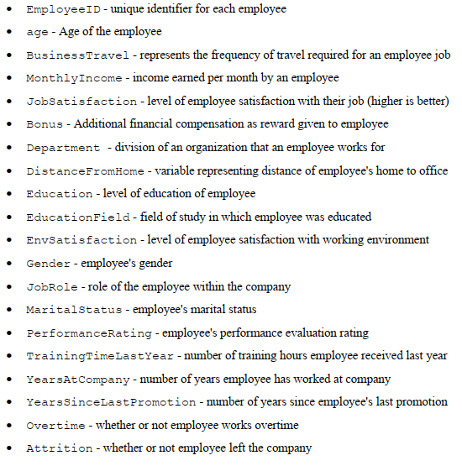
Dataset
There are 1470 observations with 18 characteristics of employees and 1 Dependent Variable

Slide 3
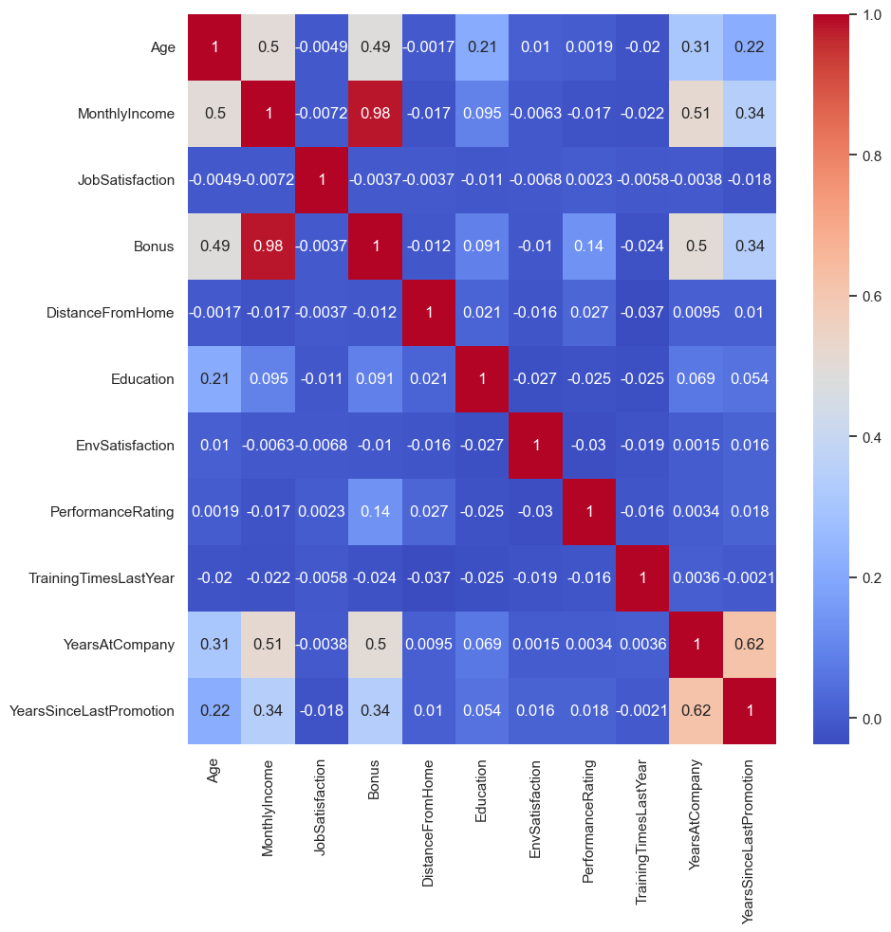
Exploratory Data Analysis (EDA)
Correlation between Numerical Variables
The highest correlation is between Bonus and Monthly Income (0.98)

Slide 4
EDA
No | Attrition | Age | Monthly Income | Job Satisfaction | Bonus | Distance From Home | Education | Env Satisfaction | Performance Rating | Training Times Last Year | Years At Company | Years Since Last Promotion
0 | No | 37.56 | 6832.74 | 2.78 | 21543.95 | 8.92 | 2.93 | 2.77 | 3.15 | 2.83 | 7.37 | 2.23
1 | Yes | 33.61 | 4787.09 | 2.47 | 14941.67 | 10.63 | 2.84 | 2.46 | 3.16 | 2.62 | 5.13 | 1.95
These are the means from the people who stays and left the company
From this we can see that there is only a significance difference in mean of Monthly Income

Slide 5
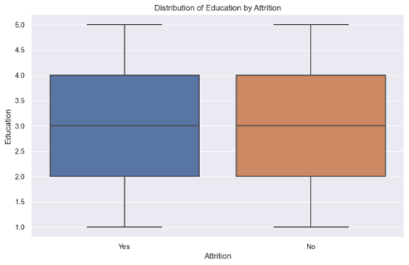
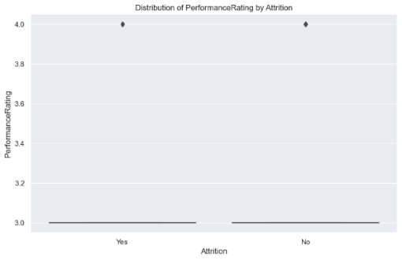
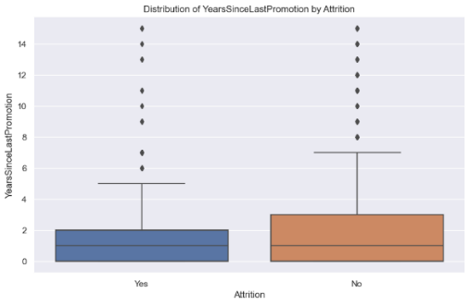
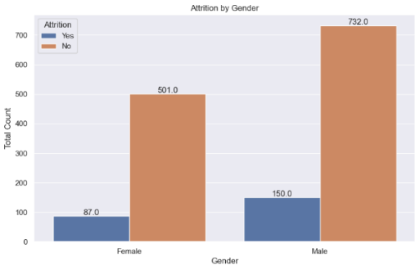
EDA
Education
Correlation: -0.0314
P-Value: 0.2293
Performance Rating
Correlation: 0.00289
P-Value: 0.9119
Years Of Last Promotion
Correlation: -0.033
P-Value: 0.2058
Gender
Chi²- Test: 0.9119
Confidence Interval = 0.05
H₀ = There is no significant correlation between variables
H₁ = There is a significant correlation between variables
From EDA we found that 4 variable that have no significant correlation with the dependant variable thus being excluded from the model

Slide 6
Baseline Model Performance
The performance metrics used in the evaluation of the model are as follows:
Accuracy Score: proportion of correct predictions out of the whole dataset
Precision Score: proportion of correct predictions out of all predicted attrition cases
Recall Score: proportion of correct predictions out of all actual attrition cases
F1 Score: optimized balance between precision and recall for the selected relevant target
Area Under ROC Curve: prediction scores from area under Receiver Operating Characteristics (ROC) curve, which is the relationship between True Positive Rate and False Positive Rate

Slide 7
Logistic Algorithm Training
Train
Generate
Train Set Data
Algorithm
Logistic Regression()
Model

Slide 8
Applying Model
Scaler.transform(x_test)
Apply
Predict
Unscaled Input from Test Set
Test Set scaled input
Model
Response
y_pred

Slide 9
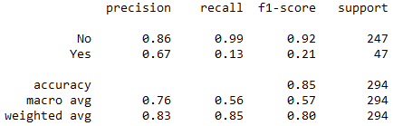
Performance Validation
Attrition | ACTUAL
PREDICTED |  | No | Yes
 | No | TP 244 | FP 41
 | Yes | FN 3 | TN 6

Slide 10
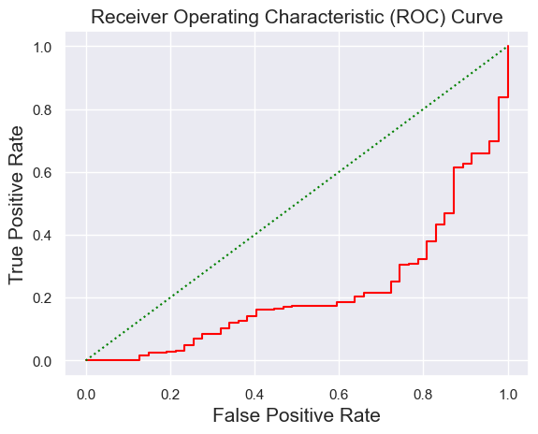
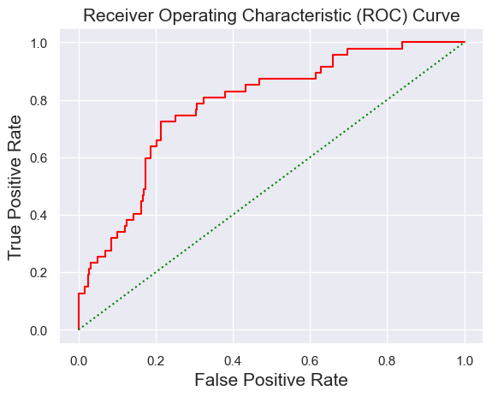
ROC
Area under ROC = 0.217
ROC score ranges from 0 to 1 with 0.5 the midline distinguishing the good and the bad predictions compared to random chances
0.2187 means that the model is having a hard time distinguishing negative classes and it might be making overlapping distributions.
Meanwhile it has a 0.783 on true positive rate score which means that this model can explain the true positive better.

Slide 11
HR Insight
F-Score for Attrition (YES) = 0.21
The model predicts employee that will undergo attrition is only correct 21% of the time. This means that there are many false positives, the employee that will undergo attrition actually didn’t and the company still retain the talent.
Precision for Attrition (NO) = 0.86
When the model predicts for people to stay in the company is 86% correct of the time. This is relatively high precision. HR should take note on the things that makes people loyal towards the company
Recall for Attrition (YES) = 0.13
The model correctly identified 13% of the employee who actually undergo Attrition. This is a low recall rate which means that employees are leaving the company without the company know the actual reason
Precision for Attrition (NO) = 0.99
The model correctly identified 99% of the employee that stayed with the company. There are few false negatives (employee that stayed with the company but identified as leavers). This shows that what the benefits that the employee are having is making them stay with the company.

Slide 12
CONCLUSION
It is impossible to have a model that can perform better at predicting both classes
Imbalance target proportion might cause bias when training the algorithm
Model predict better with higher proportion
Model is excellent on predicting employees who stays with the company with 86% precision. A performance above 79% is acceptable.
Only 67% chance of employees who are actually leaving the company when predicted as undergoing Attrition.
These can be the factors affecting the employees loyalty 'Age', 'BusinessTravel', 'MonthlyIncome', 'JobSatisfaction', 'Bonus', 'Department', 'DistanceFromHome', 'EducationField', 'EnvSatisfaction', 'JobRole', 'MaritalStatus', 'TrainingTimesLastYear', 'YearsAtCompany', 'OverTime’

