Slide 1

WELCOME TO THE PRESENTATION COURSE: ACN SECTION:C SUBMITTED TO : SHARIFA RANIA MAHMUD
SUBMITTED BY:
MD TAFIQUZZAMAN (18-36743-1)
MD MUKTHDAR RAHMAN ONKON (18-3756-1)

Slide 2

A framework & security for a multifaceted electronic voting system

Slide 3

Introduction
A framework for a multifaceted electronic voting system involves designing a comprehensive structure that integrates diverse voting methods while prioritizing security to safeguard the integrity of the electoral process. This framework combines a range of electronic voting options to enhance accessibility, efficiency, and transparency, while addressing the critical concern of maintaining the confidentiality and authenticity of votes.

Slide 4

Paper 1: A PERFORMANCE EVALUATION OF A MULTIFACETED ELECTRONIC VOTING FRAMEWORK. O. Okediran ( computer science ) published year 2019
Summary :
This paper represent a performance evaluation of a multifaceted electronic voting framework. The electronic voting model that was developed on the framework is capable of handling electronic ballots with multiple scopes simultaneously via three different electronic voting means. The model catered for probity of an election process in terms of generic and functional requirements.
Features:
1. Multiple scope handling
2. Three electronic voting means
3. Probity assurance
Ideas:
1. Multi-method approach
2. Privacy & authenticity focus
limitations:
1. Security concerns
2. Digital divide

Slide 5
Paper 2: A scheme of analysis for eVoting as a technological innovation system P. Sambo, P. Alexander published year 2018
Summary :
The paper aims to determine whether incorporating technology into electoral processes constitutes a technological innovation system. This is achieved by analyzing eVoting systems through interviews and documentation in a multicase study involving Namibia and South Africa. The study shows that the adapted analysis scheme for technological innovation systems is effectively applicable to eVoting, offering insights into system functions, electoral processes, and the introduction of innovation (techno‐change process)..
Features:
1. Technological Innovation system
2. eVoting systems
3. Multicase Study
Ideas:
1. Adapted Scheme of analysis
2. Linking Steps
limitations:
1. Scope
2. Data Sources
3.Technological context

Slide 6
Paper 3: Retina based E-voting system using fuzzy logic and hamming distance. P. Abirami,R.Jothi,V.Palaniasamy published year 2018
Summary :
This paper a biometric-based E-voting system was developed to enhance the security of confidential electronic voting processes. The use of retina-based E-voting introduced enhanced security for user authentication. The approach involved utilizing fuzzy logic for feature extraction, and matching was performed using both the Hamming distance and the Manhattan distance. These measures were employed to identify common patterns in the similarity assessments between retinal images, aiding in the detection of probabilities within the layers of the retina. Angular and radial partitioning techniques were utilized to detect similarities in blood vessel patterns. This comprehensive mechanism yielded maximum security and achieved optimal results for the E-voting system's integrity and effectiveness.
Features:
1. Biometric Security
2. Retina-based E-voting
Ideas:
1. Fuzzy logic feature extraction
2. Matching Processes
limitations:
1. Complexity
2. User Acceptance
3.Data Accuracy
4.Ethical Considerations

Slide 7
Paper 4: Anonymous and formally verified dual signature based online e-voting protocal M. N. Saqib, Junaid Kiani,A. R. Khan published year 2020 Cluster Computing
Summary :
The paper presents an Internet e-voting protocol to address concerns in traditional voting systems. While the proposal seems promising, further investigation into its security, practical implementation, and potential barriers to adoption would be essential to validate its viability as an alternative to traditional voting methods..
Features:
1. Internet E-voting Protocal
2. Dual Signature
3. Probity assurance
Ideas:
1. Core Properties
2. Formal Methods
3.Performance Evalution
limitations:
1. Security Assurance
2. Usability and adoption

Slide 8
Paper 5: Electronic voting system using an enterprise blockchain. Milo Denis González, Daniel Frias Mena, Alexi Massó Muñ Applied Sciences 12 (2), 531, 2022
Summary :
The paper suggests a solution that employs permissioned blockchain to address security, reliability, and efficiency concerns in electronic voting systems. However, practical implementation and real-world testing will be needed to validate its feasibility and effectiveness.
Features:
1. Manipulation Prevention
2. Smart Contracts
3. Flexible Network Configuration
Ideas:
1. Efficiency and Energy Reduction
2. Security and Transparency
3.Reliability Enhancement
limitations:
1. Dependence on network Configuration
2. Adoption Challenges

Slide 9
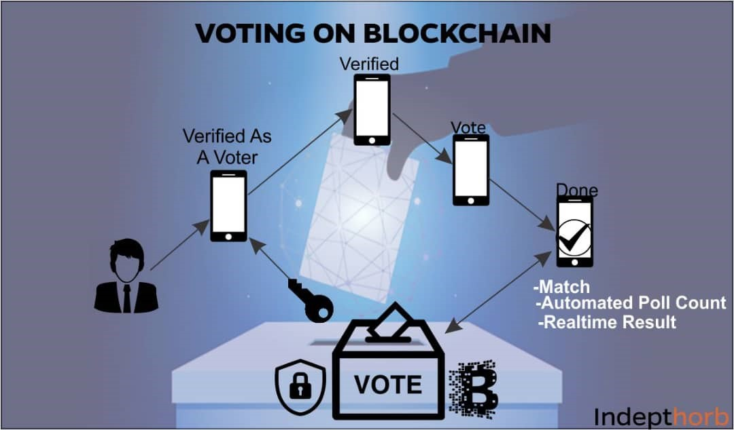
Analysis of the papers
Paper 1:
Quantitative analysis demonstrates the framework's capability to ensure privacy and authenticity for voters.
The integrity, accuracy, and verifiability of cast ballots are guaranteed. .
Paper 2: From the analysis, it can be deduced that an eVoting system may be classified as technological innovation system as the researcher was able to analyze, identify, and link the 6 steps of the scheme of analysis to the electoral processes. This analytical process is expected to provide improved insights into the techno‐change processes and the electoral processes and enhance adoption of the eVoting system. The findings not only explain how to improve the usability of the electoral system and its efficiency but also help in crafting policies and strategies that can counter the barriers of implementing and adoption of the technology.
Paper 5: This paper proposes a system that ensures high reliability by applying enterprise blockchain technology to electronic voting, securing the secret ballot. In addition, a flexible network configuration is presented, discussing how the solution addresses some of the security and reliability issues commonly faced by electronic voting system solutions.

Slide 10

Comparison
Paper 1 and 5 seem to focus on the evaluation of a multifaceted electronic voting framework's features, particularly concerning privacy, authenticity, integrity, and verifiability of the voting process. Paper 2, on the other hand, introduces a specific solution involving enterprise blockchain technology to enhance the reliability of electronic voting while discussing a flexible network configuration to address security and reliability issues.
While Papers 1 and 5 emphasize the benefits of their respective frameworks, Paper 2 delves into proposing a technological solution using blockchain for improving the reliability of electronic voting, which could potentially be integrated into multifaceted frameworks like the one discussed in Papers 1 and 5.

Slide 11

References
A PERFORMANCE EVALUATION OF A MULTIFACETED ELECTRONIC VOTING FRAMEWORK O. Okediran
Published 30 June 2019
Electionblock: An electronic voting system using blockchain and fingerprint authentication. Mohamed Ibrahim, Kajan Ravindran, Hyon Lee, Omair Farooqui, Qusay H Mahmoud 2021 IEEE 18th International Conference on Software Architecture Companion (ICSA-C), 123-129, 2021
A scheme of analysis for eVoting as a technological innovation system. P. Sambo, P. Alexander Published 1 March ,2018
Retina based E-voting system using fuzzy logic and hamming distance . P. Abirami, R. Jothi, V. Palanisamy Computer Science ,2018
Electronic voting system using an enterprise blockchain . Camilo Denis González, Daniel Frias Mena, Alexi Massó Muñoz, Omar Rojas, Guillermo Sosa-Gómez. Applied Sciences 12 (2), 531, 2022

Slide 12


