Slide 1

IntelliAD
Real Time Accurate Delivery

Slide 2

Our Scenarios

Slide 3






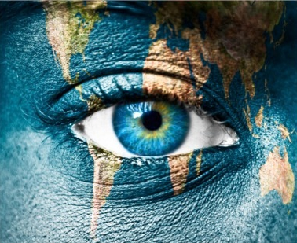


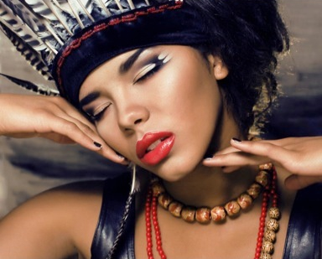
Our DEMO

Slide 4

What We Do?
Your great subtitle in this line
Recommend
Learn
Statistic

Slide 5
Road Map
Your great subtitle in this line
GOAL
DELIVER
TARGET
PREFER
LEARN
BETTER
RECOGNIZE

Slide 6
Our Data Source
Real Time Data: Camere & Face API
First Hand Data: Behavior & History
Third Hand Data: Goal & Preference

Slide 7

Our Algorithm
SVD & RNN+BPR
Recommendation
使用矩阵分析和协同过滤相关算法，根据多标签广告和实时的人群分析，加权计算相关度，并选择相关度最高的广告，进行精准投放。
learning
使用Bayesian Personal Ranking（BPR）策略作为RNN的目标函数进行优化，为人群成分和广告的标签增加置信度，为投放引入人群的历史行为信息。

Slide 8

Goals List
根据多标签数据进行给定人群精准投放
调用FaceAPI实时分析&统计行为信息
根据行为信息完成学习算法
根据行为信息生成广告效用分析报告

Slide 9

About Us
We are 5 students from Beijing University
of Posts and Telecommunications,
aiming at develop a better Ad
deliver strategy.
赵之源 吴炎桐 代亚暄 庞昊 黄煜恒

Slide 10
THANK YOU

