Slide 1
Health Dynamics
Tagishi Mashego

Slide 2
Introduction
Ever heard the saying, “If you exercise more, you can eat whatever you want”? Yeah, now I’m over 200 pounds.

Slide 3
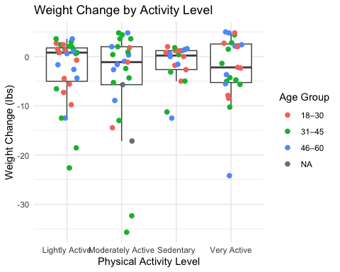
Impact of Physical Activity
Physical Activity alone does not cause weight loss
Indifference in weight change by activity level

Slide 4
Regression Results
term | estimate | std.error | statistic | p.value
(Intercept) | 6.509 | 2.552 | 2.551 | 0.012
Age | -0.008 | 0.044 | -0.179 | 0.859
Physical Activity LevelModerately Active | -0.652 | 1.431 | -0.456 | 0.650
Physical Activity LevelSedentary | -0.218 | 1.471 | -0.148 | 0.883
Physical Activity LevelVery Active | 1.644 | 1.452 | 1.132 | 0.261
Stress Level | -1.163 | 0.209 | -5.571 | 0.000
Sleep QualityFair | -0.326 | 1.705 | -0.191 | 0.849
Sleep QualityGood | -0.383 | 1.741 | -0.220 | 0.826
Sleep QualityPoor | -8.962 | 1.600 | -5.601 | 0.000
Effect on Weight Change (lbs)

Slide 5
Interpretation
Age is not a meaningful predictor of weight change , contrary to belief
Only sleep quality and stress levels are statistically significant predictors of weight change
This model has a R-Squared Value of 0.55 , thus there are a lot of pivotal variables missing

Slide 6
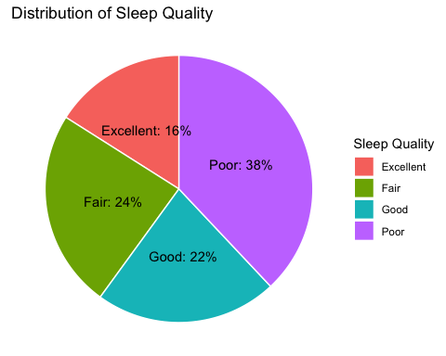
Sleep anyone ?

Slide 7
Conclusion
Sure, the evidence on weight loss might be mixed , but I’m a big believer in the power of sleep. Sleep deprivation has been scientifically shown to impair neural pathways in the brain. So even if you’re not sleeping for your waistline, at least do it for your mind.

