Slide 1
Chapter 1: OOP for Business

Slide 2
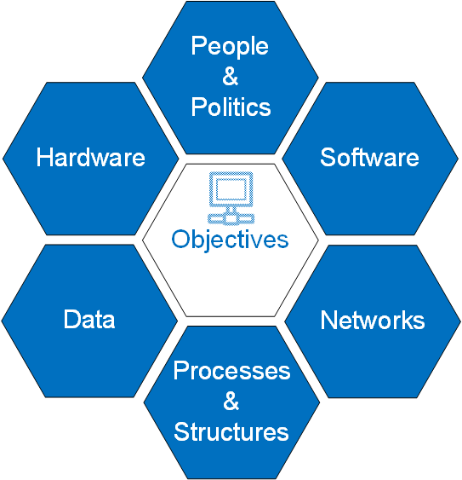
Components of an Information System
Information systems are more than hardware and software
Business objectives should drive IT investments and system functionality
Software supports business processes
Users often choose whether to use software or not
Software has to be interoperable with other hardware and software
Consider all components when designing a system

Slide 3
Programming Paradigms
A programming paradigm is a way to write code to solve problems
Examples of programming paradigms include:
Functional programming: based on mathematical functions like f(g(x))
Procedural programming: pairing together steps of logic
Object-oriented programming: systems are composed of classes and objects
Object-oriented programming is the most widely used in industry right now

Slide 4
Object Oriented Programming
Based on the idea of representing real-world “things” in systems
Business systems represent and manipulate business objects (i.e., customers, products, employees, inventory, etc.)
Learn the language of the business domain for systems you are asked to create
Some of you will be subject-matter experts helping programmers build systems
Objects in programs represent “things”
A Customer object could be created to represent a particular customer

Slide 5
Objects in OOP
Objects possess attributes and methods
Attributes are used to temporary store information about an object
Attributes of a customer might include: name, phoneNumber, and address
Attributes store values: name = Jeff; phoneNumber = “555-555-5555”; address = “fake st”
Methods are actions/behaviors an object can perform
Methods use logic to perform actions (classes contain the logic)
Methods of a Customer object might include: changePhoneNumber(); changeAddress();

Slide 6
Classes in OOP
Objects are created from classes
A class is a template for creating a particular type of object (classes don’t store data until instantiated into objects)
A Customer class can be used to create many Customer objects
A Product class can be used to create many Product objects
Classes are usually named in TitleCase: Customer, InventoryItem, Product
Objects are instantiated from classes
You can’t have an object without first writing a class for the object

Slide 7
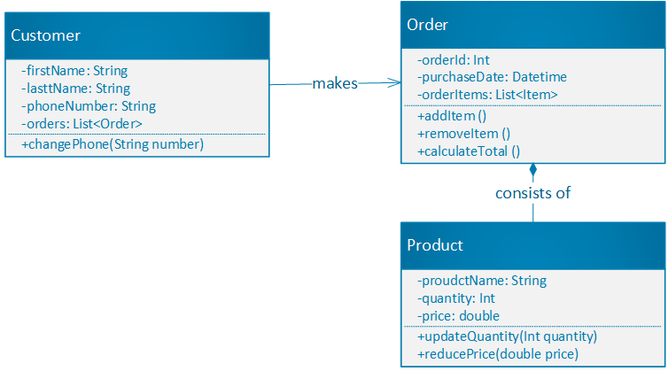
Class Diagrams
Business and systems analysts may not spend their days programming, but they may be called on to model systems and programs.
These models are used by developers to build the system.
A class diagram provides information about what classes need to be created in a system and how those classes are connected.
What does this diagram tell you?

Slide 8
Instantiating Objects
Java syntax for instantiating an object: uses new keyword and name of the class
customer1 = new Customer(); //this example is incomplete. Not the full syntax
customer2 = new Customer(); //this example is incomplete. Not the full syntax
Python syntax for instantiating an object: use the name of the class
customer1 = Customer()
customer2 = Customer()
Objects are stored in variables within computer memory
Objects are instantiated by calling the constructor of a class

Slide 9
Class Constructors
Class constructor in Java (not complete syntax):
class Customer
//this is the constructor. Not full syntax Customer() { //code to perform upon instantiation goes here }
Class constructor in Python (not complete syntax):
class Customer:
#this is the constructor. Not full syntax __init__(): #code to perform upon instantiation goes here

Slide 10
Class with Attributes and Methods (Pseudo-code)
class Customer //this is a comment in Java. Comments are ignored by the program //comments help programmers know what is happening in the program in English language
#this is a comment in Python. Comments in Python are also ignored by the Python program
//the four lines below show the attributes of this class firstName lastName phoneNumber address
//the lines below show the class constructor Constructor() //code that you want to perform when calling: new Customer(); goes here
//the lines below show the methods of the class changePhone() //code to change the phone number goes here
changeAddress()
//code to change the address goes here

Slide 11
Starting Point for Programs
The starting point for a Java program is the main() method of a class (may be called Main, App, or Program)
class Main {
public static void main(String[] args) {
customer = new Customer();
//you could add more code here to use the Customer object further
}
}
The starting point for a Python program is more flexible
customer = Customer()

Slide 12
Classes and inheritance
Inheritance is an “is a” relationship between a parent and child class
A Dog “is a” Mammal:
Mammal is the parent (aka, superclass) and Dog is the child (aka, subclass)
A Square “is a” Shape
Shape is the superclass and Square is the subclass
Subclasses inherit attributes and methods from their superclasses
Inheritance means you only need to write code once in the superclass
Inheritance in Java: public class Dog extends Mammal
Inheritance is Python: class Cyborg(Human, Robot):

Slide 13
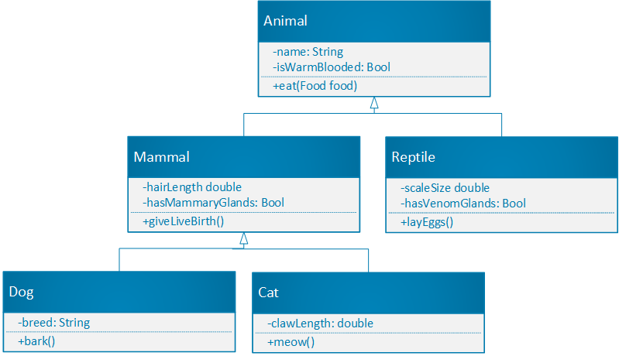
Class Diagrams and Inheritance
This class diagram shows an inheritance structure.
Mammal and Reptile inherit from Animal
Dog and Cat inherit from Mammal
What are the attributes of the Dog class?
What are the methods of the Cat class?

Slide 14
Inheritance (Pseudo-code)
class Mammal hasMammaryGlands = true hairLength
giveBirth()
//code for live birth would go here
class Dog is a Mammal
//because Dog inherits from Mammal, it will automatically possess the giveBirth() method //it will also possess the attributes: hasMammaryGlands and hairLength
//subclasses can have their own unique attributes and methods that the super class doesn’t hasFloppyEars = true
bark()
//code for barking would go here

Slide 15
Overriding Inherited Methods
Sometimes you don’t want a subclass to inherit the methods of a superclass
class Mammal hasMammaryGlands = true hairLength
giveBirth()
//code for live birth would go here
class DuckBilledPlatypus is a Mammal
//sub classes can have their own unique attributes that don’t exist in the super class hasPoisonGlands = true
//the method below tells the program to ignore the giveBirth() method in the Mammal class giveBirth()
//code for egg laying goes here instead of accepting live birth from Mammal

Slide 16
Composition Instead of Inheritance
Inheritance is useful, but it has some limitations
Creates tightly coupled systems: child classes are tightly linked to parent classes
You may not use all parent attributes and methods within some child classes
Composition is an alternative way to share functionality between classes
Classes can be composed of different behaviors through interfaces or delegation
Delegation: a class allows another class to perform an action on its behalf

Slide 17
Composition in Java Through Interfaces
An interface is like a class except that it contains no attributes and methods do not possess logic.
interface Birthable {
//notice that there is nowhere to put code for the giveBirth() method giveBirth();
}
A class can implement many interfaces, giving the class the functionality of the several interfaces
See the section “Composition instead of inheritance” for an example

Slide 18
Using an IDE
An integrated development environment (IDE) provides tools to help you write and debug code
You will learn to use:
Eclipse IDE for Java programming: https://www.eclipse.org/downloads/
Jupyter Notebook for Python programming: https://www.anaconda.com/distribution/

Slide 19
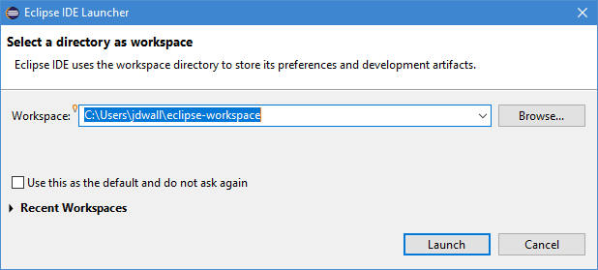
Launching Eclipse
When you start the Eclipse program, you will be asked to select the workspace
The workspace is where your preferences/files will be stored
Keep track of the location
You can leave the default location or choose a folder of your own choosing
Your program files will be stored here, so choose accordingly

Slide 20
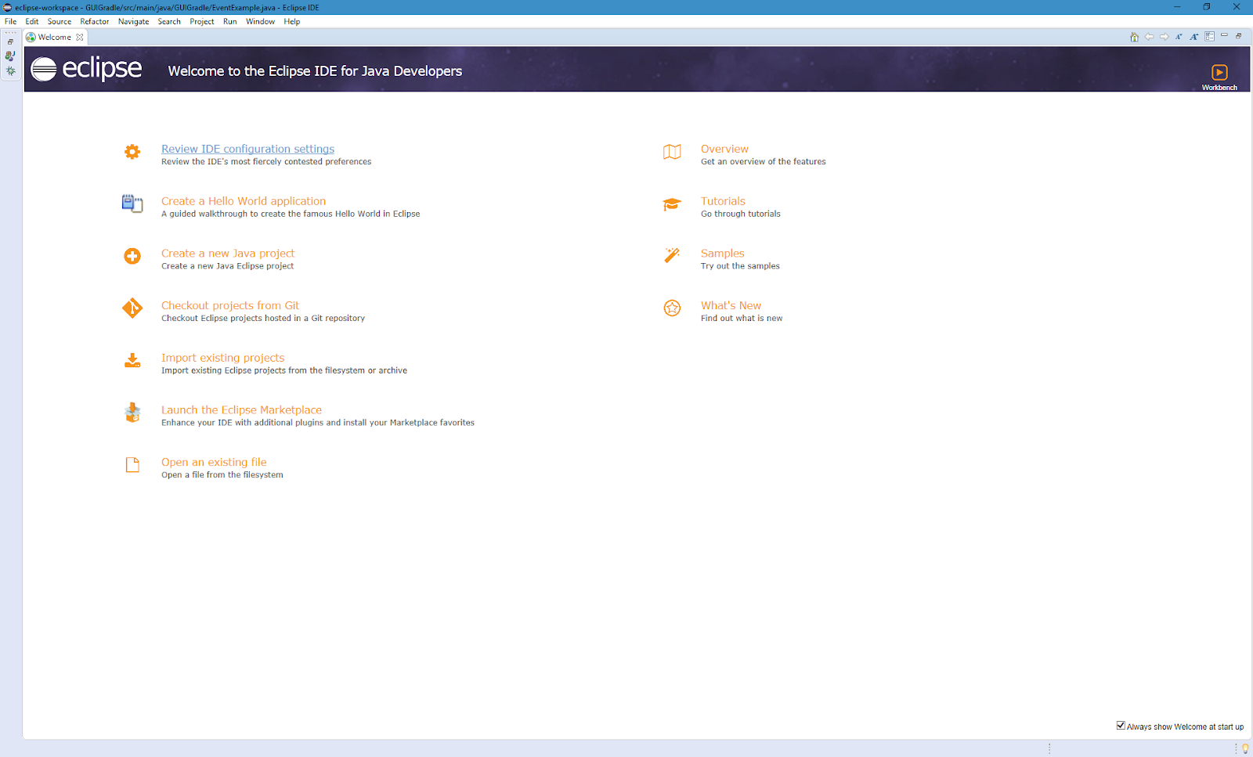
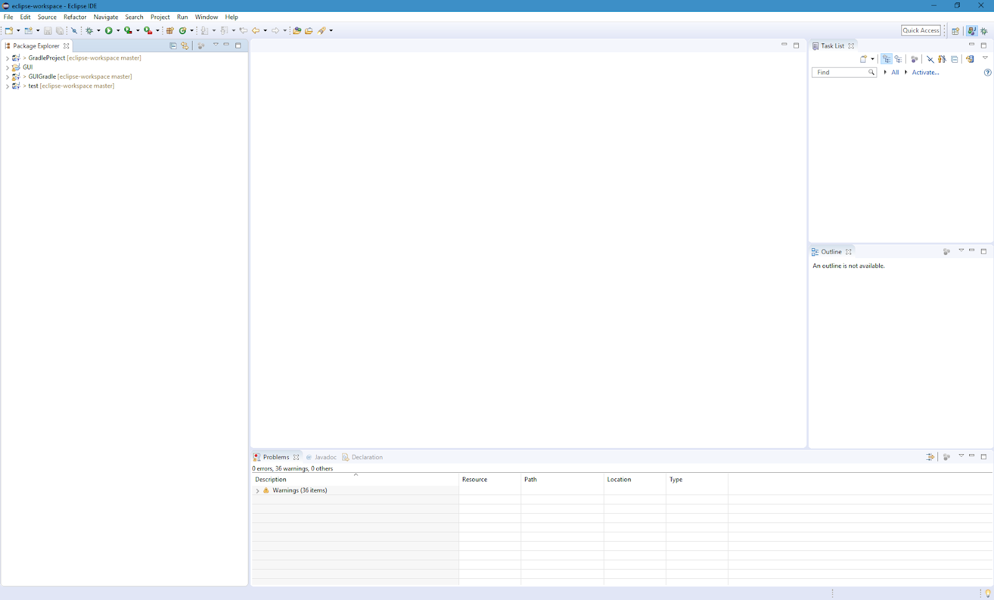
Welcome Window
On first arrival, you will see a Welcome window
Feel free to explore some of the links
After closing the Welcome window, you will see the default layout for Eclipse

Slide 21
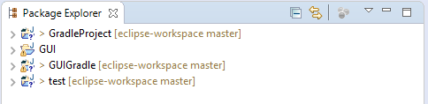
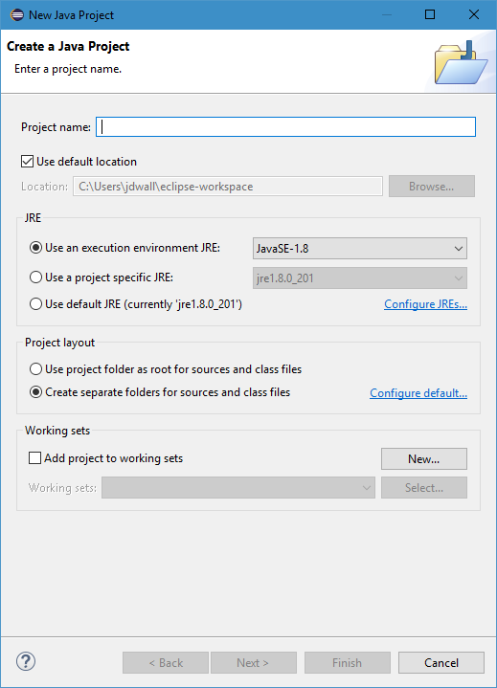
Eclipse Package Explorer
The Package Explorer window on the left side of the screen shows all of the projects you are working on
To create a project, use the top menu bar:
File-> New-> Java Project
Give the project a name
Make sure to use “JavaSE-1.8” for the JRE environment
Click “Finish”
Check the Package Explorer and you will see the newly created project

Slide 22
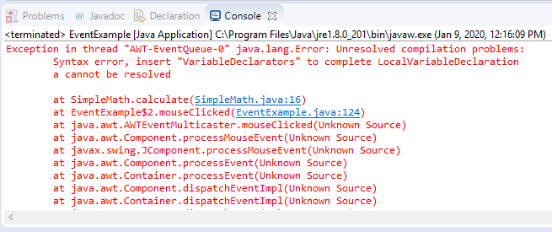
Eclipse Console Window
The Console allows you to see the results of your code when you run it
The Console will show you errors and exceptions
Google error messages and read programming forums
Post questions to programming forums if you would like
Window-> Show View-> Console in the top menu bar will open the Console if it is not displayed
You can print messages to the Console as well
System.out.println("your message will go here");

Slide 23
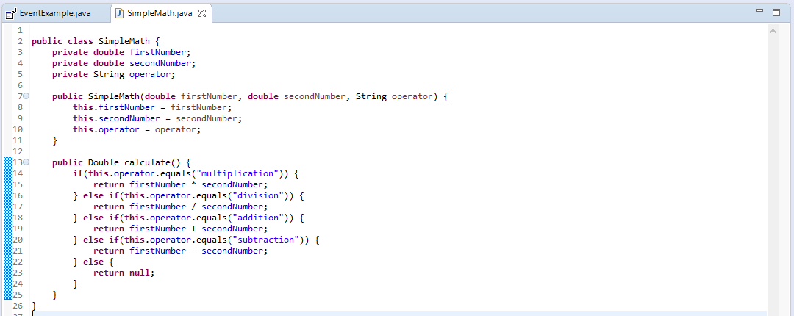
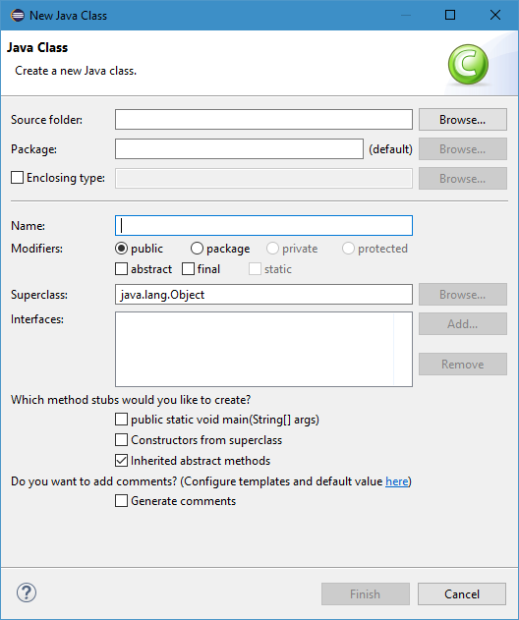
Main Programming Window
Code is written in the main window
To write code, you must create a class
All code is Java is contained in classes
Classes can be created within a project
Either click the New Java Class icon from the icon bar
Or use File-> New-> Class from the top menu bar
Provide the class a name
Click “Finish”

Slide 24
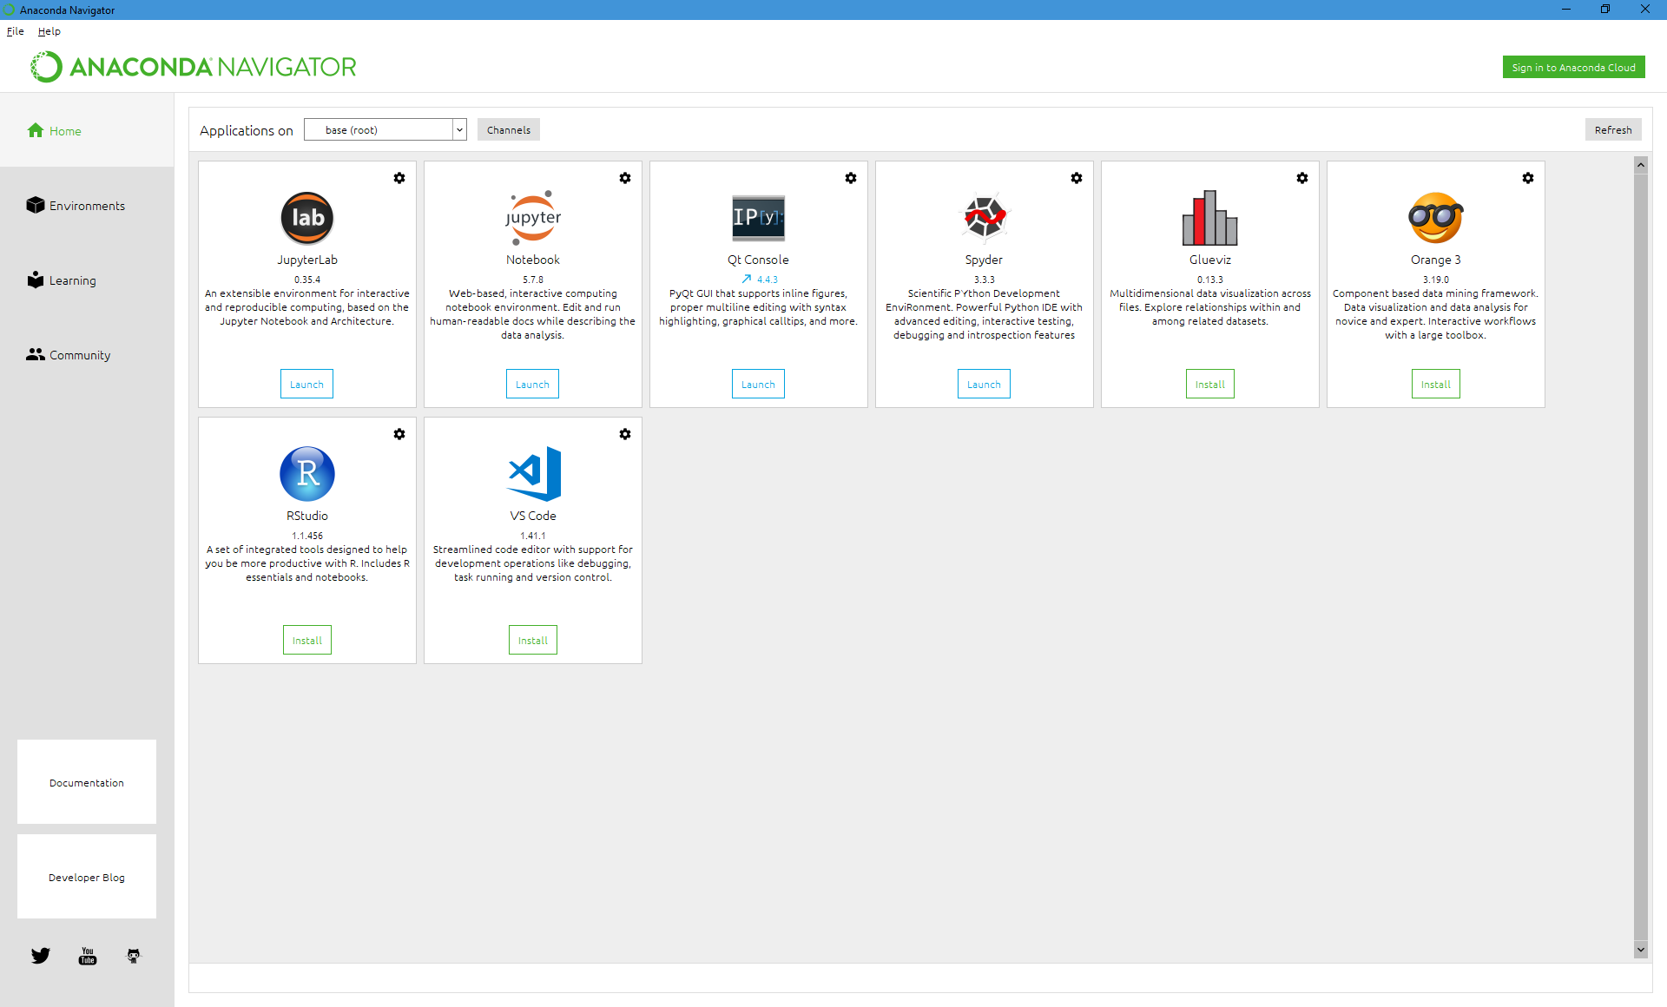
Launching Jupyter Notebook
Download Anaconda to gain access to Jupyter Notebook and other Python analytics tools.
Jupyter Notebook best used for data analytics with Python.
Not for systems development
Launch Jupyter Notebook with the Anaconda Navigator
Jupyter Notebook opens in a browser tab

Slide 25
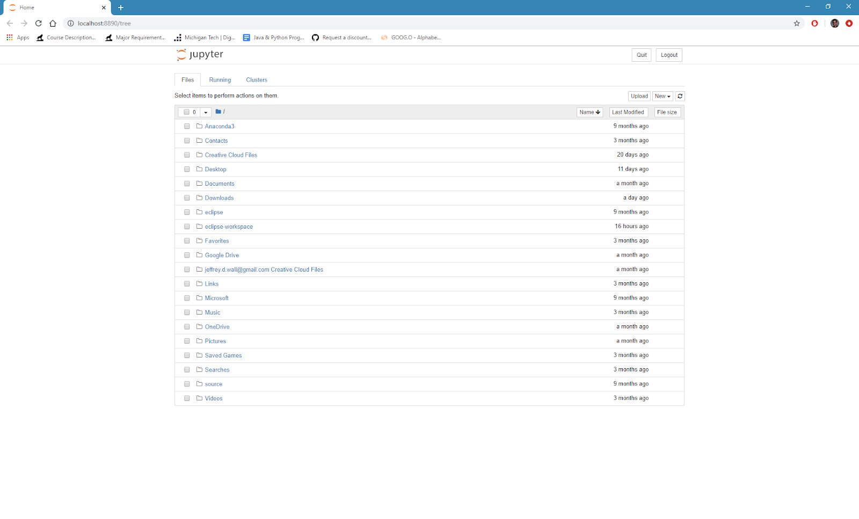
Jupyter Notebok
Starting page of Jupyter Notebook
Navigate to project folder
Create project folder in your filesystem
Not in Jupyter Notebook (too clunky)
Use “New” dropdown to create Python 3 notebooks

Slide 26
Notebooks
Notebooks are shared between users to document data analytics decisions and the results of analytics models
Notebooks consist of cells
Cells can contain text (for documentation) and Python code
Cells can draw on code from other cells
You can run the code in one cell independent of other cells
Once you run code, the results are stored in memory and can be used in later cells
Useful for only pulling datasets into the program once
Explore the buttons and file menus. Simple interface

Slide 27
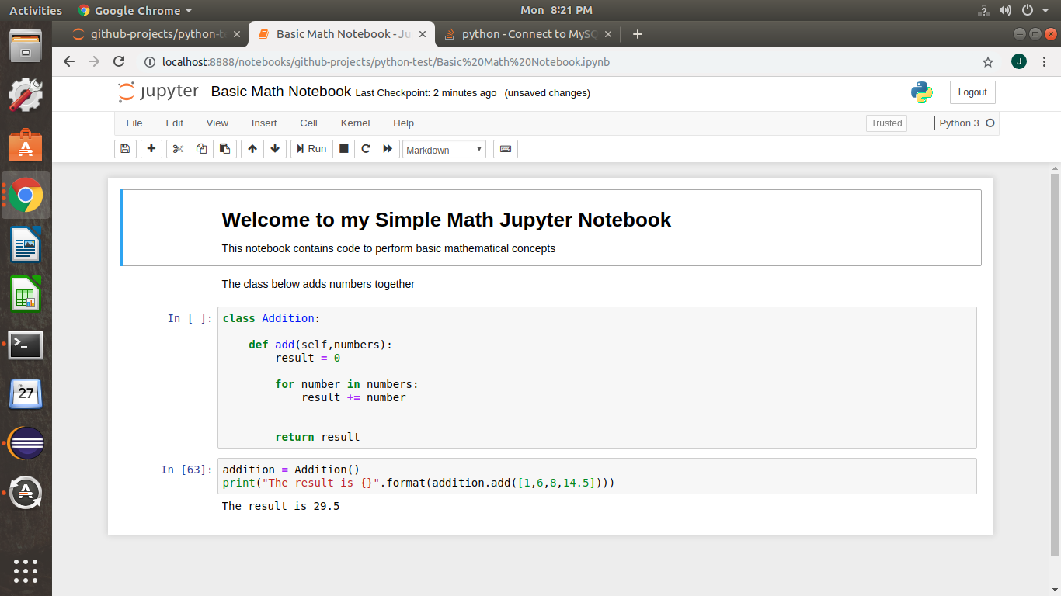
Notebooks

Slide 28
Conclusion
Any questions?

