Slide 1
Chapter 10: Business Applications for Programming

Slide 2
Automation and The Next Industrial Revolution
Often, technology advances incrementally. However, there are periods when new ideas or better infrastructure allow for revolutionary advances in technology.
We are on the cusp of a technological revolution that will change the way we live and work.
This revolution is being driven by advances in computing power that are fueling advances in machine learning, the Internet of things (IoT), robotics, and an increasingly technical workforce.

Slide 3
The Citizen Developer Movement
IT permeates every aspect of business, leaving IT departments constantly backlogged. IT labor often needs to be used for high priority, strategic initiatives.
This leaves many automatable tasks unautomated. However, that is slowly changing.
Employees from many different fields are developing IT skills. These employees are able to write code and find programs to solve the problems they face in their own work (sometimes without the assistance of the IT department).

Slide 4
The Citizen Developer Movement
These employees are referred to as “citizen developers.” Citizen developers can work on small IT tasks that the IT department doesn’t have resources to tackle.
The citizen developer movement is gaining traction in industry and some IT departments are beginning to embrace it and organize and train citizen developers.
With practice, you can become a citizen developer and lead IT efforts in your own work area.

Slide 5
The Citizen Developer Movement
You must exercise caution as a citizen developer!
Citizen developers possess foundational IT skills. However, they do not always possess deep knowledge of infrastructure or cyber security.
As such, citizen developers can create systems that violate IT policies and put organizational information systems at risk.
Follow guidelines developed by the IT department when acting as a citizen developer. Not all organizations have such guidelines. You may be able to help develop them.

Slide 6
Existing Information Technologies
Industry already relies heavily on a number of information technologies to track transactions and provide insight for decision making.
Enterprise resource planning (ERP) systems help organizations track resources and make decisions about how to use organizational resources.
ERP’s often contain many different modules. Big vendors, such as SAP and Oracle, provide full service ERP systems. Other vendors, such as workday, provide a smaller set of modules.

Slide 7
Existing Information Technologies
ERP systems often contain important finance/accounting modules that help executives and managers keep track of assets and make decisions about future assets.
Customer relationship management (CRM) systems are ERP modules that help organizations track interactions with customers to provide insight about how to improve the interactions.
Supply chain management (SCM) systems are modules that help organizations track interactions with SC partners and to share information with SC partners.

Slide 8
Emerging Technologies
Information technologies are advancing at a fast pace. Consider, for example, the various forms of automation that take place in Amazon fulfillment centers: https://www.youtube.com/watch?v=8nKPC-WmLjU
Many advances in automation are driven by machine learning and data mining, the Internet of things, and robotics.
Pay attention to advances in each of these areas to determine how your organization can leverage them to remain competitive.

Slide 9
Machine Intelligence: The Beginnings
Researchers and practitioners have been working toward intelligent machines for many years from many different perspectives.
Expert systems seek to mimic intelligence by encoding the decision logic and processes of experts into a system. Traditionally, this was accomplished through complex flow control logic.
Domain experts (i.e., doctors, engineers, accountants, etc.) would share how they make important decisions. Analysts and developers would then encode the decision logic into a program.
Expert systems provide some usefulness, but are not the intelligent systems that many seek to create.

Slide 10
Machine Intelligence : The Beginnings
Data mining offers another means to create “intelligent” systems.
Data mining is the process of using statistical algorithms (e.g., decision trees, random forests, support vector machines, some forms of regression, etc.) to extract patterns from data.
These patterns allow developers to write programs that utilize these patterns to make business decisions. For example, recommender systems tend to be based on data mining algorithms.

Slide 11
Machine Intelligence : The Beginnings
Data mining has provided many useful systems and will continue to do so for many years.
The insights data mining algorithms provide are based on careful modeling performed by statistical experts and embedded into computer logic by developers.
Despite their usefulness, a great deal of human intervention is still required for data mining. Experts must:
Extract the features from data to identify which factors help to predict or categorize
Identify the most appropriate models for prediction or categorization
Embed the models into traditional computing logic to automate decisions

Slide 12
Machine Learning
Although machine learning has also been around for years, currently, it provides the greatest promise for truly intelligent systems.
Unlike expert systems and data mining, machine learning seeks to develop systems that learn directly from data without being provided with strict flow control logic or human experts to extract features and choose an appropriate model.
Admittedly, many machine learning algorithms still require a high level of human intervention. However, researchers continue to create algorithms that can make decisions about the design of learning algorithms.

Slide 13
Machine Learning: Supervised Learning
Many machine learning algorithms in practice today rely on supervised learning.
Supervised learning requires large datasets (thousands or even billions of data points) with labeled data (i.e., known outcomes).
Algorithms learn from the labeled data through a process called “training.”
Once a model is trained, it can be shown new data and provide predictions about the outcome based on the data provided.

Slide 14
Machine Learning: Supervised Learning
Some applications of supervised learning include:
Computer vision in automated vehicles
Chat bots through natural language processing algorithms
Financial investing
Automation of manufacturing floors (e.g., identifying defective products, detecting when machines will fail, etc.)
Advances in machine learning continue to expand the possibilities of what it can be used for. For example, many customer service jobs may be automated in the near future thanks to advances in natural language processing.

Slide 15
Machine Learning: Unsupervised Learning
Unsupervised machine learning is not as widely used in industry. Although it can be found in some data mining algorithms, like clustering algorithms.
Unsupervised learning doesn’t required labeled data. The algorithm learns from data without the need for labels. Often, they are used to segment data, such as identifying customers with similar characteristics.
Currently, unsupervised learning requires humans to decipher what the computer has learned.
Unsupervised learning algorithms are heavily desired as training supervised algorithms is costly due to the amount of data and computing power required for training.

Slide 16
Machine Learning: Semi-supervised Learning
As researchers continue to search for learning algorithms that don’t require massive amounts of labeled data, many have turned to semi-supervised learning.
Semi-supervised learning algorithms rely on some labeled data, but also include unlabeled data.
The labeled is used with an unsupervised learning algorithm to label the unlabeled data. Then, the labeled data is used in a supervised fashion to train the algorithm.

Slide 17
Machine Learning: Transfer Learning
Researchers have also found other ways around the expense of training supervised learning algorithms.
Transfer learning uses a model that was trained in one context as a base model for training a new model in a different context.
Parts of the model learned from the first context are used to reduce the amount of data required to train the new model.

Slide 18
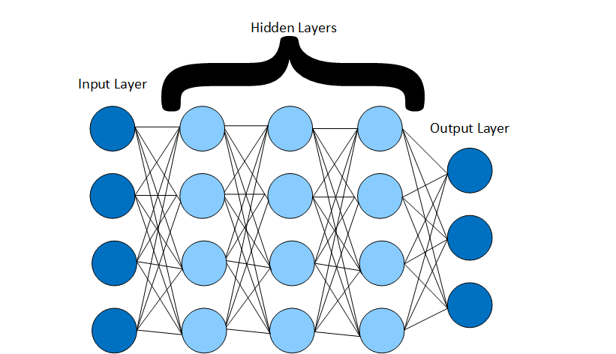
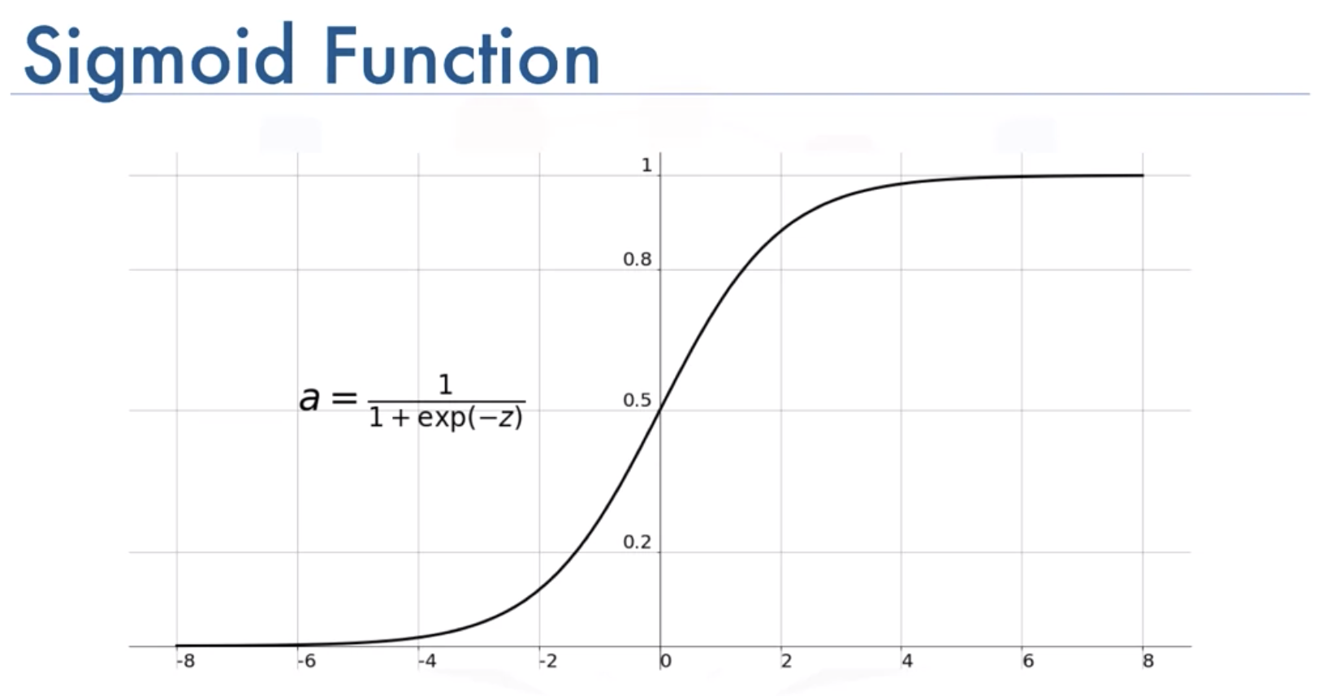
Machine Learning: Neural Networks
Neural networks are one of the most popular forms of supervised learning that are providing advances in automation.
ANN’s mimic the brain (though not exactly). They consist of “neurons” that perform weighted calculations on data that are then passed through an activation function, such as
ANN’s consist of connected layers, each containing many neurons.

Slide 19
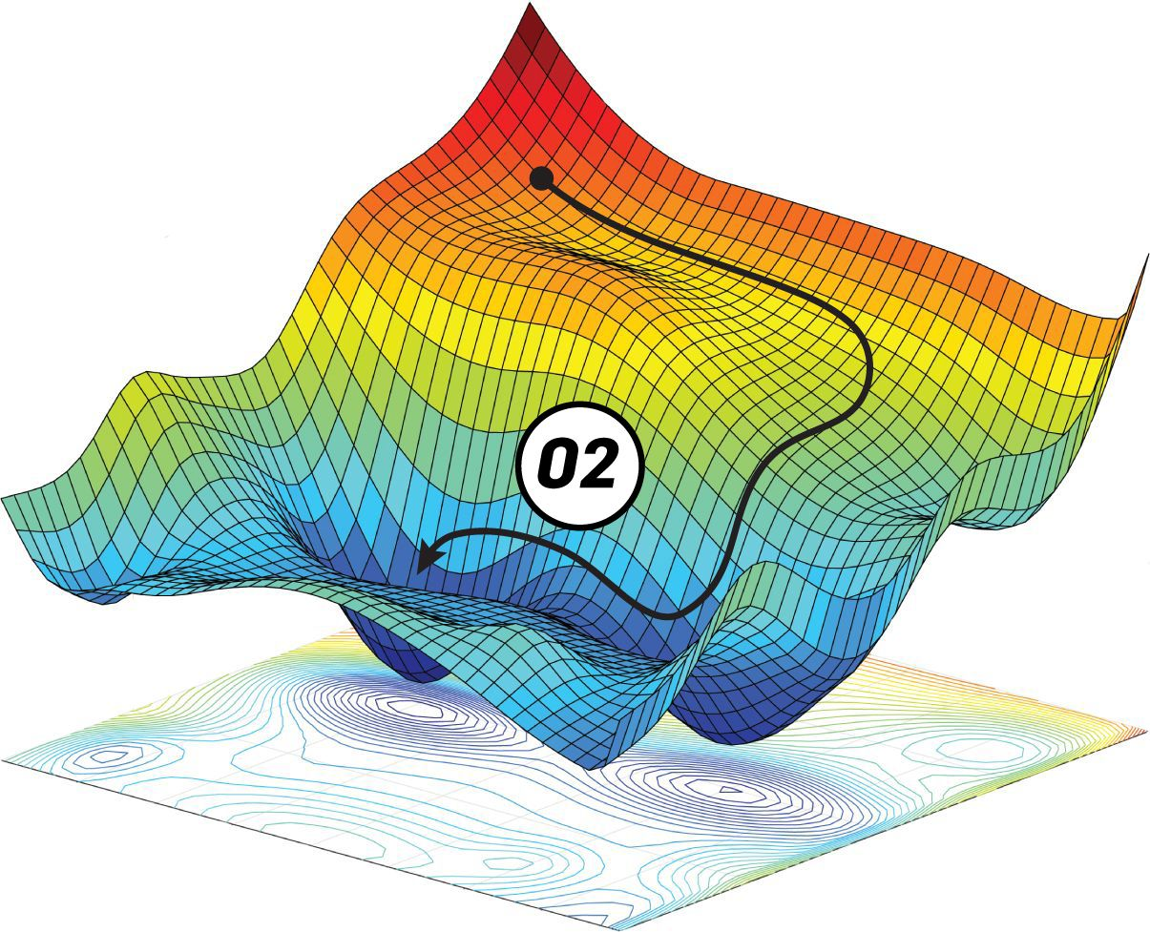
Machine Learning: Neural Networks
ANN’s consist of types of layers
An input layer that accept raw data
Many hidden layers that learn about the data from the input layer
An output layer that makes predictions based on processing in hidden layers
Learning occurs as neuron weights are adjusted through an algorithm called back propagation, which is often done through gradient descent.

Slide 20
Machine Learning: Neural Networks
There are many types of neural networks that serve different purposes
Convolutional neural networks (CNNs) are good for computer vision problems.
Recurrent neural networks (RNNs) are good for processing time series data
Generative adversarial networks (GANs) are good for producing new data based on existing data. GANs are used to produce paintings, music, stories, or fake images or video.

Slide 21
Machine Learning: Reinforcement learning
Reinforcement learning is another form of machine learning that has shown some usefulness, though mostly in gaming situations to date.
Reinforcement learning includes an agent that can perform actions within an environment and receive/not receive rewards/punishments based on those actions.
Through trial and error, the agent makes decisions at random. As it does, the agent begins to learn the best actions to take within the environment to gain the highest rewards.
AlphaGo was based on CNN’s and reinforcement learning.

Slide 22
The Internet of Things
In addition to machine learning, the Internet of things (IoT) is revolutionizing industry.
IoT is the use of Internet connected sensors to provide real-time data for making faster decisions.
Many types of sensors:
Visual sensors like cameras and lidar
Audio sensors like microphones and sonar
Heat and vibration sensors
Even sensors to detect smells

Slide 23
The Internet of Things and Intelligent Systems
IoT can be used in conjunction with machine learning and data mining to provide real time data for decision making.
For example:
Automated vehicles require many sensors to help computing algorithms make driving decisions.
Manufacturing floors require vision sensors, vibration sensors, etc. to make decisions about how to manage the manufacturing process and the machines that make it possible.
Cities are use various sensors for traffic prediction, electrical grids, etc.

Slide 24
Robotics
IoT and machine learning provide the intelligence to process data and make decisions. However, they cannot perform physical actions.
Advances in robotics in conjunction with advances in sensing and machine learning are allowing for automation of both “manual” work and “intelligent” work.
Recent advances in robotics have created robots that can move in intricate ways. Balance has been a difficult problem in robotics, but that is changing. https://www.youtube.com/watch?v=fn3KWM1kuAw

Slide 25
Robotics, Machine Learning, and IoT
The potentials for disruption are increased when advances in robotics, machine learning, and IoT are combined. It is this combined potential that is leading to the next wave of automation. For example:
As seen in the Amazon video, smart robots can move products around a warehouse instead of forklift drivers.
Smart vehicles, including smart semi-trucks, are making their way to market
Smart mental health robots are beginning to enter the market.
Smart robots are beginning to assist with search and rescue missions

Slide 26
The Future
The near future will see many changes to the way we work and live.
Some of the changes can have negative impacts on society, such as job loss for those not trained for the economy of the future.
Some of the changes will have positive impacts, such as advances in medical technology.
You need to be prepared to keep up with technological advancements. Be a leader in automation and not a laggard.

Slide 27
Conclusion
Any questions?

