Slide 1
Managing the Development Process
Chapter 2

Slide 2
The Waterfall Method
What are the core activities in the waterfall method? Describe each.
Hint: the waterfall method is also known as the “traditional SDLC” method.

Slide 3
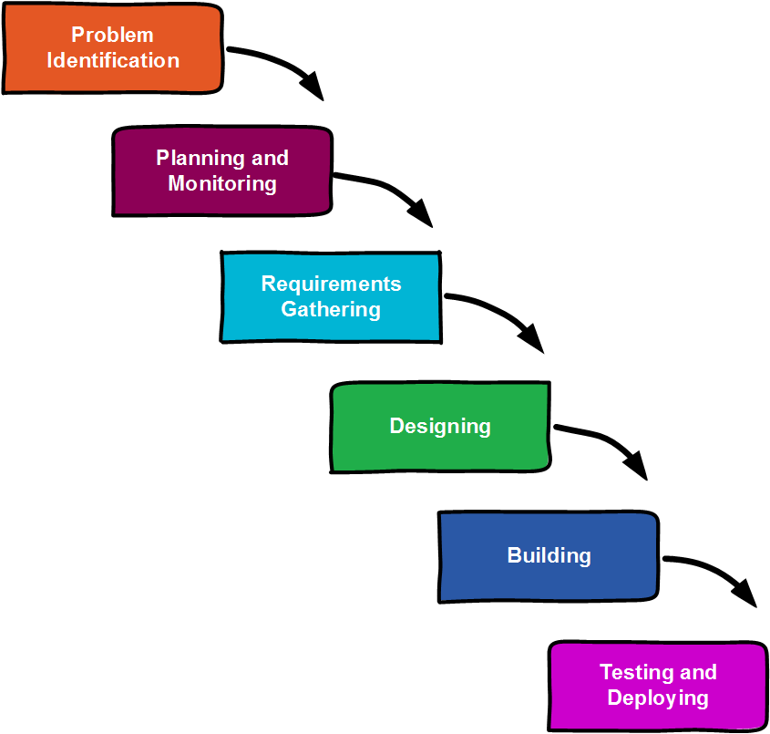
The Waterfall Method
One activity is performed and then the next in a cascading fashion.
You can move forward, but you shouldn’t move backward. You can’t swim up a waterfall.

Slide 4
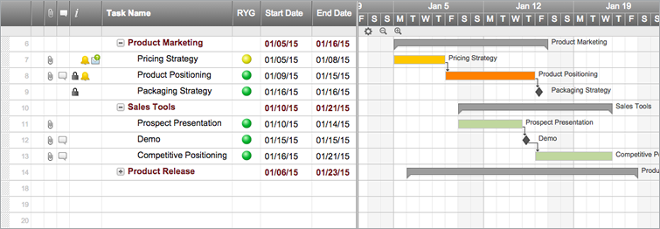
The Waterfall Method: Phases 1 & 2
Phase 1: Problem identification
What is a vision document?
Phase 2: Planning and Monitoring
Set up the team. What are SMEs?
Budget
What are Gannt and PERT charts? Why can they be useful?

Slide 5
The Waterfall Method: Phase 3
Phase 3: Requirements Gathering and Modeling
Interviewing: What is an interview protocol? What are some key topics you should cover in an interview?
Functional decomposition: What is it? What are use cases? What are the common elements of a use case? Describe the user goal technique Describe the event decomposition technique

Slide 6
The Waterfall Method: Phase 3
When interviewing, use open ended questions!
Find out:
Who users are
What they do within their roles
How they do what they do
What their work should ideally look like
What impedes this ideal state
Why they do what they do
Environmental conditions that affect their work

Slide 7
Functional Decomposition: User Goal Technique
User Goal Technique
Identify different types of users (e.g., line employees, middle management, upper management, marketing, accounting, etc.).
Interview each group to determine what their goals are within the problem domain.
Condense goals into final list.
Develop use cases from the goals.

Slide 8
Functional Decomposition: Event Decomposition
Event Decomposition Technique
Three types of Events: External, Temporal, and State. Describe each
As a team, list all external, temporal, and state events.
Interview users, observe processes, and examine documents to add to or remove from initial list of events.
Develop use cases from the events.

Slide 9
Use Cases
Principle components of a use case:
Use Case Name: a verb-noun or actor-verb-noun phrase to represent the use case.
Brief Description: a short paragraph describing the action the user performs.
Actor(s): a list of the different types of users involved in the use case
Preconditions: a list of the requirements that must exist before the use case can be enacted.
Activity Flow: an ordered list of actions taken by the user and system that are enacted to complete the use case.
Exceptions: a list of issues that may occur during the processing of the use case.
Post Conditions: a list of outcomes that the system should complete by the end of the use case.

Slide 10
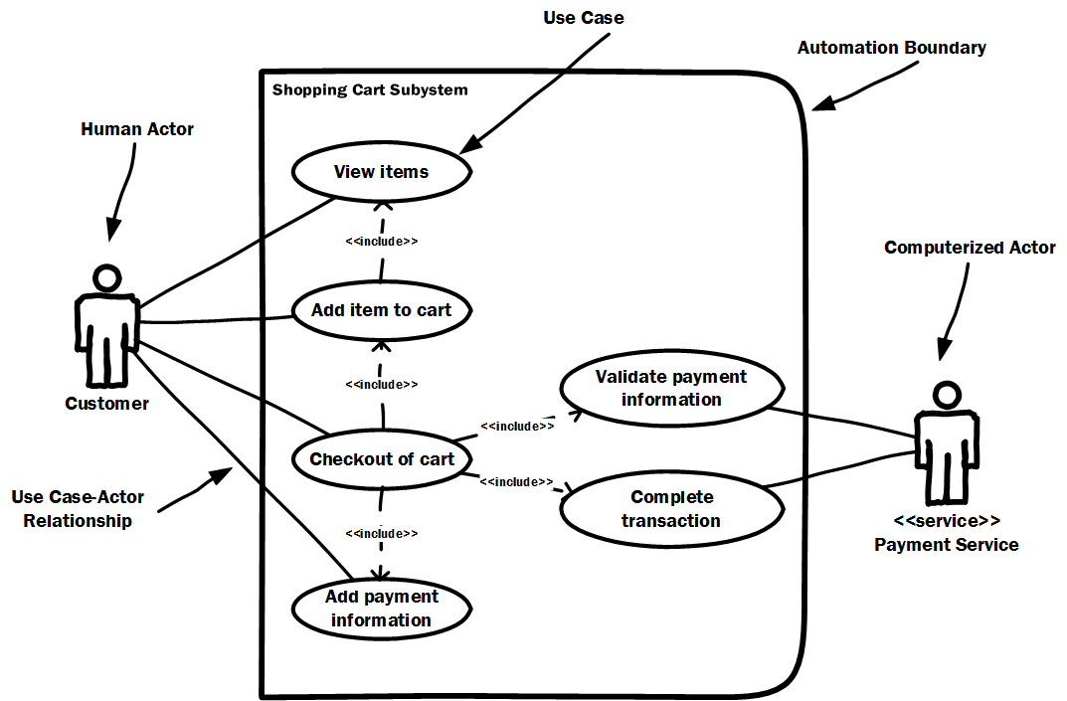
Use Case Diagrams
Use Case Diagrams Show:
Actors (human and computer)
Use Cases
Which actors interact with each use case
Visio provides simple drag and drop functionality to build use case diagrams.

Slide 11
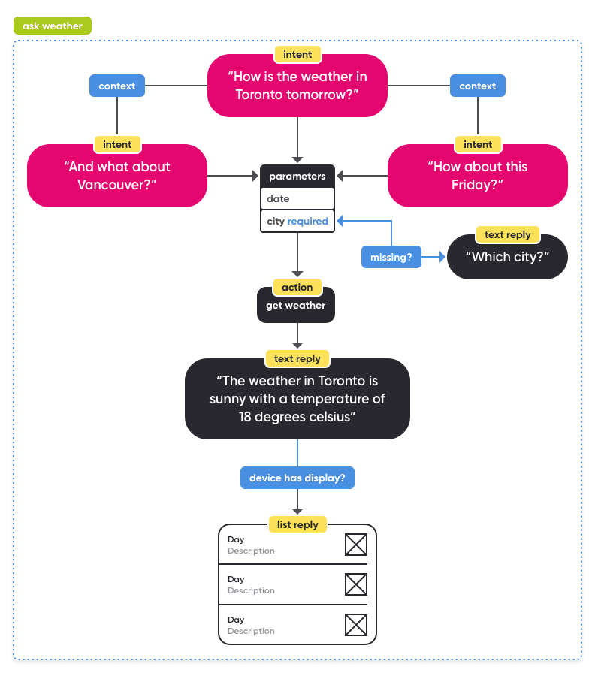
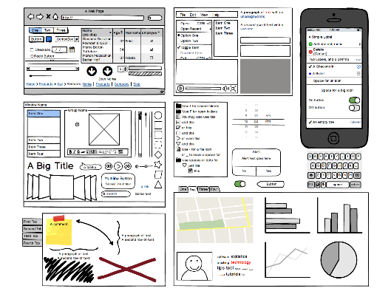
The Waterfall Method: Phase 4
Phase 4: Design
Wireframing/user interface mockups
Speech interfaces
Class diagrams; entity-relationship diagrams; network diagrams; process diagrams

Slide 12
The Waterfall Method: Phases 5 and 6
Phase 5: Build or Buy
Buy decisions: identify and compare systems
Build: do you have the talent? Do you have development processes?
Phase 6: Testing and Deployment
Acceptance tests – have you given the business and users what they want?
Change management efforts help system acceptance

Slide 13
Agile Development Methods
What are the core values of the Agile Manifesto?
What are some common misconceptions of these core values?
Name some of the common Agile methods and frameworks

Slide 14
Agile Manifesto
valuing individuals and interactions over processes and tools
Still uses processes and tools
valuing working software over comprehensive documentation
Still produces documentation; to enhance conversation
valuing customer collaboration over contract negotiation
May still set up contract; you need expectations
valuing responsiveness to change over following a plan
Still need planning; planning is smaller and incremental

Slide 15
Agile Development Methods
Common agile methods/frameworks/disciplines:
The Unified Process
Scrum
Extreme Programming

Slide 16
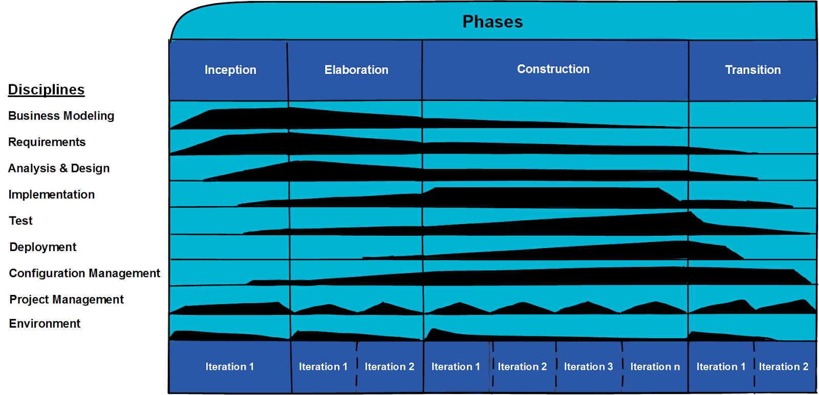
The Unified Process
Describe the Unified Process with its several disciplines and phases (UP).
Unified Modeling Language (UML) built alongside the UP to support analysis and design efforts.

Slide 17
The Unified Process – Disciplines
Business Modeling - understand the organization and its structures and problems.
Requirements - identify the function requirements of the system.
Analysis & Design - convert requirements into system designs.
Implementation - generate code to implement designs.
Test - find defects and ensure the system functions as expected.
Deployment - transfer tested system components to production environments for use.
Configuration & Change Management - identify configuration needs of different users and adjust configurations as necessary. Audit configurations.
Project Management - plan and monitor the phases of the system over time.
Environment - ensure that the development team has an environment with all of the processes and tools to successfully complete the system.

Slide 18
The Unified Process – Phases
Inception: Similar to problem identification and some early analysis (1 iteration)
Elaboration: Continued analysis and design (2 iterations)
Construction: Build, Test, Deploy (2 or more iterations)
Transition: Change management; deploy customizations (2 iterations)

Slide 19
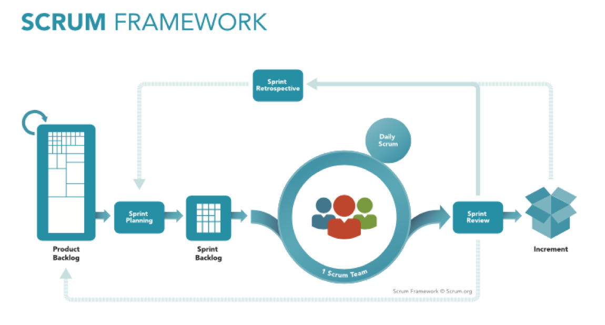
Scrum
Describe the Scrum Framework.
Define each Role: Scrum Master; Product Owner; Team Member
Define: Sprint; Product Backlog; Sprint Backlog; Increment
Define: Daily Scrum; Sprint Review; Sprint Retrospective

Slide 20
User Stories vs. Use Cases
Use case: describes a basic function users can perform within a system (e.g., delete account, purchase item).
User story: describes a user’s goals, desired outcomes, and purpose (e.g., as a student, I want to reduce study time while maintaining good grades to have more fun time).
How do they differ? What are the different types of user stories? What are the components of a user story?

Slide 21
User Stories
Epic stories (epics): summarize user’s lower level goals into higher level objectives.
User stories: more specific goals that users wish to accomplish. Some companies have layers of user stories.
Acceptance criteria/tasks: specific expectations about how the story will function. Similar to functional and non-functional requirements.

Slide 22
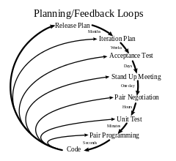
Extreme Programming
Purpose: Improve craftsmanship among software developers
Proposes several activities to improve development efforts. Some common features in practice:
What is pair programming?
What is test driven development (TDD)?
Weekly cycles/releases; Quarterly cycles/releases

Slide 23
Conclusion
Many development methodologies exist. These are only the most widely discussed. Which will you use?
Depends on project, team, organization.
Many organizations don’t adopt a pure methodology. They mix concepts and models from multiple methodologies and frameworks.

