Slide 1
Users and Value Assessment
Chapter 3

Slide 2
Problem Identification
To identify a valuable problem, you must understand users and their value propositions.
What is a value proposition?
What is a persona? How can persona’s be used to develop and understand value propositions? How do you construct personas?

Slide 3
Value Proposition/Hypothesis
Value Propositions/Hypotheses: assumptions about why a potential solution will be valuable to a user. Why users want to use and why they will benefit from system use.
The focus is on the WHY (e.g., users’ needs, motivations, frustrations, values, behavioral patterns, etc.).
Example: organizations will buy our new ERP system because it is sold modularly instead of as one large suite.
Assumes a need for an ERP, desire to save money, frustration with large suites with unused modules.

Slide 4
User Persona
User Persona: an average representation of a group of individuals that exhibit similar traits, beliefs, roles, and/or behaviors
Each persona should capture:
Defining characteristics relevant to problem domain (age, role, gender)
Cognitions and perceptions about problem domain
Emotional states when interacting in problem domain (e.g., frustrations)
Motivations that drive engagement within problem domain
Actions taken within the problem domain (i.e., behavioral patterns)

Slide 5
Interview Tips
Prepare an interview protocol to remain consistent/structured across interviews.
Semi-structured interviews are fine (i.e., small deviations from the structured protocol).
If other important topics arise during early interviews, add new questions to the interview protocol.
Ask open-ended questions (e.g., tell me about… why/how do…)
Close-ended questions (e.g., yes/no questions) for shy/quiet respondents
Close-ended questions may be useful in follow-up interviews

Slide 6
Interview Tips
Make it as conversational as possible.
Be cordial and affirm that you’re listening (ahhh…, um hmm…, interesting, etc.)
Take detailed notes!!
Two team members is helpful; one to interview and one to take notes.
Ask if you can conduct a follow up interview if needed.

Slide 7
Persona Construction
Persona development can be completed in one week or less. No more than two weeks.
Begin with team’s assumptions of personas. Draft personas.
Develop an interview protocol.
Find interview participants: Qualtrics, Amazon Turk, or go where they are
Interview people that fit each persona profile. 20-40 interviews will usually suffice. Take careful notes!!!
Sociology suggests 12 interviews per group leads to a solid understanding of a group. More than 40 may be needed if you have many personas.

Slide 8
Persona Construction
Code interview notes/transcriptions for characteristics, cognitions, emotions, motivations, and behaviors.
New personas may emerge based on coding of the elements
Coding also helps to confirm or dismiss initial assumptions in the draft personas created in step 1
Build/refine persona documents based on results of coding.
Develop value propositions for each persona based on differing pain points, motivations, cognitions, behavioral patterns, etc.

Slide 9
Identifying Solutions
What is the difference between the traditional brainstorming process and idea generation sessions?
What types of solutions are available when trying to solve a problem? When are the different types of solutions used?

Slide 10
Identifying Solutions
Traditional brainstorming sessions include the entire group sharing their idea vocally.
Can be good, but may lead to quieter voices being ignored or unheard.
Idea Generation sessions ask each individual to come up with an idea.
Each individual pitches their idea and questions/concerns are raised.
Dot voting is used to determine which idea (or parts of an idea) are most interesting.
All voices are heard

Slide 11
Different Solutions
Vendor solutions – An existing product offered by another company
Internal/outsourced development – develop a new product internally or outsource development of a proprietary product
Make sure you have the capabilities to manage internal or outsourced projects.
You should have strategic reasons for internal/outsourced development because of cost and difficulty.
If a vendor solution fits most of your processes, it is often best to adopt the vendor solution and change a few processes.

Slide 12
Comparing Different Solutions
Describe different methods to compare solutions? What are the costs and benefits of using each method?
What is sensitivity analysis and why should you conduct a sensitivity analysis?
Which method should you use?

Slide 13
Comparison Matrices
Identify important criteria for comparison from the perspective of relevant stakeholders.
Rate each possible solution based on the criteria.
Make a decision informed by understanding each solution
Comparison Matrix
 | Vendor Solution X | Vendor Solution Y | Internal Solution X | Internal Solution Y
Cost | $10/user/month 100 users = $12,000/year | $8000/year up to 200 users | $50,000 development $4,000/year maintenance | $100,000 development $6,000/year maintenance
Customizability 1=not customizable 5=highly customizable | 1 | 3 | 4 | 5
Customer Support 1=poor support 5=excellent support | 4 | 2 | 3 (potential to improve) | 3 (potential to improve)
Contract Duration | Monthly commitment | 2 years with early termination penalty | N/A | N/A
Social Networking Capabilities | Yes | No | Simple features | Yes

Slide 14
Multi-criteria Decision Making
Identify important criteria for comparison from the perspective of relevant stakeholders.
Determine how important each criteria is with a weighted score.
Rate each solution by the weighted criteria and add up the scores.
If you chose your criteria and weights well, the highest scored solution should be the best option.
Multi-Criteria Decision Analysis
 | Vendor Solution X | Vendor Solution Y | Internal Solution X | Internal Solution Y
Cost Weight = 30 | 4 4*30=12 | 5 5*30=150 | 2 2*30=60 | 1 1*30=30
Customizability Weight = 30 | 1 1*30=30 | 3 3*30=90 | 3 3*30=90 | 5 5*30=150
Support Weight = 20 | 5 5*20=100 | 2 2*20=40 | 3 3*20=60 | 2 2*20=40
Contract Weight = 10 | 4 4*10=40 | 2 2*10=20 | 5 5*10=50 | 5 5*10=50
Social Weight = 10 | 4 4*10=40 | 1 1*10=10 | 2 2*10=20 | 3 3*10=30
Weighted Total | 120+30+100+40+40 = 330 | 150+90+40+20+10 = 310 | 60+90+60+50+20 = 280 | 30+150+40+50+30 = 300
Percent of Best | 100% | 310/330 = 94% | 280/330 = 85% | 300/330 = 91%

Slide 15
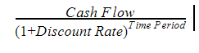
Cost-Benefit Analyses
List of Costs and Benefits for Hypothetical Cloud Based Software System
Costs | Benefits
Software fees (vendor support included): $10 * 100 users * 12 months = $12,000 per year | Reduced data entry time: 100 users * 1 hour savings/day * 260 workdays * $20/hr = $520,000 savings in data entry costs
Training costs: 4 hour training * 100 users * $20/hr = $8,000 for first year | Reduced transaction processing time: 100 users * 1 hour savings/month * 12 months * $20/hr = $24,000 savings in transaction costs
Internal troubleshooting support costs: 100 users * 20 hours/user/year * $50/hr = $100,000 for internal IT support costs per year | Assume only 75% of the benefits will be realized for the first year as users learn the system.
Total cost of $120,000 in the first year and $112,000 in subsequent years | Total benefits of $408,000 for the first year and $544,000 for subsequent years
Convert costs and benefits into dollar amounts for each solution.
Examine costs and benefits across multiple years (e.g., the life of the product)
Use NPV if over long periods of times
Consider ROI or other metrics for comparing alternatives.
Assessing The Value of the Investment
 | Benefit | Cost | Benefit - Cost | Running Total
Year 1 | $408,000 | $120,000 | $288,000 | $288,000
Year 2 | $544,000 | $112,000 | $432,000 | $720,000
Year 3 | $544,000 | $112,000 | $432,000 | $1,152,000
Year 4 | $544,000 | $112,000 | $432,000 | $1,584,000
Year 5 | $544,000 | $112,000 | $432,000 | $2,016,000
Year 6 | $544,000 | $112,000 | $432,000 | $2,448,000
Totals | $3,128,000 | $680,000 | $2,448,000
ROI = (benefit-cost)/cost = ($3,128,000-$680,000)/$680,000 = 360%

Slide 16
Sensitivity Analysis
Sensitivity analysis seeks to understand how variation in the ratings or estimates affect the outcomes of the analysis.
Ratings and estimates are rarely exact. You should understand what could happen if some of your assumptions are incorrect.
Ratings or estimates could be in a range and multiple random samples selected from the ranges to identify a solution.
In more complex analyses, distributions for each criteria could be used to identify potential outcomes.

Slide 17
Making Estimates
What are some methods organizations use to estimate costs and benefits of a system?
What are different tools organizations use to track project time?
What estimate approach should you use?

Slide 18
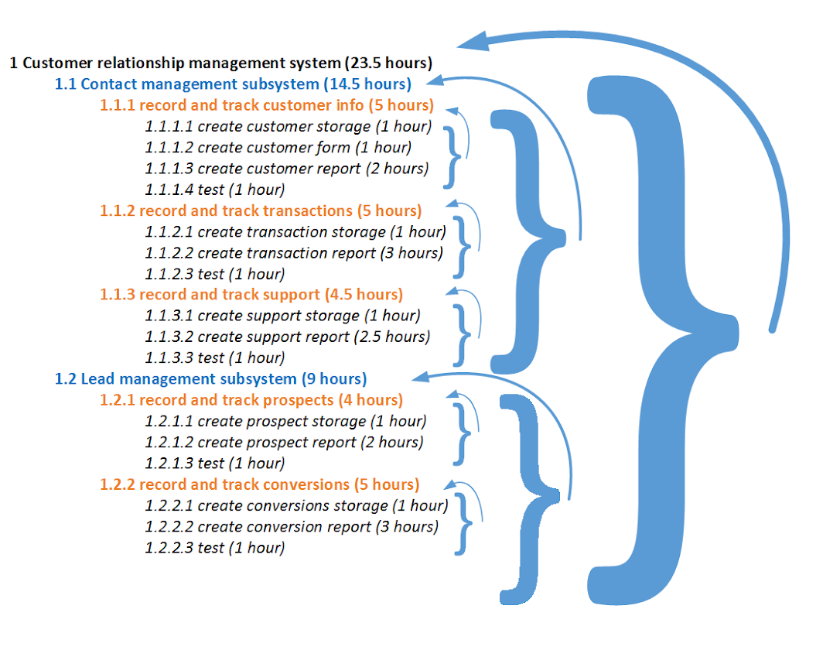
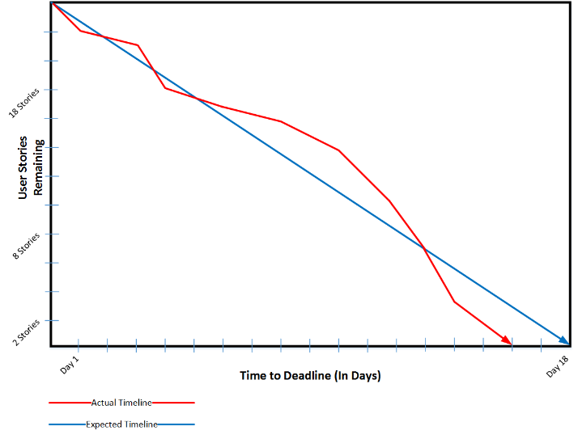
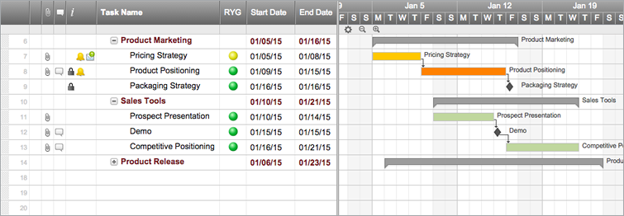
Making Estimates
Work breakdown structures
Functionally decompose the system into smaller and smaller chunks of work
Gantt or burndown charts are used for tracking

Slide 19
Making Estimates
When using the waterfall method or other traditional methods, you will likely spend time building complex work breakdown structure documents and intricate Gantt charts.
If you are using an Agile approach, you might still use work breakdown documents or Gantt charts, but many Agile practitioners believe these methods are overkill.
Some Agile practitioners prefer burndown charts or even more informal tracking
Some care should be taken to completely remove planning from Agile development.

Slide 20
The Lean Startup
What is the Lean Startup? What is the goal of the Lean Startup methodology?
Describe the build, measure, learn model.
What is a minimum viable product? Why are MVPs created?

Slide 21
Lean Startup: Testing Value Propositions
Value propositions are simply reasoned assumptions. Test them!!
The Lean Startup envisioned by Eric Ries provides a systematic approach to learning from value propositions.
Particularly when funding capital for new ideas is low, Lean Startup can provide cost effective software development.
Not just for startups. Useful for any organization that wants to innovate.

Slide 22
Lean Startup: Build, Measure, Learn
Begin with ideas and value propositions
Build the ideas
Measure and test value propositions
Learn from tests
Repeat

Slide 23
Lean Startup: Minimum Viable Product
A Minimum Viable Product (MVP) is an early prototype of a system that can be provided to customers to test the value of a potential product or service (i.e., test value propositions).
It is optimal to charge for the MVP to determine true value.
What are the three types of MVPs? Describe each and provide examples.
What is innovation accounting? How does it relate to MVPs?

Slide 24
Lean Startup: MVP Types
Concierge MVP: manually provide the software service that you wish to build.
Wizard of Oz MVP: build a façade user interface that passes data to humans who then process the data to provide a service.
Pre-order/Sign-up MVP: describe the produce on a landing page. Allow visitors to sign up for updates or pre-order.

Slide 25
Lean Startup: Experimentation and Innovation Accounting
Innovation Accounting: designing fine-grained metrics to measure the value of MVPs and features of MVPs.
Differs from tendencies to examine growth and value with simple metrics like revenue and sales volume.
As MVPs are refined, metrics can be developed to test the value of new features through scientifically valid experiments.
A/B testing (a.k.a., split testing) helps with experimental design.

Slide 26
Conclusion
You must understand your users in order to systematically produce a product/service they want.
Test the value of your products/services early and often, possibly through MVPs.
Use refined metrics and experiments to help you determine what is valuable and what is not.
Team disputes can easily be settled through A/B testing
Assignment 2: Interviews and Problem Identification

