Slide 1
Chapter 4: Introduction to Data Structures

Slide 2
Data Structures
Data structure provide a way to store, organize, access, and modify complex data.
Used to organize data in computer memory
Also used to organize long term storage (i.e., database storage structures)
Examples of data structures:
classes, stacks (LIFO), queues (FIFO), trees, graphs, arrays, lists, and maps/dictionaries
We will primarily focus on basic data structures: arrays, lists, and maps/dictionaries

Slide 3
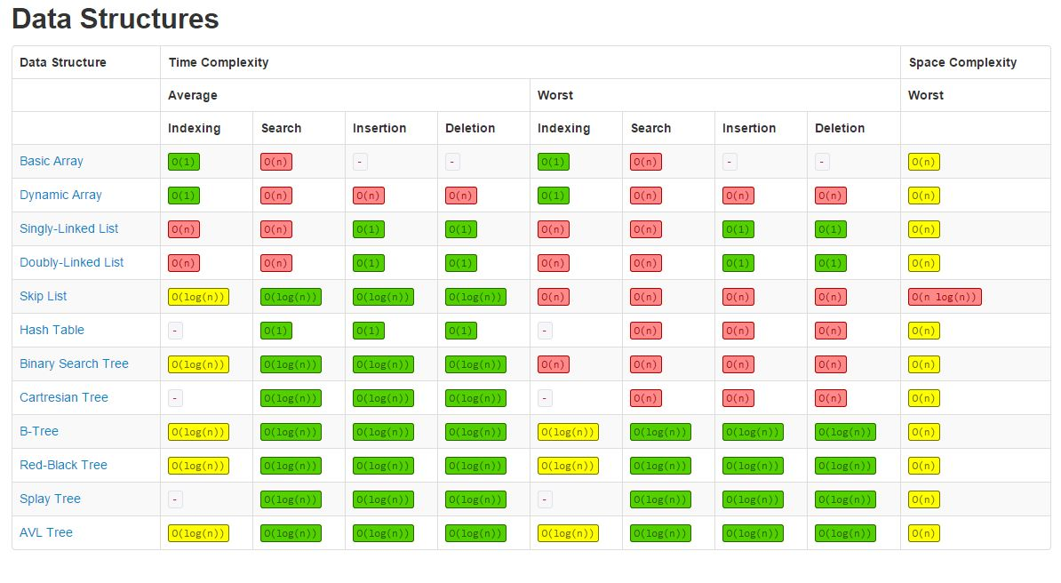
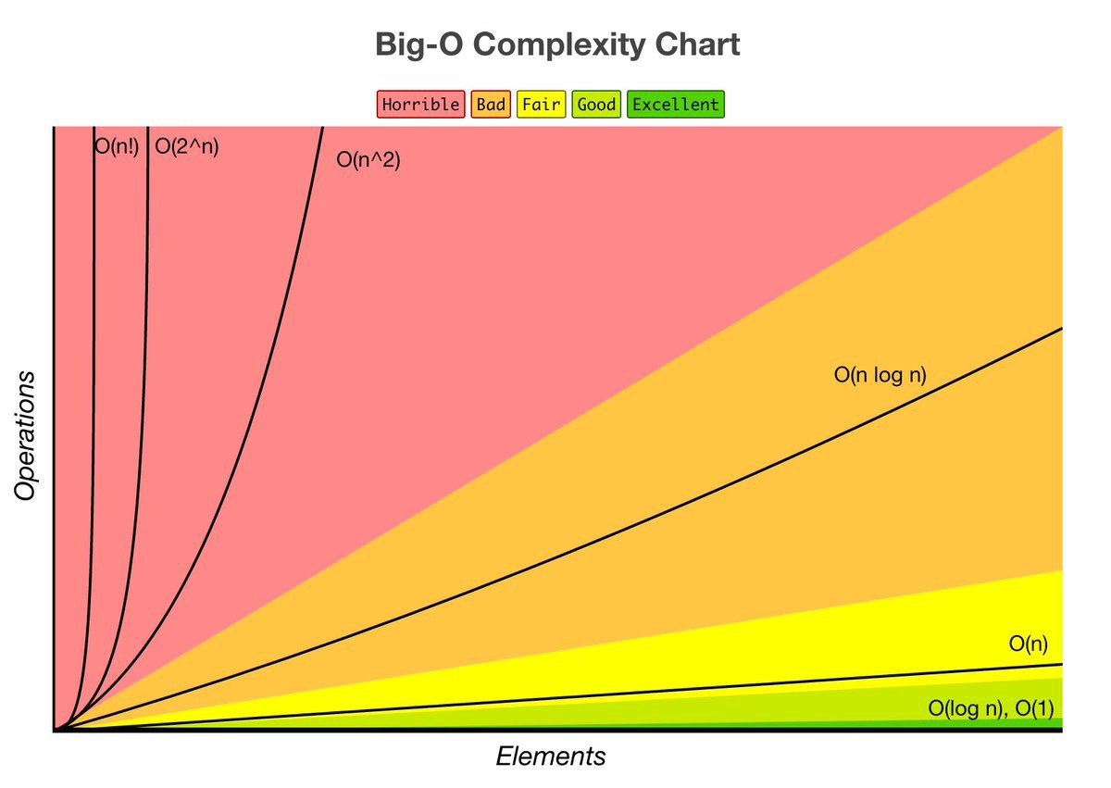
Data Structures and Big O Notation
Big O Notation identifies how efficient a data structure is (theoretically speaking)
n is number of items stored in the structure

Slide 4
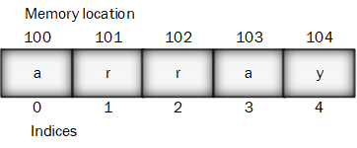
Arrays
An array is an ordered collection of items (i.e., numbers, strings, objects, etc.) represented sequentially with indices
In many programming languages, arrays start with a zero index
Count from 0 (i.e., 0, 1, 2, 3, 4, 5) instead of from 1 (i.e., 1, 2, 3, 4, 5)
Remember this when iterating over loops. The first iteration is the 0 index, the second is the 1 index and so on
Array items are stored contiguously in computer memory (i.e., in “chunks” of memory)
True arrays are of a fixed size to accommodate contiguous storage
Fast retrieval because of contiguous storage

Slide 5
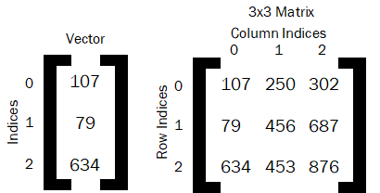
Arrays as Vectors and Matrices
Arrays are often used in programming to simplify formulas through vector/matrix mathematics (i.e., linear algebra)
Vectors are simply arrays
Each index stores a value
Matrices are multidimensional arrays
An outer array that stores inner arrays that store data
Each value is stored at the cross section of indices
What value is stored at [0][2] or (0,2)? What value is stored at [1][0] or (1,0)?

Slide 6
Arrays in Java
Arrays in Java are fixed size and all items must be of the same data type
You can declare an array in three ways (all contain brackets: [ ]):
int[] ages1;
int []ages2;
int ages3[];
Simple instantiation and initialization with {}:
String names[] = {"Pat", "Sam", "Ray"}; //size of the array determined by number of items

Slide 7
Arrays in Java
Instantiation, then initialization:
double salaries[] = new double[3]; //instantiation of an array of doubles with a size of 3
salaries[0] = 22500.00; //this value is added to the array at index 0
salaries[1] = 50000.00; //this value is added to the array at index 1
salaries[2] = 95000.00; //this value is added to the array at index 2
Can you have the following line?
salaries[3] = 45000.00;
Getting values stored at a particular index
salaries[2] //what value would this reference return?

Slide 8
Multidimensional Arrays in Java
Simple instantiation and initialization (easiest if you are manually creating the matrix):
double matrixExample[][] = { {107, 250, 302}, {79, 456, 687}, {634, 453, 876} };
Notice the outer array contains three inner arrays. What are the dimensions of this matrix?
Instantiation and then initialization (easiest if using loops to create the matrix):
double matrixExample2[][] = new double[4][3]; //a 4x3 matrix of doubles
matrixExample2[0][0] = 107; //setting the value for row 0 column 0
matrixExample2[0][1] = 250; //setting the value for row 0 column 1
matrixExample2[0][2] = 302; //setting the value for row 0 column 2
matrixExample2[1][0] = 79; //setting the value for row 1 column 0

Slide 9
Arrays in Python
Most built in arrays in Python are not fixed size arrays. They are dynamic arrays (i.e., array lists)
Most Python arrays can contain values of different data types
numpy (i.e., an analytics library in Python) arrays are closest to true fixed size arrays
Must import numpy library: import numpy as np
Import statements are often put together at the top of the first cell in Jupyter Notebook

Slide 10
Arrays in Python
numpy provides multiple ways to create arrays:
After importing numpy (i.e., import numpy as np )
ages = np.ndarray(5,float) #array of floats of size 5. NOT COMMONLY USED
ages1 = np.zeros(3,int) #array of integers of size 3 filled with all values set to 0
ages2 = np.ones(5,float) #array of floats of size 5 filled with all values set to 1
ages3 = np.empty(5,float) #array of float of size 5; not really empty
Using built in Python array list to create a numpy array
salaries = np.array([22500.00, 50000.00, 95000.00]) #array of size 3 with floats

Slide 11
Multidimensional Arrays in Python
Simple instantiation and initialization (easiest if you are manually created the matrix):
matrixExample = np.array([ [107, 250, 302], [79, 456, 687], [634, 453, 876] ], float)
Notice the outer Python array list contains three inner Python arrays.
Instantiation and then initialization (easiest if using loops to create the matrix):
matrixExample2 = np.zeros((4,3), float) #a 4x3 matrix of floats
matrixExample2[0][0] = 107 #setting the value for row 0 column 0
matrixExample2[0][1] = 250 #setting the value for row 0 column 0
You could use np.ones and np.empty as well

Slide 12
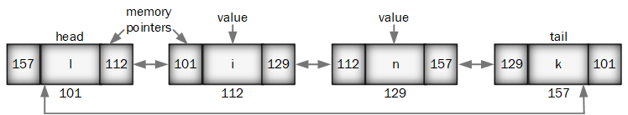
Lists
Lists come in different varieties, such as array lists and linked lists
Array lists (aka., dynamic arrays)
Can add additional items after initializing the array (i.e., not fixed size)
Stored in fixed size arrays behind the scenes
Still fast to retrieve items, but can be slower to add/delete items than other structures
Linked lists
Data not in contiguous storage; nodes contain data and pointers to the next link
Can be slower to retrieve, but can be faster to add/delete items
Can have singly linked or doubly linked lists

Slide 13
Array Lists in Java
ArrayList objects require a data type for items (NO primitive data types)
ArrayList<Integer> ages = new ArrayList<Integer>(); //a list of integers
ArrayList<Double> salaries = new ArrayList<Double>();
Adding to lists
ages.add(45); //adds the value 45 to the ages list
salaries.add(22500.00);
Remove item by index
ages.remove(0); //removes the value at index 0 (i.e., 45)

Slide 14
Array Lists in Python
The standard array in Python is an array list
No data type requirements
ages = [45, 16, 25, 34, 79] #list of integers of size 5
ages2 = [] #empty list
Adding to lists
ages.append(67) #adds the value 67 to the ages list
Remove item by first occurrence of the value
ages.remove(16) #removes the first value of 16 from the list
Remove item by index
ages.pop(0) #removes the value at index 0

Slide 15
Doubly Linked Lists in Java
The built in linked list in Java is a doubly linked list (NO primitive data types)
LinkedList<String> friends = new LinkedList<String>();
LinkedList<Double> salaries = new LinkedList<Double>();
Adding to lists
friends.add("Jayden"); //adds the value Jayden at index 0 to the list
friends.add("Ryan"); //adds the value Ryan at index 1 to the list
friends.push("Pat") //adds the value Pat at index 0 and shifts the other indices by +1
Remove item by index
friends.remove(0) //removes the value at index 0 (i.e., Pat)

Slide 16
Maps and Dictionaries
Maps and dictionaries use key:value pairs to store information
Keys can be:
integers like indices, but don’t have to be sequential like indices
Strings
Keys must be unique within a given map/dictionary
Maps/dictionaries are usually implemented through hash tables
Keys are passed through a hash function and converted to a hashed index
Theoretically, hash functions produce a unique value that is always that same given the same input
Collisions can occur with hash functions where two unique inputs provide the same output. The system handles these collisions behind the scenes.

Slide 17
Maps in Java
Creating a HashMap
HashMap<Key, Value>
HashMap<String, Integer> groceryList = new HashMap<String, Integer>();
Adding entries to a map
groceryList.put("bananas", 6); //adds the value 6 at key bananas
groceryList.put("soda", 12) ; //adds the value 12 at key soda
Removing entries from a map
groceryList.remove("soda"); //removes the value at key "soda“
Retrieving values from a map
groceryList.get(“bananas"); //would return the value 6

Slide 18
Data Structures and Classes/Objects
Classes and objects (e.g., Customers, Products, Employees, etc.) are themselves data structures
They store information in their attributes about the “things” the system needs to remember.
Data structures like arrays, lists, and maps can be used within classes and objects.
Arrays, lists, and maps can also contain objects.
Integrating classes/objects with other data structures provides enhanced functionality to a program by allowing for more complex data relationships.

Slide 19
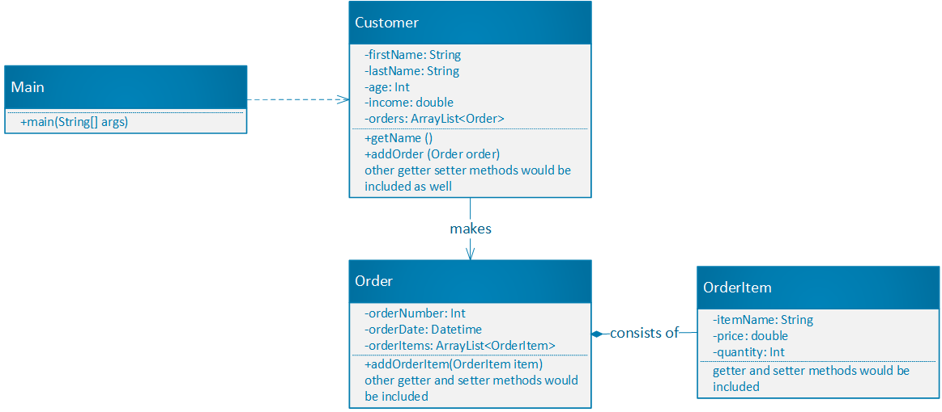
Data Structures and Classes/Objects
What data structures do you see in this diagram?

Slide 20
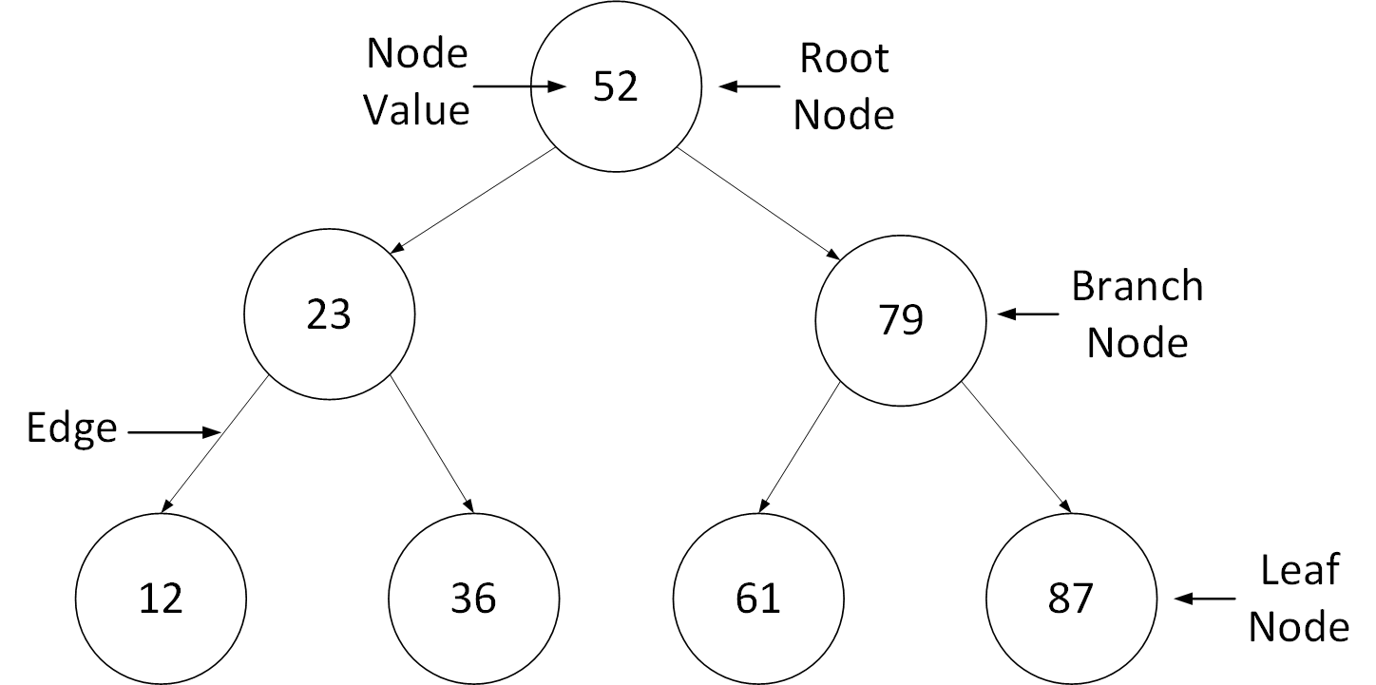
Tree Data Structures
Trees store information in a hierarchical manner that can be much more efficient than arrays, lists, and maps.
Trees have nodes, starting with a root node
Nodes store data to be used in calculations
Trees are widely used in analytics algorithms
All nodes should have at most one parent node
Nodes are connected in a hierarchy by edges
Edges are unidirectional

Slide 21
Some Uses of Tree Structures in Programming
There are many types of trees. Each tree serves a different purpose
Syntax trees help to convert the code you write into ordered directions that can be executed by the computer.
B-trees are used in databases to create indices for data.
Indices, like the index in a book, make it faster to find data values.
Binary search trees find ordered data quickly.
Each node has at most two children.
The left child node has a smaller value than the parent node
The right child node has a bigger value than the parent node

Slide 22
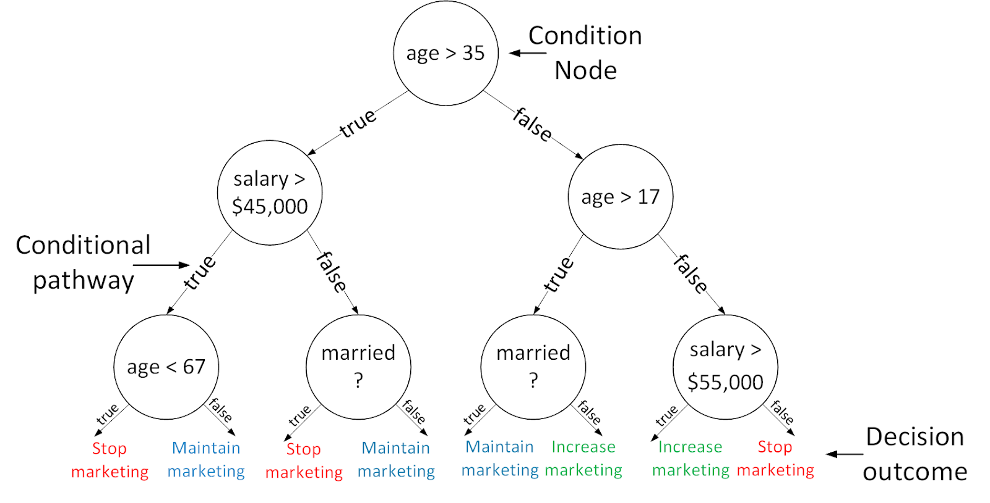
Tree Structures for Analytics
Decision trees are a common machine learning algorithm to predict an outcome based on a set of features (Ex. age, salary, marital status, gender, job title, etc.)
Nodes store feature-based conditions
Edges often represent true/false or yes/no pathways
Decision trees are created by:
Encoding expert knowledge (expert systems)
Training models from data containing the features and known outcomes
Decision trees are sensitive to changes in data
Decision trees can be combined into random forests to improve this sensitivity

Slide 23
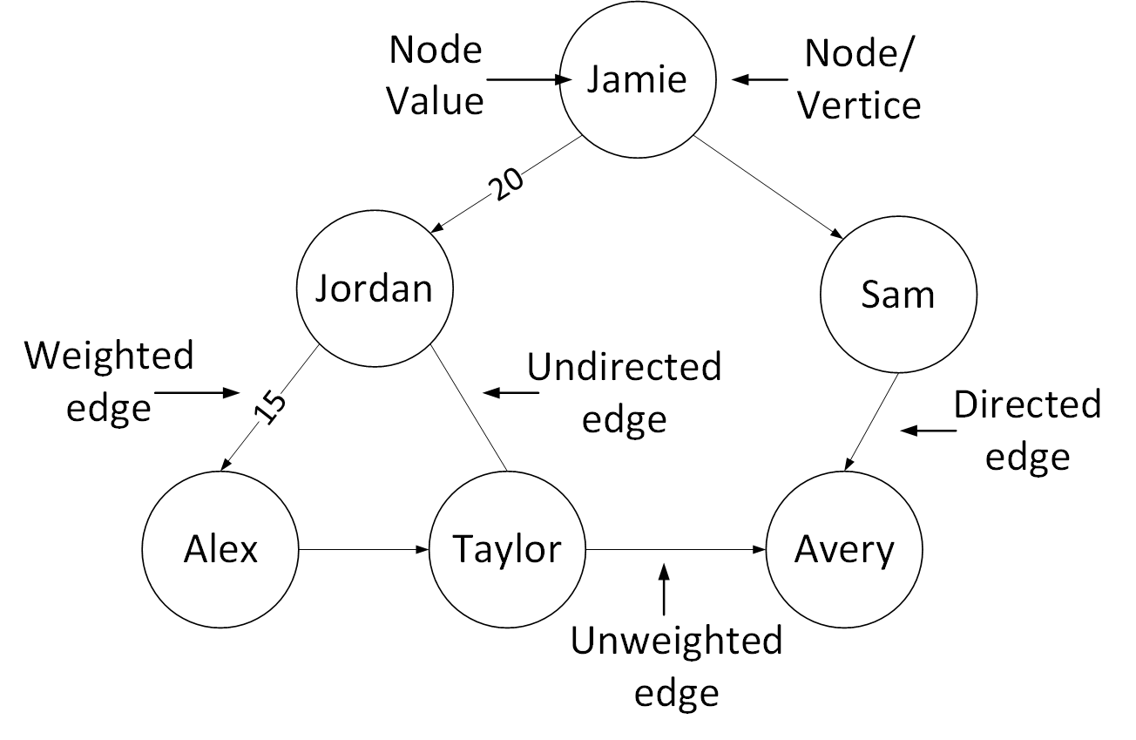
Graph Structures
Like trees, graphs rely on nodes (a.k.a., vertices) and edges
Graphs don’t have to be hierarchical like trees
Nodes can also have many “parent” nodes
Edges can be weighted or unweighted. Weighted edges can show strength of a relationship between nodes.
Edges can also be directional like trees, or undirected
Graphs are useful for storing social network data
They can find important nodes (i.e., influencers, bridges between different groups, etc.) through different measures of centrality.

Slide 24
Conclusion
Any questions?

