Slide 1
Modeling the Problem Domain
Chapter 4

Slide 2
The Problem Domain
What is a problem domain?
Why do you need to understand the problem domain?
What is process mapping and how does it relate to understanding the problem domain?

Slide 3
The Problem Domain
Problem domain: entities (e.g., people, departments, tools, etc.) that interact and events that occur within a particular environment/domain (e.g., a “working” space).
You must understand the users to develop value propositions.
You should understand the environment to know how contextual factors (e.g., regulations, budgetary limitations, organizational culture, etc.) may affect value perceptions.

Slide 4
Process Mapping
Process maps help analysts understand exactly how an organization provides value through business activities
Although many processes still require human labor, information systems are increasingly used to automate parts of processes
Recent technological innovations will increase the speed at which processes are automated by information systems and robotic systems.

Slide 5
Process Mapping
Process maps help analysts understand exactly how an organization provides value through business activities
  It also helps to identify value-adding activities vs. wasteful activities
Although many processes still require human labor, information systems are increasingly used to automate parts of processes
Recent technological innovations will increase the speed at which processes are automated by information systems and robotic systems.

Slide 6
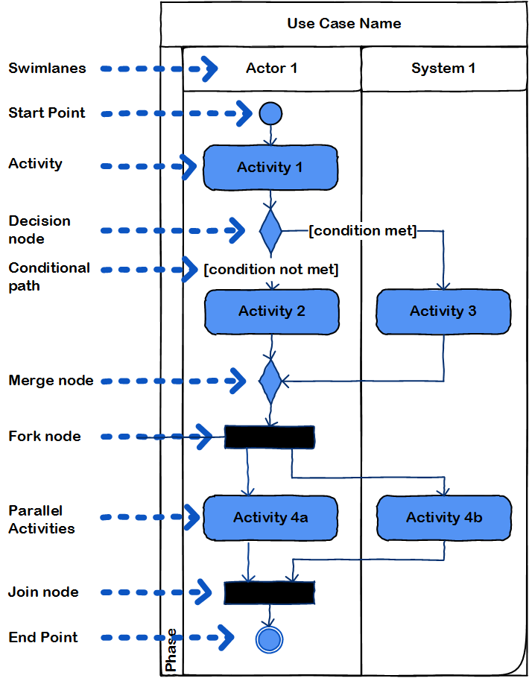
Process Mapping: Activity Diagrams
Swimlanes represent different actors (human and computer).
Boxes represent activities performed by actors.
Arrows represent flow of activities in processes.
Diamonds are decision nodes (if else conditions)
Fork nodes represent activities that can be performed simultaneously.

Slide 7
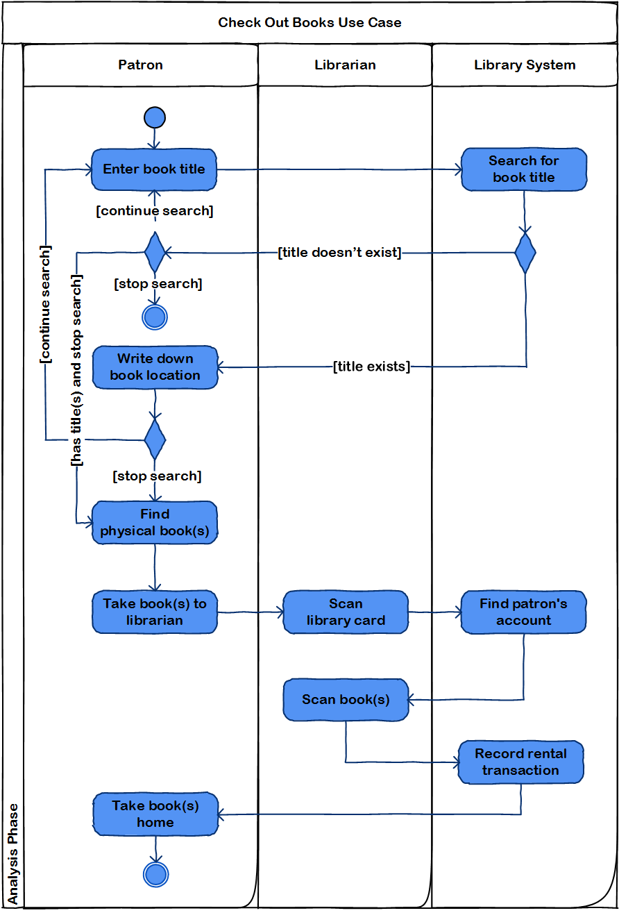
Activity Diagrams: Reading Them
Read the diagram on the right
Pay attention to the different paths that can be taken.

Slide 8
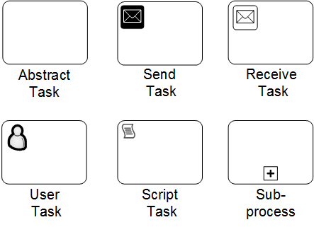
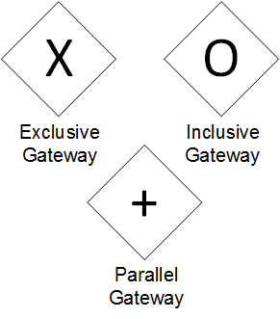
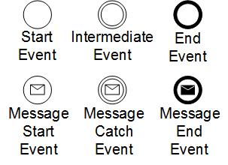
Process Mapping: BPMN
Business process mapping & notation is an updated notation to add semantic clarity to maps
Includes visual cues about task/activity type
Includes different types of decision nodes called gateways
Includes other events besides start and end events

Slide 9
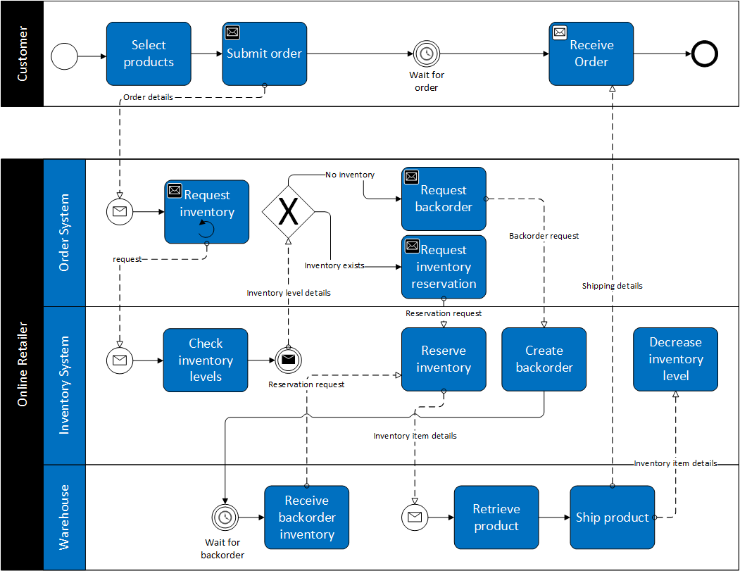
BPMN: Reading Them
Read the diagram on the right
Pay attention to the different paths that can be taken.

Slide 10
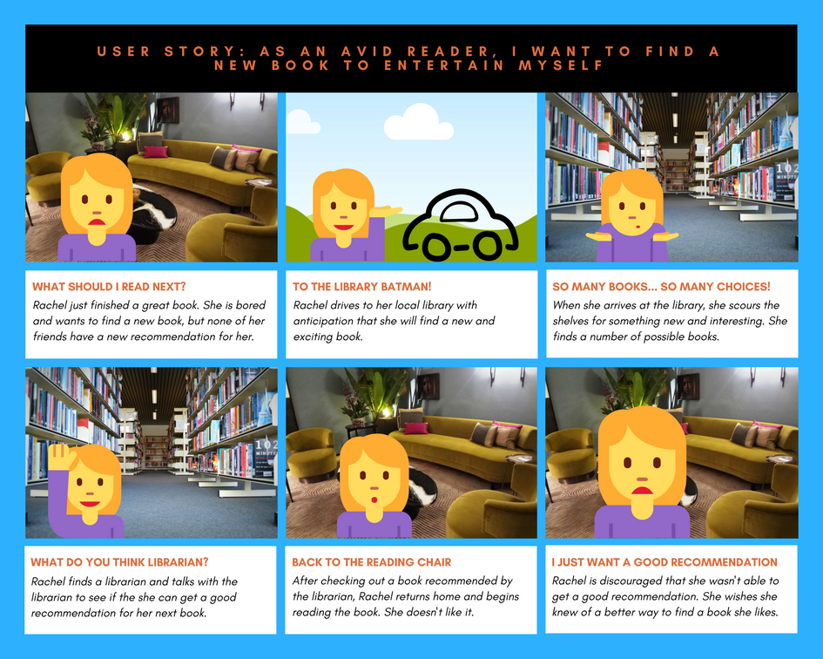
Process Mapping: Story Boards
Can be used to create understanding around user stories
Some Agile practitioners don’t use in depth process models, but may use story boards to understand processes
Often include triggers: something that kicks off a process, behavioral responses: how users respond to trigger, and motivations and frustrations of the user

Slide 11
“Things” in the Problem Domain
What is a domain class? What are the components of a domain class diagram?

Slide 12
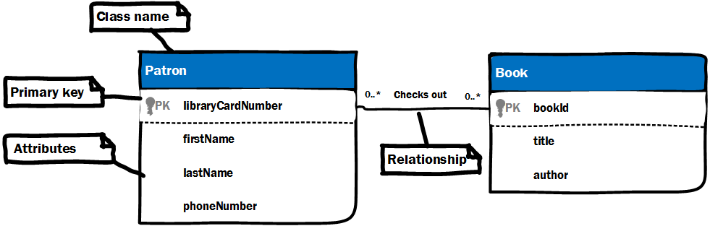
Class Diagrams
What is a relationship?
What is the multiplicity of a relationship?
What is inheritance?
What is a class? Give examples.
What are attributes? Give examples.
What is a primary key? Why is a primary key useful? Are they always necessary?

Slide 13
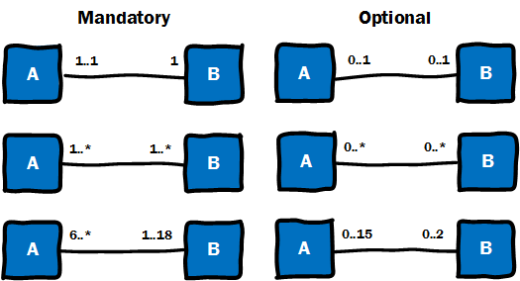
Class Diagrams: Multiplicity
Multiplicity describes how classes relate to one another.
Relationships between classes can be mandatory or optional.
  Minimum multiplicity of 0 is option; 1 is mandatory
Maximum multiplicity can be one, many (i.e., *), or a specific number.

Slide 14
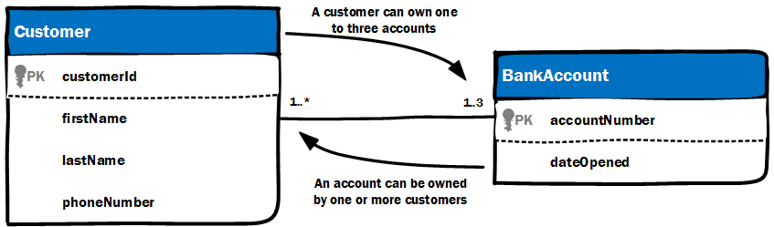
Class Diagrams: Multiplicity
Multiplicity can be read in both directions.
What does this diagram say?

Slide 15
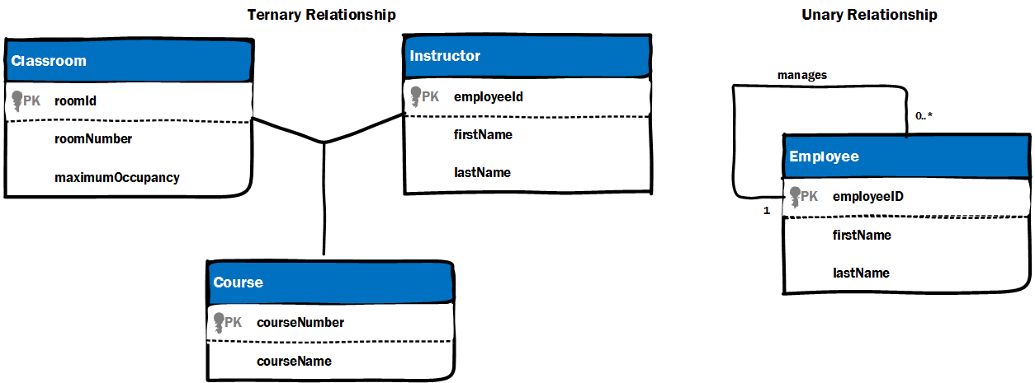
Class Diagrams: Relationships
This is a binary relationship. Why?
What are these relationships?
How do you read them?

Slide 16
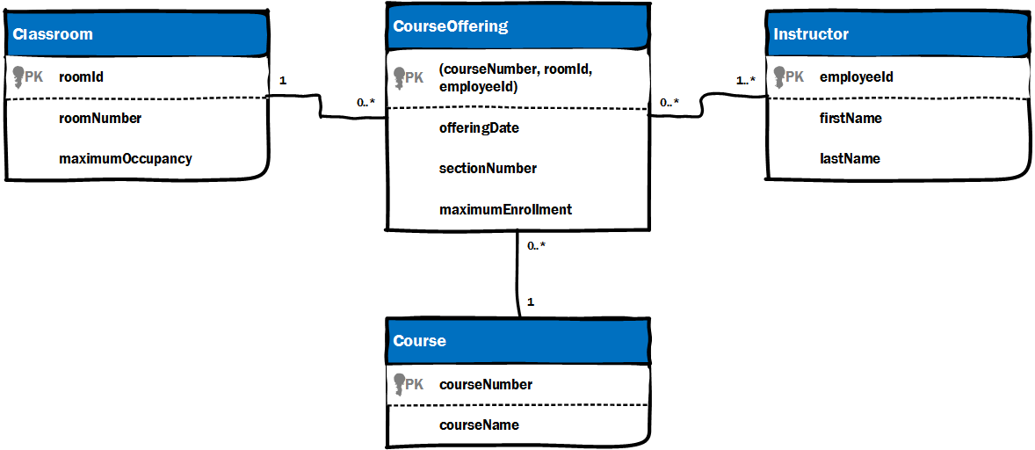
Class Diagrams: Association Classes
Complex relationships require a class to represent the relationship
  Ternary and n-ary relationships.
  Many-to-many relationship.
Where is the association class in the diagram on the right?
Where else is an association class needed?

Slide 17
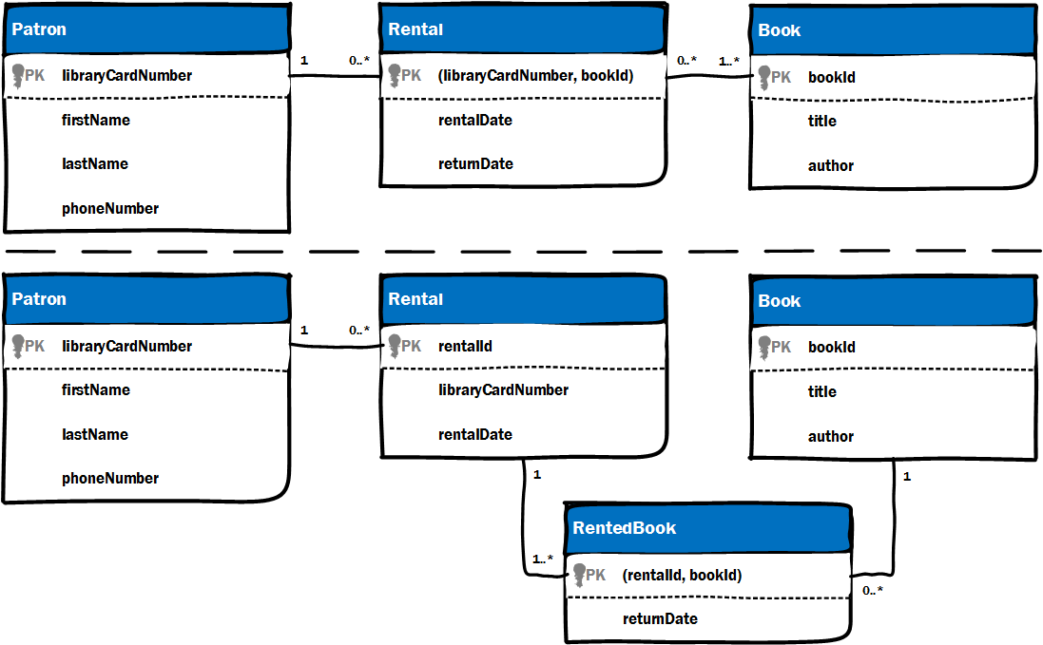
Class Diagrams: Many-to-Many Relationships
When multiplicity is many-to-many, association classes are needed.
Association class goes between many-to-many relationships.

Slide 18
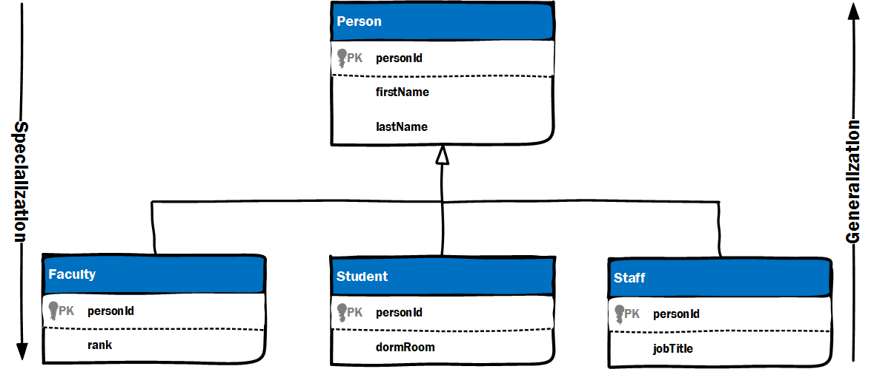
Class Diagrams: Inheritance
What is generalization and specialization?
What are the attributes of the Faculty class?
What are the attributes of the Staff class?
Inheritance is when one class receives attributes from another parent class.
Attributes flow down the hierarchy.

Slide 19
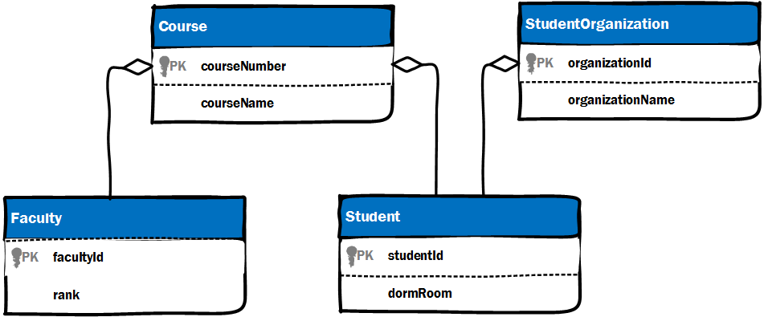
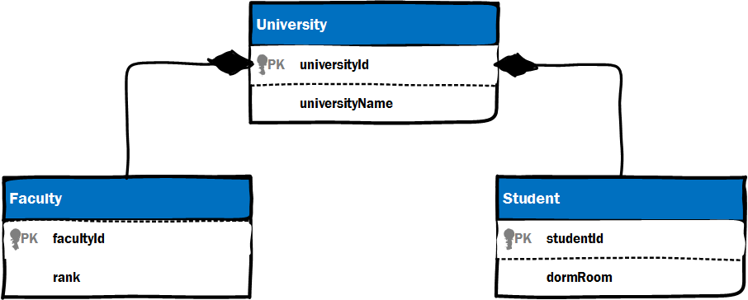
Class Diagrams: Aggregation and Composition
Part-whole relationships
You can compose an class with the behaviors of many others classes
Can be better than inheritance in many ways

Slide 20
Conclusion
Taking time to understand the problem domain will ensure that systems are tailored to the particular environment.
Use cases and user stories can rely on different models, but they are not necessarily exclusive. Mix and match where it adds value.
Take time to analyze the problem domain, but don’t over analyze!! Analysis paralysis is detrimental to projects.

