Slide 1
Chapter 5: Data Structures and Flow Control

Slide 2
Data Structures
Review: what is a data structure?
Name some different types of data structures and what makes them unique.

Slide 3
Flow Control
Flow control manages how a program moves through your classes/logic when executed
Programs usually read line by line with jumps to methods and back again when methods are called
Optional and alternative flows can be created through if() statements
If() statements can be embedded within other if() statements to create more complex flows
Loops can be used to execute the same behaviors repeatedly until some condition is met

Slide 4
If() Statements for Optional Flows
If() statements can be used to create options that should be executed under some conditions, but not under others
Many checkboxes on forms represent optional conditions in the backend code
Basic syntax:
Java: if(valueA == 6) { //code to execute if the condition is true goes here }
Python: if valueA == 6: //code to execute if the condition is true goes here
Common comparison operators include (different than assignment operators):
equal to (i.e., ValueA == ValueB)
not equal to (i.e., ValueA != ValueB)
greater than (i.e., ValueA > ValueB)
Less than (i.e., ValueA < ValueB)
greater than or equal to (i.e., ValueA >= ValueB)
less than or equal to (i.e., ValueA <= ValueB)

Slide 5
If() Statements for Alternate Flows (Java)
If() statements can be used to create alternative flows with a default flow:
if(points >= 10 && points <= 14) {
prize = "small stuffed animal";
} else if(points >= 15 && points <= 19) {
prize = "medium stuffed animal";
} else if(points >= 20) {
prize = "large stuffed animal";
} else {
prize = "pencil eraser"; //this is the default flow
}

Slide 6
If() Statements for Alternate Flows (Python)
The following code performs the same in Python:
if points >= 10 and points <= 14:
prize = "small stuffed animal"
elif points >= 15 and points <= 19:
prize = "medium stuffed animal"
elif points >= 20:
prize = "large stuffed animal"
else:
prize = "pencil eraser"

Slide 7
For, While, and ForEach Loops
For() and while() loops execute until a specific condition is met
Ex. some counter value is reached (particularly for for() loops, but works for while() loops as well)
Ex. reading lines from a file until no more lines exist (particularly for while() loops)
For each or For in loops execute until all of the items in the data structure have been iterated over

Slide 8
For and While Loops in Java
See the Java code example in section “Using for and while loops with data structure” in Chapter 5
What is happening in the example?

Slide 9
For and While Loops in Python
See the Python code example in section “Using for and while loops with data structures” in Chapter 5

Slide 10
FoREach/For-In Loops in Java
Foreach/for-in on a HashMap<String, Double> named salaries
for(Map.Entry<String, Double> salary : salaries.entrySet()) {
System.out.println("The salary for " + salary.getKey() + " is " + salary.getValue());
}
Foreach/for-in on an ArrayList<String> named items
for(String item : items) {
System.out.println("The item is " + item);
}

Slide 11
FoREach/For-In Loops in Java Lambda Style
Many data structures in Java have a built in forEach method
These methods require the use of a lambda function
Lambda functions don’t have names like most methods.
Below is a lambda function for a HashMap<String, Double> called salaries
The key holds employee names and the value stores the salary
salaries.forEach( (key, value) -> {
System.out.println(“The salary for " + key + " is " + value);
});

Slide 12
FoREach/For-In Loops in Python
Foreach on a dictionary named salaries
for key, value in salaries.items():
print("The salary for {} is {}".format(key, value))
Foreach on a list named myList
for item in myList:
print("The item value is {}".format(item))

Slide 13
Creating More Complex Flows
You can embed loops within loops (i.e., iterate through multidimensional array)
This can be inefficient though. Other data structures can be more efficient than embedded loops
You can embed if() statements within loops
You can embed loops within if() statements
You can embed if() statements in if() statements
With the basic logic tools provided by if() statements and loops, you can accomplish many tasks
More complex design patterns can be used to replace if statements and loops
Ex. Decorator pattern or factory pattern can replace complex if statements
Ex. Recursion in place of loops

Slide 14
Looping with Objects
As mentioned in the previous chapter, combining objects with other data structures allows for more complex programs.
Arrays of objects
Object attributes that store arrays or lists of other objects
Etc.
Go to the “Looping with objects” section of Chapter 5. Examine the examples.
What is happening?

Slide 15
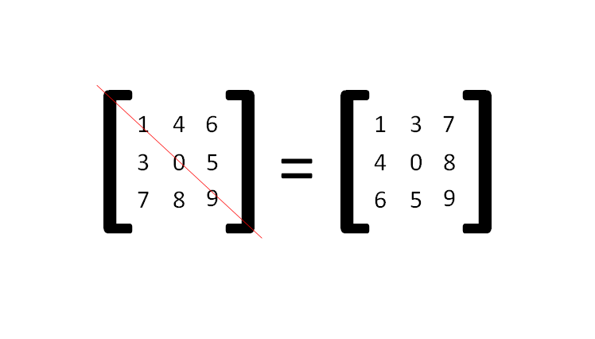
Recursion
Recursion offers an alternate way besides for(), while(), foreach(), and other loops to repeat behaviors.
Sometimes recursion is the only way to repeat complex behaviors.
Recursion works by creating a method that calls itself until a condition within the method is met, or fails to be met.
Go to the matrix transpose example in Chapter 5 under the “Recursion” section

Slide 16
Conclusion
Any questions?

