Slide 1
Designing and Prototyping for Value
Chapter 5

Slide 2
System Design
Once you understand the problem domain, you need to design a system to meet user needs. Includes design of processes and design of technology.
Questions to ask yourself:
All analysis and then all design vs. incremental analysis and design?
How do you decide which features to build first? Backlogs vs. Story mapping?
What diagrams will help you gain clarity about the solution design?

Slide 3
Improving and Reengineering Processes
What is the difference between process improvement and process reengineering?
What are some common process improvement methodologies?

Slide 4
Process Improvement: Lean Management
Lean Management is based on 5 principles
Define value: Understand your customers and what they value.
Map the value stream: Not all process activities provide value to the customer. Identify and emphasize activities that add value and remove those activities that are unnecessary.
Create flow: configure the activities to smoothly work together without unnecessary delays.
Establish pull: Pull strategies seek to produce products and services as they are demanded.
Strive for perfection: Processes require continually monitoring and improvement.

Slide 5
Process Improvement: Lean Management
Seeks to remove waste from business processes
Time spent waiting
Unnecessary movement/transportation
Excess inventory/overproduction
Defective products/services
Identity which activities are leading to waste
Improvements can be accomplished through “K

Slide 6
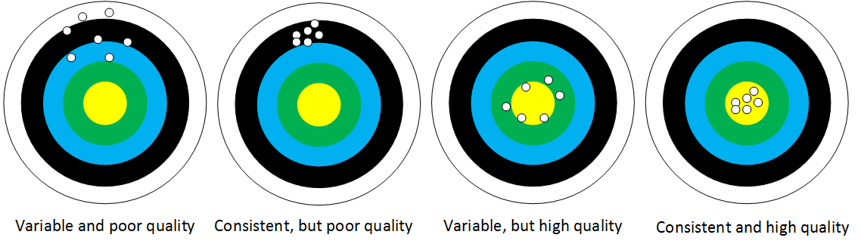
Process Improvement: Six Sigma
Six Sigma seeks to reduce defects and variability in processes
Seeks to reduce the number of defects in a product/service to 3.4 defects per million (six sigma’s on a Gaussian curve)

Slide 7
Process Improvement: Six Sigma
For improving existing processes (DMAIC)
Define - understand the problem domain and value generation potentials. Set goals.
Measure - identify metrics and measure existing process outcomes.
Analyze - determine the root causes of problems that exist in the problem domain.
Improve - prototype and implement solutions to remedy problems in the problem domain.
Control - monitor process changes and ensure that changes are sustainable and consistent.
For new processes (DMADV)
Define - understand the new problem domain and value generation potentials. Set goals.
Measure - identify customer requirements for the new process.
Analyze - explore different options for the process design based on customer needs.
Design - implement a selected process design.
Validate - test the implemented process against quality metrics.

Slide 8
Process Reengineering
Used for major restructuring efforts based on business strategy and customer demand. Can be prompted by automation efforts.
Requires a strong sponsor to manage the political tensions that will arise in major change efforts
Often requires cross-functional teams to ensure that the new process accounts for the various aspects of business
May do away with several business structures (e.g., management hierarchies and policies)

Slide 9
Systems Design: Which features first?
When using technology to improve the problem domain using Agile development, you must ask which features are most important
Two methods: traditional backlog vs. story mapping
Describe each method and the differences between them

Slide 10
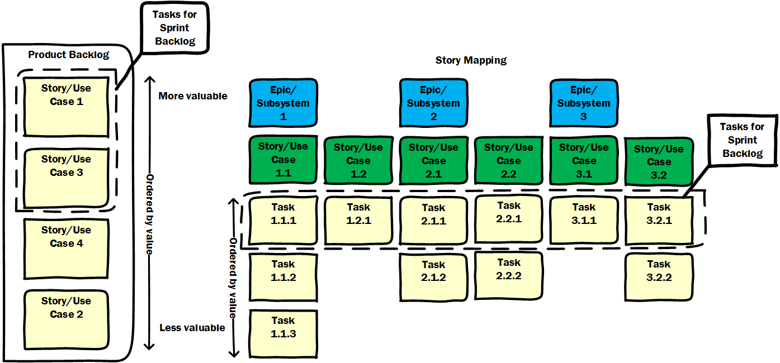
System Design: Prioritizing Features
Priorities come from Product Owner/users.
Backlog approach: build most important features first.
User story mapping: build important features across entire system.
Pros and cons of each?
Story mapping developed for user stories, but can be used for use cases.
Epics = subsystems
Stories = use cases

Slide 11
Design documents
What are some design documents that you might produce when developing a system?

Slide 12
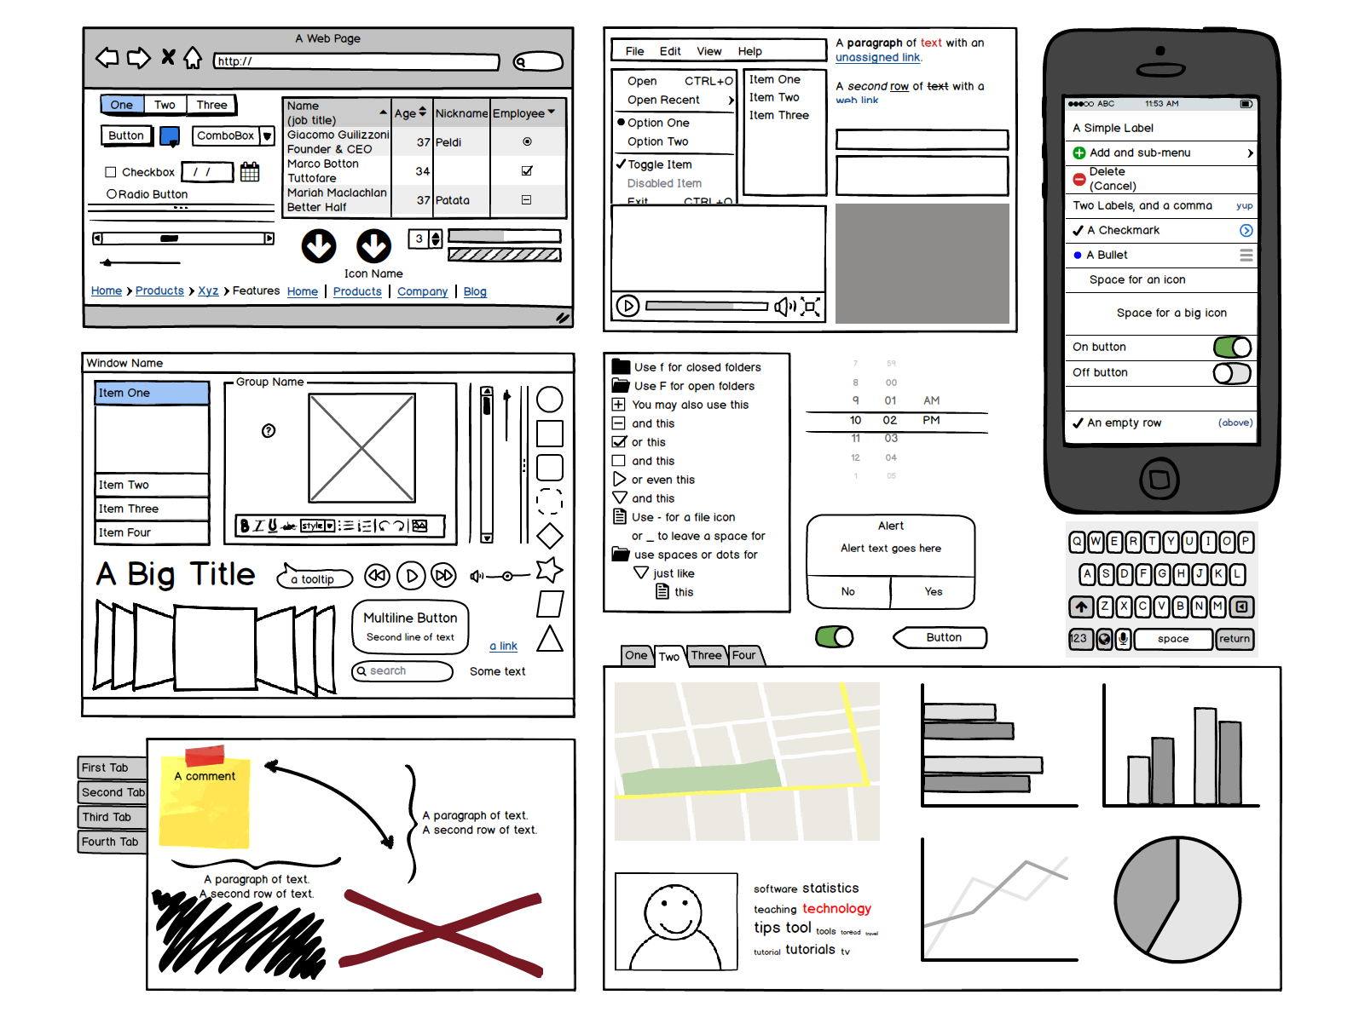
An Easy Starting Point
User interface is often a good starting point.
Easy to get quick feedback from users about features.
Visual depiction of underlying functionality.
Start with paper; move to interactive computer mockups.

Slide 13
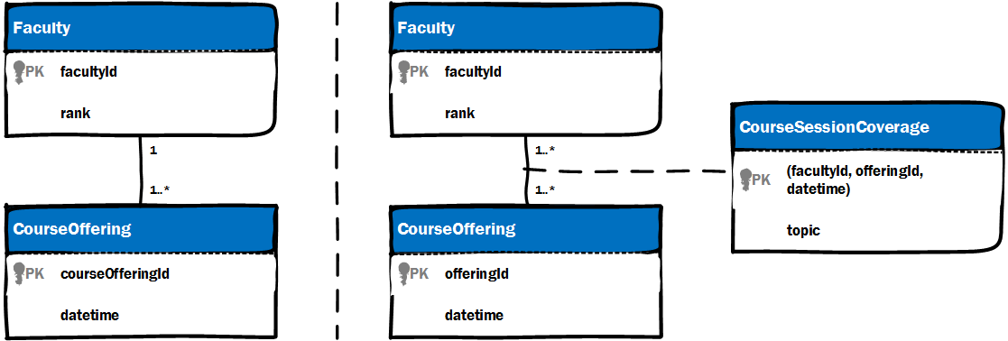
Updating Class Diagrams
Classes have attributes and methods.
What are attributes and methods?
What is visibility on attributes and methods?
What are data types?
Alter business rules of existing systems (e.g., add classes or change multiplicities).
Provide enough detail that developers can program classes.

Slide 14
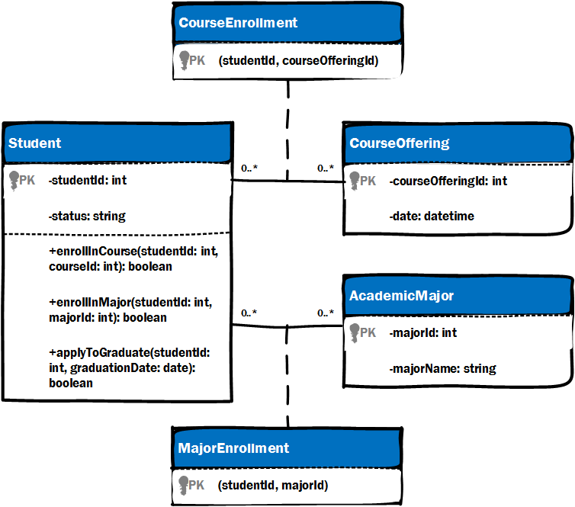
Design Class Diagrams: Methods and Visibility
Attributes: characteristics of a class.
Methods: behaviors of a class. Takes inputs, processes inputs, and return output(s).
Visibility: what other classes can use the attributes and methods of a class.
Private (“-”): only methods inside the class itself can access private attributes and methods. Usually for attributes.
Public (“+”): methods inside and outside of the class can access public attributes and methods.
Read this!

Slide 15
Design Class Diagrams: Data Types
Data type: format of data (e.g., string, integer, decimal, date, boolean, etc.)
Attributes have data types: (e.g., -student: int is an integer data type)
Methods have return types (i.e., what data type will the method return): (e.g., +enrollInMajor(…): boolean returns true or false)

Slide 16
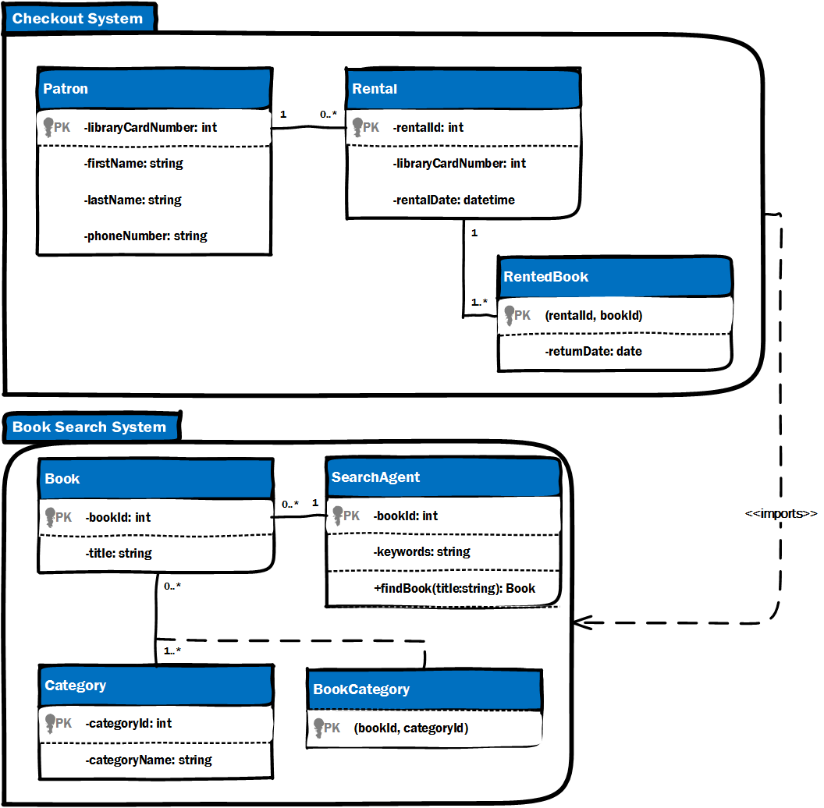
Package Diagrams
Package diagrams lump system functionality into subsystems.
Some subsystems may share classes or may rely on one another (i.e., imports).
Subsystems can be used as epics in user storying mapping to prioritize feature development.

Slide 17
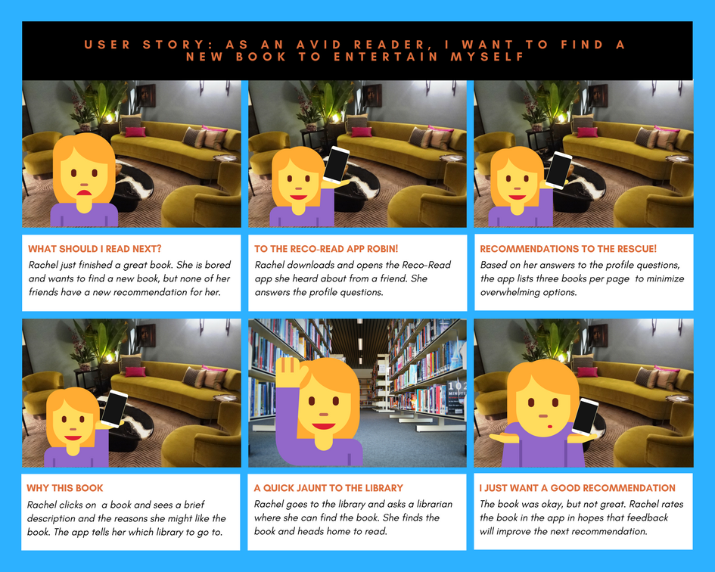
Storyboards
Early storyboards often map out users current experience, focusing on frustrations and pain points.
Design storyboards focus on how the user will react to the proposed solution(s).
Have fun with storyboading!!

Slide 18
Other Diagrams
Updated activity diagrams or BPMN diagrams can be created for designs as well.
Sequence diagrams can be used to show how classes pass messages to and from one another.
To help programmers understand the system architecture.
More on this in the architectural chapter.

Slide 19
System Design: What Diagrams to Use
Diagrams should be useful to the team. Otherwise, don’t create them!!
What makes a diagram useful?
Allows the team to envision others’ ideas and communicate well.
Allows the team to present ideas to stakeholders and users for quick feedback.
Provides documentation about how the system is constructed for future reference and new team members.
Only useful if you update the documentation as the system changes.
Provides clear guidance for programmers about what to build.

Slide 20
Conclusion
You must move beyond the problem domain to the solution domain as quickly as possible.
Model only what is necessary and useful for the team, important stakeholders, and users.
No limitations. Choose the models that will help you.
Decide carefully how to prioritize feature development (i.e., backlog vs. story mapping).

