Slide 1
Database Design and Implementation
Chapter 6

Slide 2
Databases
Most systems require data storage.
Systems need to remember information.
Databases provide a physical means to store data.
After creating system designs, you will often implement storage needs in physical databases.

Slide 3
Databases
What is a SQL database?
How do SQL databases differ from NoSQL Databases?
What is a database management system (DBMS)? What are some of the major SQL DBMS?
What are entities, relationships, and cardinality?

Slide 4
Databases: SQL, NoSQL, and DBMS
Structured Query Language (SQL): A language to query databases. For databases that contain well-structured data.
Not Only SQL (NoSQL): Alternatives to SQL that allow for less structured data. Examples: MongoDB, CouchDB.
Database Management System (DBMS): system to manage storage and retrieval of data. Common relational DBMS: MySQL, MSSQL, Oracle SQL

Slide 5
Databases: Entities & Relationships
Entities: “things” that exist in the problem domain and solution space that a system needs to remember.
Entities consist of attributes and require a primary key
Relationships (a.k.a., relations): connections between entities that exist in the problem/solution domain.
Cardinality: description of the nature of the relationship between entities (e.g., mandatory vs. optional). Maximum number of items that can be stored.

Slide 6
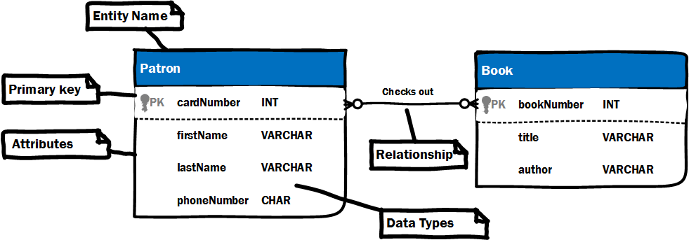
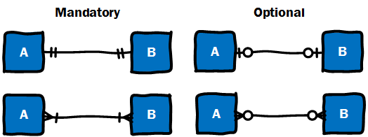
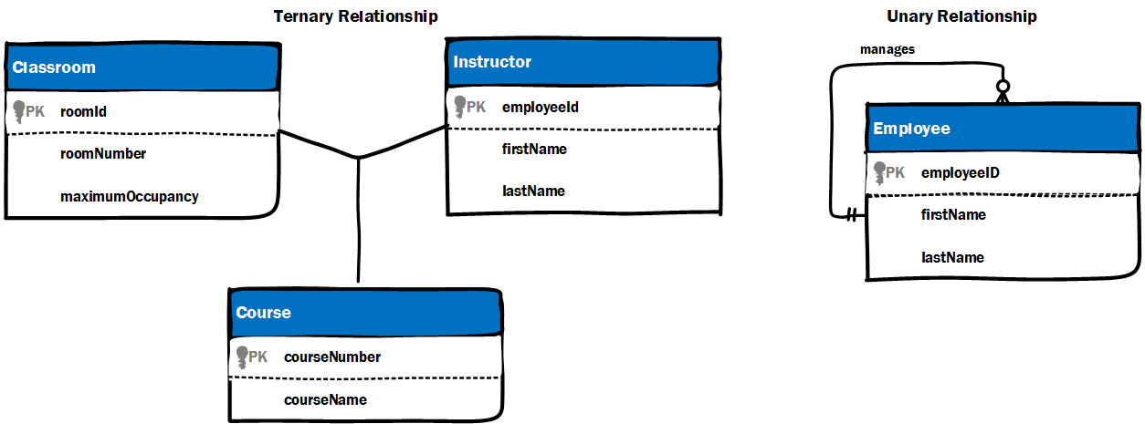
Entities & Relationships: ERDs
Entity-relationship diagrams (ERDs) are used to model relational databases.
Possible cardinalities
Can model binary, n-ary, and unary relationship (like class diagrams)

Slide 7
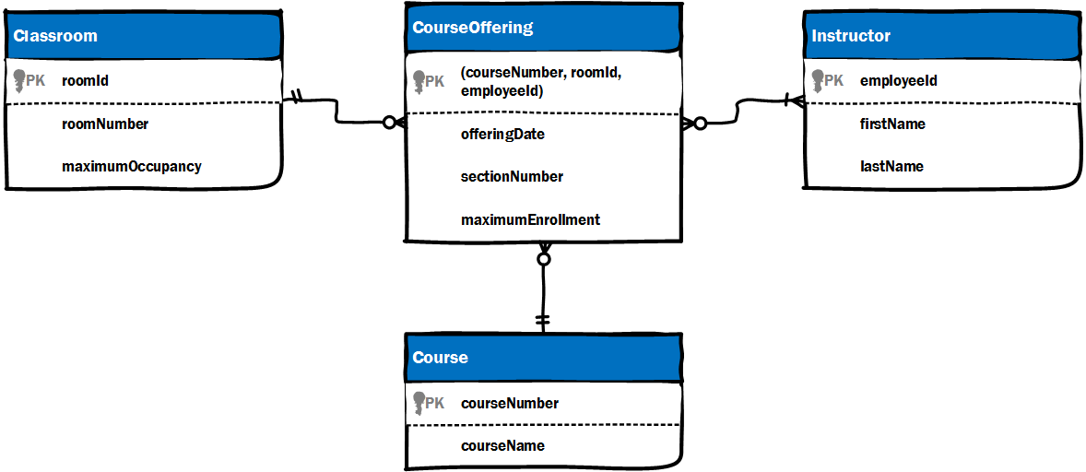
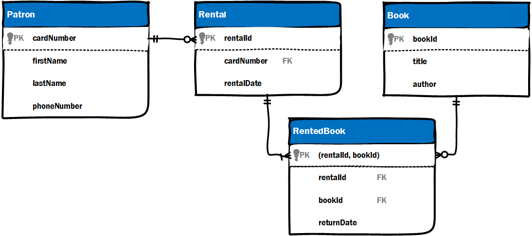
Entities & Relationships: Associative Entities
Similar to class diagrams, ERDs require extra entities to model complex relationships like ternary, n-ary, and many-to-many relationships.
Class diagrams: association class
ERD: associative entity

Slide 8
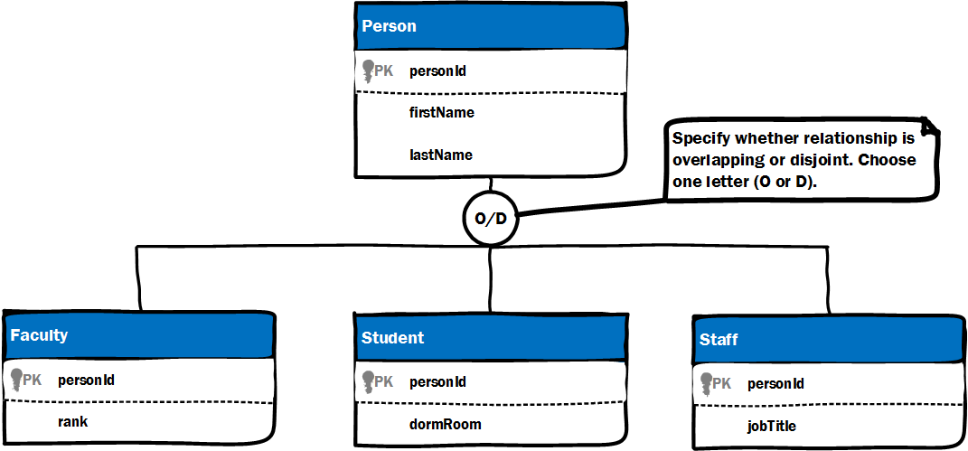
Entities & Relationships: Inheritance
Databases can store information about inheritance hierarchies similar to class diagrams.
What is the different between disjoint and overlapping inheritance structures?

Slide 9
Databases: Physical Implementation
How do relational databases physically store information about entities?
How do they physically store information about relationships between entities?

Slide 10
Databases: Physical Implementation
Store information about entities in tables.
Columns = attributes
Rows = instances of entities
Relationships stored by storing primary keys in other tables; known as foreign keys.
What is happening in these tables?
Where are the primary and foreign keys?
Patron
cardNum | firstName | lastName
1 | John | Doe
2 | Jane | Doe
3 | Jamie | Doe
Rental
rentalId | cardNum | rentalDate
1 | 1 | 2018-10-01
2 | 1 | 2018-05-05
3 | 2 | 2018-07-09

Slide 11
Databases: Structured Query Language
Three languages within SQL:
Data Definition Language (DDL): create and alter databases, tables, etc.
Data Control Language (DCL): manage access to databases, tables, etc.
Data Manipulation Language (DML): access and manage data in tables.
CRUD in DML
Create
Read
Update
Delete

Slide 12
SQL: Create Databases
Syntax will be similar across relational DBMSs
CREATE DATABASE LibrarySystem;
SHOW DATABASES;
Databases sometimes called SCHEMAs in certain DBMSs.

Slide 13
SQL: Create Tables
Tables contain schemas that describe exactly what kind of data can be entered into which fields.
CREATE TABLE Patron (
cardNum int(10) NOT NULL AUTO_INCREMENT,
firstName VARCHAR(25) NOT NULL,
lastName VARCHAR(30) NOT NULL,
CONSTRAINT patronPK PRIMARY KEY (cardNum)
);
CREATE TABLE Rental (
rentalId int(10) NOT NULL AUTO_INCREMENT,
cardNum int(10) NOT NULL,
CONSTRAINT rentalPK PRIMARY KEY (rentalId),
CONSTRAINT rentalPatronFK FOREIGN KEY (cardNum)
REFERENCES Patron(cardNum)
);
What is AUTO_INCREMENT?
What does NOT NULL mean?
What is a CONSTRAINT?
Where are the primary and foreign keys?

Slide 14
SQL: Insert Data
Insert represents the “create” part of the CRUD acronym
INSERT INTO Patron (firstName, lastName) VALUES (“John”, “Doe”);
OR
INSERT INTO PATRON VALUES (NULL, “John”, “Doe”);

Slide 15
SQL: Select Data
Select represents the “read” part of the CRUD acronym
SELECT * FROM Patron;
//specify columns
SELECT firstName, lastName FROM Patron WHERE lastName=“Wall”;
//selecting across tables using a JOIN
SELECT Patron.firstName, Patron.lastName, Rental.rentalDate
FROM Patron
INNER JOIN Rental ON (Patron.cardNum=Rental.cardNum)

Slide 16
SQL: Update Data
Update represents the “update” part of the CRUD acronym
UPDATE Patron
SET lastName = “Doe-Jones”
WHERE cardNum = 1;
Where clause is important. Without it all records will be changed!

Slide 17
SQL: Delete Data
Delete represents the “delete” part of the CRUD acronym
DELETE FROM Patron
WHERE cardNum = 1;
Don’t forget the WHERE clause or you will delete EVERYTHING in the table!!!

Slide 18
SQL: Create Users
To create different users who can access a database use the CREATE USER statement
CREATE USER [username] IDENTIFIED BY [password];
CREATE ROLE [role_name] IDENTIFIED BY [password];

Slide 19
SQL: Grant Privileges
Users/roles must be granted certain privileges, such as SELECT, INSERT, UPDATE, DELETE, CREATE, etc.
// system privilege that allows the user/role to create new tables in the database
GRANT CREATE TABLE TO [username or role_name];
//object privilege that allows the user/role to SELECT data from the Patron table
GRANT SELECT ON Patron TO [username or role_name];

Slide 20
Validating Design Completeness
You should make sure your database provides basic CRUD functionality for your entities. CRUD tables can help
 | Customer | Product | Department
Create | add-customer | create-product | create-department
Read | view-customer-info view-customers | view-product-info view-products | view-dept-info view-departments
Update | edit-customer deactivate-cust | edit-product deactivate-product | edit-department
Delete |  |  | delete-department

Slide 21
Conclusion
Databases provide a means to store information that a system needs to remember.
The most common type of databases are relational databases that rely on SQL (e.g., MySQL, MSSQL, Oracle SQL).
Keep your eye on NoSQL technologies. If you are working with unstructured data, they may be the right choice!
You will learn more about databases in a database course.

