Slide 1
Chapter 8: Working with Data in Python

Slide 2
Data Wrangling
Data wrangling is the act of collecting and cleaning data to prepare it for statistical analysis.
Some helpful Python libraries/modules that assist with data wrangling include:
numpy – the foundation for many data analytics modules in Python
pandas – create dataframes (i.e., rows and columns like spreadsheets) from raw data. Includes basic cleaning tools
pandas-datareader – collect financial/economic data of various types from a variety of sources, such as Yahoo Finance.
matplotlib.pyplot – contains many useful tools for data visualization

Slide 3
Ordered Vs. Named Parameters/Arguments
To this point, you have learned to use ordered parameters and arguments (i.e., method inputs) within methods.
Ordered parameters: def myMethod(self, parameter1, parameter2, parameter3)
Ordered arguments: mine.myMethod(“Hello”, 3, 4)
Python provides a second way to handle parameters/arguments by name
Named parameters: def myMethod(self, parameter1, parameter2, parameter3)
Named arguments: mine.myMethod(parameter2=3, parameter3=4, parameter1=“Hello”)

Slide 4
Reading Data From Files with pandas
pandas has built-in methods to help you read data from Excel and CSV files
These methods convert spreadsheet data into a pandas dataframe that can be manipulated by other pandas methods or by other Python modules/libraries.
import pandas as pd
data = pd.read_csv("C:/path/to/file/filename.csv") #for comma delimited
data = pd.read_csv("C:/path/to/file/filename.txt", sep="\t") #for tab delimited
data = pd.read_excel("C:/path/to/file/filename.xlsx")
data = pd.read_excel("C:/path/to/file/filename.xlsx", sheet_name="Sheet2")

Slide 5
Reading Financial Data with pandas-Datareader
pandas-datareader is a library that consists of several methods to help you collect data from organizations that collect and disseminate financial data (i.e., Yahoo Finance, AlphaVantage, etc.)
To install pandas-datareader:
Open Anaconda Prompt (i.e., a command line for Anaconda)
Type: conda install -c anaconda pandas-datareader
Hit Enter and the prompt will begin downloading the pandas-datareader library

Slide 6
Reading Financial Data with pandas-Datareader
Using pandas data reader is fairly simple. This is an example of an simple API.
import pandas_datareader as reader
data = reader.DataReader(“F", start="2019-1-1", end="2019-12-31", data_source="yahoo")
The code above would make a call to Yahoo Finance and get data for the Ford stock from January 1st 2019 to December 31st 2019 and puts it into a dataframe.
You simply need to know the stock ticker symbol (i.e., F for Ford, GOOG for Google, etc.)
There are many other data sources besides Yahoo Finance. Some require passwords, API keys, or other forms of authentication. Yahoo Finance is the simplest source to work with.

Slide 7
Pandas DataFrames
Be sure to import pandas into your project before trying to use its methods
import pandas as pd
pandas and pandas-datareader convert data to dataframes that store information in rows and columns like spreadsheets
Columns = variables/features/labels of your dataset (i.e., height, weight, age, salary)
Rows = entries for an entity (i.e., person, department, organization)

Slide 8
View Data in Pandas DataFrames
To view the data in a dataframe, you can use the head() and tail() methods to get the first or last few entries in the dataframe.
data.head() or data.head(10) #default will return 5 rows; an argument will return x rows
data.tail() or data.tail(10) #default will return 5 rows; an argument will return x rows
You can also view individual columns of data
data['Salary'].head() or data.Salary.head() #assumes a column named Salary exists
Or a subset of columns
data[ ['Salary', 'Age'] ].head() #assumes Salary and Age are columns

Slide 9
Data Types in Pandas DataFrames
Your data will not always import as expected when using read_csv() or read_excel()
Before you begin cleaning your data, you will want to check the data types of your dataframe columns
import pandas as pd
data = pd.read_csv("C:/path/to/file/filename.csv")
data.dtypes
Object = string (primarily)
Float64 = float
Int64 = int

Slide 10
Outliers in your Data
Outliers are extremely high or low values within your dataset
Outliers can exist within each column, within a few columns, or within no columns
Outliers can bias the results of some statistical methods; other statistical methods are more robust to outliers
First question:
Are the extreme data points legitimate or data entry errors?
Ex. the value $123,456,789 is likely to be a data entry error (i.e., 123456789)
However, $455,000 could very well be the salary of an executive
It is not always easy to tell what is a data entry error and what is legitimate

Slide 11
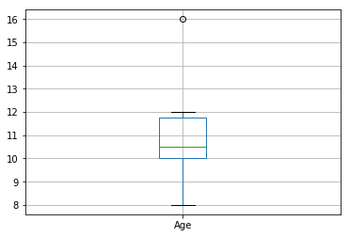
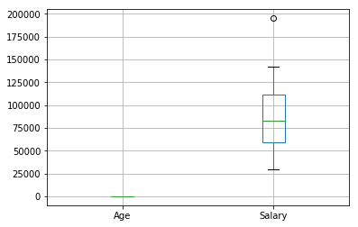
Finding and Fixing Outliers
Outliers can be found in a variety of ways:
Simple: sort your data and look for extremely high and low values
data.sort_values(by="Age", ascending=True).head(10)
data.sort_values(by="Age", ascending=True).tail(10)
Box and whisker plots based on quartiles of raw data
data.boxplot("Age")
Z-scores based on standardized data
z-score = (x – mean of x’s) / standard deviation
Outliers = z-scores > 3 or < -3

Slide 12
Finding and Fixing Outliers
Once you find outliers, you can fix them in a number of ways
You may not need to worry about them if your statistical method is not influenced by outliers
You can run your statistical model with and without the outliers to see if the outliers bias the results
If bias is likely:
drop the entire row with the outlier or
set the outlier to null (i.e., np.nan) and impute the missing value
more complex options are also available

Slide 13
Handling Missing Values
Many real-world data sets will contain missing data
Imputation is the act of filling missing values with another value
Many forms of imputation exist:
Replace all missing values in a column with a specific value (e.g., 2)
Replace missing values with the mean/median of the column
Replace missing values based on regression or interpolation methods
The fillna() method provides basic functionality. Lambda functions can be used for more complex imputation methods
data.Age = data.Age.fillna(value=22) #fill all missing values with the integer 22
data.Age.fillna(value=data.Age.mean(), inplace=True) #fill values with the mean

Slide 14
Lambda Functions
Lambda functions are methods that can be run inside of another method.
You saw lambda functions in Java when working with the WindowBuilder library
Lambda functions are used in data cleaning to perform complex behavior that simple built-in methods can’t perform.
In pandas, lambda functions are often used within the apply() method
The basic syntax is:
data.apply(lambda x: …) or data.Age.apply(lambda age: …)
The x is a variable that stores the value for each entry in the data series (e.g., each Age value in the data set)
The apply() method will loop over every entry in the data series and perform the lambda function on each iteration value in the column.

Slide 15
Lambda Functions
Lambda functions can be used to set values to null (i.e., np.nan) if certain conditions are met:
data.Age.apply(lambda age: np.nan if age < 16 or age > 100 else age)
Lambda functions can be used to impute values in more complex ways:
data.Age = data.Age.apply(lambda age: random.randrange(data.Age.min(), data.Age.max()) if pd.isnull(age) else age) #imputes a values between a certain range if an age value is null
And more

Slide 16
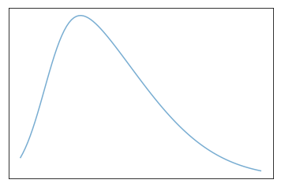
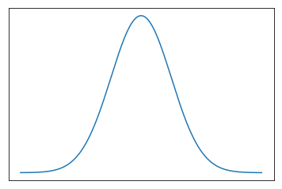
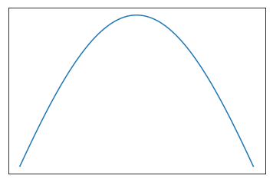
Basic Statistics and Visualizations
During and after cleaning your data, you can examine some core descriptive statistics (e.g., mean, standard deviation, min, max, quartiles, correlations, etc.) that will help you understand the distribution of your data
Mean = mean()
Median = median()
Mode = mode()
Minimum = min()
Maximum = max()
Standard deviation = std()
Variance = var()
Correlation = corr()
Covariance = cov()
Skewness = skew()
Kurtosis = kurtosis()

Slide 17
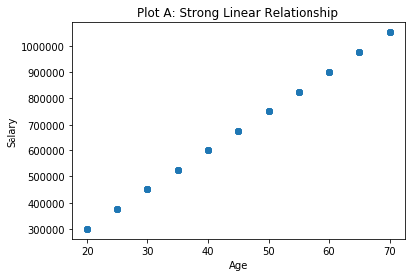
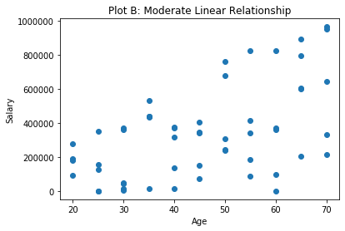
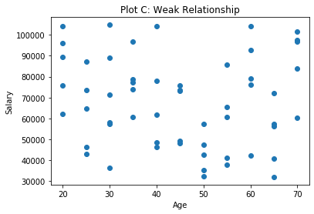
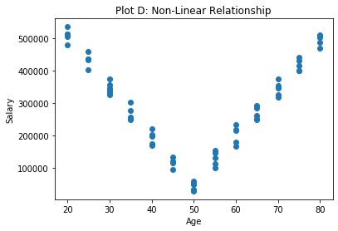
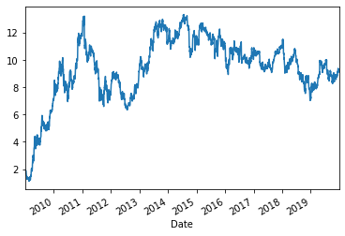
Basic Statistics and Visualizations
You can also examine key visualizations (e.g., scatter plots, times series plots)
Correlation is a statistic that will also provide information about the strength of linear relationships
Correlation of 1 means perfect linear relationship
Correlation of 0 means no linear relationship

Slide 18
Scatter Plots with MatPlotLib
Creating scatter plots with matplotlib.pyplot is fairly simple
Make sure you import matplotlib
import matplotlib.pyplot as plt
Basic syntax: plt.scatter(x,y)
plt.scatter(data.Age, data.Income) #creates a scatter plot based on column x and y
plt.xlabel("Age") #creates a label for the x-axis that is displayed below the plot
plt.ylabel("Salary") #creates a label for the y-axis that is displayed to the left of the plot
plt.title("Relationship Between Age and Salary") #creates a label for plot at the top of the plot
plt.show() #shows the plot as output of the notebook cell

Slide 19
Conclusion
Any questions?

