Slide 1
supervised Learning: Decision Trees

Slide 2
supervised Learning
Many ML algorithms used in practice rely on supervised learning techniques.
Supervised learning refers to the interventions required to prepare the data to train the ML algorithm.
Whereas unsupervised learning simply requires raw data, supervised learning requires raw data with accurate labels for each data point.
Ex. creating an algorithm to predict whether a job candidate will be likely to accept a job offer would require raw data from past candidates who have accepted or rejected a job offer (e.g., demographic information, resume, cover letter, etc.). Additionally, the dataset would need to contain an outcome variable (i.e., a label) that stores information about whether the past candidates accepted or rejected the offer.

Slide 3
supervised Learning
Although it may sound trivial to produce a dataset with labels, consider the case of computer vision that supports and will support a variety of products and services.
Ex. automated vehicles, medical imaging diagnostic tools, facial recognition, etc.
To prepare a dataset, humans (often in masses or over a long period of time) must look at images in the training dataset and label each image correctly.
Many advanced machine learning algorithms require 100,000 to 10,000,000 data points to offer valuable insight.
Training supervised learning algorithms comes with a heavily cost in human capital.

Slide 4
supervised Learning
Advanced supervised learning algorithms also require computationally expensive operations.
Some recent models have cost organizations several millions of dollars just to train the models.
Advanced models have many parameters that have to be estimated by computers (sometimes billions of parameters). That is why advanced algorithms are expensive computationally and financially.

Slide 5
Supervised Learning and Decision Trees
Decision trees have long offered a means to provide classification and regression capabilities with less labeled data.
Decision trees are still used in practice, but they are often inferior to advanced ML algorithms when the advanced algorithms have enough training data.
However, decision trees are valuable when you don’t have enough training data and/or the budget doesn’t exist to produce a large labeled dataset for training advanced algorithms.
Decision trees are also used as early prototypes for ML systems to determine if meaningful patterns exist within the data.

Slide 6
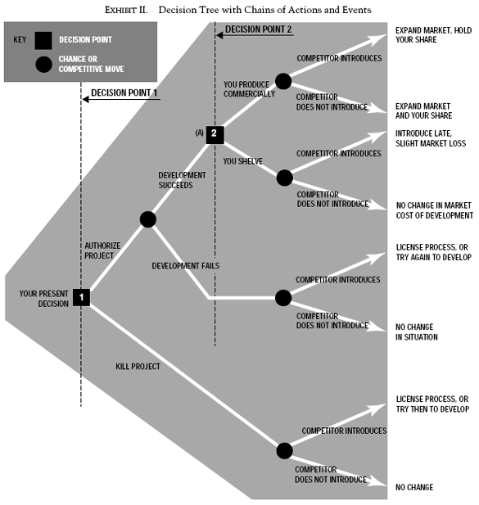
Decision Trees (Magee Reading)
Decision trees provide a way to systematically understand business decisions.
As described in the Magee article, decision trees can be calculated manually by keeping track of important decision points and events and there likelihood of occurrence.
At their core, decision trees encode if-then relationships into a tree-like structure.

Slide 7
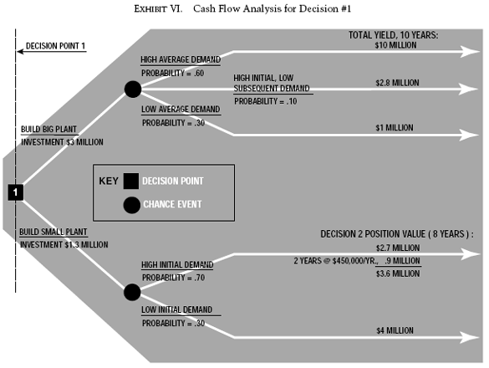
Decision Trees (Magee Reading)
Decision trees start with a root node that represents a decision that must be made.
The decision tree then branches off into key decisions/events that could happen, the likelihood that those events will happen, and the cost/benefit of those events happening.
As you move to the last level of the tree structure, you find “leaf” nodes that provide a final outcome value based on the prior event nodes in the tree.
The final score is the cumulation of event probabilities multiplied by cost/benefit values for a specific pathway through the tree (e.g., 0.7 * $1,000 + 0.3 * $2,000 + 0.2 * -$500 = $1,200)

Slide 8
Decision Trees (Magee Reading)

Slide 9
Decision Trees (Magee Reading)
The method described in the Magee article offers a manually devised and calculated tool for making “ad hoc” (i.e., one-time) decisions.
Ex. where to place a new plant, how to best set up a manufacturing floor based on possible alternatives
Although understanding how to use manual decision trees can be helpful, the goal of ML algorithms is rarely for one-off decisions.
ML algorithms seek to reduce human intervention and automate decision making.

Slide 10
Decision Trees (Chauhan Reading)
Decision trees in ML seek to remove human judgment in deciding the likelihood of events occurring, and the benefits/costs of these events.
Instead, the ML algorithm learns the likelihoods and benefits/costs of events through training on a labeled dataset of prior decisions and their outcomes.
Thus, the tree builds itself based on the available data.
Once a tree has been trained on data, the tree structure can be used to make predictions for new data points to automate decision making.
If you have good data (easier said than done), this can remove human bias/judgment about events from decision making.

Slide 11
Decision Trees (Chauhan Reading)
Decision trees can be used to predict classification or regression outcomes
Classification predictions: determine what class something belongs to (e.g., will a particular stock increase or decrease next week, will a job candidate accept or reject an offer, is an email legitimate or a phishing attack, etc.)
Classification can be binary, such as in the examples above, or multi-class (i.e., more than 2 classes, such as different colors, type of objects, etc.)
Regression predictions: determine an estimated outcome value (e.g., what will the price of a stock be tomorrow, what salary will a job candidate ask for, etc.)
We will primarily focus on classification to introduce you to the concept of trees

Slide 12
Decision Trees (Chauhan Reading)
Decision tees are advantageous for a number of reasons
Easy to visualize and understand the results of the algorithm
Less data preparation is needed
Computationally inexpensive compared to other models
Data can be categorical or numerical
Decision trees come with some limitations
Decision trees are prone to overfitting the data (i.e., learning the peculiarities of the training dataset and not the actual real-world patterns)
Decision trees can change (sometimes drastically) based on small changes to the data
Random forests (i.e., combinations of multiple trees with different data samplines) can help to reduce this issue
No guarantee of reaching a globally optimum solution
Requires balance datasets for each class. Classes with more data will dominate the results.

Slide 13
Decision Trees (Chauhan Reading)
Decision trees work by analyzing features in the data to find the best way to split into new branches.
Some features will lead to more efficient trees that find the correct class or regression prediction quickly and without great computational cost.
Decision trees rely on “splitting measures” to determine which feature should be used at the root node, the second level of branches, the third level of branches, etc.

Slide 14
Decision Trees (Chauhan Reading)
Many splitting measures exist for classification, for example:
entropy or information gain measures: seeks to identify features for splitting that reduce the amount of uncertainty in the data (i.e., entropy) or maximize information about a class by reducing entropy before and after split points (i.e., information gain).
Gini index or Gini impurity measures: seeks to measure the probability of a feature being classified incorrectly if selected randomly. The measure ranges from 0-1.
A 0 on the Gini index means the feature perfectly fits into a single class.
A 1 on the Gini index means the feature is randomly distributed across all classes
Splitting measures also exist for regression trees, such as:
Mean squared error: seeks to split in a way that minimizes the mean squared of the splits.

Slide 15
Decision Trees (Chauhan Reading)
Trees can have different depths.
A shallow tree might have 2 or 3 branching levels (i.e., 2 or 3 levels of if-then conditions), whereas a deep tree could have hundreds of branching levels (i.e., hundreds of if-then conditions).
Deep trees are more inefficient because they contain more if-then conditions. They are also more difficult to interpret. They may also memorize the dataset (i.e., overfitting).
Trees that are too shallow many not produce “leaf” nodes (i.e., the outcomes) that purely predict the outcome.
A balance is needed. ML algorithms include special “pruning” algorithms to ensure that trees don’t get too deep. Pruning algorithms remove branches from the tree.

Slide 16
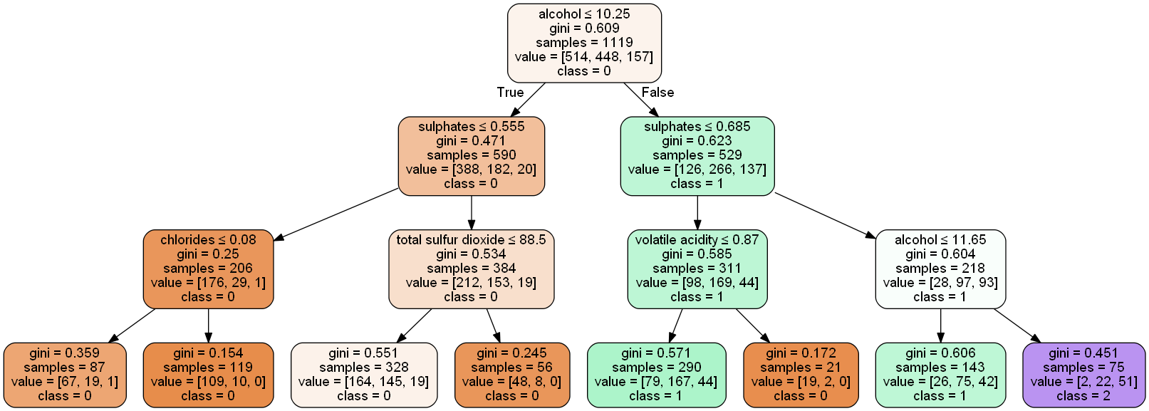
Decision Trees (Chauhan Reading)

Slide 17
Decision Trees (Chauhan Reading)
Different decision tree algorithms exist, such as:
ID3 algorithm – starts at the root node and “greedily” selects features for splitting based on entropy or information gain, repeating the process at each split.
C4.5 algorithm – A widely used extension of ID3. Improved to handle continuous and discrete data, data with missing values, and the incorporation of tree pruning.
CART (Classification and Regression Trees) algorithm – similar to C4.5 algorithm, but uses the Gini index for splitting. Also used generically to refer to all types of decision trees.

Slide 18
Decision Trees with Python (Chauhan Reading)
To use decision trees, you will need to import the scikit-learn library.
To begin, import the libraries you need.
import pandas import numpy import matplotlib.pyplot from sklearn.preprocessing import StandardScaler from sklearn.model_selection import train_test_split: used to split data into features and labels and training and test datasets from sklearn.tree import DecisionTreeClassifier: contains the classification decision tree algorithms from sklearn import metrics: used to calculate the accuracy of models

Slide 19
Decision Trees with Python (Chauhan Reading)
After importing libraries, be sure to split your data into the feature and label sets and train and test sets
X_train, X_test, y_train, y_test = train_test_split(features, labels)
Use the standard scaler to scale your data (if desired)
Not as important for decision trees as for other ML algorithms, but it doesn’t hurt either
Decision trees aren’t sensitive to differences in variance between features
Next, set up the decision tree classifier
tree = DecisionTreeClassifer() #defaults to using the Gini index for splitting tree.fit(X_train, y_train)

Slide 20
Decision Trees with Python (Chauhan Reading)
Once the training data is fit to the decision tree model, you can test its accuracy by using the predict()method
y_predictions = tree.predict(X_test)
The accuracy of the model can be ascertained through the metrics library by comparing the labels of the test dataset to predictions created with the predict() method
metrics.accuracy_score(y_test, y_predictions)
Additional analyses of accuracy can be examined using a confusion matrix to identify false positive and false negatives
Libraries also exist to visualize the decision tree, so you can interpret how it is making decisions.

Slide 21
Decision Trees with Python: Sklearn Documentation
There are more advanced features to the sklearn decision tree algorithm, such as pruning (i.e., max depth)
You can view the additional features or read more about the features presented here by going to:
https://scikit-learn.org/stable/modules/generated/sklearn.tree.DecisionTreeClassifier.html

Slide 22
Conclusion
Any questions?

