Slide 1
SUPERVISED LEARNING: SUPPORT VECTOR MACHINES

Slide 2
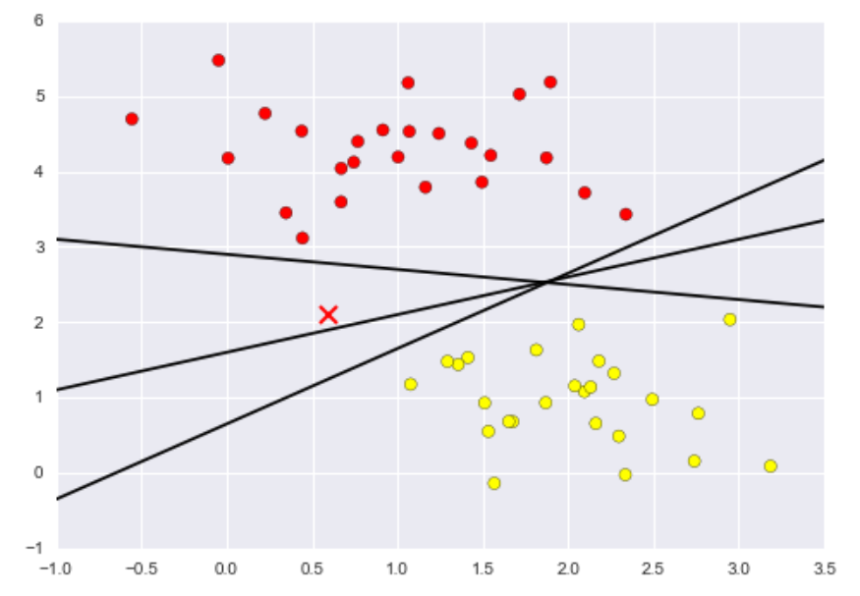
SUPPORT VECTOR MACHINES (VANDERPLAS READING)
Support Vector Machine (SVM) is a supervised learning algorithm (i.e., requires features and labels) that can be used for classification (i.e., categorical outcomes) or regression (i.e., numerical outcomes)
We will primarily focus on classification problems as an introduction to SVM
SVM for classification uses a form of discriminative classification to separate data points into different classes
It does so by finding lines that best separate data points into different classes

Slide 3
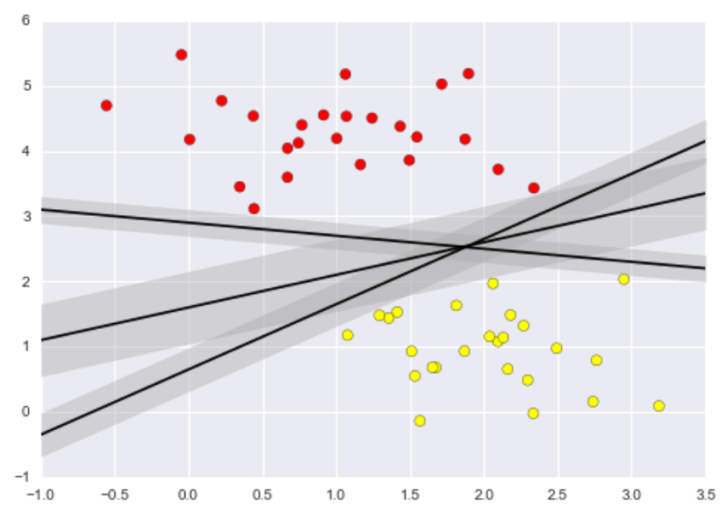
SUPPORT VECTOR MACHINES (VANDERPLAS READING)
The SVM algorithm trains on the labeled dataset by finding a line with the largest margin around it that separates the labeled data into the correct classes.
Once the SVM algorithm has been trained, the line is used to determine how to classify new data points
As with most supervised learning algorithms, you should create at least training and test data sets to validate the accuracy of the training

Slide 4
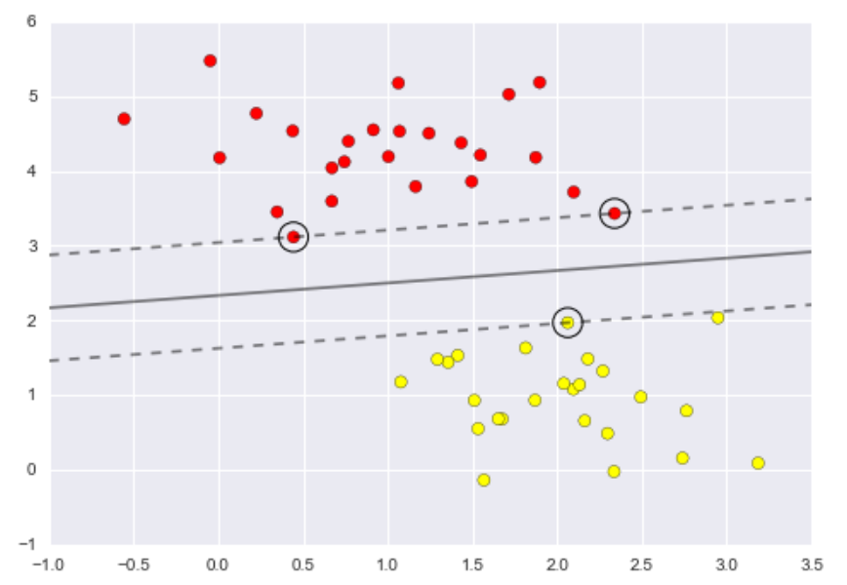
SUPPORT VECTOR MACHINES (VANDERPLAS READING)
SVMs require only small amounts of memory because the SVM algorithm does not use all of the data to make decisions during training.
The SVM algorithm creates a “support vector” made up of the points that frame the margin of the dividing line
Because only a portion of the data are used to learn a pattern, SVMs are excellent for data with many features

Slide 5
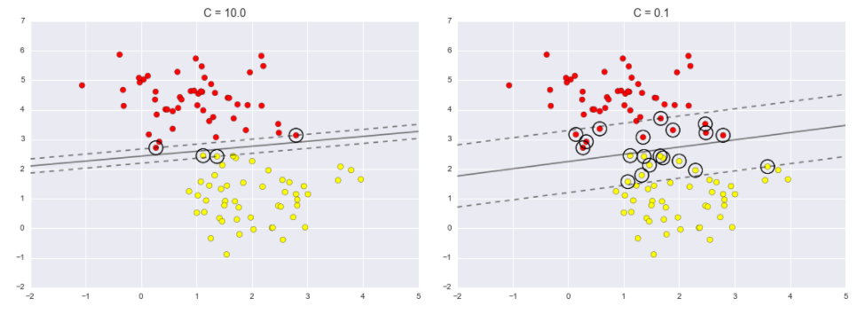
SUPPORT VECTOR MACHINES (VANDERPLAS READING)
In real world datasets, data rarely separates perfectly into classes as depicted in the previous images. Real data is messy.
Overlap is common in data, which requires SVM to “soften” the margin around the dividing boundary.
Instead of the support vector consisting of points at the border of the margin, a soft margin includes some data points within the margin.
The amount of data points included depends on a hyperparameter C
If you create training, validation, and test sets, you can use the validation set to identify the most appropriate value for C before using the test set

Slide 6
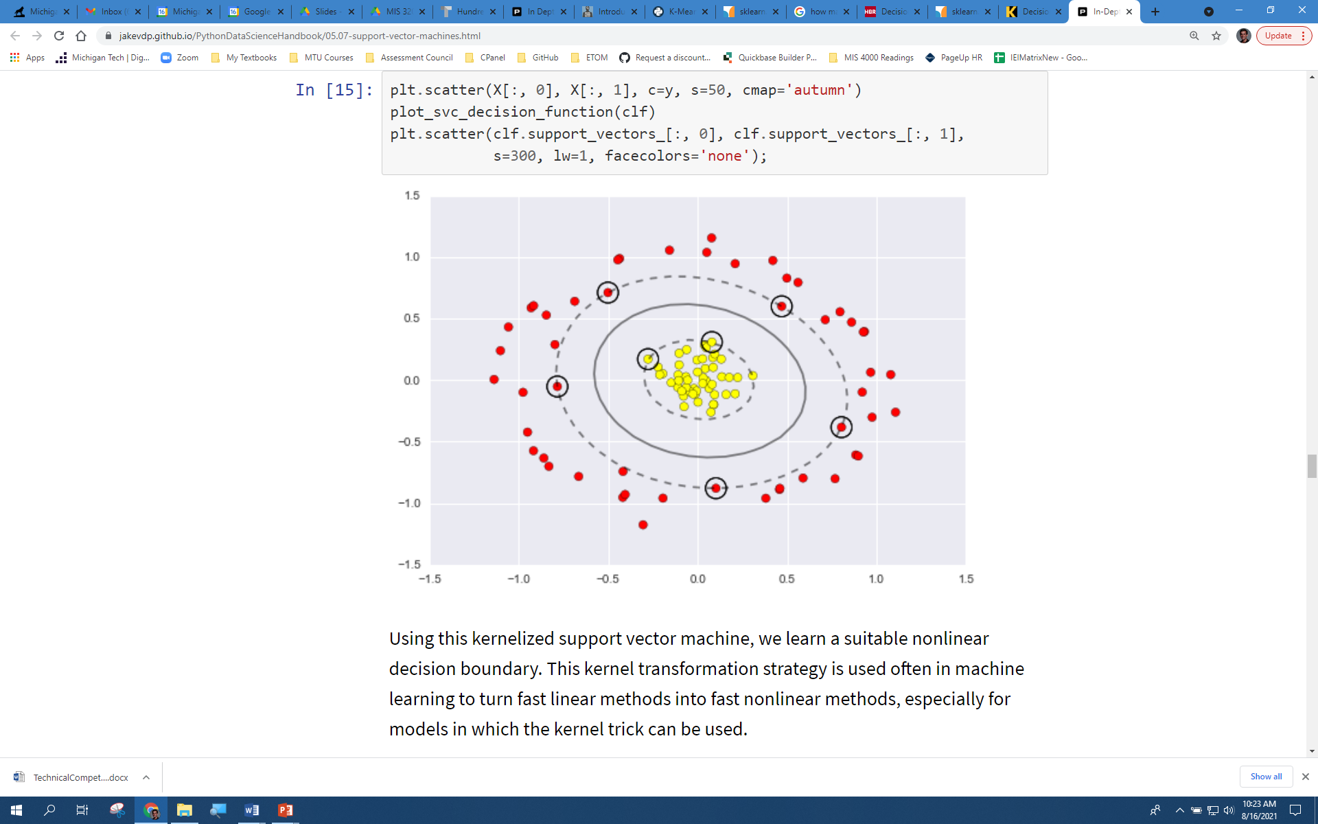
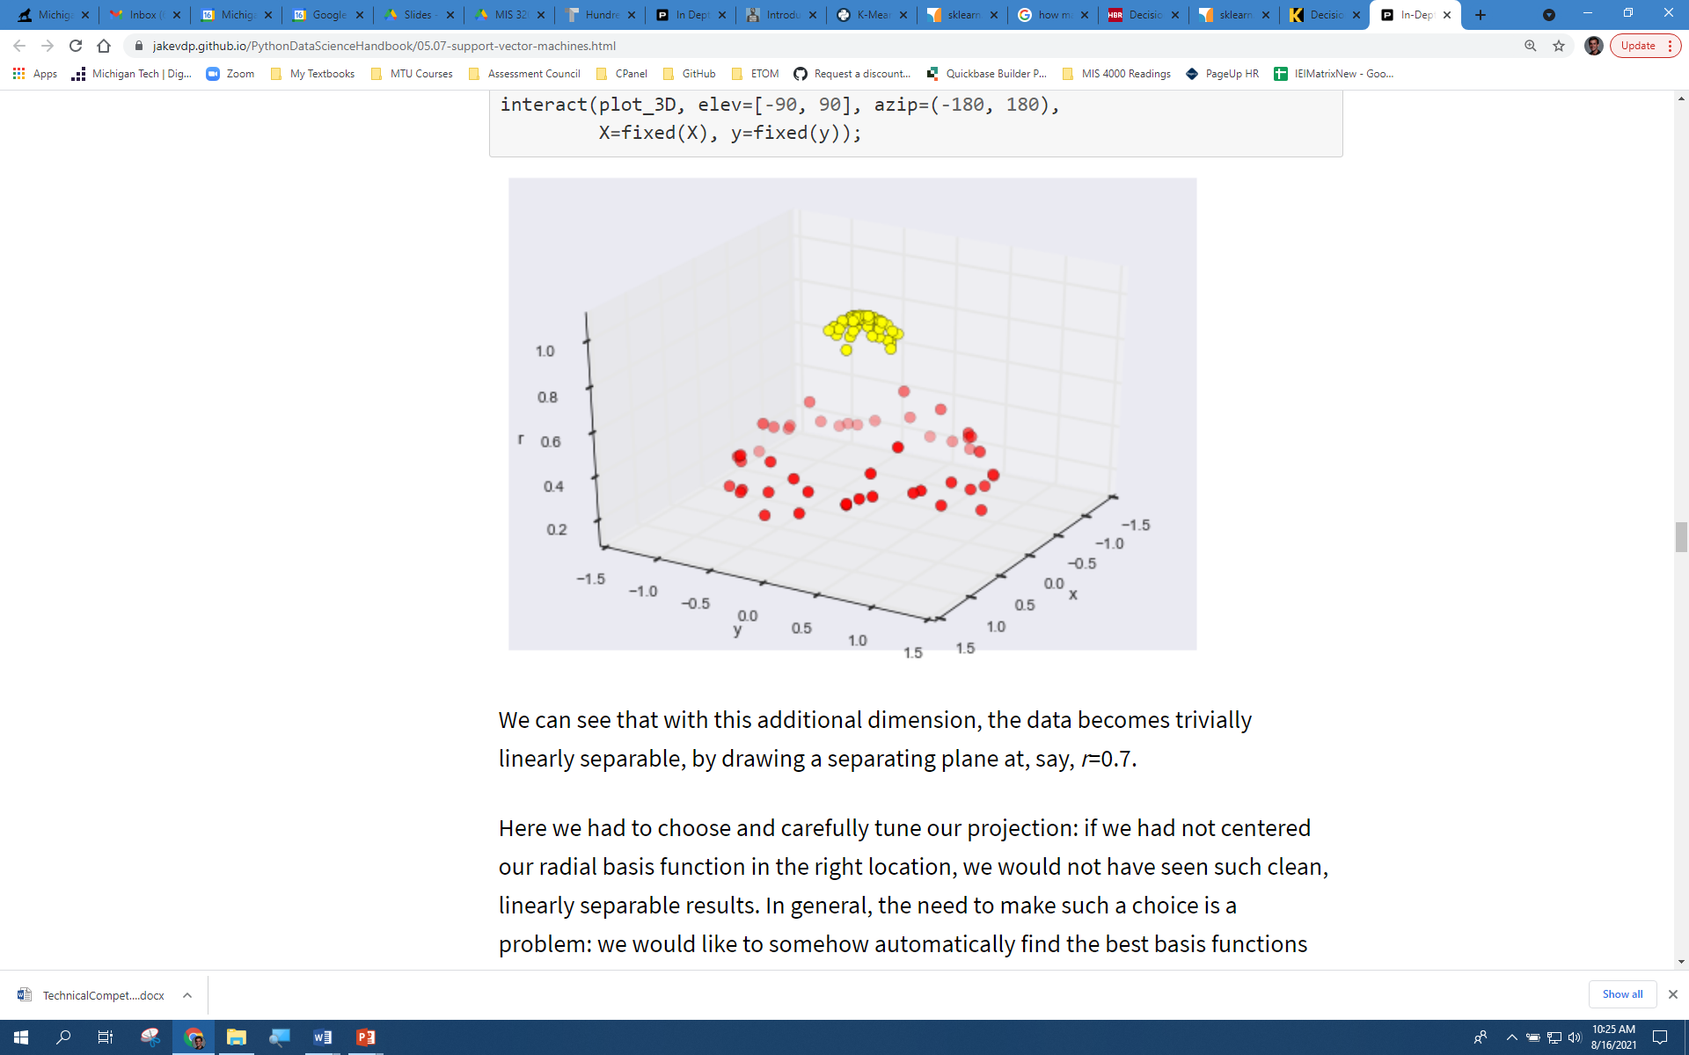
SUPPORT VECTOR MACHINES (VANDERPLAS READING)
SVMs can be used to solve linear problems, such as those datasets depicted in the previous examples.
However, not all data can be separated with a simple line.
The SVM algorithm can be used with various kernels to examine non-linear relationships.
A “kernel” projects data into a higher dimension to make a problem that can’t be separated linearly able to do so.
The SVM kernel creates this separation automatically

Slide 7
SUPPORT VECTOR MACHINES (VANDERPLAS READING)
A variety of kernels can be used with SVMs to help with a variety of different data distributions.
The Guassian radial basis function (RBF) used in the article is a general purpose kernel that can be used when you are not sure of the data distribution
Other kernels exist as well:
Guassian kernel – similar to RBF
Polynomial kernel
Sigmoid kernel

Slide 8
SVM WITH PYTHON (SCIKIT LEARN READING)
As with any ML algorithm, begin by importing the libraries you will use
import numpy as np from sklearn.preprocessing import StandardScaler – scale data prior to SVM analysis from sklearn import svm
Once your libraries are imported, you can set up a SVM object
svmModel = svm.SVC()
SVC is SVM for classification problems
SVR is used for regression problems

Slide 9
SVM WITH PYTHON (SCIKIT LEARN READING)
After setting up the SVM object, you can train the model using the fit() method
Remember that your data should be split into feature and label sets, as well as training and testing sets
X_train , X_test , y_train, y_test = train_test_split(features, labels)
svmModel = svm.SVC() svmModel.fit(X_train, y_train)
You can view aspects of the learned model, such as details about the support vector
svmModel.support_vectors_ - returns the coordinates for the data points within the support vector

Slide 10
SVM WITH PYTHON (SCIKIT LEARN READING)
After training you model, you can test it using the test set
y_predictions = svmModel.predict(X_test, y_test)
Like with the decision tree model, you can examine the accuracy of your model using the metrics library.
metrics.accuracy_score(y_test, y_predictions)
A confusion matrix can also be used to assess misclassification errors

Slide 11
SVM WITH PYTHON (VANDERPLAS READING)
To use a kernel on your data, by adding parameters to the initial SVC object
svmModel = svm.SVC(kernel="rbf")
You can also adjust the “softness” of the SVM margin by adjusting the C parameter
svmModel = svm.SVC(C=0.5)

Slide 12
SVM WITH PYTHON: SKLEARN DOCUMENTATION
There are more advanced features to the sklearn SVM for classification (SVC) algorithm
You can view the additional features or read more about the features presented here by going to:
https://scikit-learn.org/stable/modules/generated/sklearn.svm.SVC.html
If you want to learn about the SVM for regression with sklearn, visit:
https://scikit-learn.org/stable/modules/generated/sklearn.svm.SVR.html

Slide 13
CONCLUSION
Any questions?

