Slide 1
Intro to Artificial Neural Networks and Keras

Slide 2
Neural Networks
Artificial Neural Networks (ANNs) consist of data structures that vaguely mimic the functionality of neurons in the brain.
ANNs are a type of artificial intelligence that has gained notoriety in the last decade for their ability to solve problems with a high degree of accuracy that other ML algorithms could not.
At a high-level, there are two types of artificial intelligence
Narrow AI: “intelligence” is limited to specific tasks (e.g., image recognition, facial recognition, stock investment, etc.). This is the current state of AI. ANNs are currently a form of narrow AI.
General AI: intelligence that can learn a variety of information and new skills (like human brain)

Slide 3
Value of Neural Networks (Wiggers Reading)
As a narrow AI, neural networks have still achieved human or super-human performance on a number of tasks, such as image recognition (e.g., medical imaging diagnosis).
Recently, Gartner reported a 270% increase in the usage of AI within organizations.
Deloitte found that in 2018, around 60% of organizations used some form of AI.
Deloitte also found that 42% of executives believe that AI will be of critical importance in as little as two years.
Neural networks could produce between $3.5 and 5.8 trillion in value annually (Harvard Business Review).
Taking some time to learn about neural networks and considering their use in business will make you a valuable asset in the near future!

Slide 4
Value of Neural Networks (Wiggers Reading)
Many business domains could benefit from the use of AI. For example:
Credit evaluation and loan delinquency in banking industry
Fraud detection in financial institutions
Customer behavior predictions for marketing and sales
Customer segmentation
Real-time transportation route suggestions
Diagnosing/maintaining machines (e.g., vehicles, manufacturing machines) (i.e., predictive maintenance)
Medical diagnosis

Slide 5
Value of Neural Networks (Wiggers Reading)
Despite providing clear value, neural networks exhibit some limitations:
Training data isn’t always available.
Data quality is a HUGE problem (estimated to be 80+ percent of issues currently experienced).
Training is expensive (backpropagation algorithm is computationally expensive)
Sometimes millions of dollars for networks with hundreds of billions of parameters to estimate
Finding skilled personnel is difficult and business practices surrounding AI are immature.

Slide 6
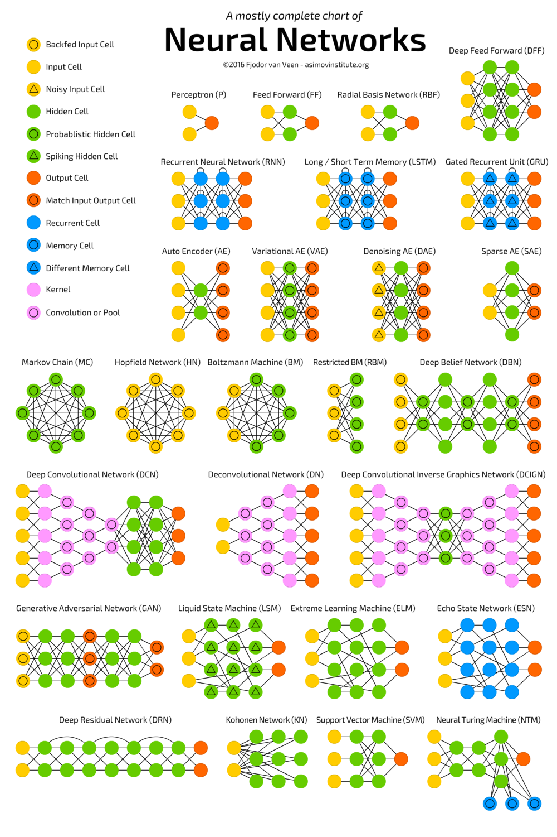
Types of Neural Networks (Varteq Reading)
Neural networks come in many and varied forms.
New models are created regularly by scientists and R&D practitioners.
Neural networks consist of nodes called “neurons” (i.e., the dots in the image to the right).
Neurons are connected to each other in layers to form a network of neurons.
Each type of network provides different behavior.
We only have time to examine a few types.

Slide 7
Types of Neural Networks (Varteq Reading)
Three foundational types of layers in neural networks include:
Input layer – nodes in this layer accept raw data inputs
Hidden layers – many hidden layers can exist. Hidden layers perform additional calculations. The number of hidden layers is what provides the networks “depth” (i.e., deep learning)
Output layer – the output layer accepts scores from one or more hidden layers. It then predicts the desired outcome.

Slide 8
Types of Neural Networks (Varteq Reading)
Some networks also use other types of layers:
Recurrent layers – some data/problems are sequential, such as time series data. For these problems some neural networks seek to retain a memory of past events in the series/sequence.
Kernel layers – In some networks, hidden layers perform calculations using a kernel, such as convolutional kernels in convolutions networks.

Slide 9
Neural Networks and Keras (Keras Reading)
Keras is a Python library that provides a high-level interface to the TensorFlow library designed to build, train, and use neural networks.
Keras works by allowing you to work with “blocks” of different calculations that can be stacked and layered to create a neural network.
You often don’t have to work with data matrices and perform manual calculations, such as the dot product, when using Keras.
TensorFlow requires a deeper understanding of linear algebra and the operations of specific calculations.
For applied purposes, Keras is an amazing library to help organizations produce and test neural networks quickly.

Slide 10
Neural Networks and Keras (Keras Reading)
Keras requires specific data structures, such as numpy arrays, for data inputs.
Many times, data must be converted from its raw form to numerical values. For example:
Each pixel in a color image must be converted into three separate scores for the red, green, and blue (RGB) value of the pixel (values range from 0 to 255).
The words in a text must be replaced with numerical representations (i.e., indices). For example, the word “neuron” would be replaced by the number 45 and “network” by 48.
The number isn’t important as long as it is unique to each word and is used consistently every time that a word appears in a document.
Data is also often normalized/standardized (e.g., convert the raw score to a z-score)
This can be done with Keras or another library like Scikit-learn

Slide 11
Neural Networks and Keras (Keras Reading)
Keras contains many useful utilities to convert your data to the appropriate data structure (i.e., a tensor)
Simply put, a tensor is a generalized form of a matrix that can exist in n-dimensions (i.e. 2D, 3D, 4D, etc.)
For more of an introduction to tensors, you can read: https://medium.com/@quantumsteinke/whats-the-difference-between-a-matrix-and-a-tensor-4505fbdc576c
Some data is more difficult to manually convert than other data, such as images and text. Keras provides simple tools to do difficult work:
tf.keras.preprocessing.image_dataset_from_directory – Converts image files in a directory into tensors
tf.keras.preprocessing.text_dataset_from_directory – Converts text files in a directory into tensors
When possible, create end-to-end models: your ML models should be able to accept raw inputs, preprocess them and perform the model calculations.
Minimize reliance on external tools. It reduces the portability of your ML algorithms

Slide 12
Neural Networks and Keras (Keras Reading)
Vectorizing text: the sequence of words in a sentence means something. Converting text data to tensors requires that the sequence of words be correctly captured.
Words in text are replaced with index values. For example:
“The red rabbit is fictional” might convert to [2, 45, 643, 3, 342]
“The rabbit in Alice in Wonderland is fictional” might convert to [2, 643, 5, 789, 5, 805, 3, 342]
Notice that in these sentences the word “the” is consistently replaced with 2, “is” with 3, “in” with 5, etc.
Text vectorization must be consistent and each word must receive a unique index value
from tensorflow.keras.layers import TextVectorization vectorizer = TextVectorization(output_mode="int") vectorizer.adapt(training_data) #assigns text in the data to an index to build a dictionary of index:word pairs vectorizer(new_data) #converts a new string of text to index values using the dictionary created with the adapt() method

Slide 13
Neural Networks and Keras (Keras Reading)
Normalizing Data: You have seen normalization in other ML algorithms. Normalization converts raw feature data to a standardized scale (e.g., a z-score).
Some ML algorithms are sensitive to differences in the magnitudes of feature values. Normalization put all feature values on the same scale.
from tensorflow.keras.layers import Normalization normalizer = Normalization(axis=-1) normalizer.adapt(training_data) #creates normalization scores based on data normalized_data = normalizer(training_data) #returns normalized data in tensor form

Slide 14
Neural Networks and Keras (Keras Reading)
Once you preprocess your data, you can begin to build and train models with Keras
Neural networks consist of layers of calculations.
Keras encapsulates these layers of calculations in a “model”
To create a model, begin by programming the layers of the model
from tensorflow.keras import layers
Often you will start with an Input layer
inputs = keras.Input(shape=(200, 300, 3))
This input layer would be for a tensor of images that have a pixel height of 200, a pixel width of 300, and a depth of 3. The depth refers to the RGB channels (i.e., 3 channels: red, green, and blue)
Notice that the layer doesn’t contain actual data, just the type of layer and the size of the data in the layer

Slide 15
Neural Networks and Keras (Keras Reading)
After creating the input layer, you can pass the output of the input layer to subsequent layers
input = keras.Input(shape=(200, 300, 3))
You then continue to pass the output from the current layer to the next layer. Consider for example a simple convolutions neural network:
input = keras.Input(shape=(200, 300, 3)) hidden = layers.Conv2D(filters=32, kernel_size=(3, 3), activation="relu")(input) #notice input is passed to this layer hidden = layers.MaxPooling2D(pool_size=(3, 3))(hidden) #notice the previous “hidden” layer is passed to this layer hidden = layers.Conv2D(filters=32, kernel_size=(3, 3), activation="relu")(hidden) hidden = layers.GlobalAveragePooling2D()(hidden) output = layers.Dense(5, activation="softmax")(hidden) #hidden transformations passed to an output layer
Once the layers are built, you can add them to a Keras model
model = keras.Model(inputs=input, outputs=output)
Calling model.summary() will show you the order of your layers, the shape of each layer, and the number of trainable parameters in each layer

Slide 16
Neural Networks and Keras (Keras Reading)
Once you have constructed a model with its layers, you can train the model with training data
Before you train the data, you must set values to tell the network how to learn, such as the
Optimizer: an algorithm that adjusts the parameter weights of a neural network to help it learn. Many different optimizers exist.
Loss function: a function that calculates the error of what is expected vs. what the network actually learned. Many different loss functions exist.
model.compile(optimizer='rmsprop', loss='categorical_crossentropy’)
After setting these values, you can train the model with data using the fit() method like you did for other supervised ML algorithms
model.fit(features, labels, batch_size=32, epochs=10)
batch_size = number of samples from the dataset to calculate at one time. Batch_size isn’t necessary if your data is already batched.
epochs = number of times to iterate over the entire dataset

Slide 17
Neural Networks and Keras (Keras Reading)
You can evaluate your model for testing purposes by using the evaluate() method
loss, accuracy = model.evaluate(validation_dataset)
You can also make predictions on new data points after training your data
predictions = model.predict(new_dataset)
Keras has many advanced features to assist in improving your model and the speed of training.
Creating custom training steps by extending keras.Model
Debugging tools
Multi-GPU support
Synchronous and asynchronous execution
Hyperparameter tuning to identify the best hyperparameters for a model

Slide 18
Neural Networks with Python: Keras Documentation
There are even more advanced features to the Keras library
You can view the additional features or read more about the features presented here by going to:
https://keras.io/
https://keras.io/api/

Slide 19
Conclusion
Any questions?

