Slide 1

Conduct a suitable experiment in Matlab/Simulation to control the speed of separately excited DC motor chopper drive.
PECD CASE STUDY- 1
DEPARTMENT OF EEE
IV year -1semester
Academic year: 2020-2021
Presented By:
18985A0208 – A.SAI SAMPATH
18985A0232 – G.CHINNA
18985A0247 – L.RATNAKARA RAO
18985A0271 – Y.VASUDEVA
FACULTY:
Dr. V. Sudheer
Associate professor
RAGHU ENGINEERING COLLEGE
(AUTONOMOUS)

Slide 2
Introduction.
An electrical drive consists of electric motors, its power controller and energy transmitting shaft. In modern electric drive system power electronic converters are used as power controller. Electric drives are mainly of two types: DC drives and AC drives. The two types differ from each other in that the power supply in DC drives is provided by DC motor and power supply in AC drives is provided by AC motor.
For controlling the speed and current of DC motor, speed and current controllers are used. The main work of controller is to minimize the error and the error is calculated by comparing output value with the set point. This thesis mainly deals with controlling DC motor speed using Chopper as power converter and PI as speed and current controller.

Slide 3
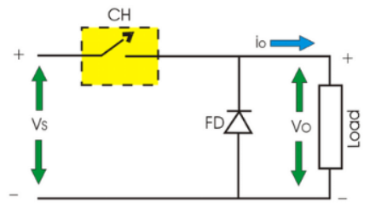
What is a Chopper?
A chopper is a device that converts fixed DC input to a variable DC output voltage directly. Essentially, a chopper is an electronic switch that is used to interrupt one signal under the control of another.

Slide 4
Types Of Choppers
Step-up chopper
Step-down chopper
Step-up / step-down chopper

Slide 5
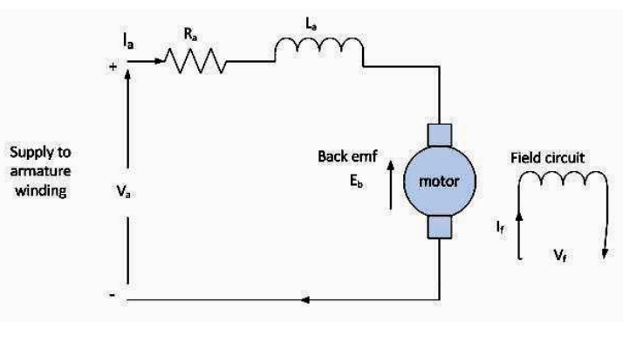
Separately Excited DC Motor
Separately excited dc motor has field and armature winding with separate supply voltage.
Field winding supplies field flux to armature. When DC voltage is applied to motor, current is fed to the armature winding through brushes and commutator.
Since rotor is placed in magnetic field and it is carrying current also. So motor will develops a back emf and a torque to balance load torque at particular speed.

Slide 6
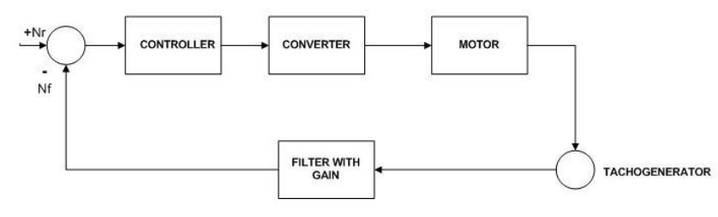
Closed loop model for speed control of dc motor
An electrical DC drive is a combination of controller, converter and DC motor. Here we will use chopper as a converter.
The basic principle behind DC motor speed control is that the output speed of DC motor can be varied by controlling armature voltage keeping field voltage constant for speed below and up to rated speed .

Slide 7
Contd.
The output speed is compared with the reference speed and error signal is then fed to speed controller. If there is a difference in the reference speed and the feedback speed, Controller output will vary.
The output of the speed controller is the control voltage Eg that controls the operation duty cycle of converter.
The converter output gives the required voltage V to bring motor speed back to the desired speed.
The Reference speed is provided through a potential divider because it is linearly related to the speed of the DC motor.
The tacho voltage we will get from the tacho generator contains ripple and it will not be perfectly dc.
So, we require a filter with a gain to bring Tacho output back to controller level.

Slide 8
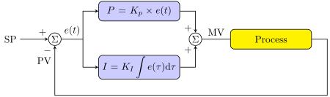


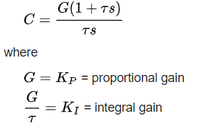
PI Controller
PI controller (proportional-integral controller) is a special case of the PID controller in which the derivative (D) of the error is not used.
The controller output is given by
where is the error or deviation of actual measured value (PV) from the setpoint (SP).
Setting a value for G is often a trade off between decreasing overshoot and increasing settling time.

Slide 9
Idea For Usage Of PI Controller
In proportional controller error speed is proportional to the measured output.
This controller has the limited use and can never force the motor to run exactly at the set point speed. Therefore an improvement is required for correction in the output.
In PI controller, the proportional term does the job of fast correction and the integral term takes finite time to act and makes the steady state error zero. In derivative approach further refinement is done.
This controller will allow the rate of change of error speed to apply an additional correction to the output drive.
It can be used to give a very fast response to sudden changes in motor speed

Slide 10
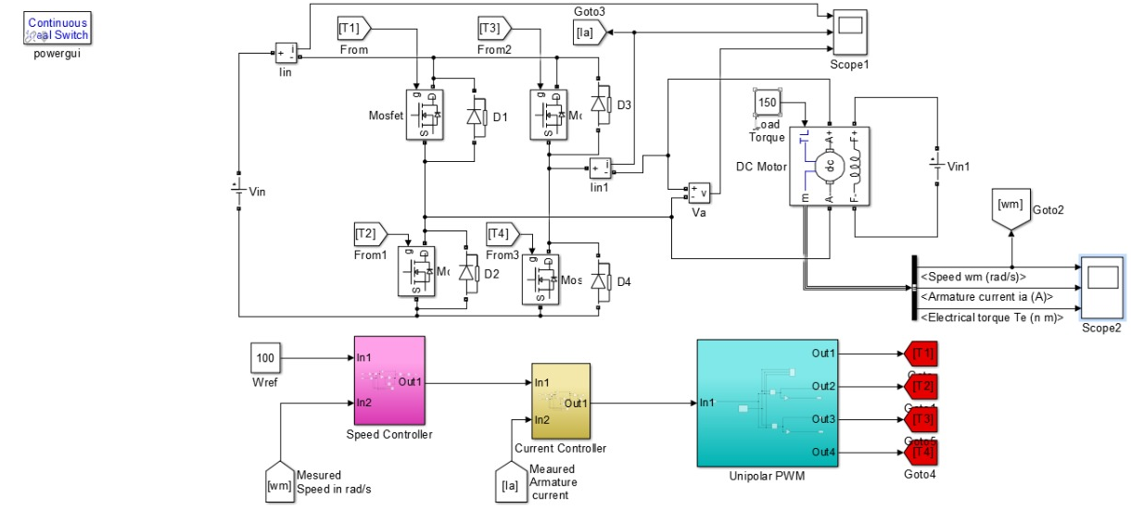
Simulation Using PI controller

Slide 11
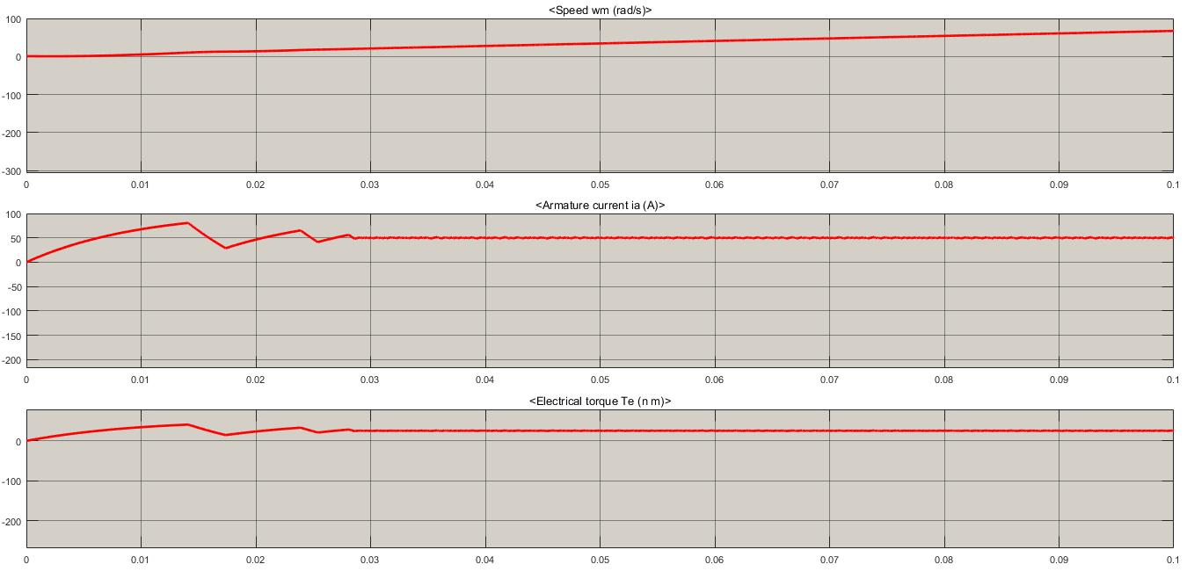
Simulation Results
Output at 10nm

Slide 12
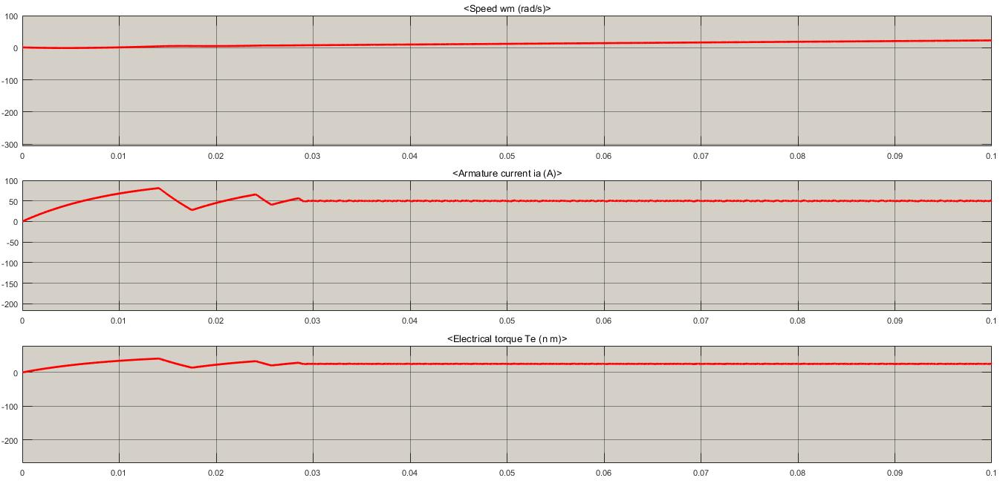
Simulation Results
Output at 20nm

Slide 13
Applications.
Chopper circuits are used in multiple applications, including:
Switched mode power supplies, including DC to DC converters.
Speed controllers for DC motors
Driving brushless DC torque motors or stepper motors in actuators
Class D electronic amplifiers
Switched capacitor filters
Variable-frequency drives
D.C. voltage boosting
Battery-operated electric cars
Battery chargers
Railway traction
Pi controllers applications are
it can be used to control any process that has a measurable output (PV), a known ideal value for that output (SP), and an input to the process (MV) that will affect the relevant PV.
Controllers are used in industry to regulate temperature, pressure, force, feed rate, flow rate, chemical composition, weight, position, speed, and practically every other variable for which a measurement exists.

Slide 14
Conclusion.
The speed of a dc motor has been successfully controlled by using Chopper as a converter and Proportional-Integral type Speed and Current controller based on the closed loop model of DC motor. Initially a simplified closed loop model for speed control of DC motor is considered and requirement of current controller is studied. Then a generalized modelling of dc motor is done. After that a complete layout of DC drive system is obtained. Then designing of current and speed controller is done. Now the simulation is done in MATLAB under varying load condition, varying reference speed condition and varying input voltage. The results are also studied and analyzed under above mentioned conditions. The model shows good results under all conditions employed during simulation. Since, the simulation of speed control of DC motor has been done. We can also control the speed of DC motor above rated speed and this can be done by field flux control.

Slide 15
Thank You.

