Slide 1
Model View Controller MVC
UI Presentation Pattern

Slide 2
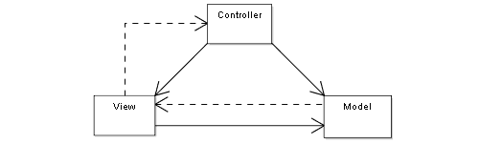

Slide 3
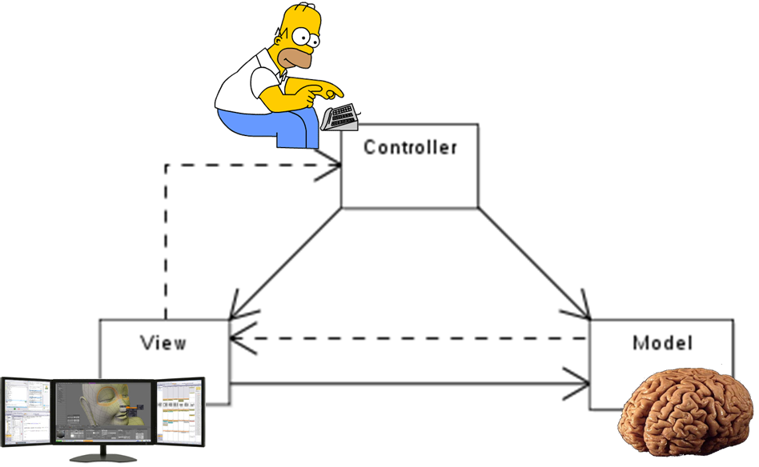

Slide 4
Display / Editor Templates

