Slide 1
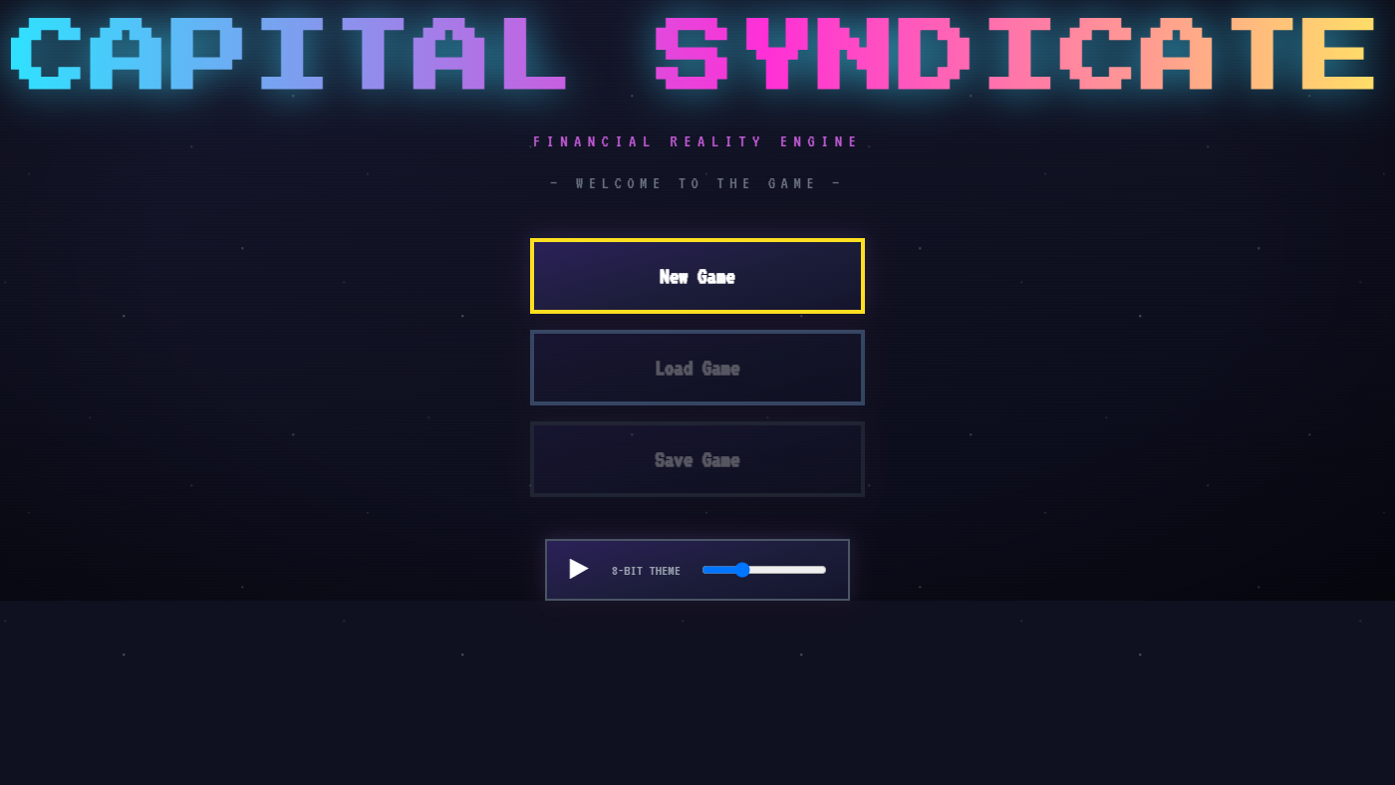
WHAT IT IS & HOW IT'S BUILT
Pornpavis Jongdepaisarn • Ataya Chitmeesilp • Thanakorm Kornmatisuk
Lapat Jitsangvorawong • Poom Rangsisingpipat • Tan Briton Rungwattanasophon

Slide 2
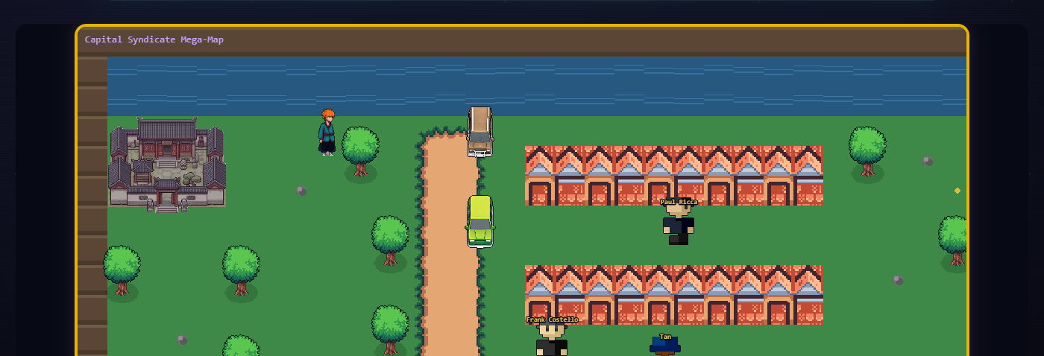
// LIVE GAMEPLAY - ACTUAL SCREENSHOT
WHAT IS BOARD OF REALITIES?
› A top-down, open-world life-and-finance simulation game, playable in the browser
› You play a university student who leverages his way into -$10,000,000 in debt on day one
› Starting from just $1,000, you climb back to +$10,000,000 through investing, business, crime, and gambling

Slide 3
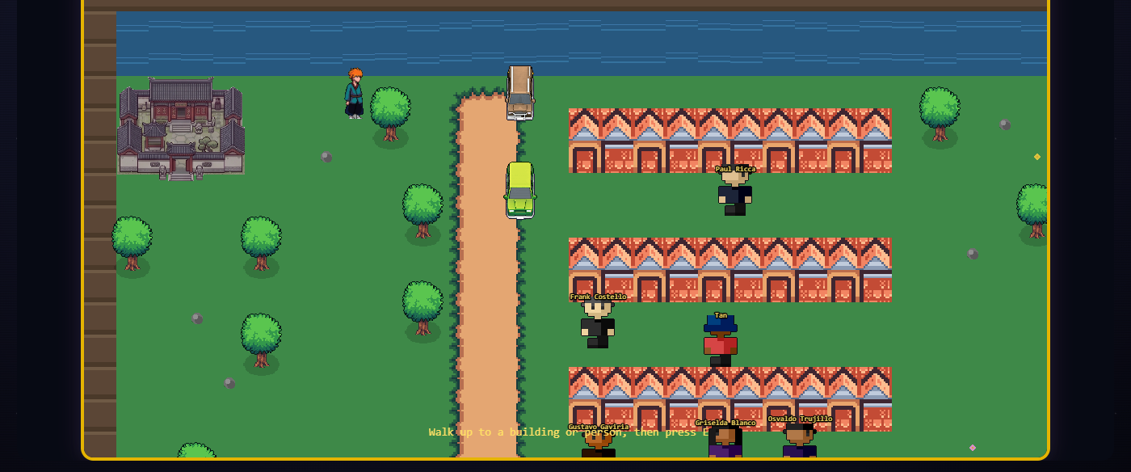
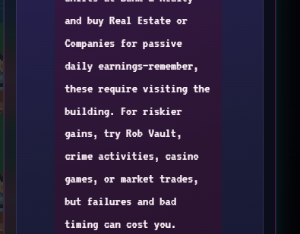
HOW IT'S BUILT
FRONTEND (in the browser)
BACKEND (a separate server)
^ the actual 2D world, rendered live by Phaser
^ Aria, replying live - generated by the real backend call
› React — every menu, modal, and HUD element
› Phaser 4 — the 2D game world you walk around in
› Zustand — one shared state store (cash, day, inventory)
› Vite — instant hot-reload dev server + build tool
› Python + FastAPI, served by Uvicorn
› Connected to OpenAI — every NPC has a written persona
› Generates each NPC's live, in-character reply as you type
› One simple API call connects the two halves — no database

Slide 4
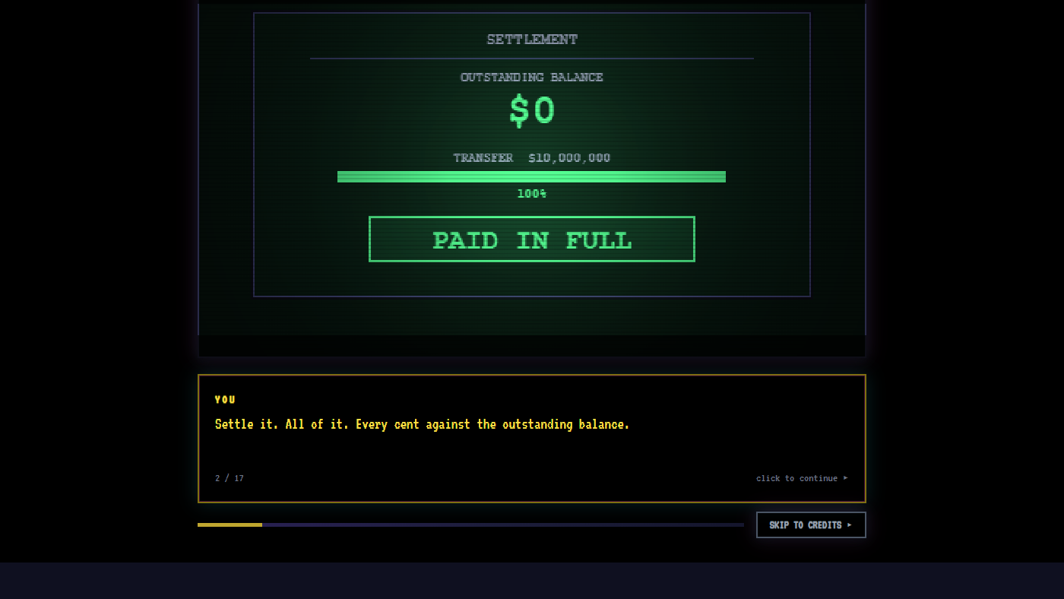
THANK YOU
Board of Realities — built end-to-end by a 6-person student team
Questions?

