Slide 1
Facial Emotion Recognition Using Deep Learning
Taha Ahmed 394159
Shujaullah 384101
Prithvi Raj 374458

Slide 2
Introduction
Significance of Emotion Detection: Plays a vital role in human-computer interaction, sentiment analysis, and mental health monitoring.
Complexity of Facial Expression Recognition: Recognizing emotions from facial expressions is intricate due to individual variations and subtle nuances.
Leveraging Deep Learning: Emphasis on automatic learning of hierarchical representations for intricate pattern recognition using CNN.
Project Objectives: Construction of a CNN model, data preprocessing, augmentation, and fine-tuning for high accuracy.

Slide 3
Roles and Responsibility Matrix
Task/Activity | Shujaullah | Taha Ahmed | Prithvi Raj
Project Planning | R | R | R
Data Set Selection | C | C | R
Dataset Preprocessing | C | R | A
Model Selection | R | A | C
UI Development | A | R | A
Data Augmentation | C | A | R
Real-time Video Analysis Integration | R | A | A

Slide 4
Dataset
NAME: FER2013
SIZE: 117 MB
NUMBER OF IMAGES: 30219
Classes: Five Classes (Angry, Happy, Neutral, Sad and Surprise)
Dimension and Format: 48x48 pixel in Grayscale
Partitioning: The dataset is commonly divided into training, validation, and test sets for model development and evaluation.
Labeling: Each image in the dataset is associated with a corresponding label indicating the emotion or facial expression it represents.

Slide 5
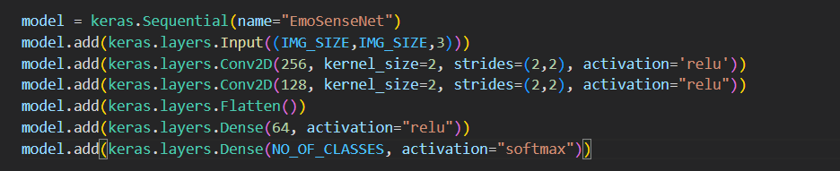
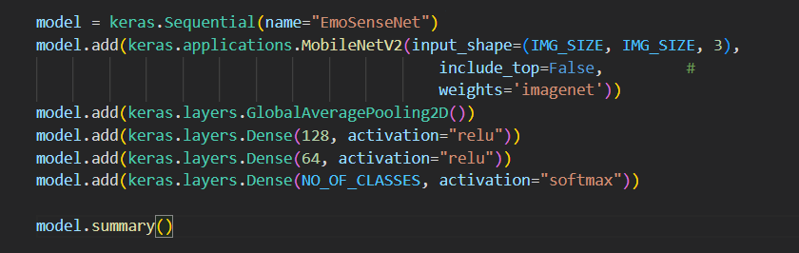
Model Selection History
OUR VERY FIRST MODEL
Mobile Net

Slide 6
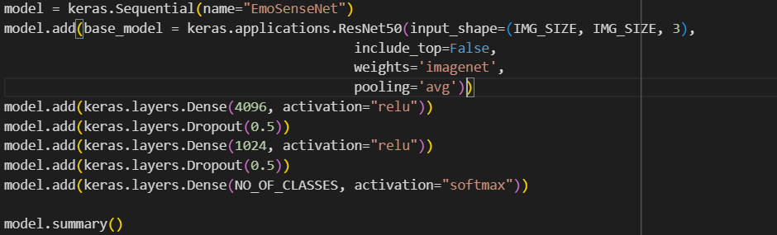
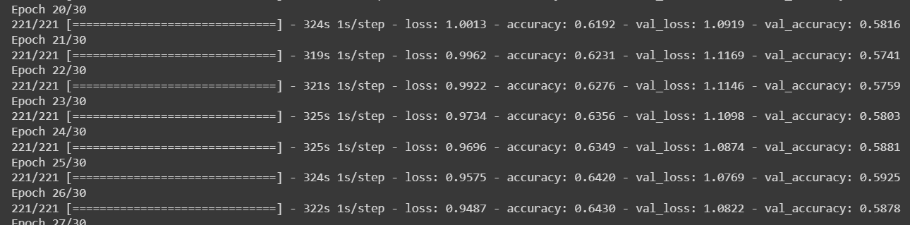
Model Selection History
ResNet50 V1

Slide 7
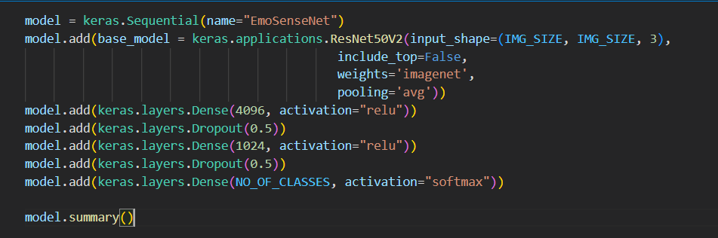
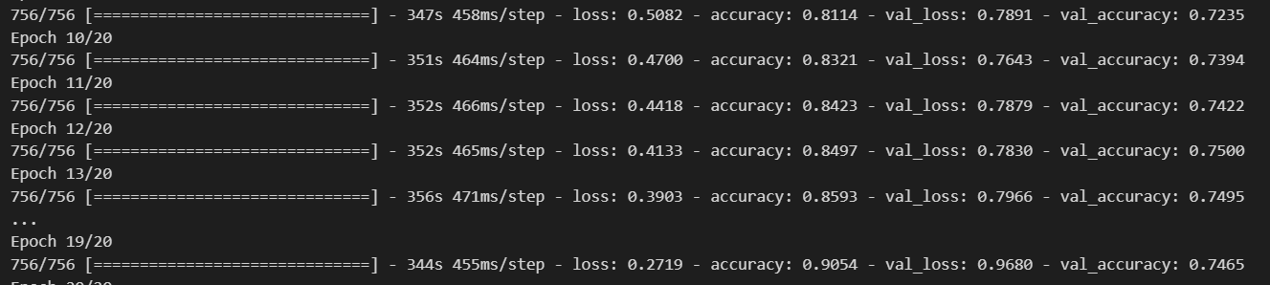
Model Selection History
ResNet 50 v2

Slide 8
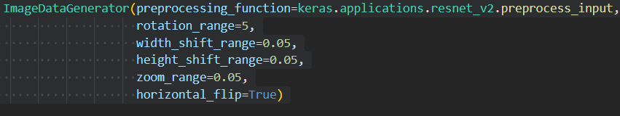
Model Training and Hyper Parameters
Learning rate = 0.001
Batch Size = 32 it generalize better
Epochs = 20
Data Augmentation Parameters

Slide 9
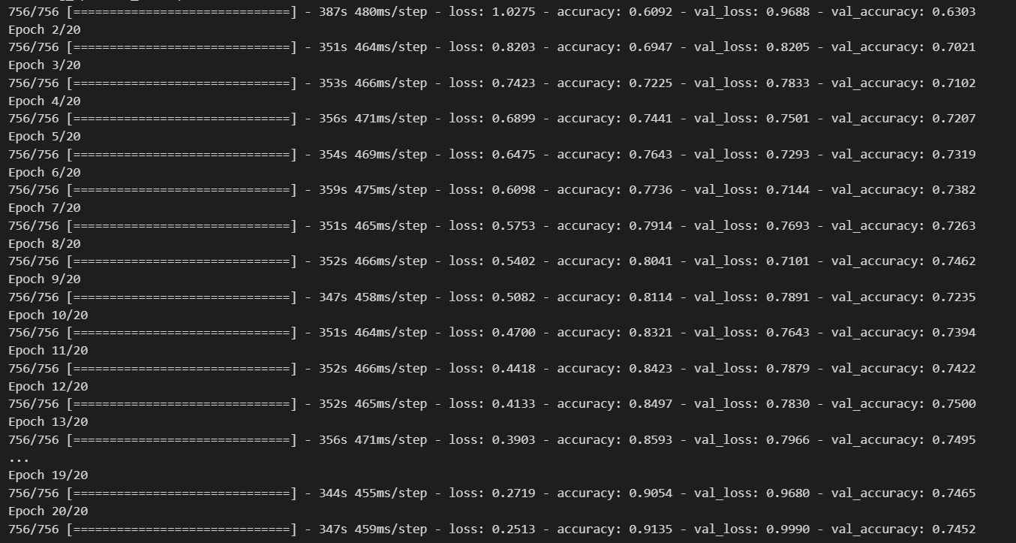
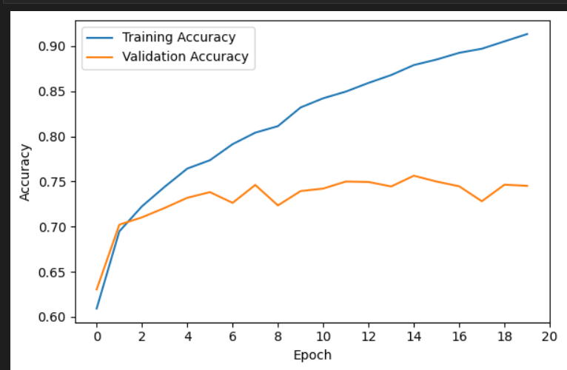
Graphs and Accuracy

Slide 10

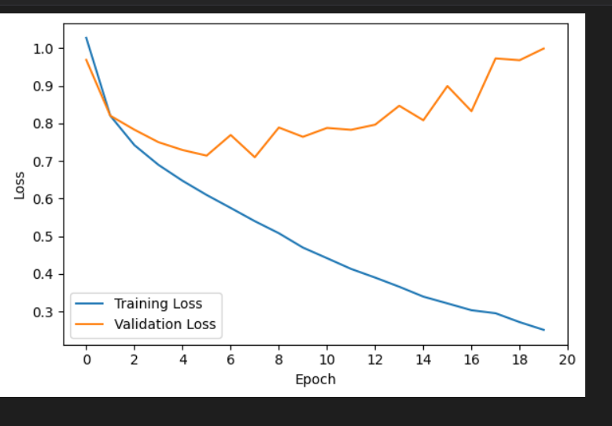
Graphs and Accuracy

Slide 11
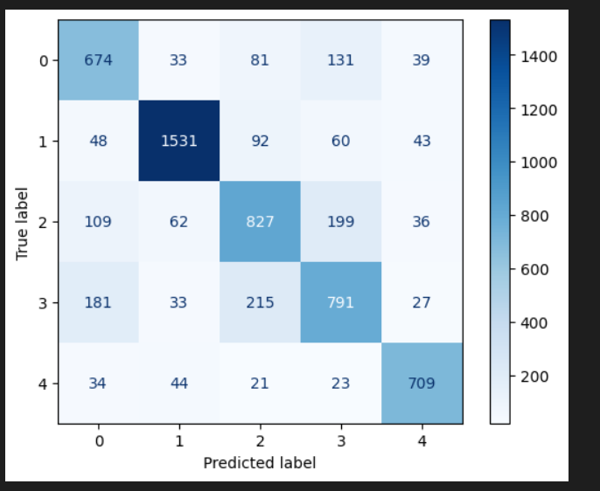
Confusion Matrix
0 | Angry
1 | Happy
2 | Neutral
3 | Sad
4 | Surprise

Slide 12
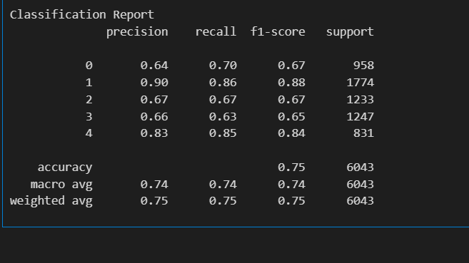
Classification Report

Slide 13




Limitation and Problem Faced
Dataset
The original FER2013 dataset have irrelevant pictures in it
The FER2013plus dataset, a cleaner version of original, has some limitation in sad and angry class
Computational Resource: Google Colab Notebook, it let us use its GPU for certain amount of time

