Slide 1
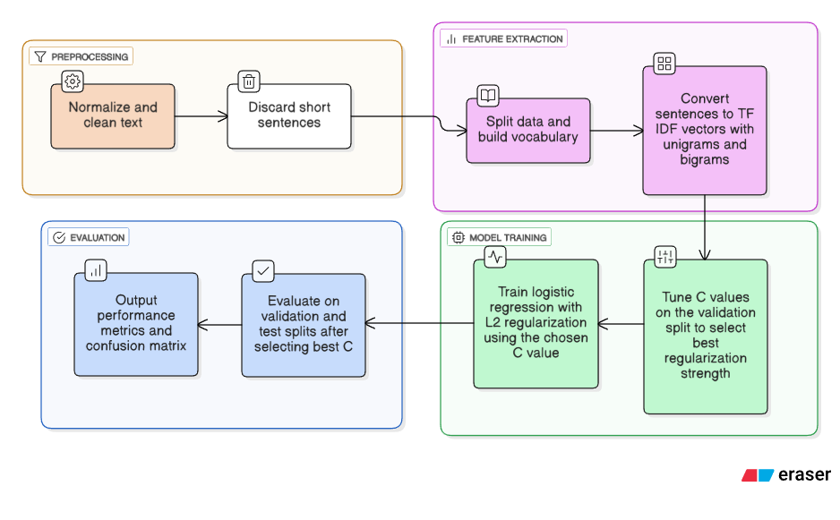
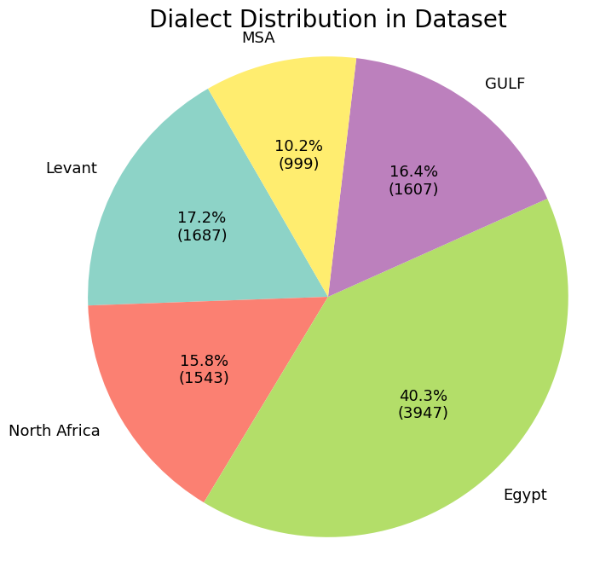
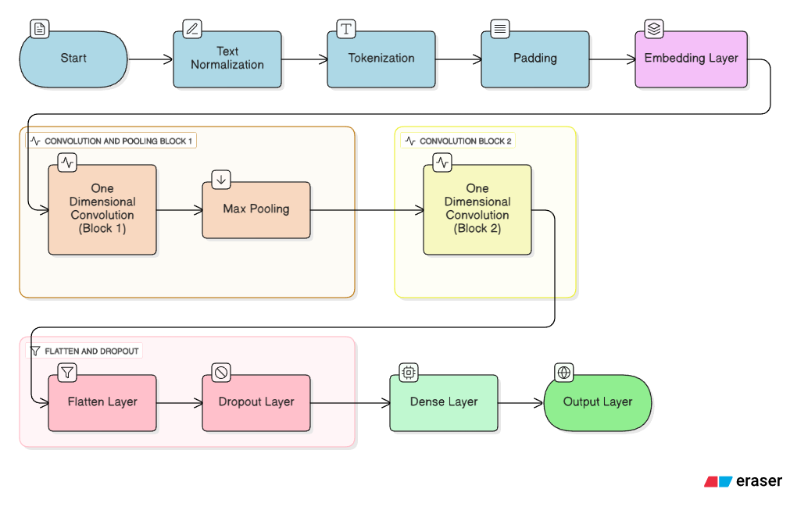
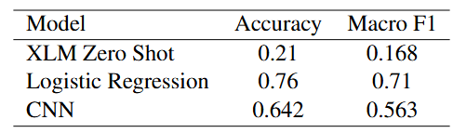
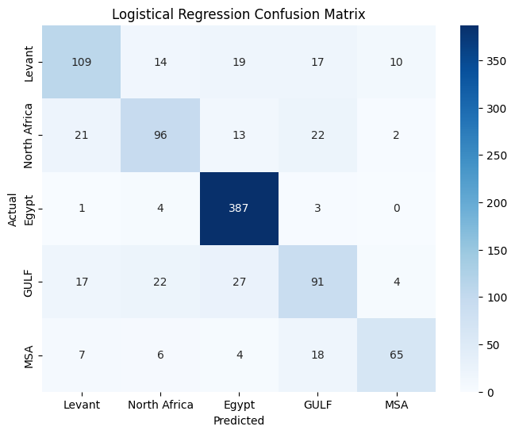
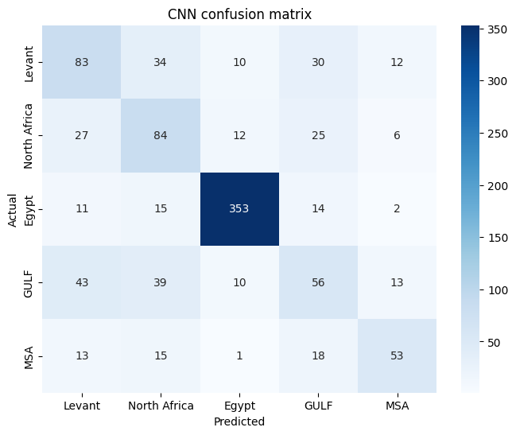
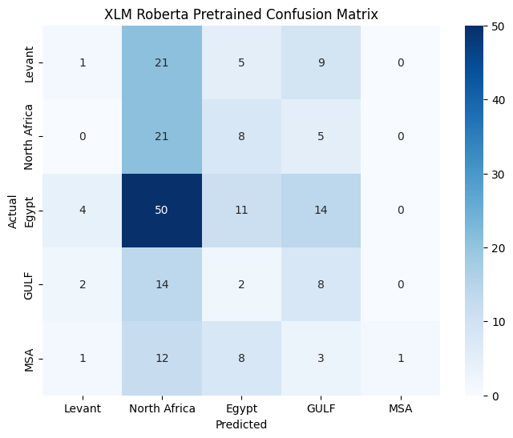




Teach a Model Arabic and Watch It Panic: A Study of Arabic Dialect Classification
Taha Alnasser, Malik Binmahfouz
Methods
Logistic regression baseline
Multi-class Convolutional Neural Network
Tokenized the text, padded each sequence to a fixed length, and converted tokens into learned embeddings
Applied one-dimensional convolution layers with sixty-four and one hundred twenty-eight filters to extract local patterns
Used ReLU activations and a max pooling layer to compress the sequence
Flattened the resulting features, added dropout, and passed them through a dense layer with two hundred fifty-six units
Trained the model with the Adam optimizer and cross entropy loss using mini batches and early stopping
Abstract
This project investigates written Arabic dialect classification across five regional varieties using three different modeling approaches. The first model is a logistic regression baseline built on TF-IDF features, providing a simple reference point for performance. The second model is a custom convolution-based neural network implemented in PyTorch that learns token embeddings and extracts local sequence patterns through one-dimensional convolutions, pooling, and fully connected layers. The third model is a zero-shot classifier based on a pretrained XLM-Roberta model that has been adapted for Arabic through multilingual Twitter data and Arabic XNLI, allowing it to assign dialect labels without any additional training. Together these models show how performance changes from classical feature-based methods to learned representations to large pretrained language models applied in a zero-shot setting.
Zero-shot XLM-Roberta Pretrained model
• Loaded a pretrained XLM-Roberta model adapted for Arabic through multilingual Twitter data and Arabic XNLI
• Used the model in evaluation mode without any additional training
• Compared each text against natural language hypotheses representing the five dialects
• Computed probabilities from the model’s entailment scores and selected the most likely dialect
• Applied this zero-shot approach to a sample of the test set for evaluation
Results
Future Work
Future work could explore a more advanced way of tokenizing Arabic sequences, since simple whitespace splitting does not capture the complexities of Arabic words. Tokenization methods such as subword tokenization could help the model learn better, richer patterns. Another direction would be to expand the dataset, as the current size of ten thousand sentences for five dialects limits the neural network from generalizing.
Acknowledgements
Ai co-pilot for Technical Design. Eraser. (n.d.). https://app.eraser.io/
Morit, H. U. (2021). Xlm-roberta-base xnli arabic model. https://huggingface.co/morit/ arabic_xlm_xnli. Pretrained model for zero shot text classification fine tuned on Arabic XNLI data.

