Slide 1

PIZZA ORDERING SYSTEM
College Logo
Here
Avishek Majhi,Ankur Kasyap, Chetan Kumar,Prakash Kumar &Taha Kasim Saifee

Slide 2
Table of Contents
ABSTRACT
INTRODUCTION
SYSTEM REQUIREMENTS
Hardware Requirement Specification
Software Requirement Specification
Use CASE Diagram/E-R Diagram/Data Flow Diagram
Screen Shots
Test Cases
Future Scope
Conclusion
References

Slide 3
ABSTRACT
The project planned to automate "Pizza Ordering System" is a Web application intended to be used by user for ordering of pizza. The ordering mechanism is fairly easy as the system becomes computerized.

Slide 4
INTRODUCTION
The system interacts to the users (customer, admin) by means of some front-end form. To enter the system a signin form will appear where userIDand Password for both Admins and for the Customers will have to be entered to log into the system and then this will check the Type of that user. According to type the System is loaded.
After signin, customers enters into their profile. Customer can check the pizza menu and order it.
After signin,admin can enter into its profile. Admin can view the Food list, Order List and Store List.Admin can also update/modify/add the details of Pizza and Store. New users must have to register before signin. Every stage data is stored in the database. This is why the system is very easy to use and every user can accept the system by thinking its utility in present and by applying the idea of Prototyping Model the system can be developed with more features in future.

Slide 5
SYSTEM REQUIREMENTS
Software Requirements
Adobe DreamweaverCS6
WAMP Packages
MS Office
Dia Tools

Slide 6
SYSTEM REQUIREMENTS
Hardware Requirements
Client Machine
Harddisk 200MB
Pentium 4 or newer processor that supports SSE2
512MB Memory
Server Machine
Harddisk 320GB
Dual core or newer processor
2GB Memory

Slide 7
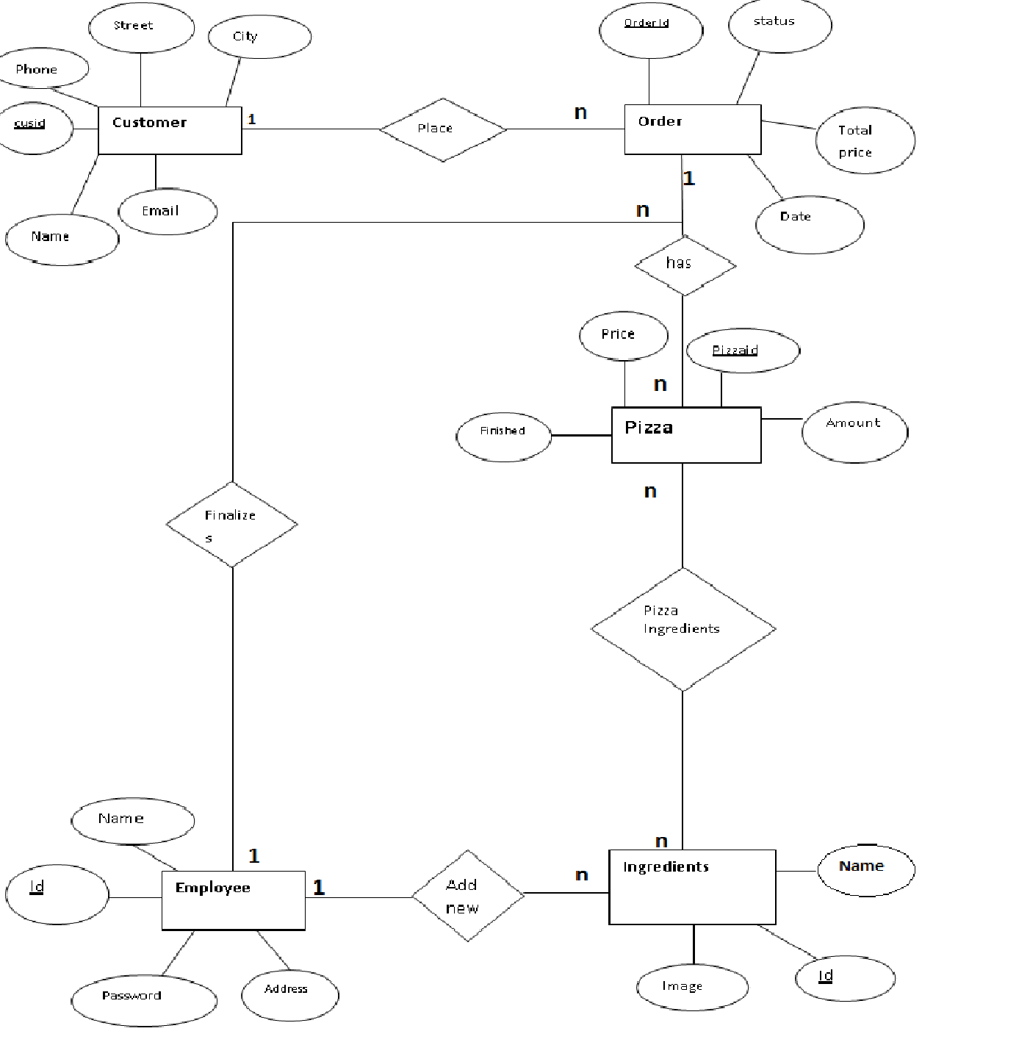
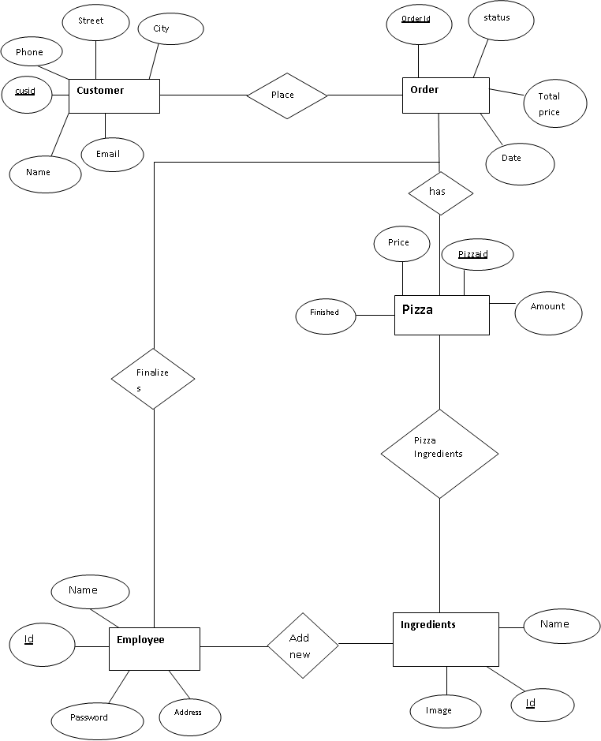
E-R DIAGRAM

Slide 8
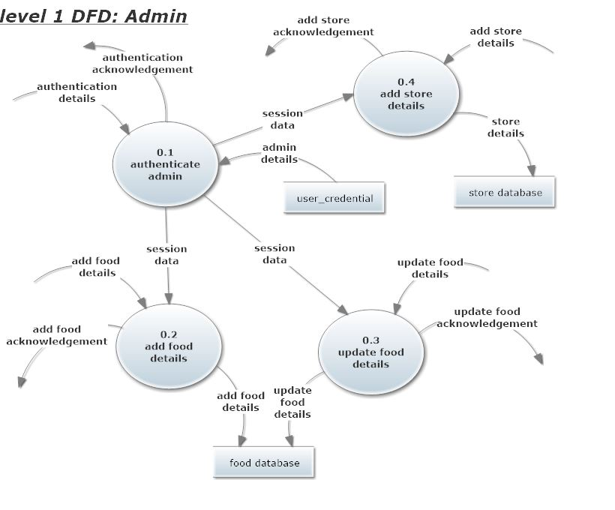
DATA FLOW DIAGRAM

Slide 10
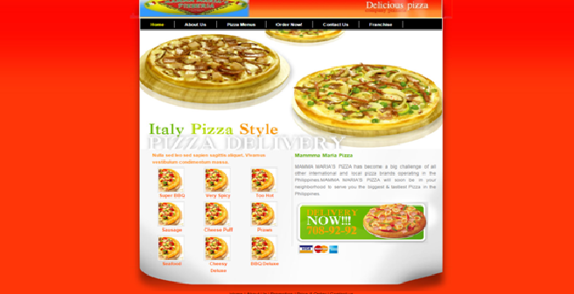
SCREENSHOTS
HOME PAGE

Slide 11
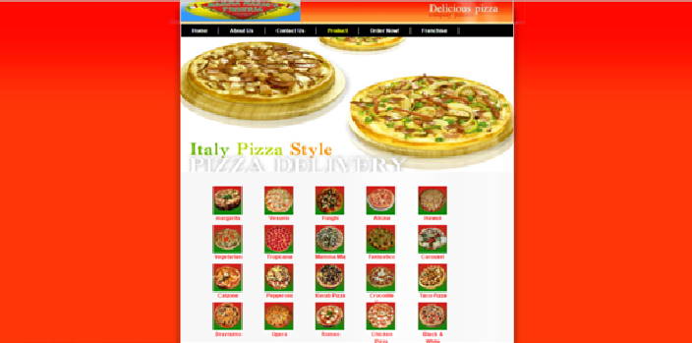
MENU PAGE

Slide 12
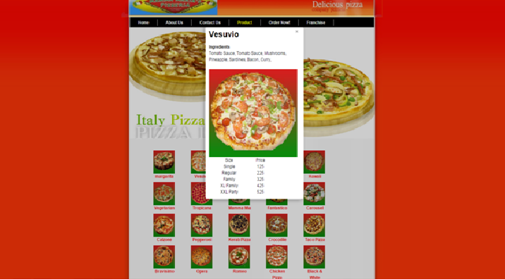
MENU PAGE

Slide 13
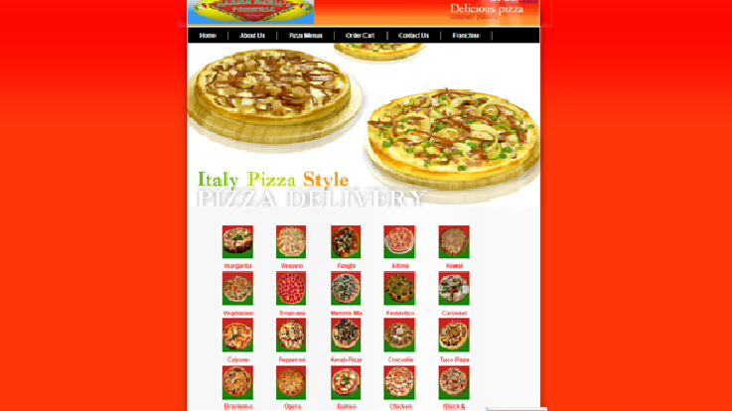
ORDER PAGE

Slide 14
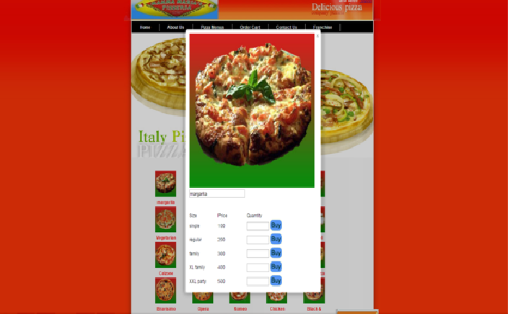
ORDER PAGE

Slide 15
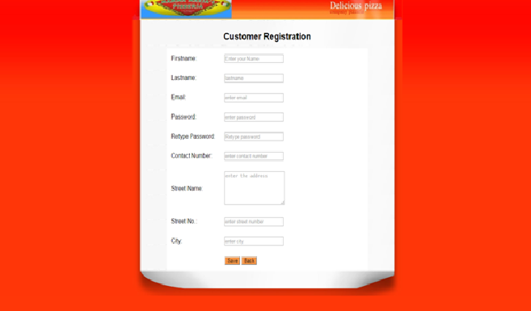
REGISTRATION PAGE

Slide 16
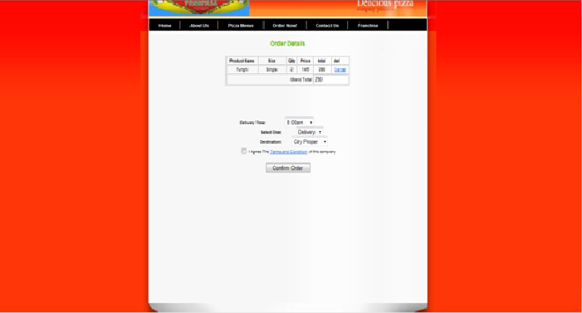
PURCHASE CART

Slide 17
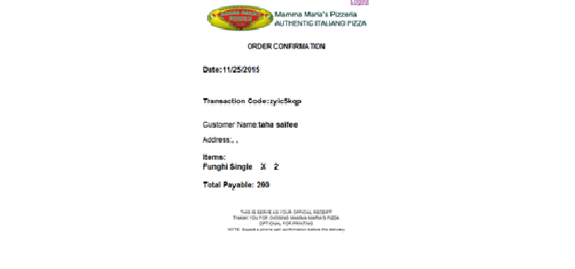
Confirmation Page

Slide 18
TEST CASES
Tested By : Avishek Majhi and Prakash Kumar
Test Type : Mysql Testing
Test Case Number : 1
Test Case Name : User Identification
Test Case Description : The user should enter his/ her accurate userid and password so that he/she can able to go for the further options. The test case will check the application for the same since a user can only login with the correct userid, password.
Item(s) to be tested : 1
Specifications : Verification of the userid and password with the record in the database.
Output/Result : Correct User id and password , Incorrect Id or Password , Successful login & Failure Message

Slide 19
FUTURE SCOPE
Pizza ordering system has lot of enhancement options. In future documents may be classified category wise. It may try to analyze the user behavior and preference and accordingly suggest document categories.

Slide 20
CONCLUSION
This new system is surely to benefit the user and let the user order the pizza in a much faster and efficient way.

Slide 21
REFERENCE
W3school.com
Mysql
PHP by Khanna

