Slide 1
Fakebook
https://github.com/Taha-cmd/Fakebook

Slide 2
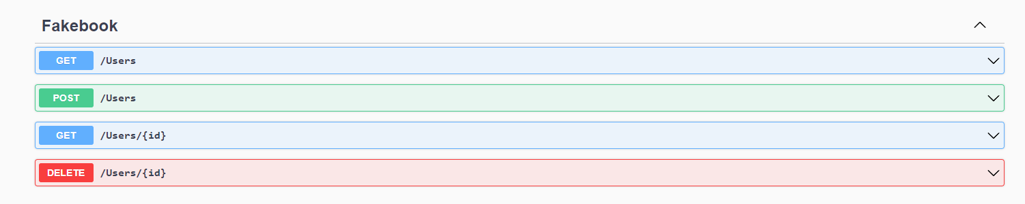
OpenAPI Contract

Slide 3
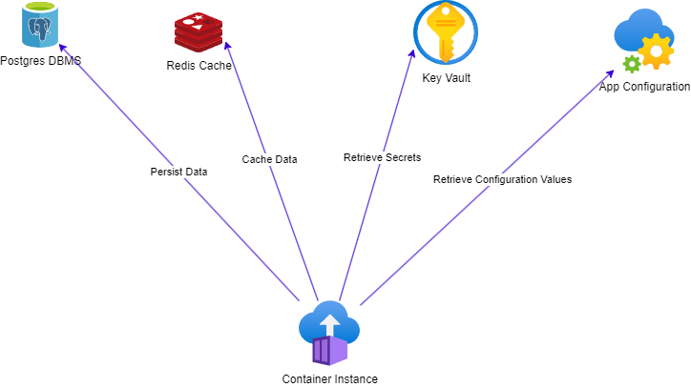
System Architecture

Slide 4
Security Challanges
Each used cloud service is a target for attackers: more services -> bigger attack surface
Two common challanges when dealing with distributed cloud services:
Firewall & Networking (out of scope for this project)
Authentication & Authorization (focus of this project)

Slide 5
Authentication & Authorization
How do the services talk to each other?
Anonymous access -> security nightmare
With admin credentials -> bad idea
With dedicated user credentials with limited permissions -> better
With dedicated user with limited permissions using Azure AD authentication -> even better
Best secret management is having no secrets at all

Slide 6
Azure AD authentication (the happy path)
Give your app a managed identity
Assign the identity the right roles over the right scope
Optional: Disable password authentication (or access keys)
In Application Code: Use the Azure Identity SDK
In C#: Azure.Identity Nuget Package
The Azure Identity library can read credentials from different sources

Slide 7
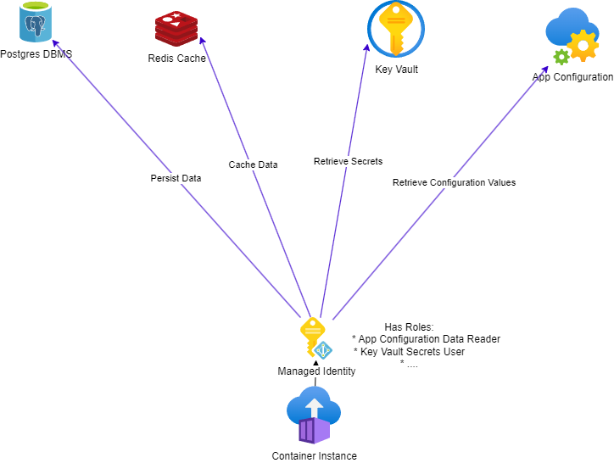
Refined System Architecture

Slide 8
Demo
See code

