Slide 1


MindEase
MindEase
Mental Health Support App Prototype for Students Using Figma / Stitch
COURSE & INSTRUCTOR
GROUP MEMBERS
Technical and Business Writing (TBW)
Taha Ahmed 23K-0534
Furqan Halari 23K-0556
Ms. Nazia Imam
Mirza Sarim Ali Baig 23K-0048
Umar bin Abid 23K-0009
FAST National University of Computer and Emerging Sciences — Karachi Campus
Tuaha Ahmed 23K-0713
Sobaan Nayaar 23K-0893
MAY 2026

Slide 2
CONTENTS
Table of Contents
1.0
Introduction & Problem Statement
1.1
Literature Review
2.0
Methodology
3.0
Findings & Discussion
4.0
Conclusion
4.1
Recommendations
—
References
MINDEASE · TBW RESEARCH
02 / 28

Slide 3
OVERVIEW
Abstract
19
This study investigates the mental health needs of university students at FAST-NUCES Karachi and proposes a digital solution in the form of a mobile application prototype. A survey of 19 students revealed that 94.7% experience stress, yet 89.5% use no mental health app. Key barriers include stigma, lack of culturally relevant tools, and poor app usability. Using a User-Centered Design approach, a high-fidelity prototype called MindEase was developed in Stitch — comprising 9 screens designed to be anonymous, culturally relevant, and visually simple.
Students surveyed at FAST-NUCES Karachi
9
High-fidelity screens designed in Stitch
UCD
User-Centered Design methodology
MINDEASE · TBW RESEARCH
03 / 28

Slide 4

1.0
Introduction
Understanding the problem before designing the solution

Slide 5
1.0 · THE PROBLEM
Stress is loud. The places to talk about it are quiet.
01
02
03
04
94%
89%
57%
84%
of students report experiencing stress regularly
currently use no mental health application
prefer to self-manage instead of seeking help
cite career uncertainty as their top stressor
MINDEASE · TBW RESEARCH
05 / 28

Slide 6
1.0 · PROBLEM STATEMENT
A research question and four objectives.
RESEARCH QUESTION
Existing mental health apps often lack simplicity and student-focused features, leading to low engagement. How can a mental health support application be designed using Figma / Stitch to improve usability and accessibility for students?
1
Identify key mental health needs of university students
2
Design a low-fidelity wireframe of the application
3
Develop a high-fidelity interactive prototype
4
Evaluate usability through structured user feedback
MINDEASE · TBW RESEARCH
06 / 28

Slide 7
1.1
Literature Review
What research tells us about student mental health and digital solutions

Slide 8
1.1 · LITERATURE REVIEW
Mental health challenges in university students.
The Struggle
Why Students Stay Silent
Academic workload and deadlines
Social isolation and adjustment
Competitive academic environments
Fear of judgment and stigma
Limited access to counseling services
Cultural stigma around mental health
Lack of awareness of available resources
Trust issues with support systems
Fear of being judged or labeled
MINDEASE · TBW RESEARCH
08 / 28

Slide 9
1.1 · LITERATURE REVIEW
Digital solutions & design principles.
01
02
03
M
H
U
mHealth Apps
HCI Principles
User-Centered Design
Mood tracking, journaling, and guided exercises available anytime, anywhere. Research shows measurable reductions in anxiety symptoms across student populations.
Simplicity, clarity, and reduced cognitive load. Interfaces in this domain must be supportive, intuitive, and non-intimidating to users in vulnerable states.
Continuous feedback and iteration. User comfort and emotional safety are critical factors in any tool that asks people to share what they are feeling.
MINDEASE · TBW RESEARCH
09 / 28

Slide 10
1.1 · LITERATURE REVIEW
Why Stitch for prototyping?
01
02
03
04
05
Rapid prototyping
Iterative design
Real-time collaboration
Catches flaws early
Cost-effective
Adjust quickly based on real user feedback.
Right-sized for student-led research projects.
Build interactive screens without writing code.
Whole team contributes from any device.
Surfaces design problems before development begins.
MINDEASE · TBW RESEARCH
10 / 28

Slide 11
2.0
Methodology
How we conducted our research

Slide 12
2.0 · METHODOLOGY
Research methodology.
1
2
3
4
5
User Research
Data Analysis
Wireframing
Prototyping
Evaluation
Survey of 19 students conducted via Google Forms.
Combined quantitative and qualitative coding.
Low-fidelity layouts for core flows.
Nine high-fidelity screens designed in Stitch.
Structured usability feedback and review.
TOOL
SAMPLE
METHOD
Google Forms + Stitch
19 FAST-NUCES students
Mixed (survey + open-ended)
MINDEASE · TBW RESEARCH
12 / 28

Slide 13
3.0
Findings & Discussion
What 19 students told us

Slide 14
3.0 · FINDINGS
Who we surveyed.
3rd or 4th year students
84%
19
Engineering / Computer Science
95%
Total respondents — all from FAST-NUCES Karachi
FAST-NUCES Karachi campus
100%
13 male
6 female
Recruited via Google Forms
19 / 19
MINDEASE · TBW RESEARCH
14 / 28

Slide 15
3.0 · FINDINGS
Stress is universal among students.
How often students feel stressed
Top causes of stress (n=19)
1
3
7
4
4
Career uncertainty
16 · 84%
Never
Academic workload
13 · 68%
Family expectations
7 · 37%
Rarely
Financial pressure
5 · 26%
Often
Always
Social relationships
2 · 11%
Sometimes
MINDEASE · TBW RESEARCH
15 / 28

Slide 16
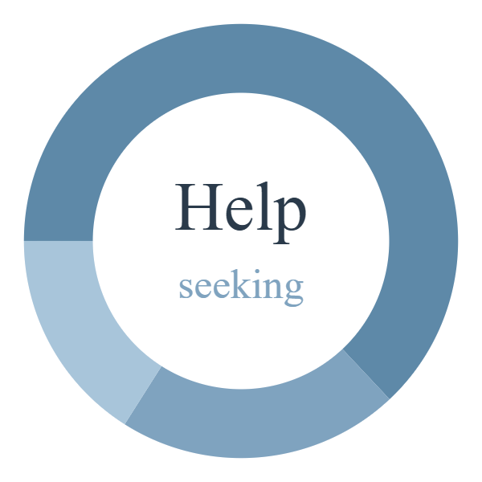
3.0 · FINDINGS
The design gap.
89.5%
currently use no mental health app
Never sought help
63%
Wanted to but didn't
21%
MAIN BARRIERS
Sought help
16%
Preferred self-management
57%
Did not know where to go
21%
Too expensive
16%
Fear of stigma
5%
MINDEASE · TBW RESEARCH
16 / 28

Slide 17
3.0 · FINDINGS
What students actually want.
LOWER = MORE WANTED
ANONYMITY PREFERENCE
FEATURE
AVG RANK
42%
37%
21%
Progress Tracker & Reminders
2.89
Anonymous
Personalized
Either
Journaling / Daily Diary
3.00
Mood Tracking
3.21
UI EASE OF USE
Emergency Contact / Crisis Support
3.21
100%
Mental Health Resources & Articles
3.47
said an easy UI is important or extremely important
Guided Relaxation & Breathing
3.53
MINDEASE · TBW RESEARCH
17 / 28

Slide 18
3.0 · FINDINGS
What students said — in their own words.
“
“
ANONYMITY
GENERIC CONTENT
I often feel like I don't have an outlet or someone who could hear me out without judgment.
Generic solutions, no room for exclusivity. Having to re-explain my situation every time.
“
“
CULTURAL RELEVANCE
NORMALIZATION
If it keeps sending motivational quotes — or Quranic verses or Hadiths.
No one wants to feel special — they just want to feel normal.
MINDEASE · TBW RESEARCH
18 / 28

Slide 19
MindEase
The Prototype
Nine high-fidelity screens designed for Pakistani university students

Slide 20
PROTOTYPE
Design system.
COLOR PALETTE
TYPOGRAPHY
TIMES NEW ROMAN
Breathe with the circle.
Headlines · journal body · quotes
Mist
Sky
Stillwater
Deepwater
Ink
#EEF2F7
#A8C5DA
#7FA3BF
#5E89A8
#2A3A4A
ACCENTS
CALIBRI / INTER
Check in · Breathe · Journal
UI labels · buttons · navigation
VOICE
A quiet place for the mind — built for university students, between classes and everything else.
Mint
Lavender
Sand
#B7D4C7
#C9C2DD
#E5D9C3
PRINCIPLES
Flat and calm — no gradients, no textures
Anonymous by default
Culturally relevant content
Two-minute friendly interactions
MINDEASE · TBW RESEARCH
20 / 28

Slide 21
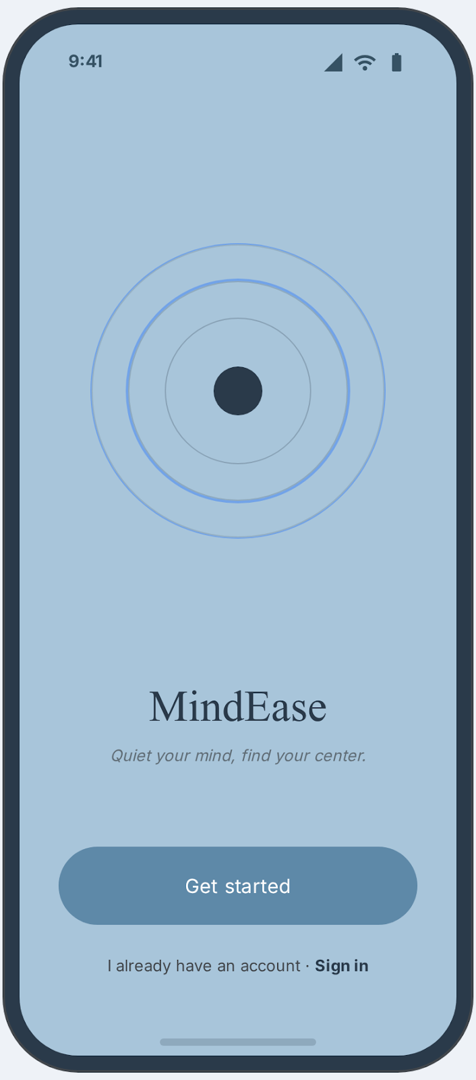
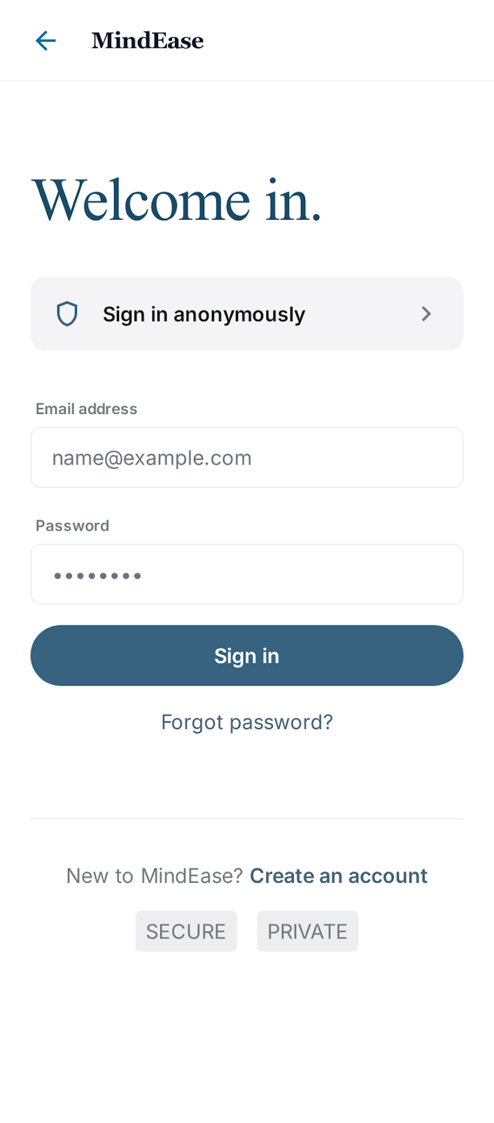
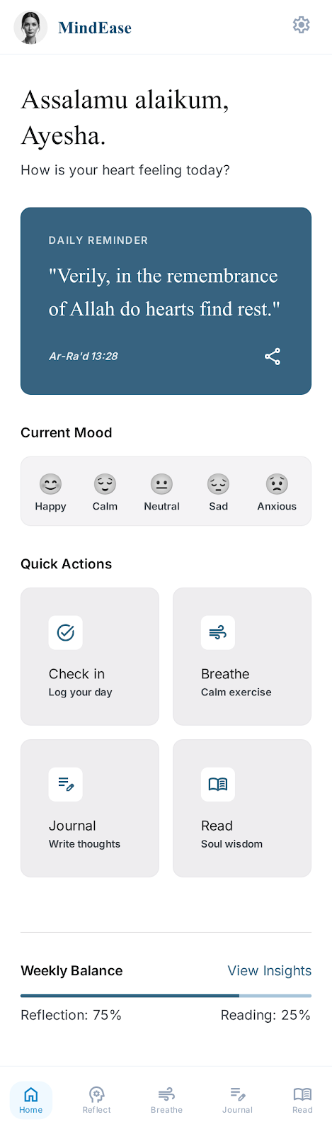
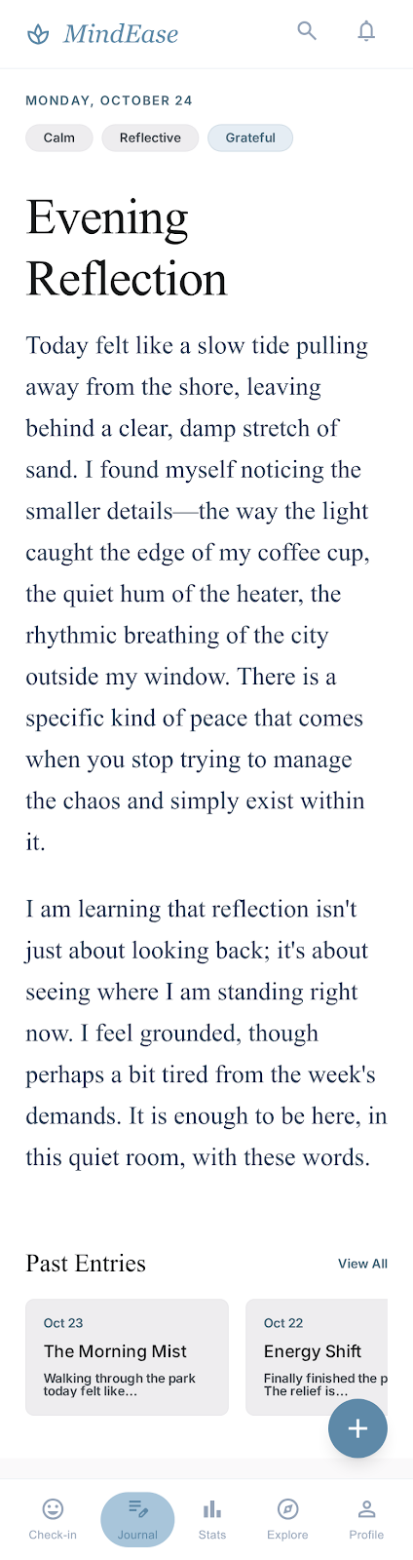
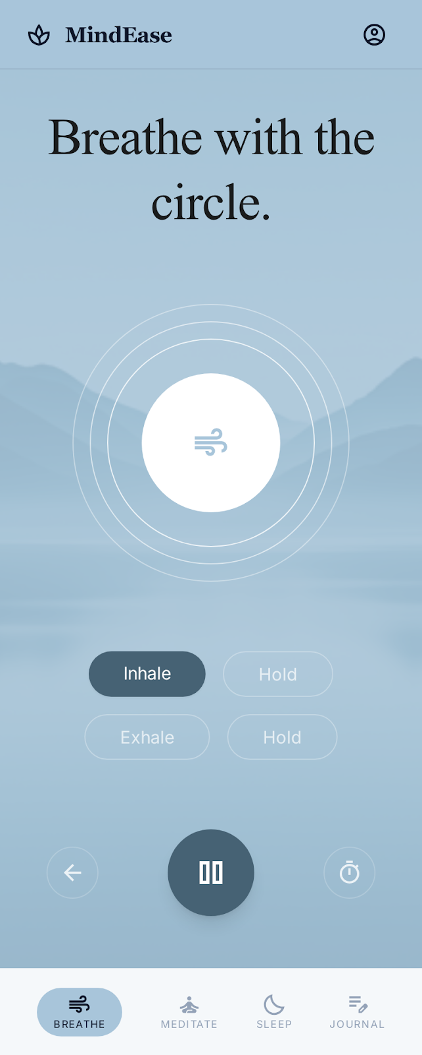
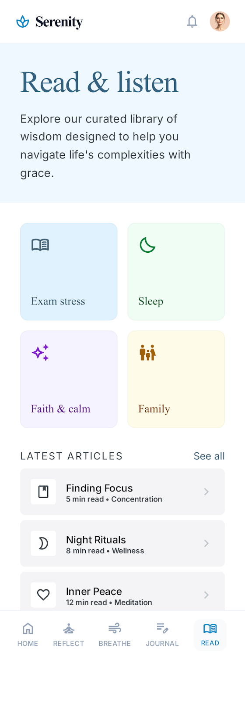
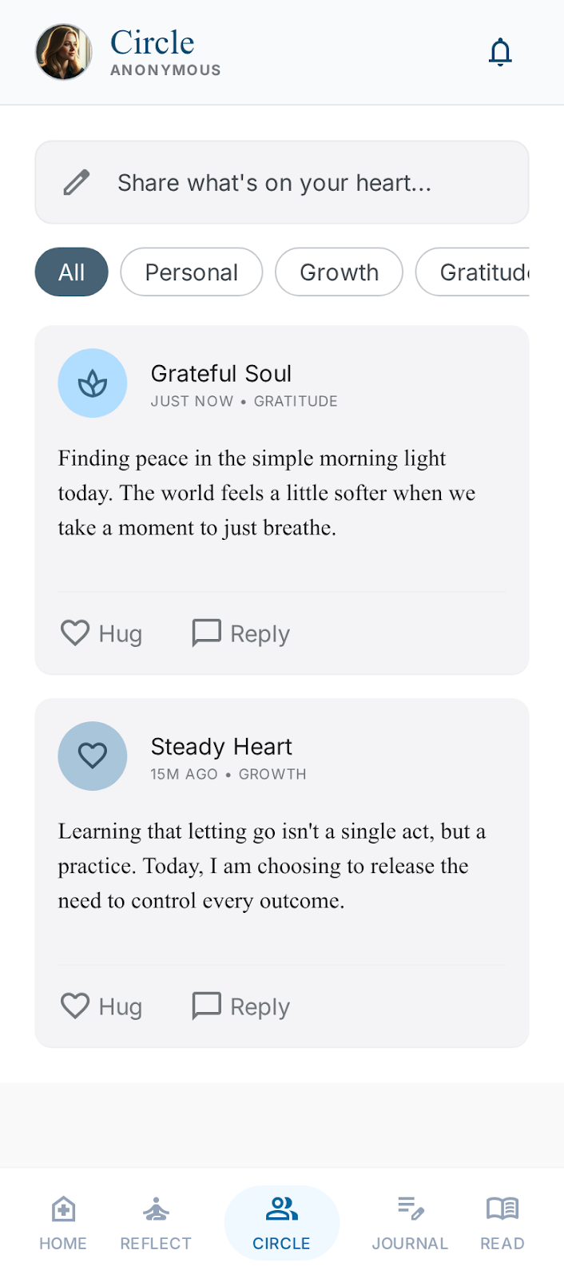
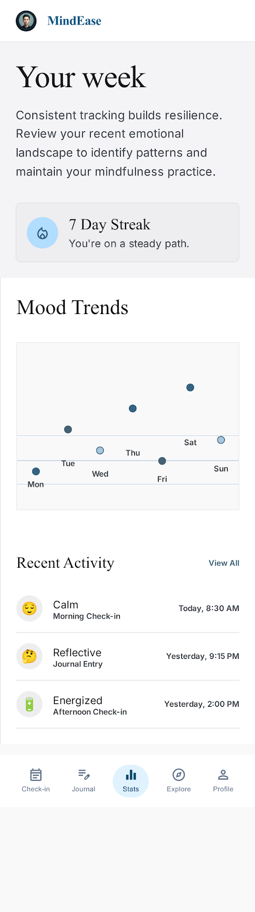
PROTOTYPE
Screens at a glance.
MINDEASE · TBW RESEARCH
21 / 28
Welcome
Sign In
Home
Journal
Breathe
Resources
Circle
Progress

Slide 22
PROTOTYPE · PART 1
Core screens.
MINDEASE · TBW RESEARCH
22 / 28
Welcome
Sign In
Home
First impression — concentric rings, quiet entry into the app.
Anonymous-first approach with clear secondary login.
Greeting, daily reminder, mood check, quick action tiles.

Slide 23
PROTOTYPE · PART 2
Feature screens.
MINDEASE · TBW RESEARCH
23 / 28
Journal
Breathe
Circle
Times New Roman body, tag chips, past-entries shelf.
Full blue background, animated breathing circle.
Anonymous community, peer hugs and replies.

Slide 24
4.0
Conclusion
What we achieved and what comes next

Slide 25
4.0 · CONCLUSION
Conclusion.
This research identified a significant unmet need for a student-centered mental health application at FAST-NUCES. The data confirmed a gap between the demand for support and the supply of usable, culturally grounded tools. MindEase is the first response to that gap.
94.7% of students experience stress, but 89.5% use no mental health app.
A clear design gap — demand exists, supply is inadequate.
MindEase prototype directly addresses identified student needs.
Anonymity, cultural relevance, and simplicity are non-negotiable.
The prototype is the foundation for future full development.
MINDEASE · TBW RESEARCH
25 / 28

Slide 26
4.1 · RECOMMENDATIONS
Where MindEase goes next.
1
2
Full Development
Expand Research
Convert the prototype into a functional application with backend integration, secure storage, and account anonymity preserved end-to-end.
Conduct usability testing with a larger and more diverse student sample across multiple campuses and faculties.
3
4
Cultural Expansion
Institutional Partnership
Add Urdu language support and broaden the Islamic content library so daily reminders reflect the user's tradition.
Collaborate with the FAST counseling department to surface verified resources and an in-app pathway to professional support.
MINDEASE · TBW RESEARCH
26 / 28

Slide 27
REFERENCES
References.
[1]
Lattie et al. (2020). Digital mental health interventions for college students. JMIR Mental Health , 7(7), e15988.
[2]
Chan & Honey (2022). User perceptions of mental health apps. Journal of Psychiatric Nursing , 29(3), 440–451.
[3]
Nieto-Riveiro et al. (2020). Technologies and co-design. JMIR mHealth and uHealth , 8(2), e14214.
[4]
Farao et al. (2020). A user-centred design framework for mHealth. PLOS ONE , 15(8), e0237910.
[5]
Bautista & Schueller (2023). Digital mental health usage among students. JMIR Mental Health .
[6]
Koumpouros (2022). Digital tools in healthcare design. Technologies.
[7]
Vial et al. (2022). Human-centered design in mental health. JMIR Mental Health.
[8]
Saparamadu et al. (2021). User-centered design process. JMIR mHealth.
MINDEASE · TBW RESEARCH
27 / 28

Slide 28

Thank you.
Questions & discussion.
MINDEASE · TBW · MAY 2026
A quiet place for the mind — built for university students, between classes and everything else.
Taha Ahmed 23K-0534
Furqan Halari 23K-0556
Mirza Sarim Ali Baig 23K-0048
Umar bin Abid 23K-0009
Tuaha Ahmed 23K-0713
Sobaan Nayaar 23K-0893

