Slide 1

CINESTOP
"Bringing Stories to Life with Cinematic Excellence."
PRESENTED BY:
TAHA (2512363)
MUHAMMAD YOUSUF (2512374)

Slide 2

Introduction - CINESTOP
CINESTOP is a modern, user-friendly digital platform that enables users to explore and discover movies and TV shows across a wide range of genres. The website presents well-structured content, including detailed descriptions, genre classifications, and ratings, helping users make informed viewing decisions.
Key Points:
Modern and user-friendly movie & TV show platform
Designed as a one-stop entertainment destination
Simple, clear, and cinematic browsing experience
Detailed descriptions and genre-based classification

Slide 3
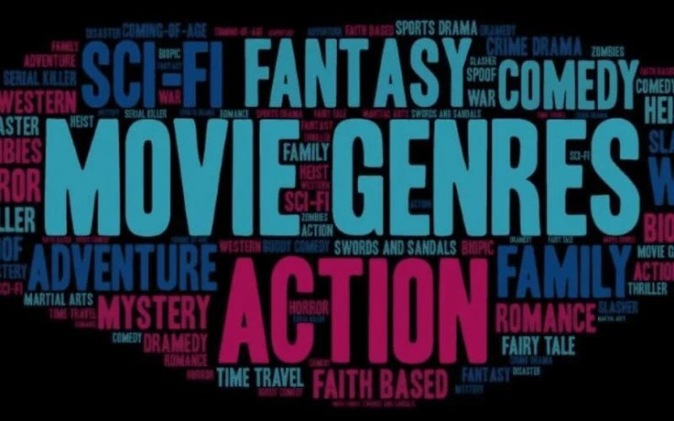
Genres
Genres play a vital role in organizing movies and TV shows by their storytelling style and themes. CINESTOP categorizes content into clearly defined genres, allowing users to easily explore entertainment based on their interests, mood, and preferences.
Key Points:
Action
Comedy
Adventure
Horror
Thriller
Drama
Science Fiction
Animation

Slide 4



Genre - Action
Action Genres
Example
Fast-paced and high-energy storytelling
Focuses on physical feats, stunts, and intense sequences
Common elements: fights, chases, explosions
Appeals to thrill-seeking audiences
Fast and Furious
Jawan
Avengers

Slide 5



Genre - Adventure
Adventure Genres
Example
Focuses on exploration and journeys
Includes quests, discoveries, and survival
Often set in exotic or imaginary locations
Combines excitement with storytelling
HTTY Dragon 3
King Kong
Jurassic World

Slide 6
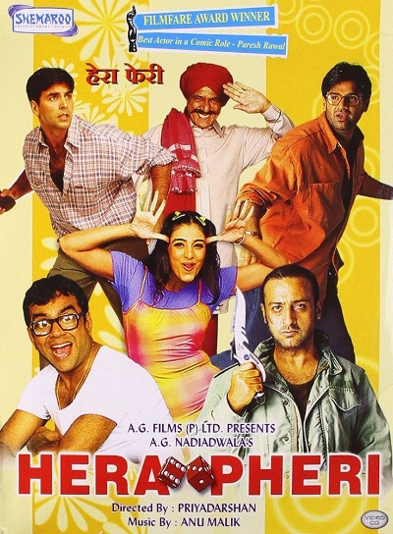


Genre - Comedy
Comedy Genres
Example
Designed to entertain and amuse audiences
Uses humor, satire, and exaggerated situations
Can be situational, romantic, or dark comedy
Often light-hearted and relatable
Hera Pheri
Home Alone
Golmaal

Slide 7



Genre - Horror
Horror Genres
Example
Aims to create fear and suspense
Uses eerie atmosphere and tension
Common themes include the supernatural and psychological fear
Strong emotional impact on viewers
Sinister
The Ring
Tumbbad

Slide 8



Genre - Thriller
Thriller Genres
Example
Builds tension and suspense
Involves mystery, crime, or psychological elements
Keeps viewers guessing until the end
Often includes plot twists
Oppenheimer
The Family Man
Alice In Borderland

Slide 9



Genre - Drama
Drama Genres
Example
Focuses on emotional and realistic storytelling
Explores relationships and personal struggles
Strong character development
Often inspired by real-life situations
Khuda Kay Liye
Kota Factory
Bol

Slide 10
Key Features of CINESTOP
Ratings & Reviews Section
User-Friendly Navigation
Data & Visualization
Builds trust
Helps compare content easily
Improves user decision-making
Clear menus
Organized layout
Easy browsing experience
Genre distribution charts
Proper Visual Representations
Average rating comparisons

Slide 11
Visual Representation
Line-Chart:

Slide 12
Visual Representation
Pie-Chart:

Slide 13

Conclusion
CINESTOP successfully demonstrates how digital tools can be used to organize and present entertainment content in a clear and engaging manner. By combining structured genres, reliable ratings, and a user-friendly interface, the platform enhances the overall movie discovery experience.
This project reflects effective use of technical skills, creativity, and thoughtful design, making CINESTOP a valuable and practical entertainment catalogue.

