Slide 1


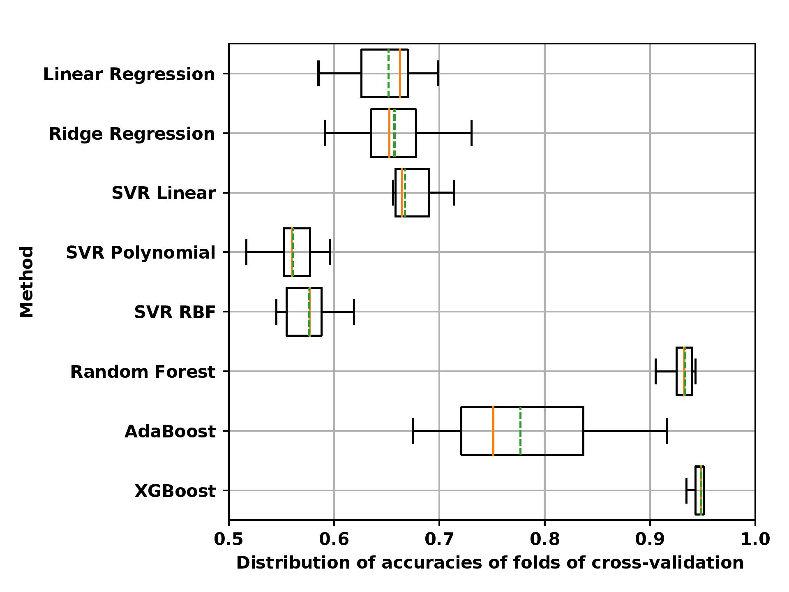
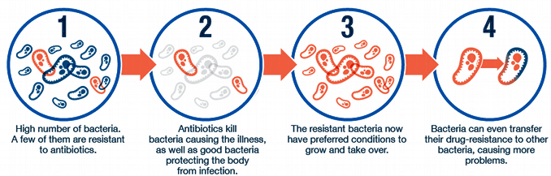
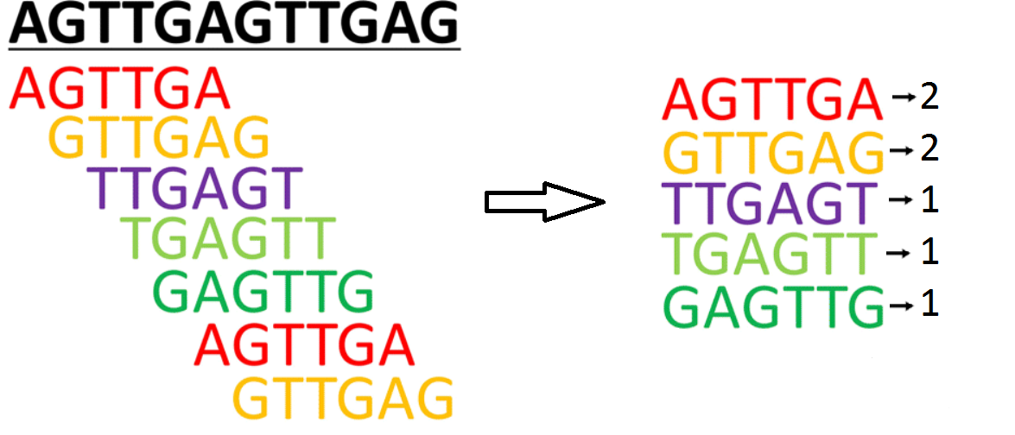
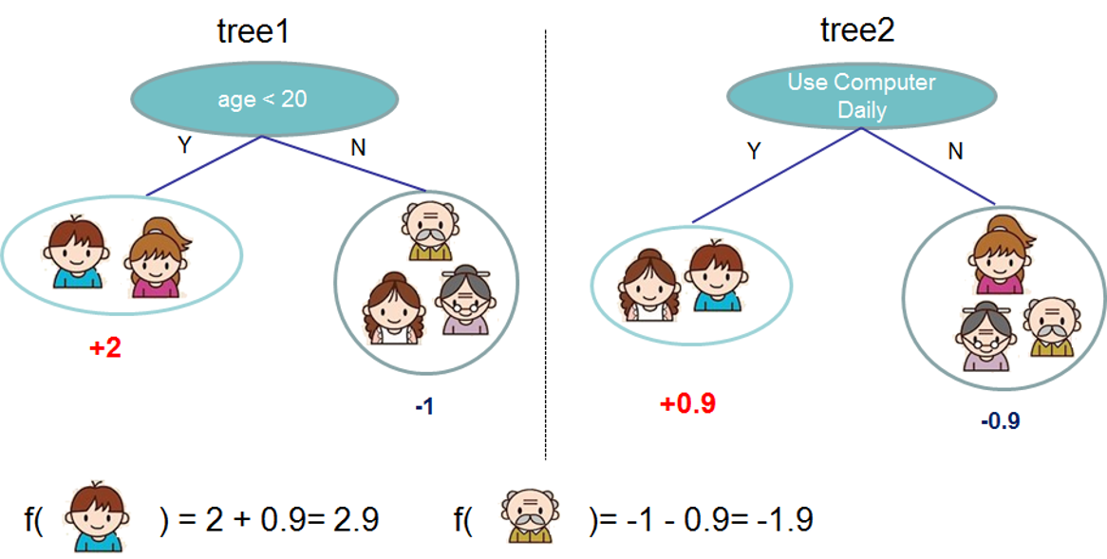
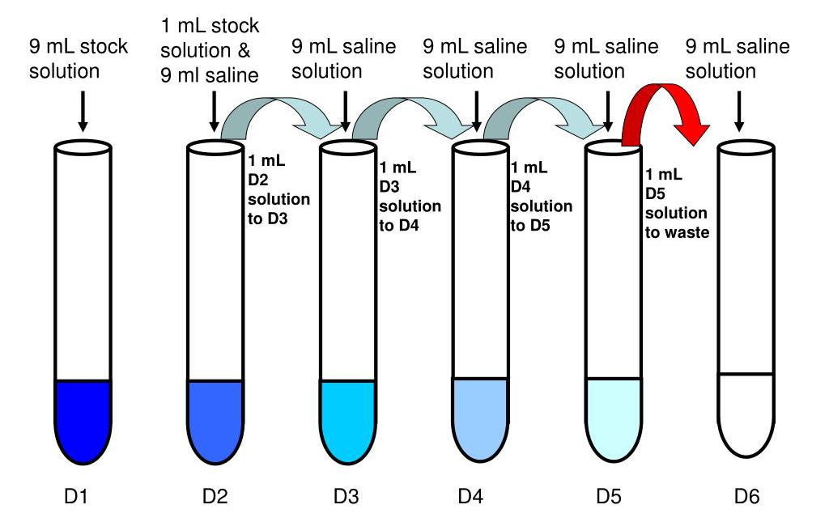
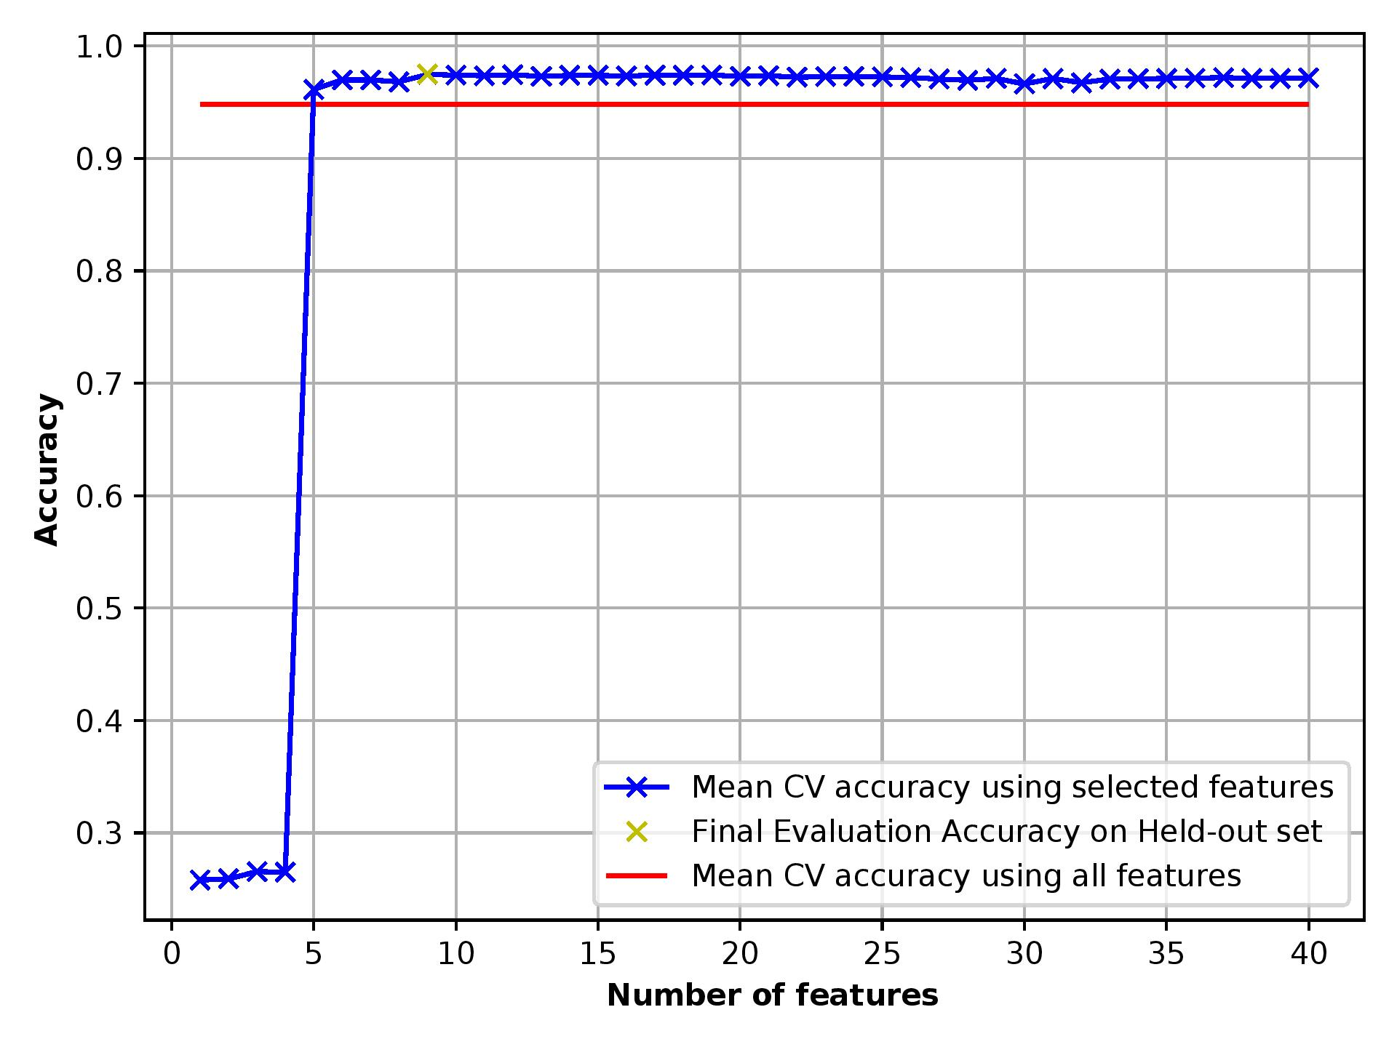
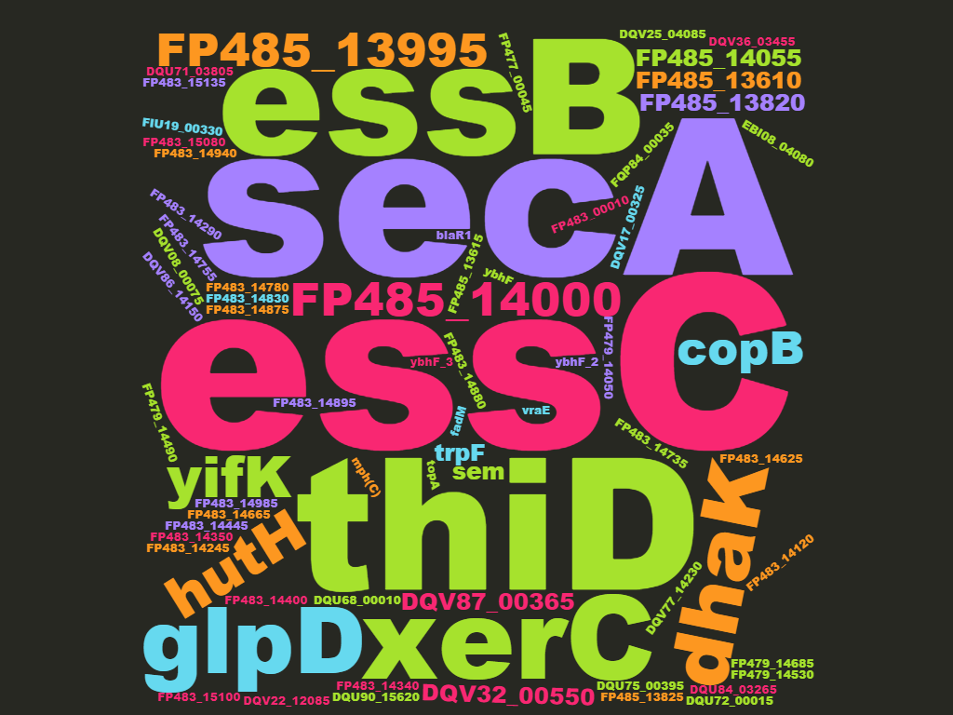
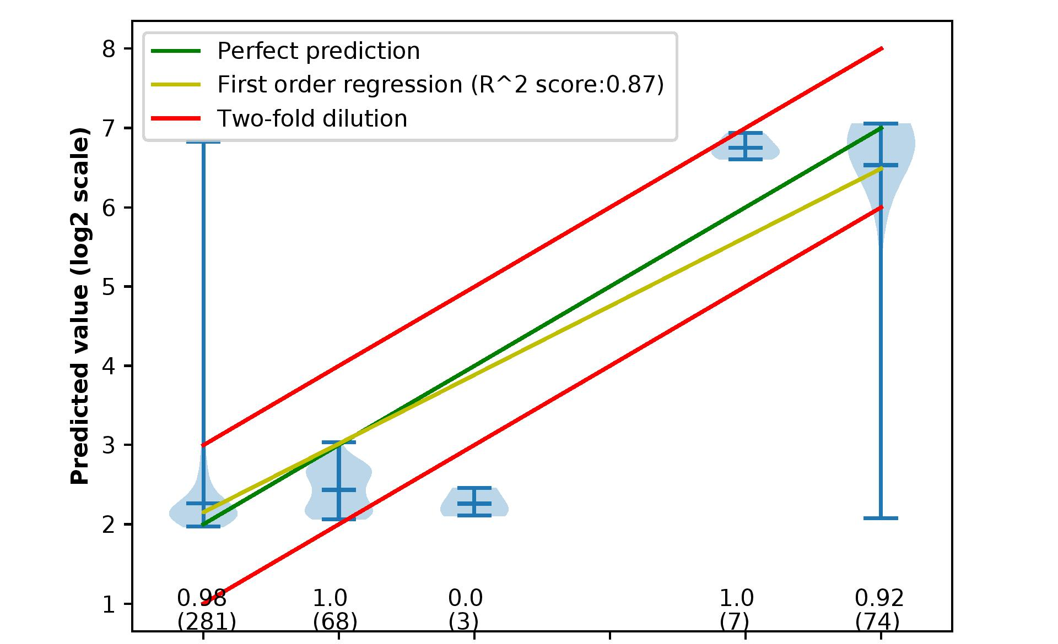
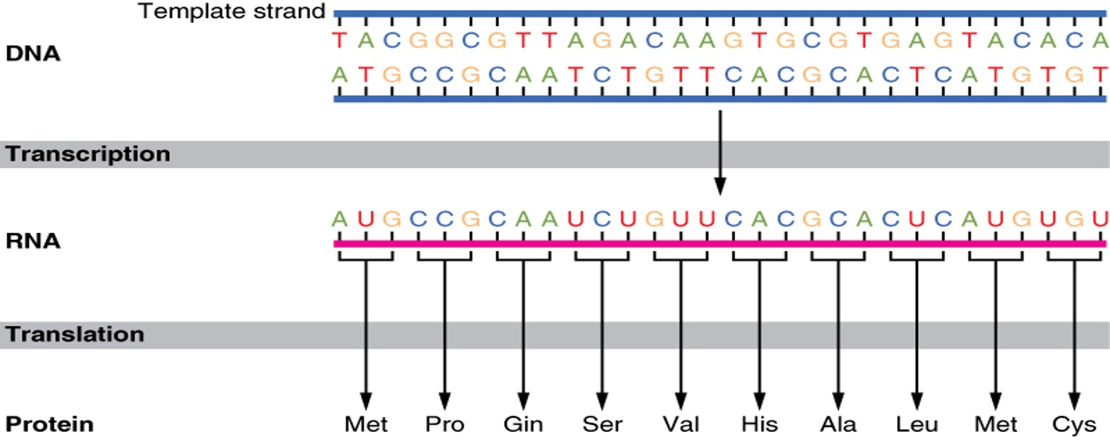

Using Machine Learning for Predicting Antimicrobial Resistance
Taha ValizadehAslani; Gail Rosen, PhD
Department of Electrical and Computer Engineering, Drexel University
Objectives
Methods
Other machine learning methods
To predict Minimum Inhibitory Concentration with a good accuracy, low cost and fast speed from the genome of a microbial strain
To find the genetics determinants of antimicrobial resistance
Data Preprocessing
DNA is converted to k-mers.
Double-Dilution Accuracy
FDA range of correct prediction [1-3]:
$${MIC}_{predicted}∈[\frac{{MIC}_{target}}{2}, {MIC}_{target}∗2]$$
XGBoost Model [2]
AA4-mers of Salmonella enterica ampicillin
DNA | Antibiotic | MIC
AACTTATATACACAGGGTACACAT… | Ampicillin | 2 g/ liter
GGGTACCCTGATGTGAACCATGRA… | Ampicillin | 1 g/liter
CCCGGTAGCTGACTGCTAGTGGGG… | Tetracycline | 4 g/ liter
ATCGGGGTCATTGCAAATGACCGT... | Ampicillin | 1 g/liter
Introduction
Anti-Microbial Resistance (AMR) occurs when bacteria change in response to the use of medicines.
The antibiotics should not be overprescribed. Only the minimum concentration must be used to treat the infection.
MIC: Minimum inhibitory concentration : The lowest concentration of a chemical, usually a drug, which prevents visible growth of a bacterium
Feature selection
After training the model, the important features were extracted, and a new model was trained using only the selected features.
Important genes were found by searching the important k-mers on NCBI database.
Left: Accuracy of the XG Boost model only using a few important features (effect of ampicillin on Salmonella enterica 4-mers of aminoacidic)
Right: Important genes that affect AMR for Staphylococcus aureus (extracted after training the model with 15-mers of nucleotide)
Results
Accuracy of prediction
Accuracy of XGBoost for effect of Ampicillin on Salmonella enterica
Visualization of the predictions
Distribution of prediction of values of MIC (effect of nalidixic acid
on Campilobacter Jejuni. 4-mers of AA)
Data | Mean accuracy | Standard Deviation
10-mers NT | 0.935 | 0.012
3-mers AA | 0.747 | 0.038
4-mers AA | 0.941 | 0.012
5-mers AA | 0.959 | 0.008
DNA and amino acid
DNA of the bacterium contains the AMR information and can be used for predicting MIC
DNA sequences are translated to amino acid squences
Conclusions
Given enough number of genomes, machine learning can be used to predict MIC with a good accuracy
Instead of nucleotide sequences, amino acid sequences can be used for increasing accuracy
XG Boost outperforms other methods for MIC prediction from genome
Feature selection can identify genes that are important to AMR
Contact
References
Taha ValizadehAslani
EESI lab, Drexel University
DrexelEESI.com
tv349@drexel.edu
[1] M. Nguyen, T. Brettin, S.W. Long, J.M. Musser, R.J. Olsen, R. Olson, M. Shukla, R.L. Stevens, F. Xia, H. Yoo, J.J. Davis, Developing an in silico minimum inhibitory concentration panel test for Klebsiella pneumonia, Sci. Rep. 8 (2018) 421. doi:10.1038/s41598-017-18972-w.
[2] T. Chen, C. Guestrin, XGBoost : A Scalable Tree Boosting System, (n.d.).
[3] M. Nguyen, S.W. Long, P.F. McDermott, R.J. Olsen, R. Olson, R.L. Stevens, G.H. Tyson, S. Zhao, J.J. Davis, Using Machine Learning To Predict Antimicrobial MICs and Associated Genomic Features for Nontyphoidal Salmonella, J. Clin. Microbiol. 57 (2018). doi:10.1128/JCM.01260-18.

