Slide 1
MULTIPLE SEQUENCE ALIGNMENT
TAHA ASLANI
XIONGJIAN CHEN

Slide 2
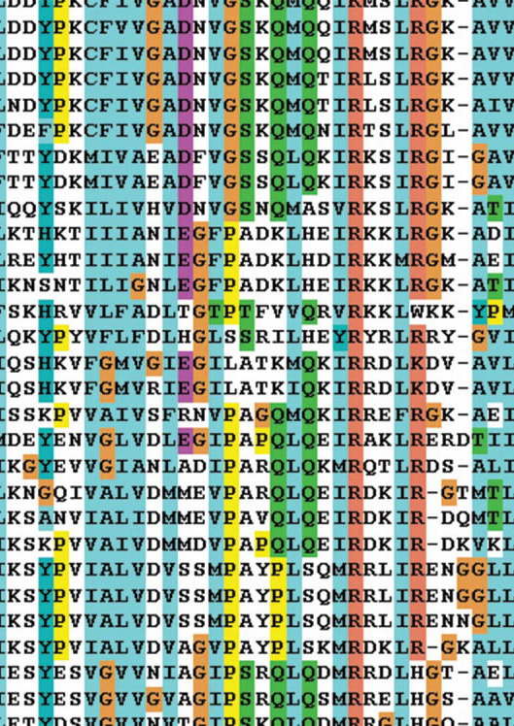
MULTIPLE SEQUENCE ALIGNMENT
More than two sequences
Building phylogenetic tree
All sequences must be aligned together
Cannot do pairwise alignment
Computational burden

Slide 3

Muscle

Slide 4
MULTIPLE SEQUENCE COMPARISON BY LOG-EXPECTATION (MUSCLE)

Slide 5
THREE STAGES OF ALGORITHM
Stage 1: Draft progressive (k-mers distance)
Stage 2: Improved progressive (Kimura distance)
Stage 3: Refinement
All the profile alignments are based on log-expectation score.
MUSCLE-p stage has time complexity O(N²L + NL²) and space complexity O(N² + NL + L²).
Refinement adds an O(N³L) term to the time complexity.
where sequence length L and number of sequences N
MUSCLE-p stage
Notes:
MUSCLE-p has time complexity O(N²L + NL²) and space complexity O(N² + NL + L²). Refinement adds an O(N³L) term to the time complexity.

Slide 6
PROFILE ALIGNMENT AND LOG-EXPECTATION
LE^{xy} = (1 – f ^{x}_{G}) (1 – f ^{y}_{G}) log (Σ _{i} Σ _{j} f ^{x}_{i} f ^{y}_{j} p_{ij} /p_{i} p_{j} )
Let i and j be amino acid types, p_{i} the background probability of i, p_{ij} the joint probability of i and j being aligned to each other, f^{x}_{i} the observed frequency of i in column x of the first profile, and f ^{x}_{G} the observed frequency of gaps in that column at position x in the family (similarly for position y in the second profile).
Notes:
In order to apply pairwise alignment to profiles, a scoring function must be defined on an aligned pair of profile positions, i.e. a pair of multiple alignment columns
MUSCLE uses probabilities pi and pij derived from the 240 PAM VTML matrix . Frequencies fi are normalized to sum to 1 when indels are present (otherwise the logarithm becomes increasingly negative with increasing numbers of gaps even when aligning conserved or similar residues). The factor (1 – fG) is the occupancy of a column, introduced to encourage more highly occupied columns to align.

Slide 7
SUM OF PAIRS(SP) AND DISTANCE
Seq1: M Q P I L L P
Seq2: M L R – L – P
Seq3: M P V I L K P
SP-score of column 6 = Score(L,-)+Score(L,K)+Score(K,-)
Total SP-score is the sum of the scores of all the columns
K-mer distance:
Related sequences tend to have more kmers in common than expected by chance. The kmer distance is derived from the fraction of kmers in common in a compressed alphabet
Kimura distance:
http://bioinformatics.psb.ugent.be/downloads/psb/Userman/treecon_distance.html
Notes:
match = 1, a mismatch = -1, and a gap = -2.

Slide 8
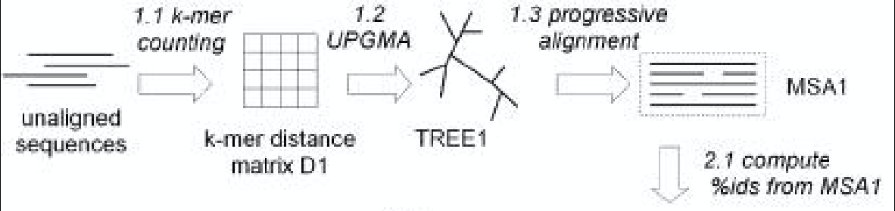
STAGE 1: DRAFT PROGRESSIVE (K-MER DISTANCE)
Notes:
Stage 1, Draft progressive. The goal of the first stage is to produce a multiple alignment, emphasizing speed over accuracy.
1.1 The kmer distance is computed for each pair of input sequences, giving distance matrix D1.
1.2 Matrix D1 is clustered by UPGMA, producing binary tree TREE1.
1.3 A progressive alignment is constructed by following the branching order of TREE1. At each leaf, a profile is constructed from an input sequence. Nodes in the tree are visited in prefix order (children before their parent). At each internal node, a pairwise alignment is constructed of the two child profiles, giving a new profile which is assigned to that node. This produces a multiple alignment of all input sequences, MSA1, at the root.

Slide 9
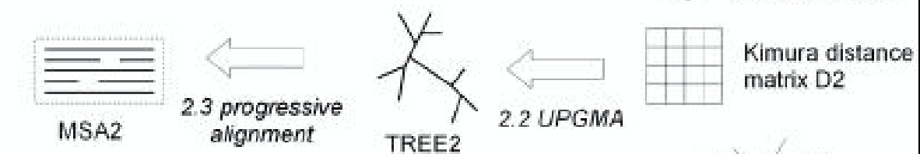
STAGE 2: IMPROVED PROGRESSIVE (KIMURA DISTANCE)
Notes:
Stage 2, Improved progressive. The main source of error in the draft progressive stage is the approximate kmer distance measure, which results in a suboptimal tree. MUSCLE therefore re-estimates the tree using the Kimura distance, which is more accurate but requires an alignment.
2.1 The Kimura distance for each pair of input sequences is computed from MSA1, giving distance matrix D2.
2.2 Matrix D2 is clustered by UPGMA, producing binary tree TREE2.
2.3 A progressive alignment is produced following TREE2 (similar to 1.3), producing multiple alignment MSA2. This is optimized by computing alignments only for subtrees whose branching orders changed relative to TREE1.

Slide 10
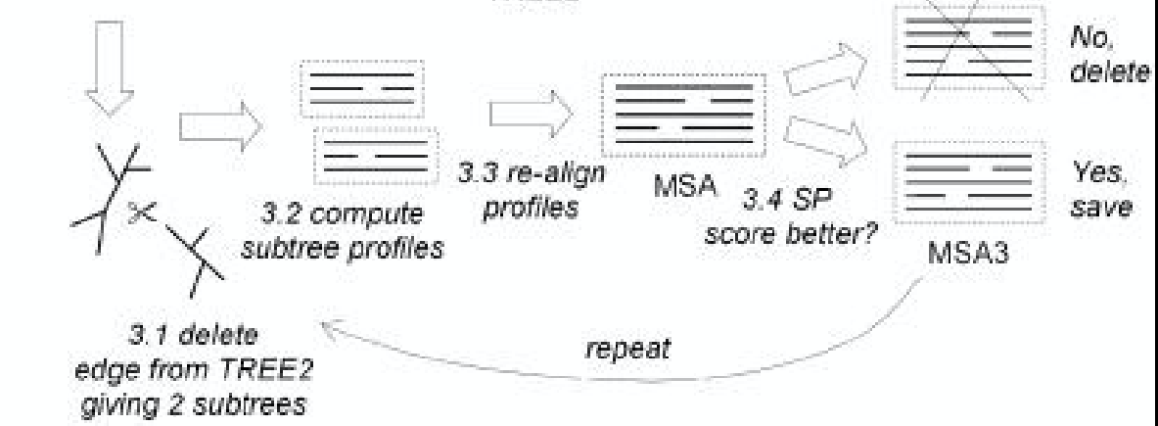
STAGE 3: REFINEMENT
Notes:
3.1 An edge is chosen from TREE2 (edges are visited in order of decreasing distance from the root).
3.2 TREE2 is divided into two subtrees by deleting the edge. The profile of the multiple alignment in each subtree is computed.
3.3 A new multiple alignment is produced by re-aligning the two profiles.
3.4 If the SP score is improved, the new alignment is kept, otherwise it is discarded.
Steps 3.1–3.4 are repeated until convergence or until a user-defined limit is reached. This is a variant of tree-dependent restricted partitioning

Slide 11

INSTALLATION AND OPERATION
Download the file from the link: http://www.drive5.com/muscle/
Notes:
Distance matrices are clustered using UPGMA , which we find to give slightly improved results over neighbor-joining

Slide 12
MULTIPLE SEQUENCE ALIGNMENT BASED ON FAST FOURIER TRANSFORM (MAFFT)

Slide 13
TWO TYPES OF STATISTICS
MAFFT offers various multiple alignment strategies.
They are classified into three types,:(a) the progressive method, (b) the iterative refinement method with the WSP score, and (c) the iterative refinment method using both the WSP and consistency scores.
In general, there is a tradeoff between speed and accuracy.
The order of speed is a > b > c, whereas the order of accuracy is a < b < c.

Slide 14
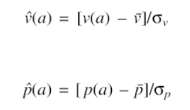
FORMULA
an amino acid a is assigned to a vector whose components are the volume value v(a) and the polarity value p(a) introduced by Grantham
Grantham R., (1974) Amino acid difference formula to help explain protein evolution. Science, 185, 862–864
Normalize volume and polarity

Slide 15


CORRELATION
Calculation of the correlation between two amino acid sequences

Slide 16
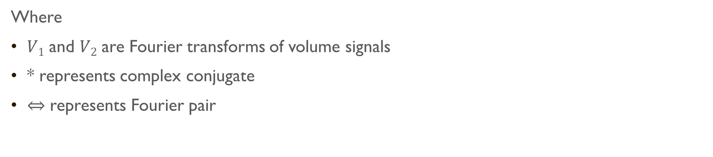
CORRELATION IN FREQUENCY DOMAIN

Slide 17
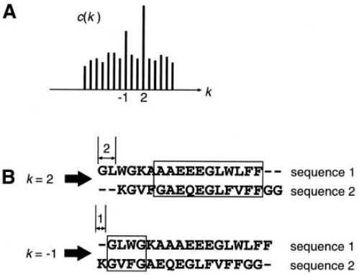
CORRELATION
Finding homologous segments.
If two sequences compared have homologous regions, the correlation c(k) has some peaks corresponding to these regions

Slide 18
CORRELATION
By the FFT analysis, however, we can know only the positional lag k of a homologous region in two sequences but not the position of the region.
To determine the positions of the homologous region in each sequence, a sliding window analysis with the window size of 30 sites is carried out.
Identify a segment of 30 sites with score value exceeding a given threshold

Slide 19
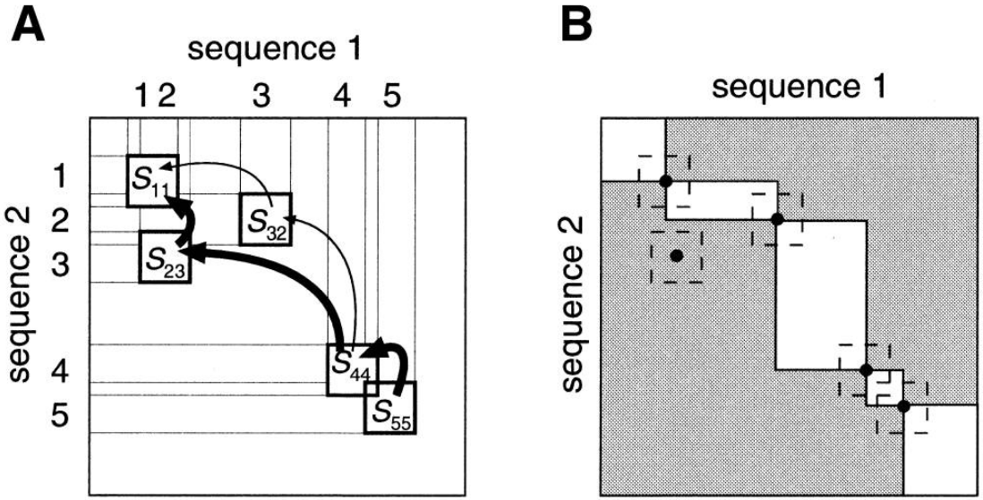
HOMOLOGY MATRIX
A matrix S_{ij}(1 ≤ i, j ≤ n, n is the number of homologous segments) is constructed
If the ith homologous segment on sequence 1 corresponds to the jth homologous segment on sequence 2, S_{ij} has the score value of the homologous segment calculated above
otherwise S_{ij} is set to 0

Slide 20
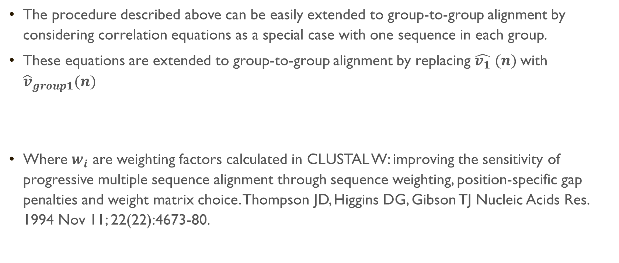

EXTENSION TO GROUP-TO-GROUP ALIGNMENTS.

Slide 21
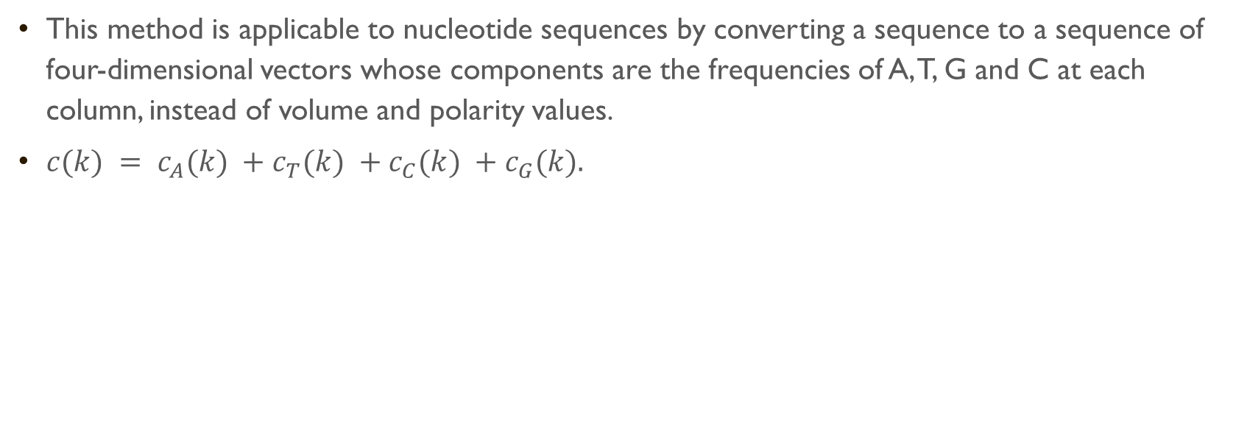
NUCLEOTIDE SEQUENCES

Slide 22
Using the FFT algorithm and the normalized similarity matrix described above, input sequences are progressively aligned
Here CPU time is O(K²), where K is the number of sequences.
Rapid calculation of a distance matrix is important for the case of large K.
20 amino acids are grouped into six physico-chemical groups.
The guide tree is constructed from this distance matrix using the UPGMA method
input sequences are progressively aligned following the branching order of sequences in the guide tree

Slide 23
MORE ACCURATE BUT SLOWER METHODS
An alignment obtained by Progressive method is subjected to further improvement, in which the alignment is divided into two groups and realigned .
A technique called tree-dependent restricted partitioning is employed for that purpose.
Comprehensive study on iterative algorithms of multiple sequence alignment. Hirosawa M, Totoki Y, Hoshida M, Ishikawa M Comput Appl Biosci. 1995 Feb; 11(1):13-8.
WSP
both the WSP and consistency scores.
This process is repeated until no better scoring alignment is obtained in respect of the score described above.

Slide 24
HOW TO RUN
1. Create Cipres user account. (http://www.phylo.org/sub_sections/portal/)
2. Create a folder for the project - provide a descriptive name.
3. In the folder your just created open the data subfolder and upload the fasta input.
4. Go to the tasks subfolder and create a new task. Choose the ’MAFFT’ alignment tool. Next, select the data, provide a descriptive name, then save the task. Click on the task subfolder and run the task you just created. Click the view status button. You can then click the refresh button to see when the task is complete. The task should take a few minutes to run.
5. Once the task is complete, click on the View link. Inspect the output.MAFFT file.

Slide 25
COMPARISON

Slide 26
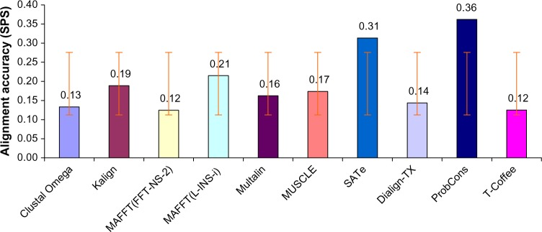
COMPARISON
Reference:https://www.ncbi.nlm.nih.gov/pmc/articles/PMC4267518/
Notes:
BAliBASE reference datasets (RV11, RV12, RV20, RV30, RV40 and RV50) respectively

Slide 27
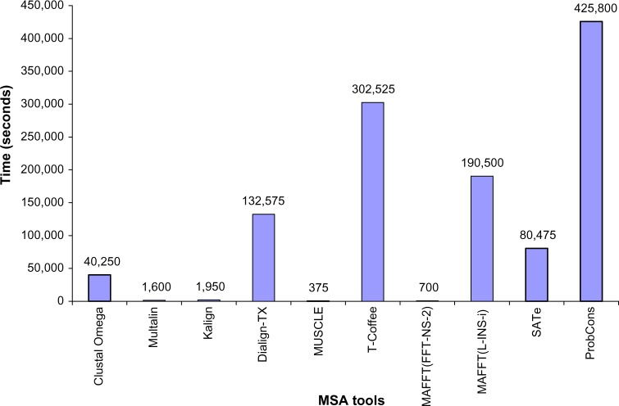
COMPARISON
Reference:https://www.ncbi.nlm.nih.gov/pmc/articles/PMC4267518/
Notes:
BAliBASE reference datasets (RV11, RV12, RV20, RV30, RV40 and RV50) respectively

Slide 28
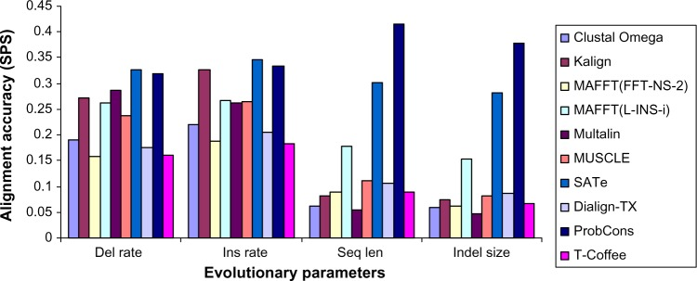
COMPARISON
Reference:https://www.ncbi.nlm.nih.gov/pmc/articles/PMC4267518/
Notes:
BAliBASE reference datasets (RV11, RV12, RV20, RV30, RV40 and RV50) respectively

Slide 29
LINKS
Paper:(MAFFT) https://www.ncbi.nlm.nih.gov/pmc/articles/PMC135756/#gkf436c18
(MUSCLE) https://www.ncbi.nlm.nih.gov/pmc/articles/PMC390337/#gkh340c9
Website: https://mafft.cbrc.jp/alignment/software/
Online tool:
(MAFFT)https://mafft.cbrc.jp/alignment/server/ (MUSCLE)http://www.drive5.com/muscle/

Slide 30


