Slide 1




Slide 2
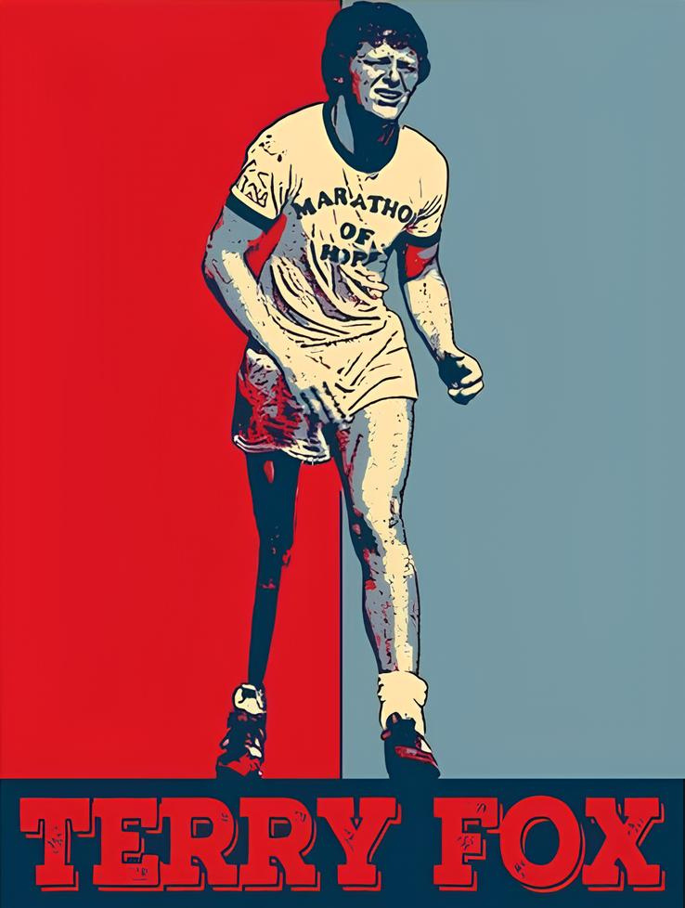

Who is Terry Fox?
A Canadian athlete and humanitarian
Born in Winnipeg, Canada, Terry was active in sports like basketball and track.
Diagnosed with osteosarcoma at 18, leading to the amputation of his right leg.

Slide 3
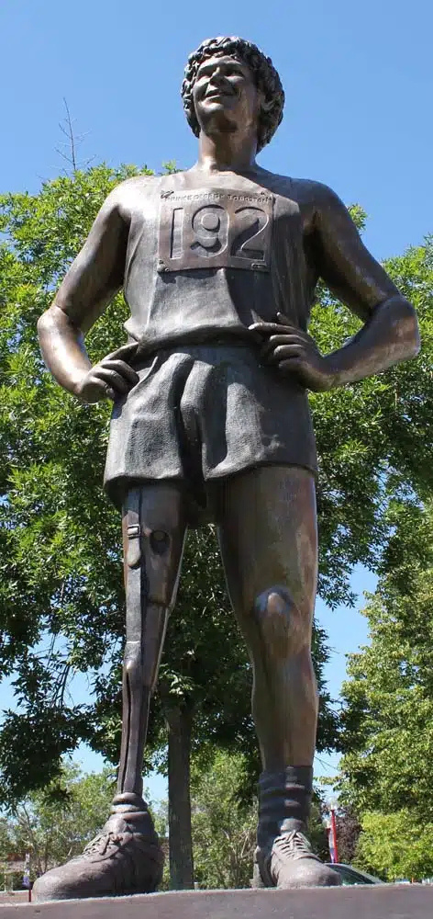
Why is he famous?
He embarked on the "Marathon of Hope" to raise funds and awareness for cancer research.
The Vision:
Terry aimed to run across Canada, covering one marathon daily, to raise $1 million for cancer research.

Slide 4
Legacy
Ran 5,373 kilometers over 143 days. Although he couldn’t complete the journey due to his illness, he inspired millions.

Slide 5
THANKS FOR LISTENING

