Slide 1

Gemy
IoT Training eng mohammed hatem

Slide 2
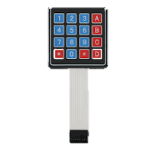

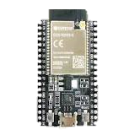

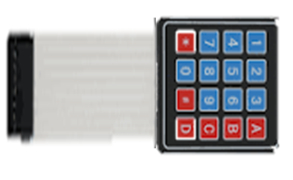
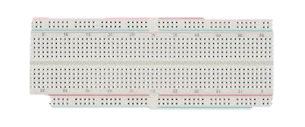

Makket ,HOW It Connected? (Semantics)
C.gnd
Power
servo
speaker
IR
State LED
touch
LDR
handfree
VCC

Slide 3
Makket ,HOW It Connected? ports
playing_led_pin=18 ##intialization ok or giving messages
ldr_pin=34
ir_pin=35
touch_pin = TouchPad(Pin(4))
rows = [Pin(i, Pin.OUT) for i in (32,33,25,26)]#(13,12,14,27)]
cols = [Pin(i, Pin.IN, Pin.PULL_UP) for i in (27,14,12,13)]
Sevo :15
Mic_pin=02
Speaker :5

Slide 4
Makket ,HOW It Connected?
VCC are all on one line breadboard (+) (except LCD need VIN)
Ground in the - line
Power is just cutting the wire of the ground
The state led is 2 LEDs in parallel (with resistor)
LDR is in simple PCB in cartoon
The speaker and hand free port connected in parallel sue to limitation of ports

