Slide 1
Lecture # 10
Course: Data Science Tools & Techniques
Instructor: Dr. Mateen Yaqoob

Slide 2
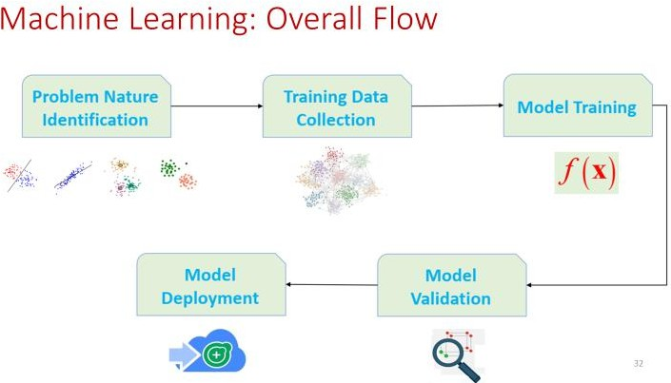
Notes:
1. Problem Nature Identification
Objective: Clearly define the problem you are solving. Is it a classification, regression, clustering, or recommendation problem? The identification of the problem type shapes the choice of models and techniques.
Example: If the goal is to predict customer churn (whether a customer will leave or stay), it’s a classification problem.
Key Steps:
Understand the business context or domain requirements.
Define success criteria (e.g., accuracy, precision, recall for classification tasks).
Determine whether it's a supervised, unsupervised, or reinforcement learning task.
2. Training Data Collection
Objective: Gather a dataset that represents the problem you are trying to solve. This data should have relevant features (independent variables) and, for supervised learning, the target (dependent variable) you wish to predict.
Example: For predicting housing prices, the dataset might include features like square footage, location, and the number of bedrooms, with the target being the price.
Key Steps:
Collect data from multiple sources (databases, APIs, logs, surveys, etc.).
Ensure the data is representative of the population for the problem.
Address any data privacy, ethical, or legal concerns.
3. Model Training
Objective: Use the training data to build a model that can learn the relationships between features and the target variable.
Example: In a housing price prediction model, the algorithm (e.g., Linear Regression) learns from the data to predict the price based on the input features.
Key Steps:
Select the appropriate algorithm based on the problem type (e.g., Linear Regression for regression, Decision Trees for classification).
Split the data into training and validation sets (commonly 80%-20%).
Train the model using the training set and fit it to the data.
4. Model Validation
Objective: Evaluate the model’s performance on a separate validation dataset that wasn’t used in training. This helps to fine-tune hyperparameters, detect overfitting, and select the best model.
Example: After training, you evaluate your housing price model using a validation set to ensure it generalizes well to unseen data.
Key Steps:
Use techniques like k-fold cross-validation, grid search, or random search for hyperparameter tuning.
Evaluate performance using appropriate metrics (e.g., accuracy, F1-score, RMSE).
Adjust model complexity and tune parameters to improve performance.
5. Model Deployment
Objective: Once the model has been validated and performs well, it’s ready for deployment in a production environment where it can make predictions on new data.
Example: The trained housing price prediction model is deployed as an API that takes input features (house attributes) and returns a predicted price.
Key Steps:
Package the model using appropriate frameworks (e.g., Flask, FastAPI for APIs, cloud platforms for scalability).
Set up monitoring to track the model’s performance on real-world data.
Implement feedback loops to gather data for future retraining and improvement.

Slide 3
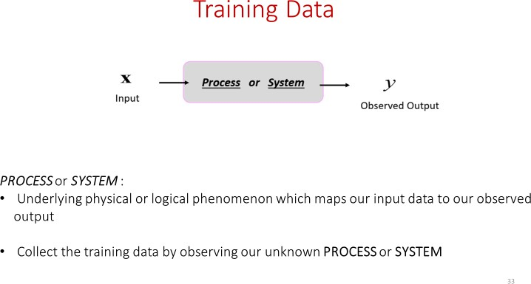

Slide 4
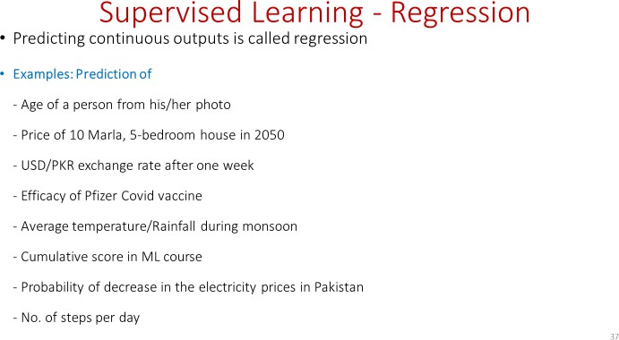

Slide 5
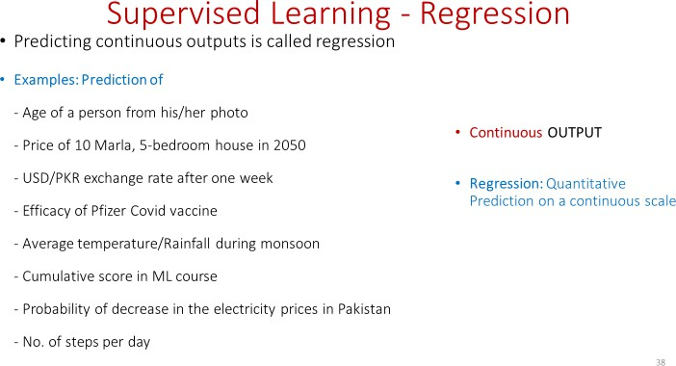

Slide 6
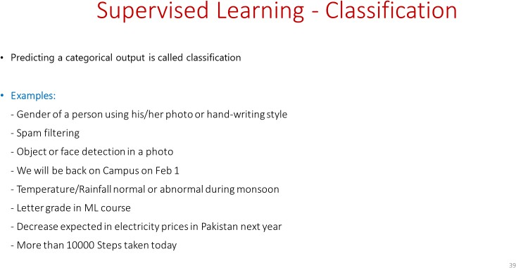

Slide 7
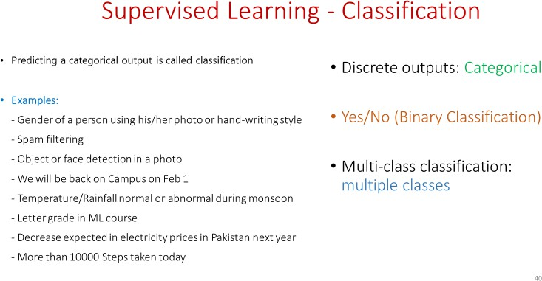

Slide 8
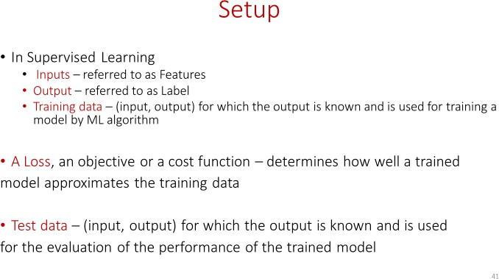

Slide 9
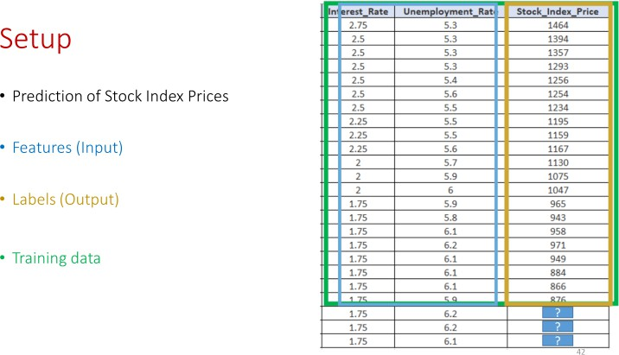

Slide 10
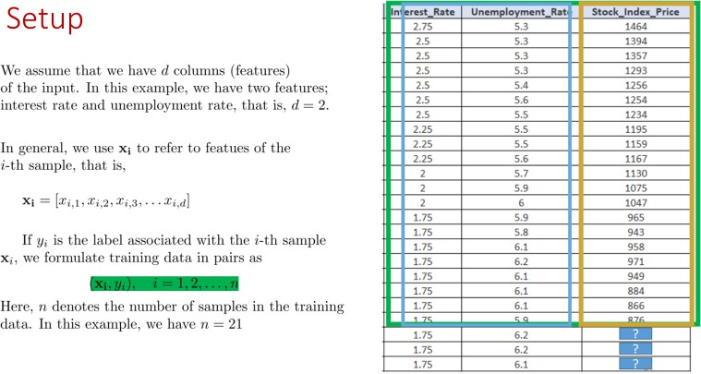

Slide 11
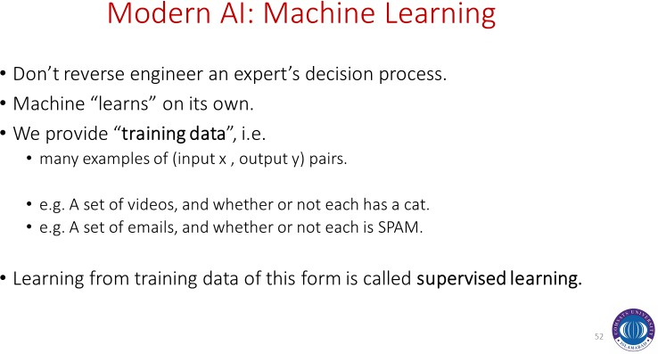

Slide 12
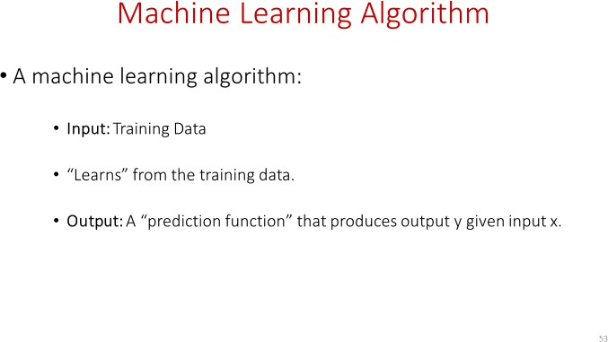

Slide 13
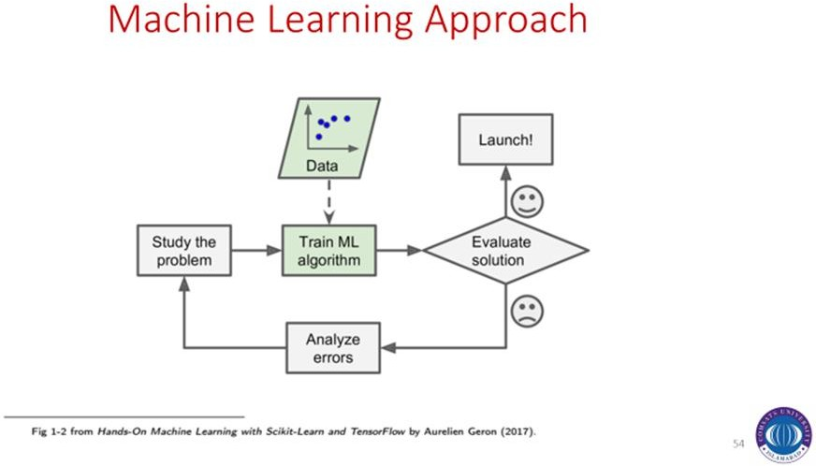

Slide 14
Key Concepts
most common ML problem types
  classification (hard or soft/probabilistic)
  multiclass (hard or soft/probabilistic)
  regression
prediction function
  predicts output y given input x
training data
  a set of (input x, output y) pairs
supervised learning algorithm
  takes training data and produces a prediction function

Slide 15
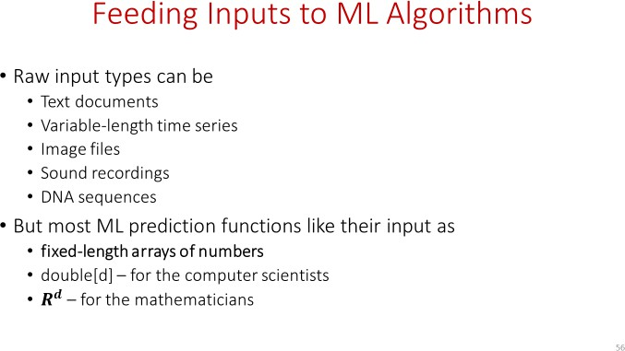

Slide 16
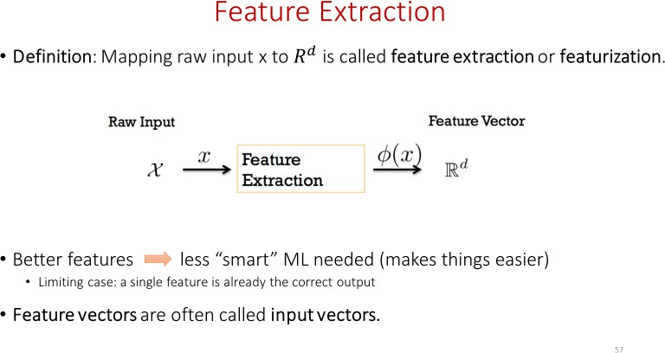

Slide 17
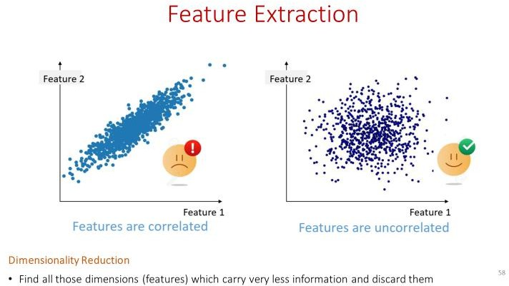
Notes:
Features are correlated:
When two or more features are highly correlated, they share similar information. This can lead to redundancy in the data, as one feature can often predict the values of another.
Uncorrelated Features
When features are uncorrelated, it means they provide independent information that is not related to each other. Each feature contributes distinct information to the model.
Highly Correlated-
Effects:
- Causes multicollinearity in linear models.
- May lead to overfitting in complex models.
- Reduces model interpretability.
Actions:
- Remove one of the correlated features.
- Use PCA to reduce dimensionality.
- Apply regularization (e.g., Lasso).
Uncorrelated
Effects:
- Improves model interpretability.
- Helps prevent overfitting.
- Makes feature importance clearer.
Actions:
- Keep all useful features.
- Consider adding interaction terms if needed.

Slide 18
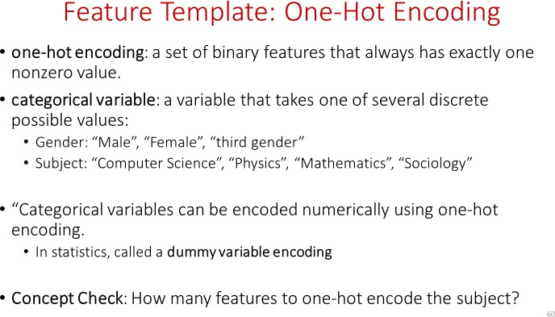

Slide 19
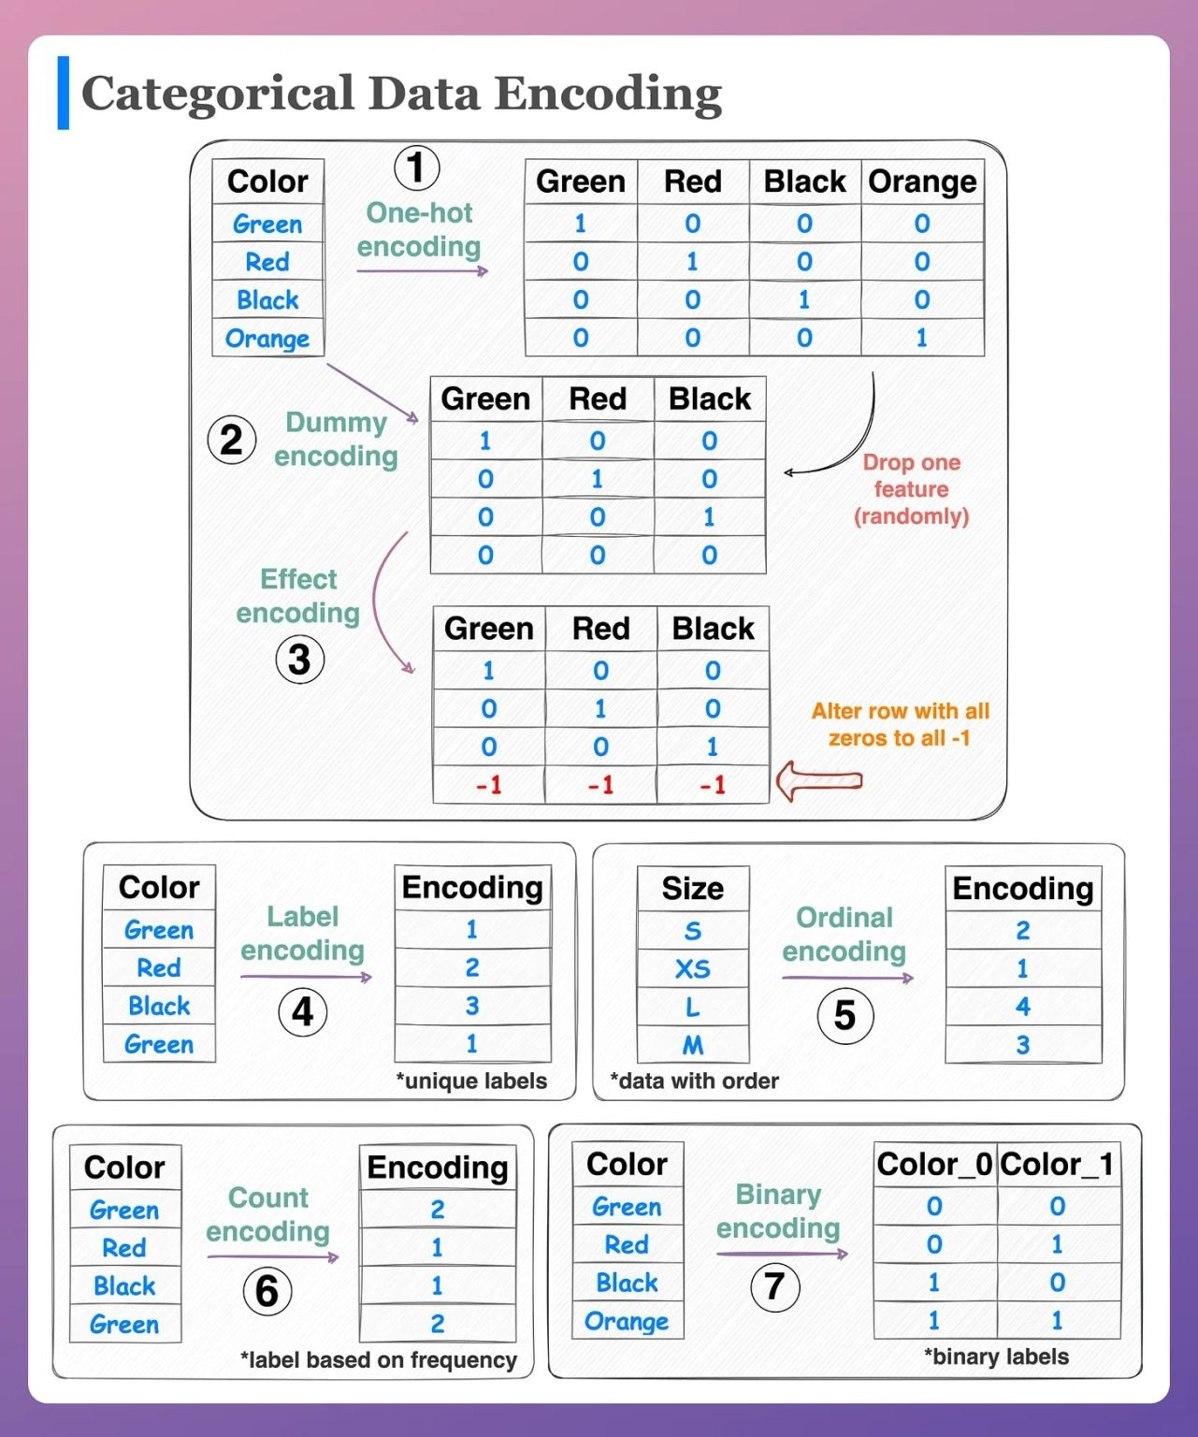

Slide 20
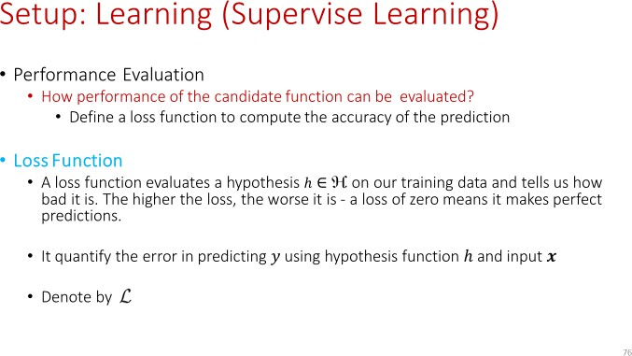

Slide 21
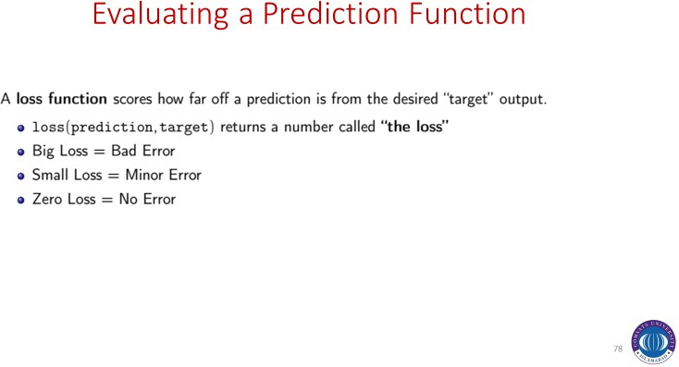

Slide 22
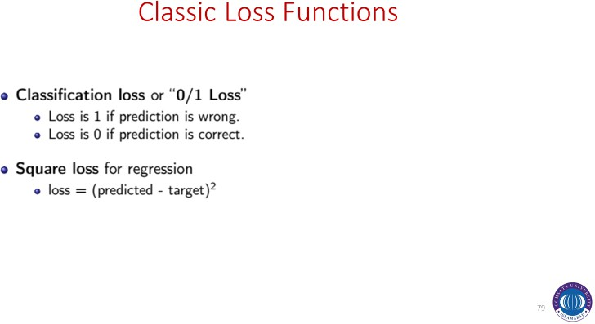

Slide 23
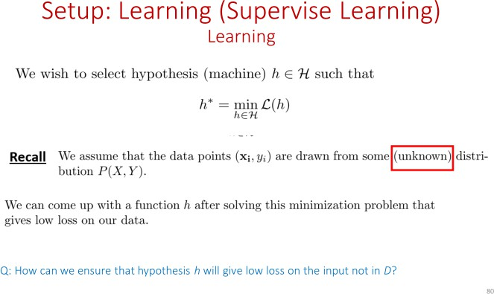

Slide 24
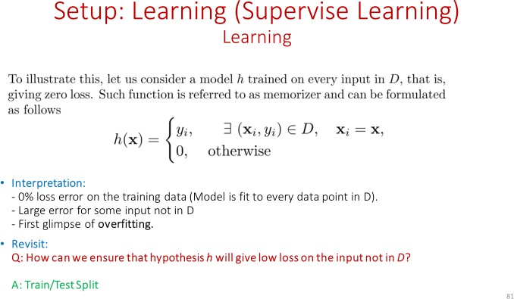

Slide 25
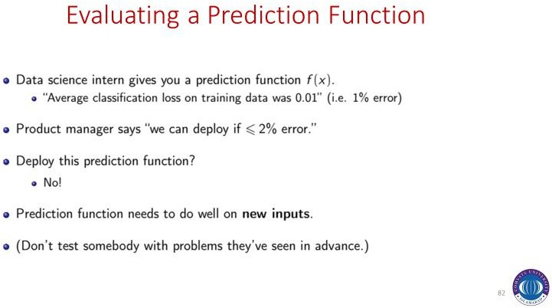

Slide 26
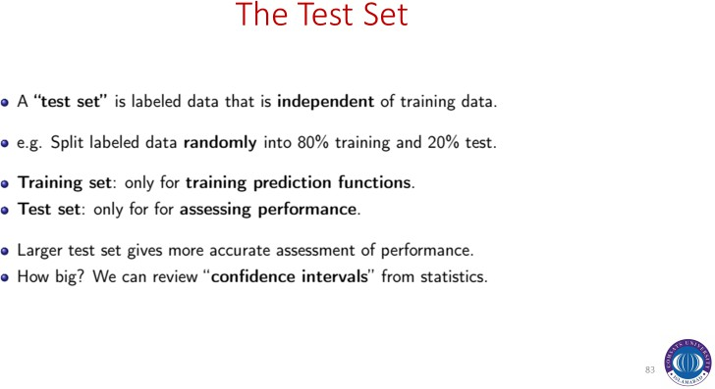

Slide 27
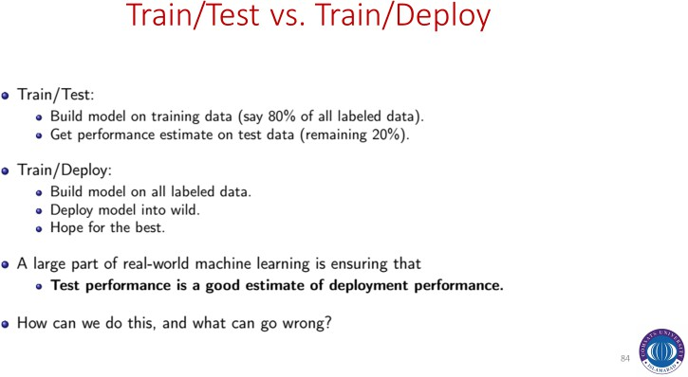

Slide 28
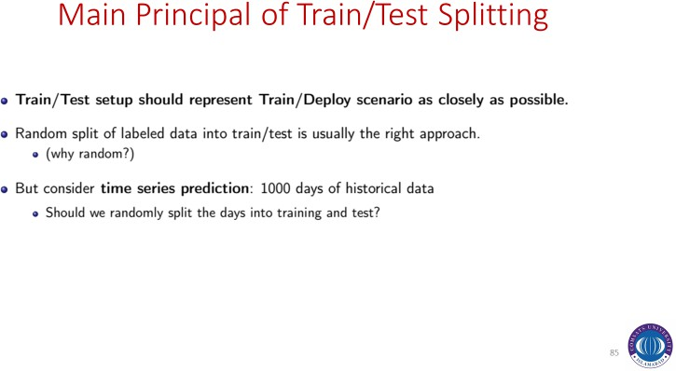

Slide 29
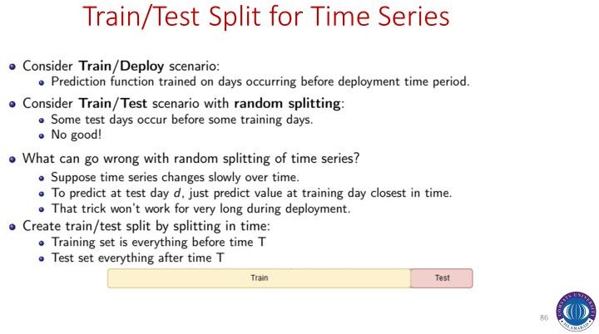

Slide 30
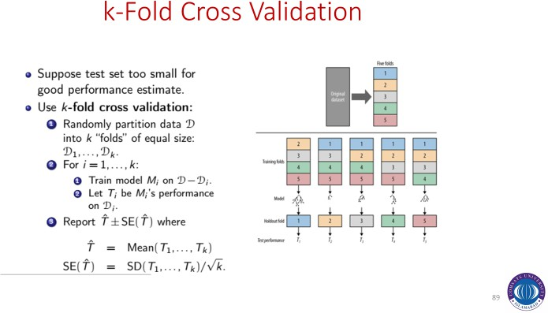

Slide 31
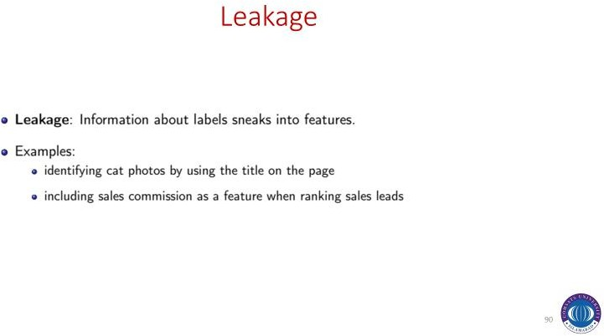

Slide 32
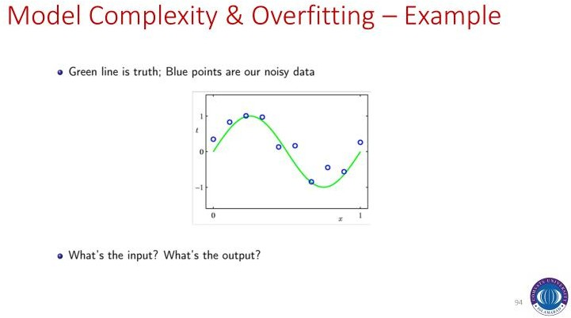

Slide 33
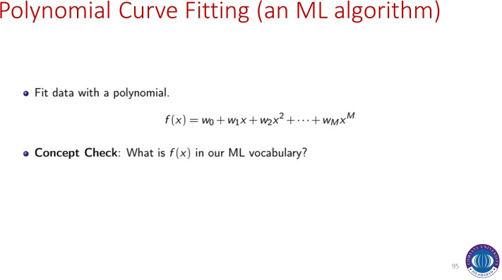

Slide 34
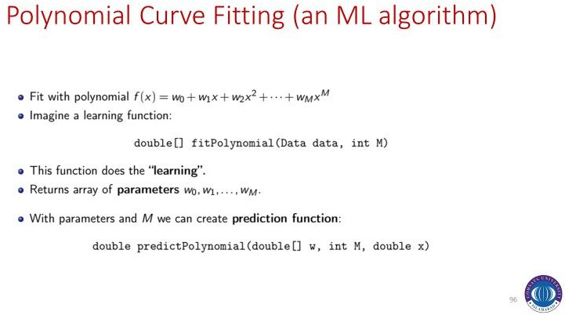

Slide 35
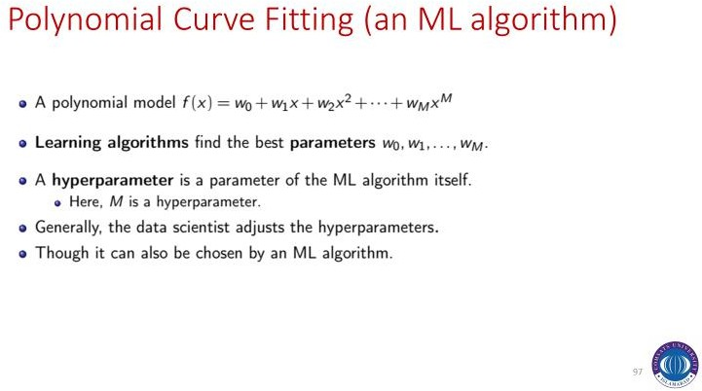

Slide 36
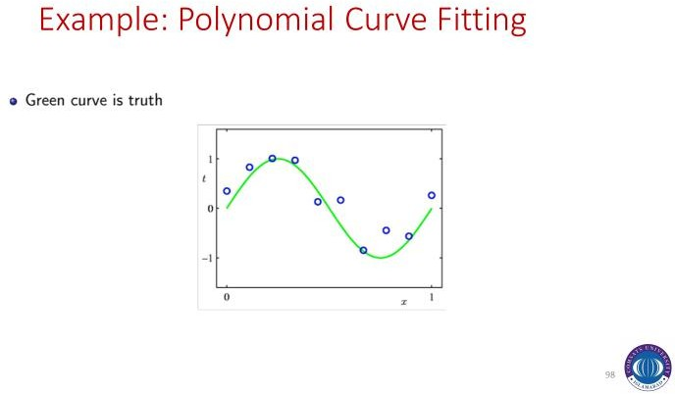

Slide 37
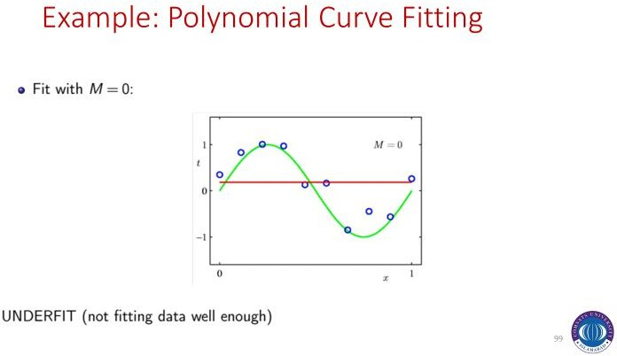

Slide 38
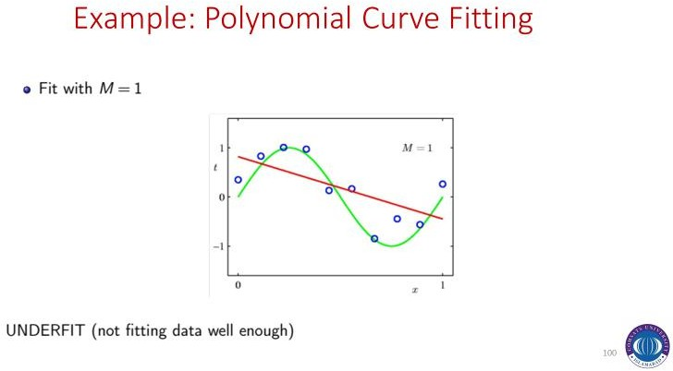

Slide 39
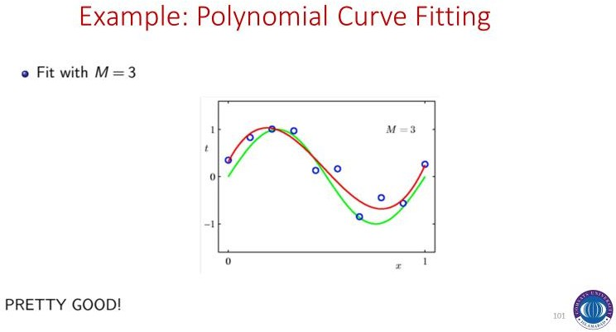

Slide 40
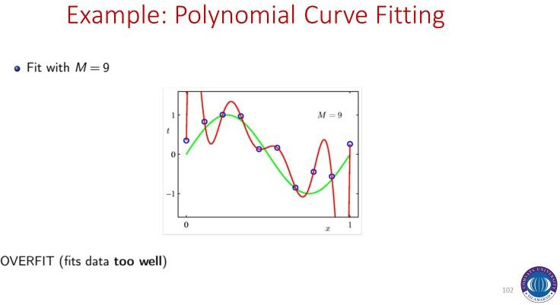

Slide 41
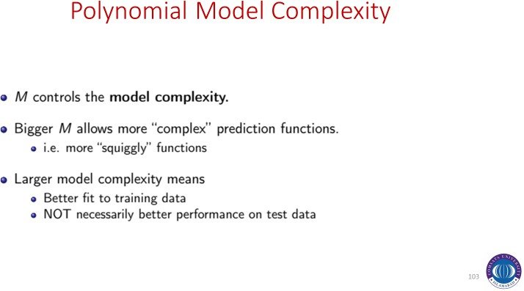

Slide 42


