Slide 1
Lecture # 11
Course: Data Science Tools & Techniques
Instructor: Dr. Mateen Yaqoob

Slide 2
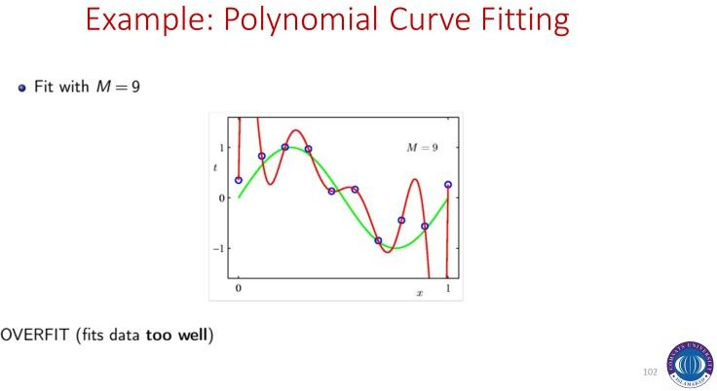

Slide 3
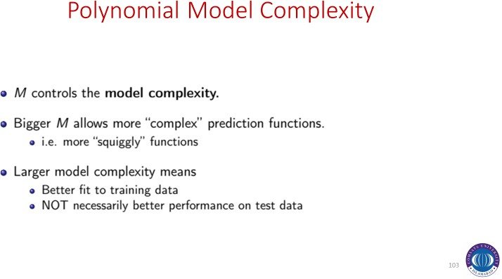

Slide 4
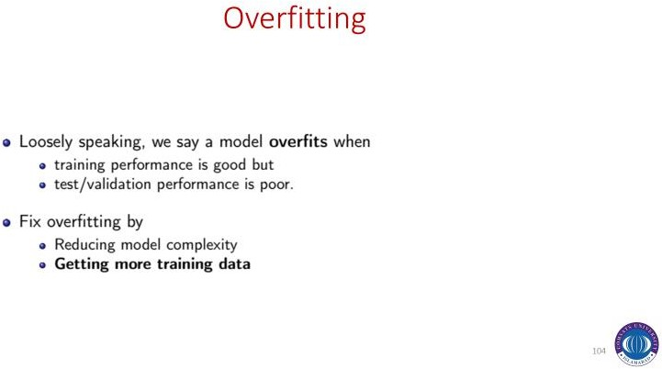

Slide 5
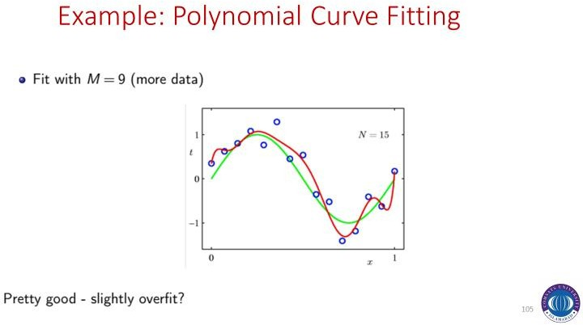

Slide 6
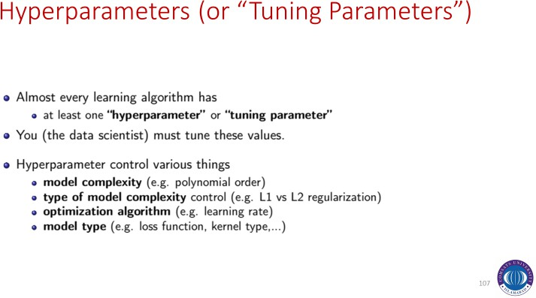

Slide 7
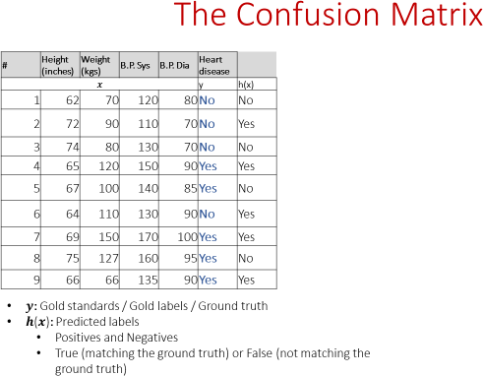

Slide 8
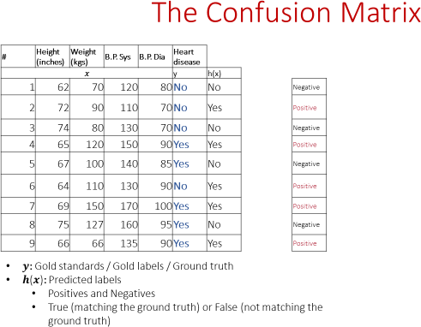

Slide 9
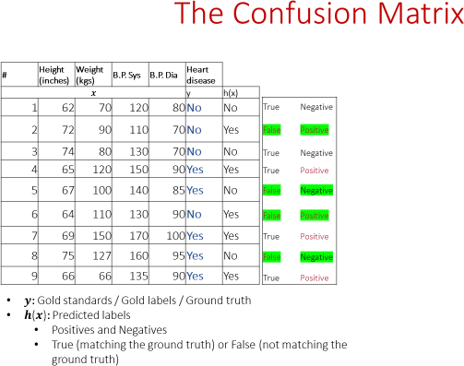

Slide 10
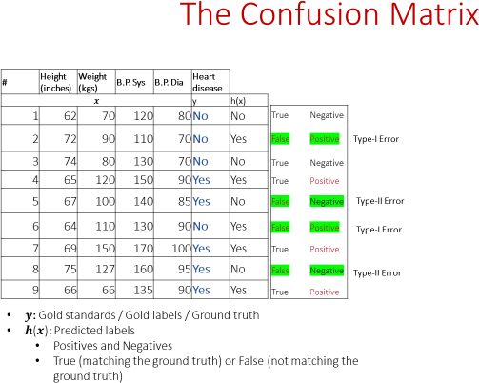

Slide 11
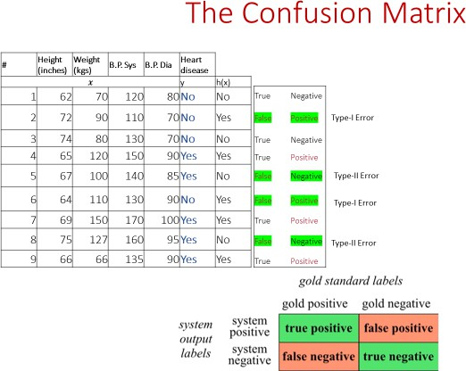

Slide 12
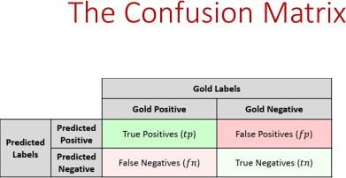

Slide 13
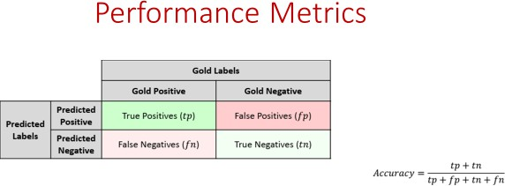

Slide 14
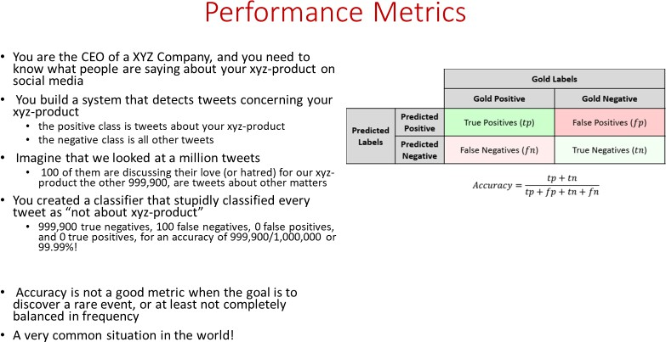

Slide 15
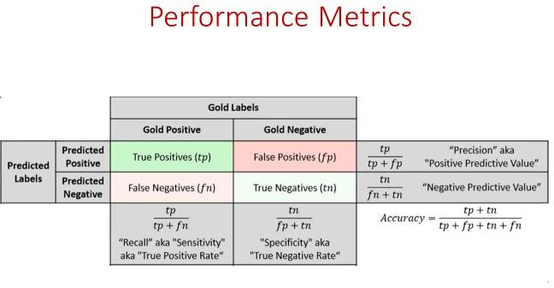

Slide 16
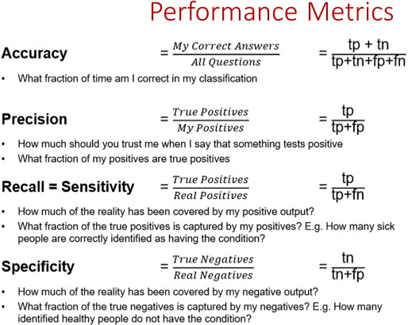

Slide 17
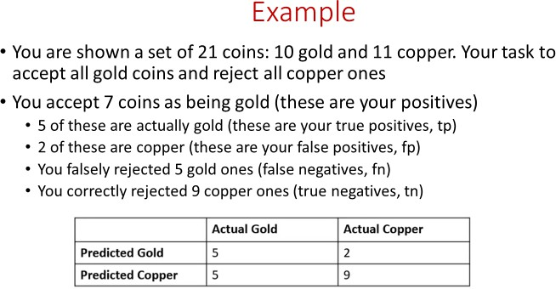

Slide 18
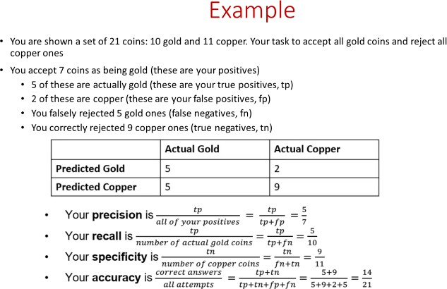

Slide 19
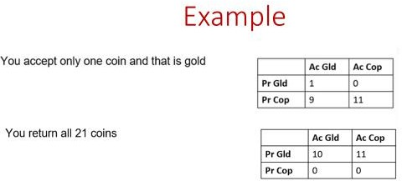

Slide 20
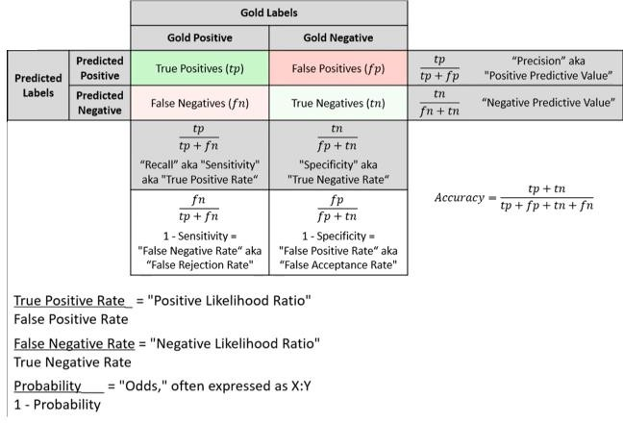

Slide 21
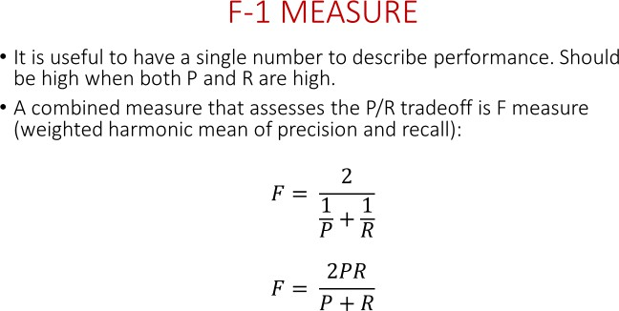

Slide 23
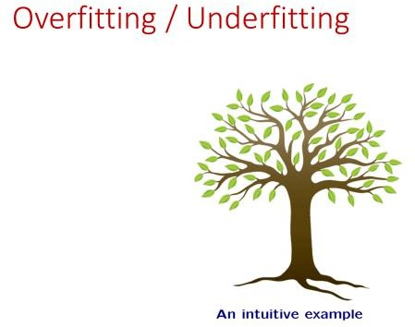

Slide 24
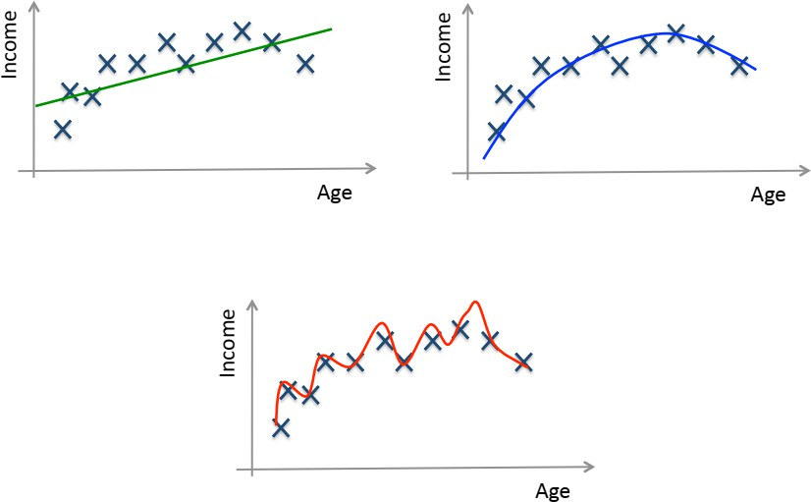
Training / Testing

Slide 25
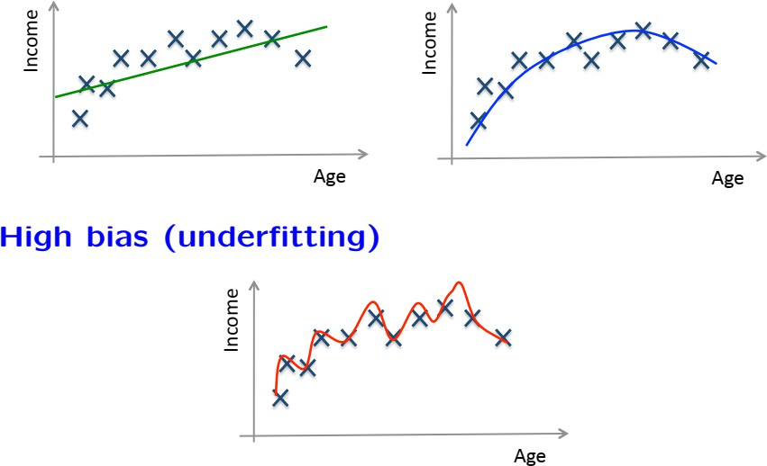
Training / Testing

Slide 26
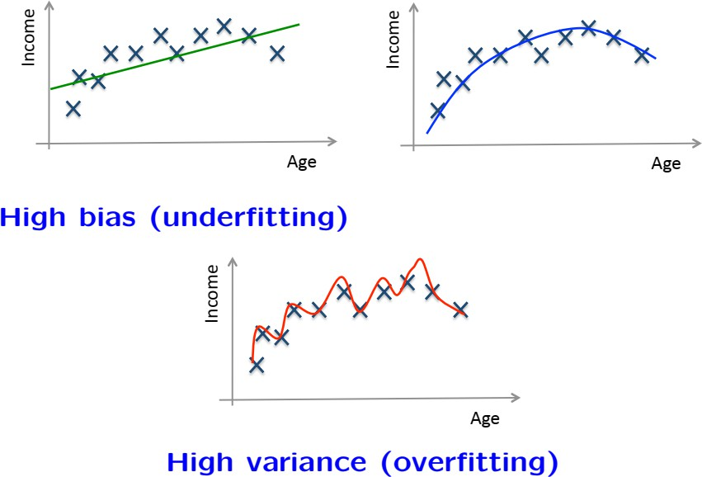
Training / Testing

Slide 27
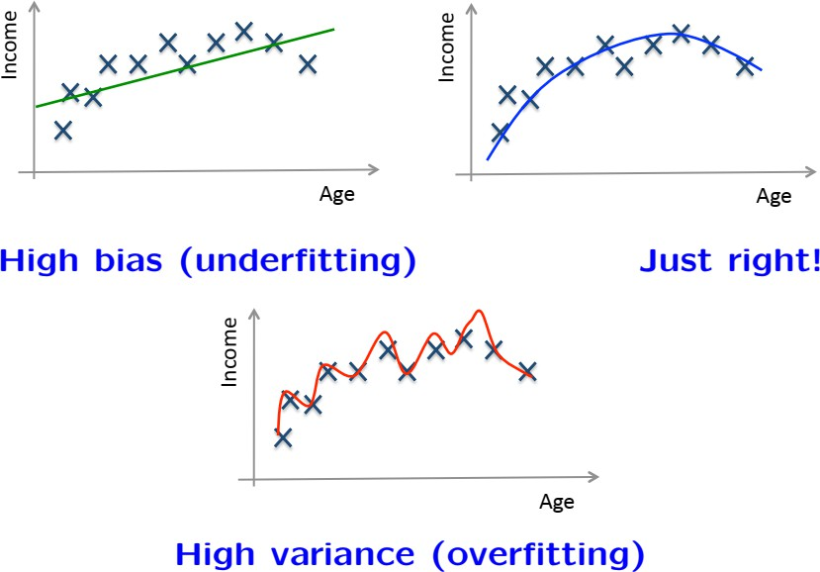
Training / Testing

Slide 28
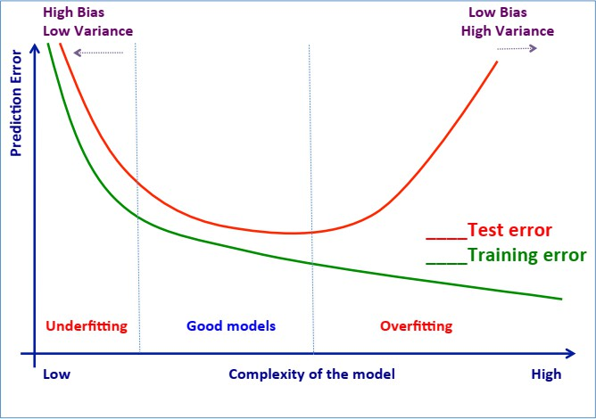
Structural Risk Minimization

Slide 29
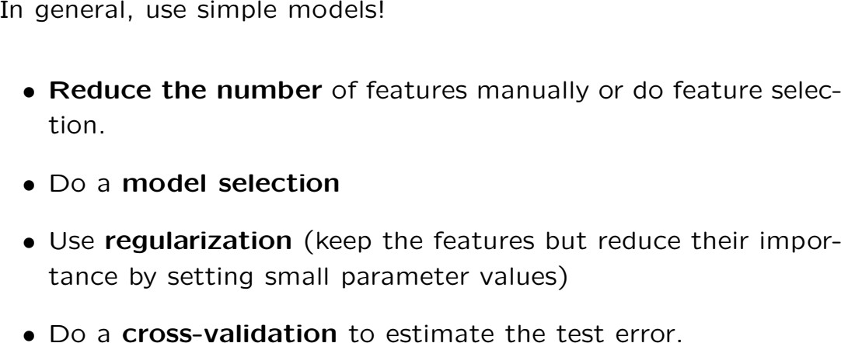
Avoid overfitting

Slide 30
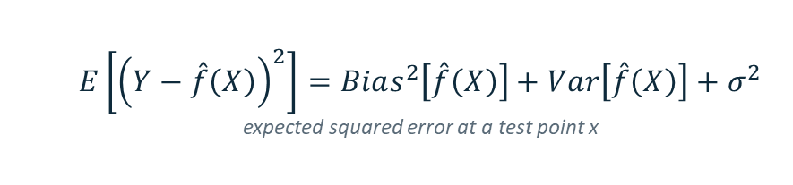
Pre-processing is part of the model
BIAS-VARIANCE DECOMPOSITION
$$E\left[{\left(Y−\overset{ˆ}{f}\left(X\right)\right)}^{2}\right]=Bias^{2}\left[\overset{ˆ}{f}\left(X\right)\right]+Var\left[\overset{ˆ}{f}\left(X\right)\right]+σ^{2}$$
expected squared error at a test point x
Every stage of pre-processing moves at least one of the three terms. Two pipelines with the same learner can differ more than two learners with the same pipeline.
Notes:
Walk through the decomposition. Aggregation and denoising reduce the irreducible-looking noise term; feature selection and sampling control variance; feature creation reduces bias.

Slide 31
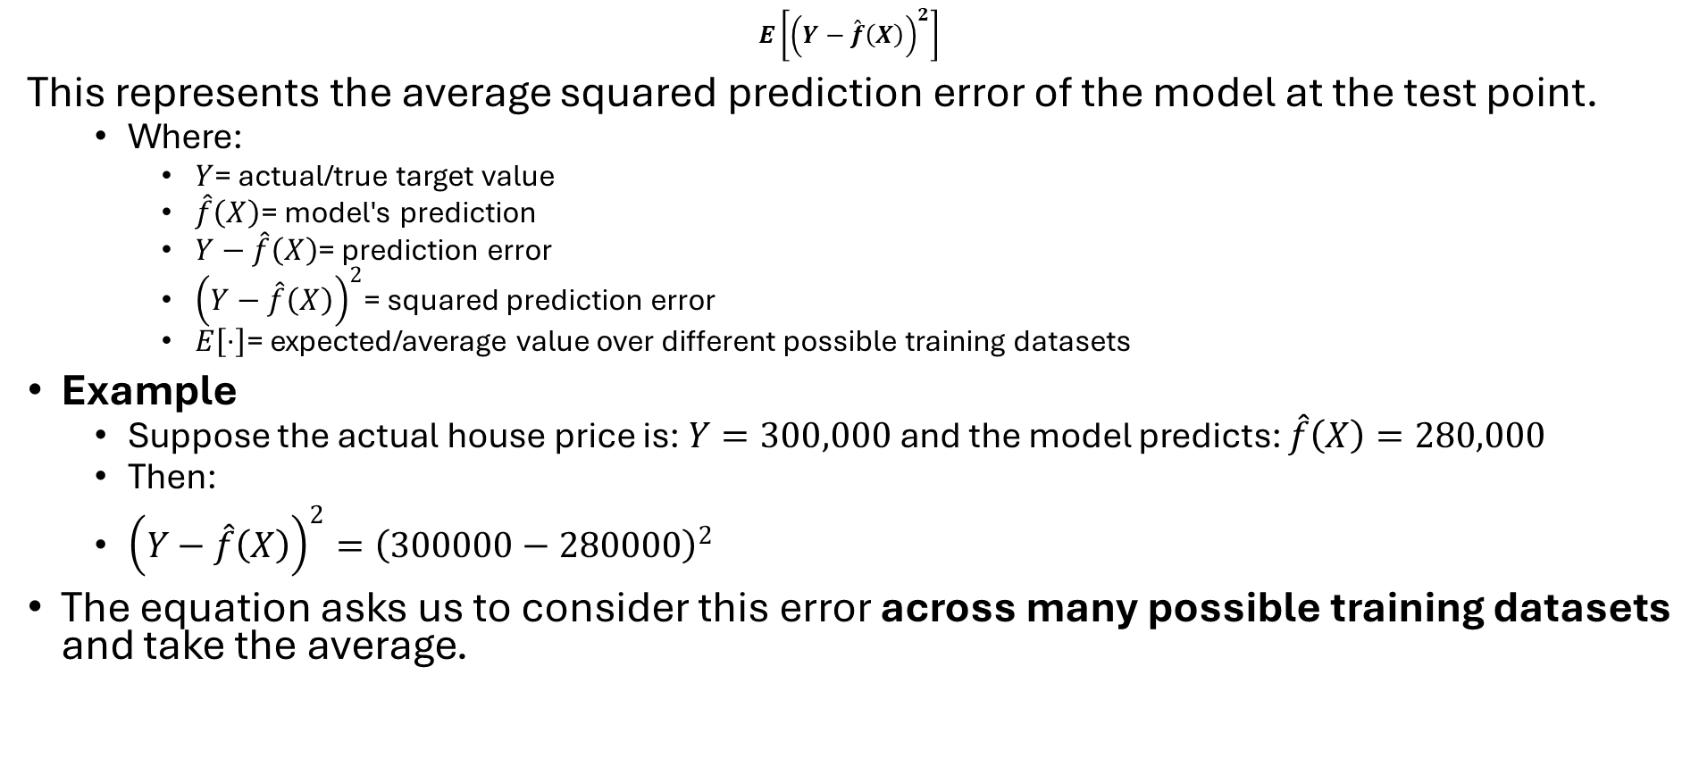
Expected Squared Error
$$E\left[{\left(Y−\overset{ˆ}{f}\left(X\right)\right)}^{2}\right]$$
This represents the average squared prediction error of the model at the test point.
  Where:
    $Y$= actual/true target value
    $\hat{f}\left(X\right)$= model's prediction
    $Y−\hat{f}\left(X\right)$= prediction error
    ${\left(Y−\hat{f}\left(X\right)\right)}^{2}$= squared prediction error
    $E\left[⋅\right]$= expected/average value over different possible training datasets
Example
  Suppose the actual house price is: $Y=300,000$ and the model predicts: $\hat{f}\left(X\right)=280,000$
  Then:
  ${\left(Y−\hat{f}\left(X\right)\right)}^{2}={\left(300000−280000\right)}^{2}$
The equation asks us to consider this error across many possible training datasets and take the average.

Slide 32
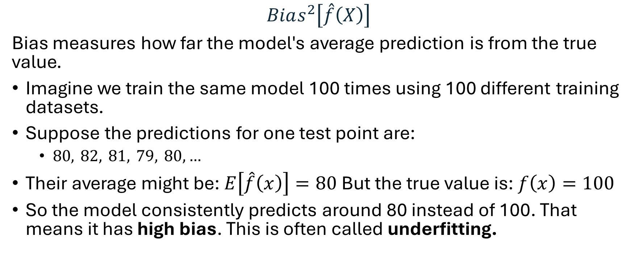
Bias²
$$Bias^{2}\left[\overset{ˆ}{f}\left(X\right)\right]$$
Bias measures how far the model's average prediction is from the true value.
Imagine we train the same model 100 times using 100 different training datasets.
Suppose the predictions for one test point are:
  $80, 82, 81, 79, 80,…$
Their average might be: $E\left[\hat{f}\left(x\right)\right]=80$But the true value is: $f\left(x\right)=100$
So the model consistently predicts around 80 instead of 100. That means it has high bias. This is often called underfitting.

Slide 33
Variance
Variance measures how much the model's prediction changes when we use different training datasets.
High variance means:
  The model is very sensitive to the particular training data it receives.
This is commonly associated with overfitting.

Slide 34
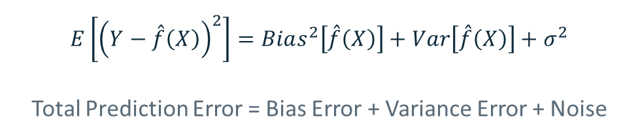
Now Everything Together
$$E\left[{\left(Y−\overset{ˆ}{f}\left(X\right)\right)}^{2}\right]=Bias^{2}\left[\overset{ˆ}{f}\left(X\right)\right]+Var\left[\overset{ˆ}{f}\left(X\right)\right]+σ^{2}$$
Total Prediction Error = Bias Error + Variance Error + Noise
Reduce noise σ²
1
Cleaning, smoothing, aggregation, outlier handling
Reduce variance
2
Fewer and better features, dimensionality reduction, balanced and adequate samples
Reduce bias
3
Feature creation, non-linear transforms, interaction terms, better encodings
Notes:
Walk through the decomposition. Aggregation and denoising reduce the irreducible-looking noise term; feature selection and sampling control variance; feature creation reduces bias.

Slide 35
Example: Very simple model
Model predicts almost everyone around 70:
Actual: 40 60 80 95 50
Prediction: 70 70 70 70 70
The predictions don't change much. Therefore:
Bias → High
Variance → Low
Underfitting → likely

Slide 36
Example: Extremely complex model
Now suppose the model learns the training data almost perfectly. For different training datasets, however, its predictions are:
  Dataset 1 → 95
  Dataset 2 → 55
  Dataset 3 → 110
  Dataset 4 → 72
  Dataset 5 → 40
The predictions change dramatically. Therefore:
Bias → Low
Variance → High
Overfitting → likely

Slide 37
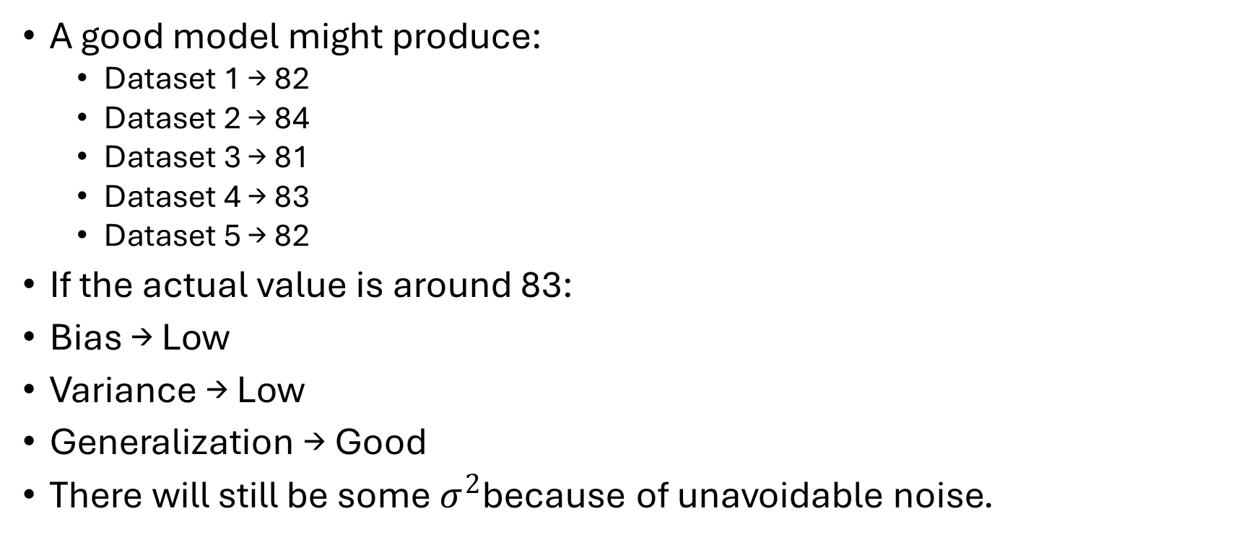
Example: Balanced Model
A good model might produce:
  Dataset 1 → 82
  Dataset 2 → 84
  Dataset 3 → 81
  Dataset 4 → 83
  Dataset 5 → 82
If the actual value is around 83:
Bias → Low
Variance → Low
Generalization → Good
There will still be some $σ^{2}$because of unavoidable noise.

Slide 38
Underfitting vs. Overfitting
Underfitting
Good fit
Overfitting
Bias
High
Low
Very low
Variance
Low
Low / moderate
High
Training error
High
Low
Very low
Test error
High
Low
High
Model complexity
Too low
Appropriate
Too high
7

