Slide 1
Lec # 13
Course: Data Science Tools & Techniques
Instructor: Dr. Mateen Yaqoob

Slide 2
What is Data Distribution?
The way values of variables are spread out.
A way to describe how values of a dataset are spread or arranged.
Shows frequency/probability of occurrence.
Important for data analysis, visualization, and statistical modeling.
Continuous: Probability density (clusters, skewness, tails).
Categorical: Frequency of categories.
Formal definition:
  If X is a random variable → Distribution = P(X) or f(X).

Slide 3
Why Data Distribution Matters?
Helps detect patterns, skewness, and outliers.
Guides data preprocessing (normalization, scaling).
Assists in selecting the right statistical or ML models.

Slide 4
Types of Data Distributions
Normal Distribution (bell-shaped)
Uniform Distribution (equal probabilities)
Skewed Distribution (left/right skew)
Multimodal Distribution (multiple peaks)

Slide 5
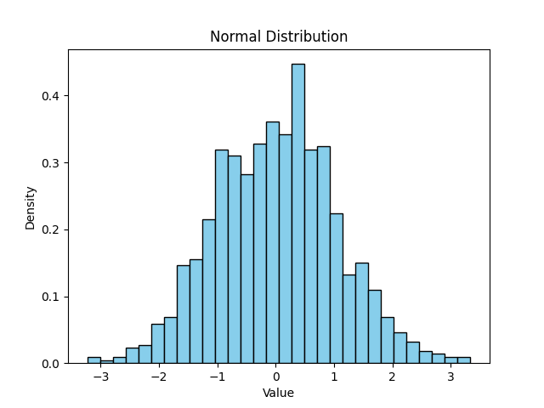
Example: Normal Distribution
Many natural datasets (e.g., heights, test scores).
Symmetrical around the mean.
Used widely in hypothesis testing and ML.

Slide 6
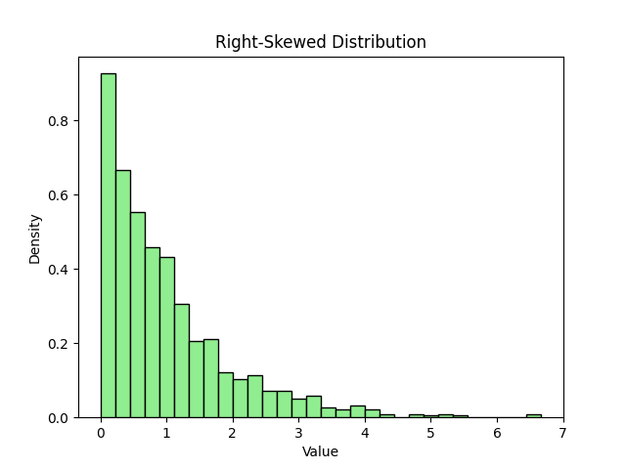
Example: Skewed Distribution
- Income, house prices often show skewness.
- Right skew: long tail on higher values.
- Left skew: long tail on lower values.

Slide 7
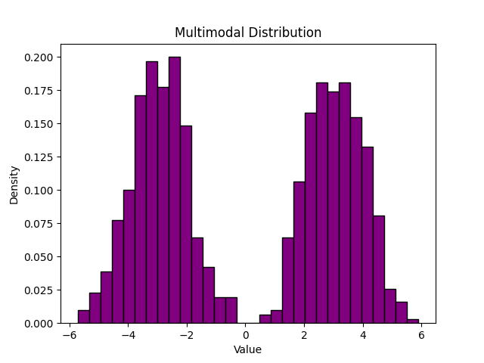
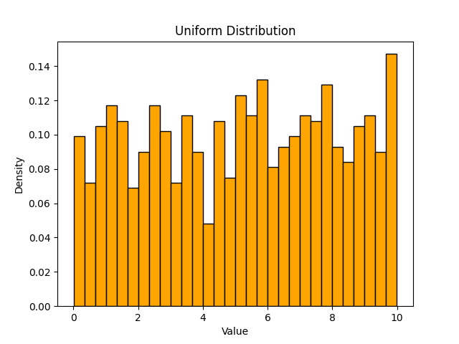

Slide 8
What is IID?
Independent and Identically Distributed
Independent: samples don’t depend on each other
Identically Distributed: all from same distribution
Example: Coin tosses, Iris dataset

Slide 9
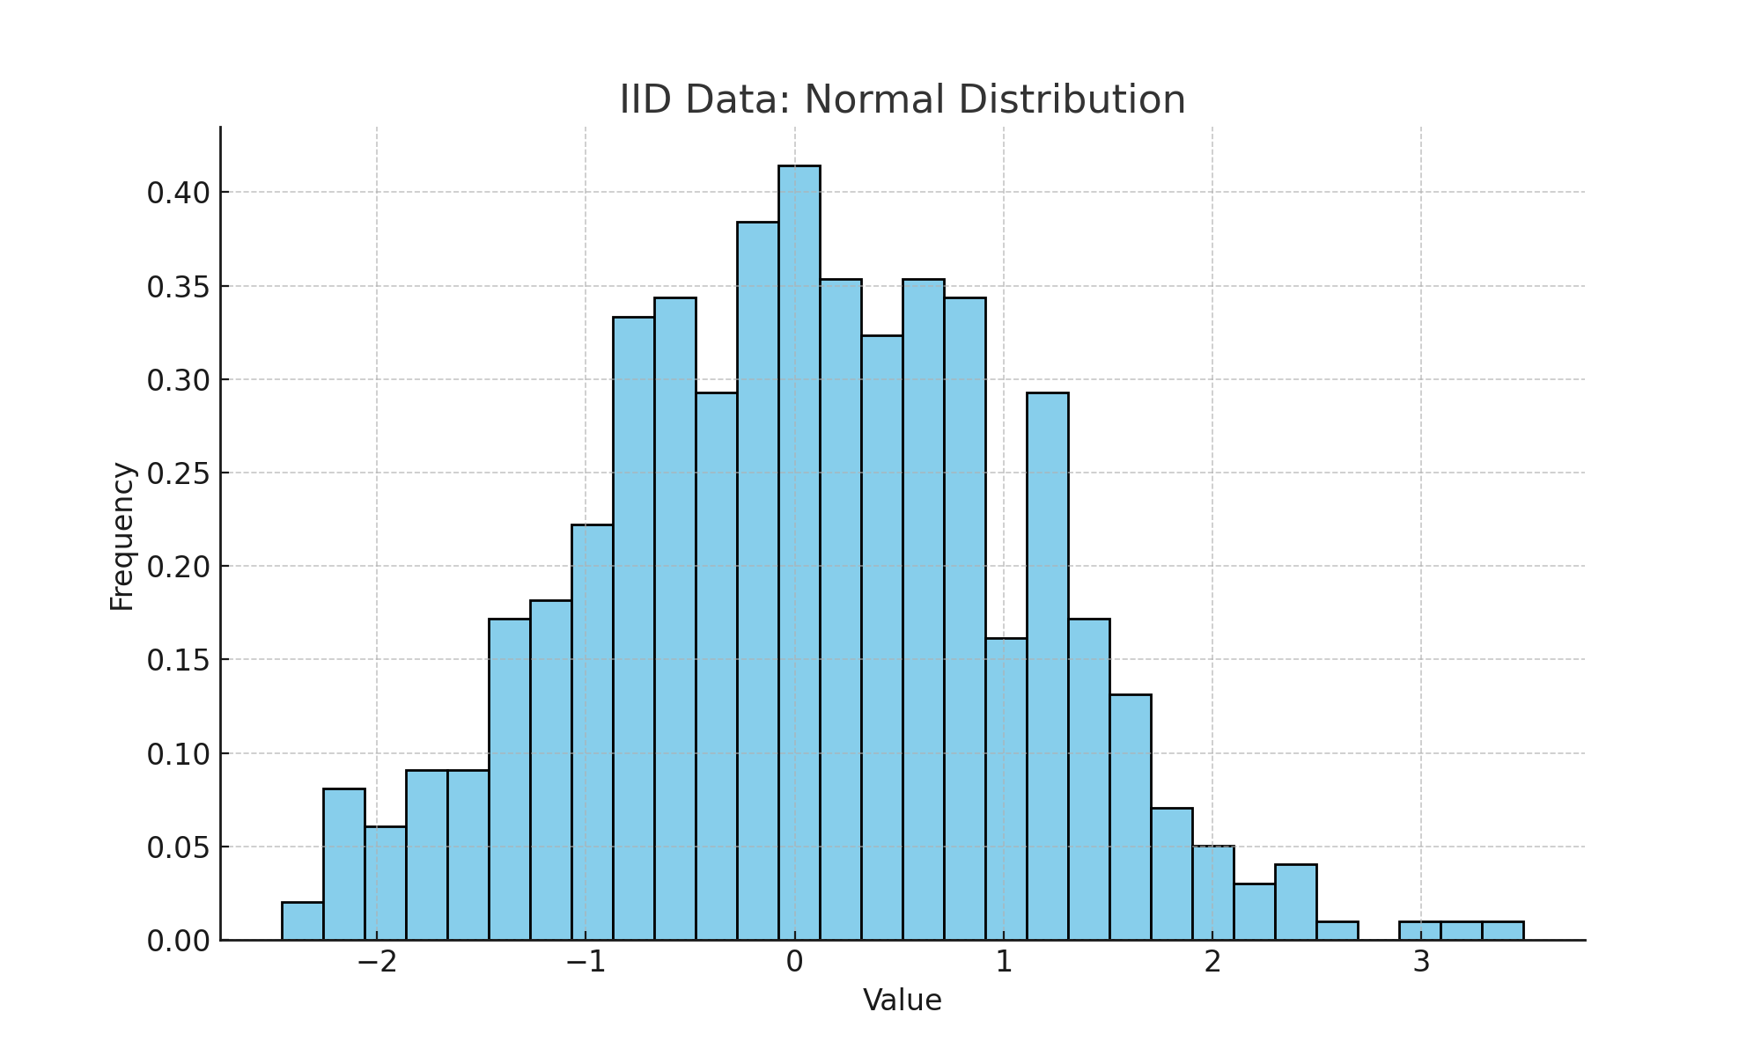
IID Data Distribution

Slide 10
What is Non-IID?
Not Independent: samples correlated (time-series)
Not Identically Distributed: data from different distributions
Examples: Stock prices, federated learning data from hospitals

Slide 11
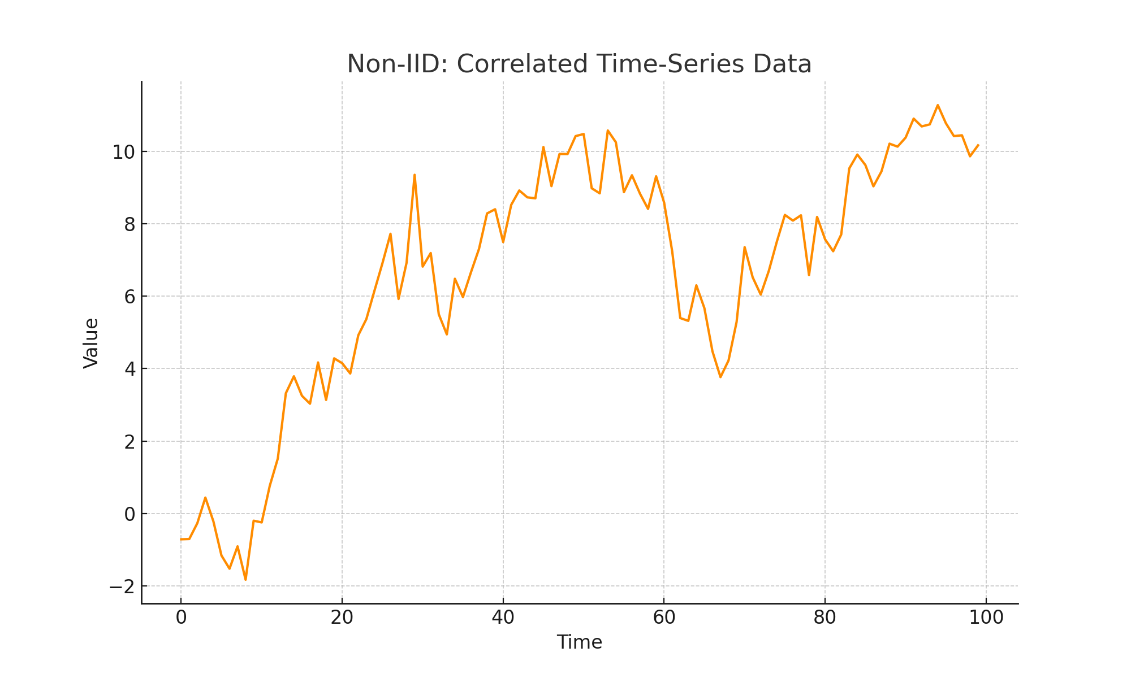
Non-IID (Not Independent)

Slide 12
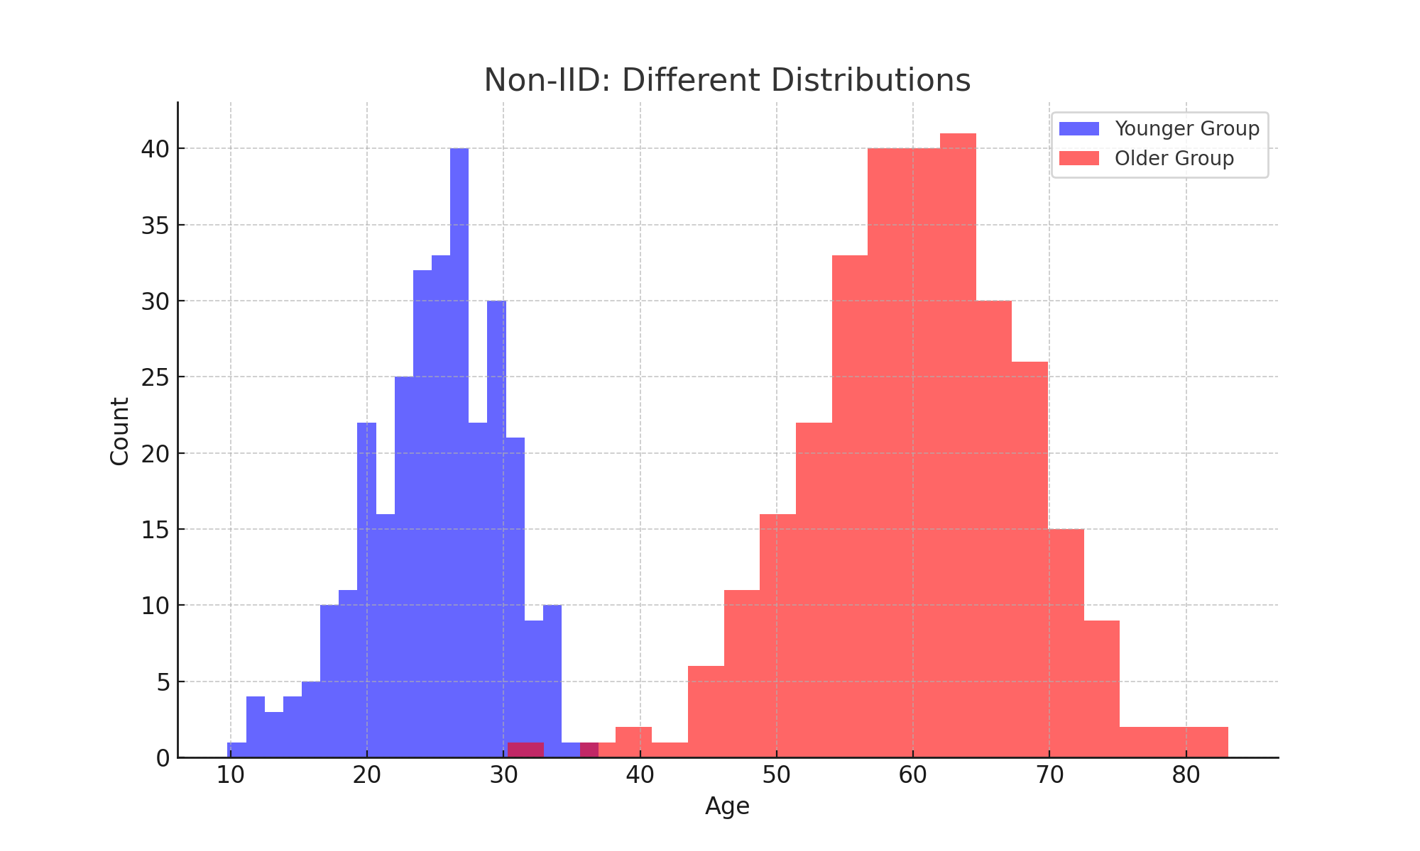
Non-IID (Not Identically Distributed)

Slide 13
Why IID vs Non-IID Matters
Most ML algorithms assume IID
Real-world data is often non-IID
Impacts:
  Model generalization
  Bias & fairness issues
  Harder optimization

Slide 14
Real-World Example – IID Data
Dataset: Iris Dataset
  Each flower measurement (sepal, petal) is independent
  Data is sampled from the same distribution
  Commonly used for classification problems

Slide 15
Real-World Example – Non-IID Data
1. Stock Prices (Time-Series):
  Each price depends on previous ones (temporal dependency)
2. Federated Learning in Healthcare:
  Different hospitals collect patient data
  Distributions vary by demographics & conditions
  Leads to heterogeneous (non-IID) datasets

Slide 16
Visualization Tools
Histograms: Show frequency of data bins.
Boxplots: Show spread, median, outliers.
KDE plots: Show probability density.

Slide 17
Applications in Data Science
Feature engineering: scaling, transformation.
Model assumptions: many ML models assume normality.
Outlier detection and anomaly analysis.

Slide 18
Why pandas?
One of the most popular library that data scientists use
Labeled axes to avoid misalignment of data
  When merge two tables, some rows may be different
Missing values or special values may need to be removed or replaced
 | height | Weight | Weight2 | age | Gender
Amy | 160 | 125 | 126 | 32 | 2
Bob | 170 | 167 | 155 | -1 | 1
Chris | 168 | 143 | 150 | 28 | 1
David | 190 | 182 | NA | 42 | 1
Ella | 175 | 133 | 138 | 23 | 2
Frank | 172 | 150 | 148 | 45 | 1
 | salary | Credit score
Alice | 50000 | 700
Bob | NA | 670
Chris | 60000 | NA
David | -99999 | 750
Ella | 70000 | 685
Tom | 45000 | 660

Slide 19
Overview
Python Library to provide data analysis features similar to: R, MATLAB, SAS
Rich data structures and functions to make working with data structure fast, easy and expressive.
It is built on top of NumPy
Key components provided by Pandas:
  Series
  DataFrame
From now on:
from pandas import Series, DataFrame
import pandas as pd

Slide 20
Why Pandas for Data Science?
Easy to handle structured data
Powerful data preprocessing
Works with CSV, Excel, SQL, JSON, etc.
Used in every DS pipeline: cleaning → analysis → ML input

Slide 21
Series
One dimensional array-like object
It contains array of data (of any NumPy data type) with associated indexes. (Indexes can be strings or integers or other data types.)
By default , the series will get indexing from 0 to N where N = size -1
from pandas import Series, DataFrame
import pandas as pd
obj = Series([4, 7, -5, 3])
print(obj)
print(obj.index)
print(obj.values)
#Output
0 4
1 7
2 -5
3 3
dtype: int64
RangeIndex(start=0, stop=4, step=1)
[ 4 7 -5 3]

Slide 22
Series – array/dict operations
Can be thought of as a dict.
Can be constructed from a dict directly.
obj3 = Series({'d': 4, 'b': 7, 'a': -5, 'c':3 })
print(obj3)
#output
d 4
b 7
a -5
c 3
dtype: int64
obj4 = obj3[obj3>0]
print(obj4)
#output
d 10
b 7
c 3
dtype: int64
print(obj3**2)
#output
d 100
b 49
a 25
c 9
dtype: int64
print(‘b’ in obj3)
#output
true
numpy array operations can also be applied, which will preserve the index-value link

Slide 23
Series – from dictionary
print(pd.isnull(obj4))
#output
Texas False
Ohio False
Oregon False
Iowa True
dtype: bool
print(pd.notnull(obj4))
#output
Texas True
Ohio True
Oregon True
Iowa False
dtype: bool
print(obj4[obj4.notnull()])
#output
Texas 10.0
Ohio 20.0
Oregon 15.0
dtype: float64
sdata = {'Texas': 10, 'Ohio': 20, 'Oregon': 15, 'Utah': 18}
states = ['Texas', 'Ohio', 'Oregon', 'Iowa']
obj4 = Series(sdata, index=states)
print(obj4)
#output
Texas 10.0
Ohio 20.0
Oregon 15.0
Iowa NaN
dtype: float64
dictionary
Missing value

Slide 24
Series – auto alignment
sdata = {'Texas': 10, 'Ohio': 20, 'Oregon': 15, 'Utah': 18}
states = ['Texas', 'Ohio', 'Oregon', 'Iowa']
obj4 = Series(sdata, index=states)
print(obj4)
#Output
Texas 10.0
Ohio 20.0
Oregon 15.0
Iowa NaN
dtype: float64
sdata = {'Texas': 10, 'Ohio': 20, 'Oregon': 15, 'Utah': 18}
states = ['Texas', 'Ohio', 'Oregon', 'Utah']
obj5 = Series(sdata, index=states)
print(obj5)
#Output
Texas 10
Ohio 20
Oregon 15
Utah 18
dtype: int64
print(obj4.add(obj5))
#output
Iowa NaN
Ohio 40.0
Oregon 30.0
Texas 20.0
Utah NaN
dtype: float64
Notes:
print(obj4.add(obj5, fill_value=0)) to avoid NaN

Slide 25
Series name and index name
sdata = {'Texas': 10, 'Ohio': 20, 'Oregon': 15, 'Utah': 18}
states = ['Texas', 'Ohio', 'Oregon', 'Iowa']
obj4 = Series(sdata, index=states)
obj4.name = 'population'
obj4.index.name = 'state'
print(obj4)
#output
state
Texas 10.0
Ohio 20.0
Oregon 15.0
Iowa NaN
Name: population, dtype: float64

Slide 26
Series name and index name
Index of a series can be changed to a different index.
  obj4.index = ['Florida', 'New York', 'Kentucky', 'Georgia']
  Florida 10.0
  New York 20.0
  Kentucky 15.0
  Georgia NaN
  Name: population, dtype: float64
Index object itself is immutable.
  obj4.index[2]='California'
  TypeError: Index does not support mutable operations
  print(obj4.index)
  Index(['Florida', 'New York', 'Kentucky', 'Georgia'], dtype='object')

Slide 27
Indexing, selection and filtering
Series can be sliced/accessed with label-based indexes, or using position-based indexes
S = Series(range(4), index=['zero', 'one', 'two', 'three'])
print(S['two'])
2
print(S[['zero', 'two']])
zero 0
two 2
dtype: int64
print(S[2])
2
print(S[[0,2]])
zero 0
two 2
dtype: int64
list operator for items >1

Slide 28
Indexing, selection and filtering
Series can be sliced/accessed with label-based indexes, or using position-based indexes
S = Series(range(4), index=['zero', 'one', 'two', 'three'])
print(S[:2])
zero 0
one 1
dtype: int32
print(S['zero': 'two'])
zero 0
one 1
two 2
dtype: int32
print(S[S > 1])
two 2
three 3
dtype: int32
print(S[-2:])
two 2
three 3
dtype: int32
Inclusive
Notes:
Slices are

Slide 29
DataFrame
A DataFrame is a tabular data structure comprised of rows and columns, akin to a spreadsheet or database table.
It can be treated as an ordered collection of columns
  Each column can be a different data type
  Have both row and column indices
data = {'state': ['Ohio', 'Ohio', 'Ohio', 'Nevada', 'Nevada'],
'year': [2000, 2001, 2002, 2001, 2002],
'pop': [1.5, 1.7, 3.6, 2.4, 2.9]}
frame = DataFrame(data)
print(frame)
#output
state year pop
0 Ohio 2000 1.5
1 Ohio 2001 1.7
2 Ohio 2002 3.6
3 Nevada 2001 2.4
4 Nevada 2002 2.9

Slide 30
DataFrame
df.head(), df.tail() → view rows
df.shape → rows × columns
df.columns → column names
df.describe() → statistics

Slide 31
DataFrame – specifying columns and indices
Order of columns/rows can be specified.
Columns not in data will have NaN.
frame2 = DataFrame(data, columns=['year', 'state', 'pop', 'debt'], index=['A', 'B', 'C', 'D', 'E'])
Print(frame2)
year state pop debt
A 2000 Ohio 1.5 NaN
B 2001 Ohio 1.7 NaN
C 2002 Ohio 3.6 NaN
D 2001 Nevada 2.4 NaN
E 2002 Nevada 2.9 NaN
Same order
Initialized with NaN

Slide 32
DataFrame – from nested dict of dicts
Outer dict keys as columns and inner dict keys as row indices
pop = {'Nevada': {2001: 2.9, 2002: 2.9}, 'Ohio': {2002: 3.6, 2001: 1.7, 2000: 1.5}}
frame3 = DataFrame(pop)
print(frame3)
#output
Nevada Ohio
2000 NaN 1.5
2001 2.9 1.7
2002 2.9 3.6
Transpose
print(frame3.T)
2000 2001 2002
Nevada NaN 2.9 2.9
Ohio 1.5 1.7 3.6
Union of inner keys (in sorted order)

Slide 33
DataFrame – index, columns, values
frame3.index.name = 'year'
frame3.columns.name='state‘
print(frame3)
state Nevada Ohio
year
2000 NaN 1.5
2001 2.9 1.7
2002 2.9 3.6
print(frame3.index)
Int64Index([2000, 2001, 2002], dtype='int64', name='year')
print(frame3.columns)
Index(['Nevada', 'Ohio'], dtype='object', name='state')
print(frame3.values)
[[nan 1.5]
[2.9 1.7]
[2.9 3.6]]

Slide 34
DataFrame – retrieving a column
A column in a DataFrame can be retrieved as a Series by dict-like notation or as attribute
data = {'state': ['Ohio', 'Ohio', 'Ohio', 'Nevada', 'Nevada'],
'year': [2000, 2001, 2002, 2001, 2002],
'pop': [1.5, 1.7, 3.6, 2.4, 2.9]}
frame = DataFrame(data)
print(frame['state'])
0 Ohio
1 Ohio
2 Ohio
3 Nevada
4 Nevada
Name: state, dtype: object
print(frame.state)
0 Ohio
1 Ohio
2 Ohio
3 Nevada
4 Nevada
Name: state, dtype: object

Slide 35
DataFrame – getting rows
loc for using indexes and iloc for using positions
  loc gets rows (or columns) with particular labels from the index.
  iloc gets rows (or columns) at particular positions in the index (so it only takes integers).
data = {'state': ['Ohio', 'Ohio', 'Ohio', 'Nevada', 'Nevada'],
'year': [2000, 2001, 2002, 2001, 2002],
'pop': [1.5, 1.7, 3.6, 2.4, 2.9]}
frame2 = DataFrame(data, columns=['year', 'state', 'pop', 'debt'], index=['A', 'B', 'C', 'D', 'E'])
print(frame2)
year state pop debt
A 2000 Ohio 1.5 NaN
B 2001 Ohio 1.7 NaN
C 2002 Ohio 3.6 NaN
D 2001 Nevada 2.4 NaN
E 2002 Nevada 2.9 NaN
print(frame2.loc['A'])
year 2000
state Ohio
pop 1.5
debt NaN
Name: A, dtype: object
print(frame2.loc[['A', 'B']])
year state pop debt
A 2000 Ohio 1.5 NaN
B 2001 Ohio 1.7 NaN
print(frame2.loc['A':'E',['state','pop']])
state pop
A Ohio 1.5
B Ohio 1.7
C Ohio 3.6
D Nevada 2.4
E Nevada 2.9
print(frame2.iloc[1:3])
year state pop debt
B 2001 Ohio 1.7 NaN
C 2002 Ohio 3.6 NaN
print(frame2.iloc[:,1:3])
state pop
A Ohio 1.5
B Ohio 1.7
C Ohio 3.6
D Nevada 2.4
E Nevada 2.9

Slide 36
DataFrame – modifying columns
frame2['debt'] = 0
print(frame2)
year state pop debt
A 2000 Ohio 1.5 0
B 2001 Ohio 1.7 0
C 2002 Ohio 3.6 0
D 2001 Nevada 2.4 0
E 2002 Nevada 2.9 0
frame2['debt'] = range(5)
print(frame2)
year state pop debt
A 2000 Ohio 1.5 0
B 2001 Ohio 1.7 1
C 2002 Ohio 3.6 2
D 2001 Nevada 2.4 3
E 2002 Nevada 2.9 4
val = Series([10, 10, 10], index = ['A', 'C', 'D'])
frame2['debt'] = val
print(frame2)
year state pop debt
A 2000 Ohio 1.5 10.0
B 2001 Ohio 1.7 NaN
C 2002 Ohio 3.6 10.0
D 2001 Nevada 2.4 10.0
E 2002 Nevada 2.9 NaN
Rows or individual elements can be modified similarly. Using loc or iloc.

Slide 37
DataFrame – removing columns
del frame2['debt']
print(frame2)
year state pop
A 2000 Ohio 1.5
B 2001 Ohio 1.7
C 2002 Ohio 3.6
D 2001 Nevada 2.4
E 2002 Nevada 2.9
Notes:
Df = frame.drop('r1', 0) # 0 for row, 1 for columns

Slide 38
More on DataFrame indexing
import numpy as np
data = np.arange(9).reshape(3,3)
print(data)
[[0 1 2]
[3 4 5]
[6 7 8]]
frame = DataFrame(data, index=['r1', 'r2', 'r3'], columns=['c1', 'c2', 'c3'])
print(frame)
c1 c2 c3
r1 0 1 2
r2 3 4 5
r3 6 7 8
print(frame['c1'])
r1 0
r2 3
r3 6
Name: c1, dtype: int32
print(frame.loc['r1'])
c1 0
c2 1
c3 2
Name: r1, dtype: int32
print(frame['c1']['r1'])
0
print(frame[['c1', 'c3']])
c1 c3
r1 0 2
r2 3 5
r3 6 8
print(frame.loc[['r1','r3']])
c1 c2 c3
r1 0 1 2
r3 6 7 8
print(frame.iloc[:2])
c1 c2 c3
r1 0 1 2
r2 3 4 5
print(frame[:2])
c1 c2 c3
r1 0 1 2
r2 3 4 5
Row slices

Slide 39
More on DataFrame indexing - 2
print(frame.loc[['r1', 'r2'], ['c1', 'c2']])
c1 c2
r1 0 1
r2 3 4
print(frame.iloc[:2,:2])
c1 c2
r1 0 1
r2 3 4
v = DataFrame(np.arange(9).reshape(3,3), index=['a', 'a', 'b'], columns=['c1','c2','c3'])
print(v)
c1 c2 c3
a 0 1 2
a 3 4 5
b 6 7 8
print(v.loc['a'])
c1 c2 c3
a 0 1 2
a 3 4 5
print(frame.loc['r1':'r3', 'c1':'c3'])
c1 c2 c3
r1 0 1 2
r2 3 4 5
r3 6 7 8
Duplicated keys

Slide 40
More on DataFrame indexing - 3
print(frame)
c1 c2 c3
r1 0 1 2
r2 3 4 5
r3 6 7 8
print(frame <3)
c1 c2 c3
r1 True True True
r2 False False False
r3 False False False
print(frame[frame['c1']>0])
c1 c2 c3
r2 3 4 5
r3 6 7 8
print(frame['c1']>0)
r1 False
r2 True
r3 True
Name: c1, dtype: bool
frame[frame<3] = 3
print(frame)
c1 c2 c3
r1 3 3 3
r2 3 4 5
r3 6 7 8

Slide 41
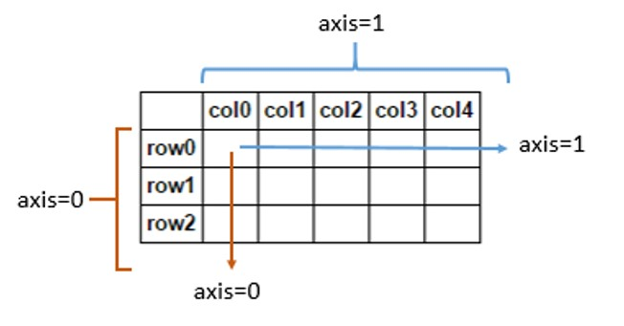
Removing rows/columns
print(frame)
c1 c2 c3
r1 0 1 2
r2 3 4 5
r3 6 7 8
print(frame.drop(['r1']))
c1 c2 c3
r2 3 4 5
r3 6 7 8
print(frame.drop(['r1','r3']))
c1 c2 c3
r2 3 4 5
print(frame.drop(['c1'], axis=1))
c2 c3
r1 1 2
r2 4 5
r3 7 8
This returns a new object

Slide 42
Reindexing
Alter the order of rows/columns of a DataFrame or order of a series according to new index
frame2 = frame.reindex(columns=['c2', 'c3', 'c1'])
print(frame2)
c2 c3 c1
r1 1 2 0
r2 4 5 3
r3 7 8 6
frame2 = frame.reindex(['r1', 'r3', 'r2', 'r4'])
c1 c2 c3
r1 0.0 1.0 2.0
r3 6.0 7.0 8.0
r2 3.0 4.0 5.0
r4 NaN NaN NaN
This returns a new object

Slide 43

Function application and mapping
DataFrame.applymap(f) applies f to every entry
DataFrame.apply(f) applies f to every column (default) or row
print(frame)
c1 c2 c3
r1 0 1 2
r2 3 4 5
r3 6 7 8
def square(x):
return x**2
print(frame.applymap(square))
c1 c2 c3
r1 0 1 4
r2 9 16 25
r3 36 49 64
def max_minus_min(x):
return max(x)-min(x)
print(frame.apply(max_minus_min))
c1 6
c2 6
c3 6
dtype: int64
print(frame.apply(max_minus_min,axis=1))
r1 2
r2 2
r3 2
dtype: int64

Slide 44
Function application and mapping - 2
def max_min(x):
return Series([max(x), min(x)], index=['max', 'min'])
print(frame.apply(max_min))
c1 c2 c3
max 6 7 8
min 0 1 2

Slide 45
Other DataFrame functions
sort_values()
sort_index()
frame.index=['A', 'C', 'B']; frame.columns=['b','a','c'];
print(frame)
b a c
A 0 1 2
C 3 4 5
B 6 7 8
print(frame.sort_index())
b a c
A 0 1 2
B 6 7 8
C 3 4 5
print(frame.sort_index(axis=1))
a b c
A 1 0 2
C 4 3 5
B 7 6 8
frame = DataFrame(np.random.randint(0, 10, 9).reshape(3,-1), index=['r1', 'r2', 'r3'], columns=['c1', 'c2', 'c3'])
print(frame)
c1 c2 c3
r1 6 9 0
r2 8 2 9
r3 8 0 6
print(frame.sort_values(by='c1'))
c1 c2 c3
r1 6 9 0
r2 8 2 9
r3 8 0 6
print(frame.sort_values(axis=1,by=['r3','r1']))
c2 c3 c1
r1 9 0 6
r2 2 9 8
r3 0 6 8

Slide 46
Other DataFrame functions
mean()
  Mean(axis=0, skipna=True)
sum()
cumsum()
describe(): return summary statistics of each column
  for numeric data: mean, std, max, min, 25%, 50%, 75%, etc.
  For non-numeric data: count, uniq, most-frequent item, etc.
corr(): correlation between two Series, or between columns of a DataFrame
corr_with(): correlation between columns of DataFram and a series or between the columns of another DataFrame

Slide 47
Importing Pandas & Loading Data
Example: Adult Dataset (UCI ML Repository)
import pandas as pd
df = pd.read_csv("adult.csv")
print(df.head())
print(df.info())

Slide 48
Selecting Data
# Select column
df['age']
# Select multiple columns
df[['age', 'income']]
# Select rows (by index)
df.iloc[0:5]
# Filter rows
df[df['age'] > 50]

Slide 49
Handling Missing Data
df.isnull().sum() # Check NA
df['income'].fillna('Unknown') # Fill NA
df.dropna() # Drop missing rows

Slide 50
Data Transformation
# Rename column
df.rename(columns={'education-num':'edu_num'}, inplace=True)
# Apply function
df['income_flag'] = df['income'].apply(lambda x: 1 if x=='>50K' else 0)
# Encoding categorical data
pd.get_dummies(df['gender'])

Slide 51
Visualization
df['age'].hist() # Histogram
df['income'].value_counts().plot(kind='bar')

Slide 52
Handling missing data
Filtering out missing values
from numpy import nan as NaN
data = Series([1, NaN, 2.5, NaN, 6])
print(data)
0 1.0
1 NaN
2 2.5
3 NaN
6.0
dtype: float64
print(data.notnull())
0 True
1 False
2 True
3 False
4 True
dtype: bool
print(data[data.notnull()])
0 1.0
2 2.5
4 6.0
dtype: float64
print(data.dropna())
0 1.0
2 2.5
4 6.0
dtype: float64
Notes:
s.dropna(inplace=True)

Slide 53
Handling missing data - 2
data = DataFrame([[1, 2, 3], [1, NaN, NaN], [NaN, NaN, NaN], [NaN, 4, 5]])
print(data)
0 1 2
0 1.0 2.0 3.0
1 1.0 NaN NaN
2 NaN NaN NaN
NaN 4.0 5.0
print(data.dropna())
0 1 2
0 1.0 2.0 3.0
print(data.dropna(how='all'))
0 1 2
0 1.0 2.0 3.0
1 1.0 NaN NaN
NaN 4.0 5.0
print(data.dropna(axis=1, how='all'))
0 1 2
0 1.0 2.0 3.0
1 1.0 NaN NaN
2 NaN NaN NaN
3 NaN 4.0 5.0
data[4]=NaN
print(data)
0 1 2 4
0 1.0 2.0 3.0 NaN
1 1.0 NaN NaN NaN
2 NaN NaN NaN NaN
NaN 4.0 5.0 NaN
print(data.dropna(axis=1, how='all'))
0 1 2
0 1.0 2.0 3.0
1 1.0 NaN NaN
2 NaN NaN NaN
3 NaN 4.0 5.0

Slide 54
Filling in missing data
print(data)
0 1 2 4
0 1.0 2.0 3.0 NaN
1 1.0 NaN NaN NaN
2 NaN NaN NaN NaN
NaN 4.0 5.0 NaN
print(data.fillna(0))
0 1 2 4
0 1.0 2.0 3.0 0.0
1 1.0 0.0 0.0 0.0
2 0.0 0.0 0.0 0.0
3 0.0 4.0 5.0 0.0
print(data)
0 1 2
0 1.0 2.0 3.0
1 1.0 NaN NaN
2 NaN NaN NaN
3 NaN 4.0 5.0
print(data.fillna(data.mean(skipna=True)))
0 1 2
0 1.0 2.0 3.0
1 1.0 3.0 4.0
2 1.0 3.0 4.0
3 1.0 4.0 5.0
print(data.fillna(0, inplace=True))
print(data)
0 1 2 4
0 1.0 2.0 3.0 0.0
1 1.0 0.0 0.0 0.0
2 0.0 0.0 0.0 0.0
3 0.0 4.0 5.0 0.0
replace nan with column mean
Modify the dataframe instead of returning a new object (default)

Slide 55
Home Activity # 1
Create a numpy array of the shape (3,5): 3 rows and 5 columns with random values from 1 to 100
  Use np.random.randint(low,high, (shape))
Use the numpy array to generate a Data Frame with index = a,b,c and columns 1,2,3,4,5
Transpose (using .T) the DataFrame and change the values less than 40 to 0 in the Data Frame.
Notes:
Obj = pd.read_csv(‘values.csv’)

Slide 56
Home Activity # 2
Use the Data Frame created at the Home Activity # 1
Apply a lambda function to calculate the square root of each value in the data frame
  import math math.sqrt()
Notes:
Obj = pd.read_csv(‘values.csv’)

Slide 57
Any Questions ?

