Slide 1
Lec # 15
Course: Data Science Tools & Techniques
Instructor: Dr. Mateen Yaqoob

Slide 2
Learning Objectives
Understand text analysis fundamentals
Apply tokenization, stemming, and lemmatization
Build Bag of Words and TF-IDF models
Visualize and compare feature importance

Slide 3
Why text representation matters?
Raw text is unstructured: computers need numeric features
Representation determines model performance and interpretability
Use cases: classification, clustering, retrieval, information extraction

Slide 4
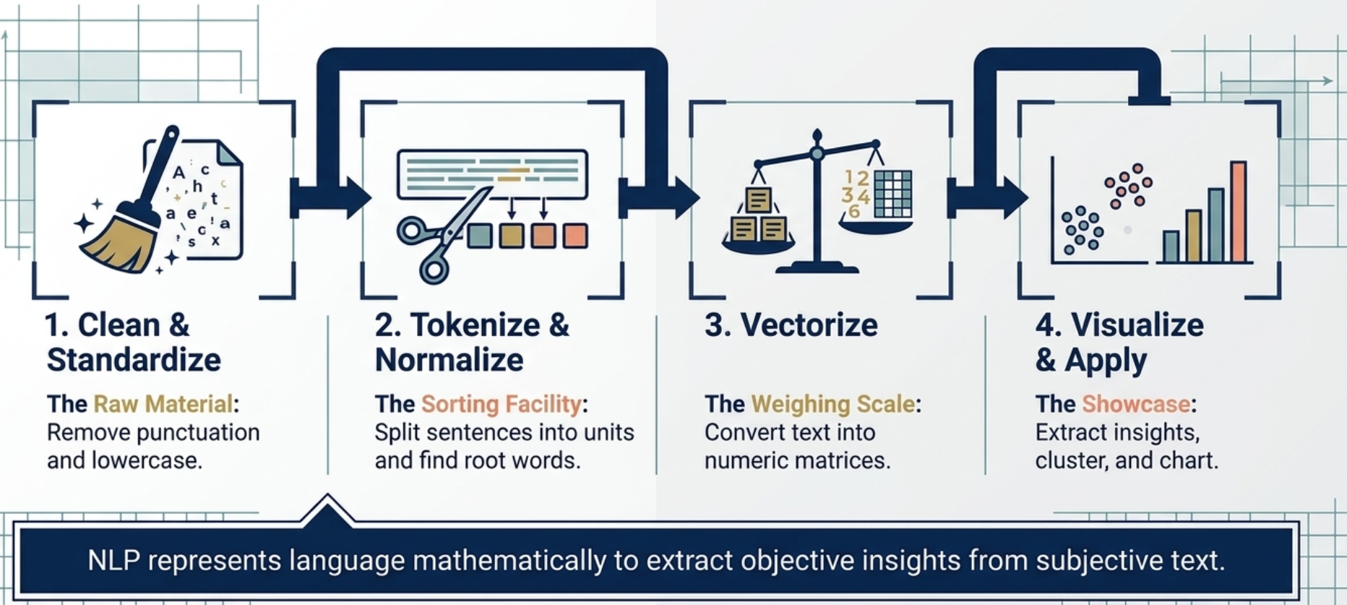
NLP Pipeline Overview

Slide 5
NLP Pipeline Overview
Text Cleaning → Tokenization → Stopword Removal → Stemming/Lemmatization → Feature Extraction → Modeling

Slide 6
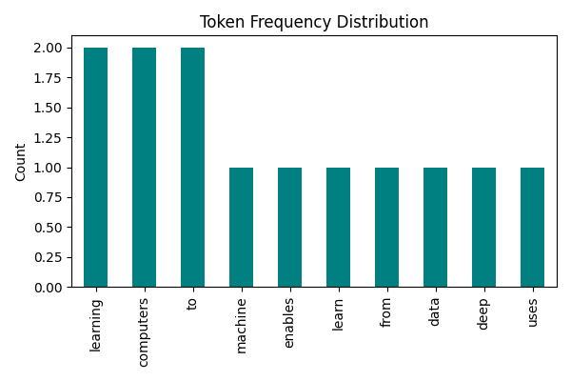
Tokenization
Definition: Splitting a text document D into a sequence of tokens.
T (D) = {w₁, w₂, w₃, . . . , w_{n}}
Example:
Input: “Machine learning enables computers to learn from data.” Output Tokens: [machine, learning, enables, computers, learn, data]

Slide 7
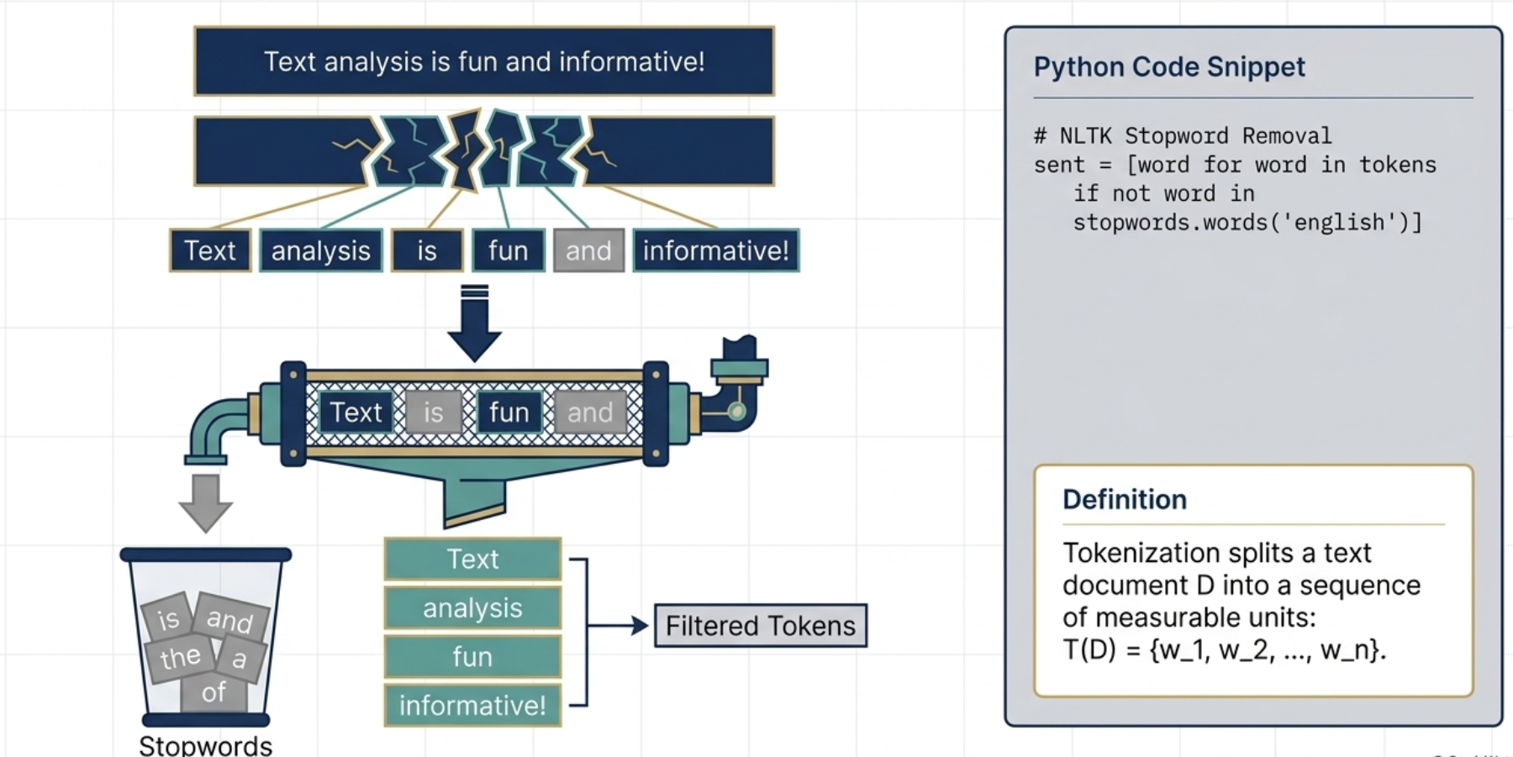
Tokenization

Slide 8
Example: Tokenization and Stopwords
Sentence: "Text analysis is fun and informative!"
After tokenization: ['Text', 'analysis', 'is', 'fun', 'and', 'informative']
After stopword removal: ['Text', 'analysis', 'fun', 'informative']

Slide 9
Stemming vs Lemmatization
Stemming: Reduces words to their root forms by removing suffixes.
stem(word ) = root(word )
Lemmatization: Uses morphological analysis to return the dictionary base form (lemma).
lemma(word ) = dictionary form(word )
Example:
Original | Stemmed | Lemmatized
running | run | run
studies | studi | study
better | better | good
ta

Slide 10
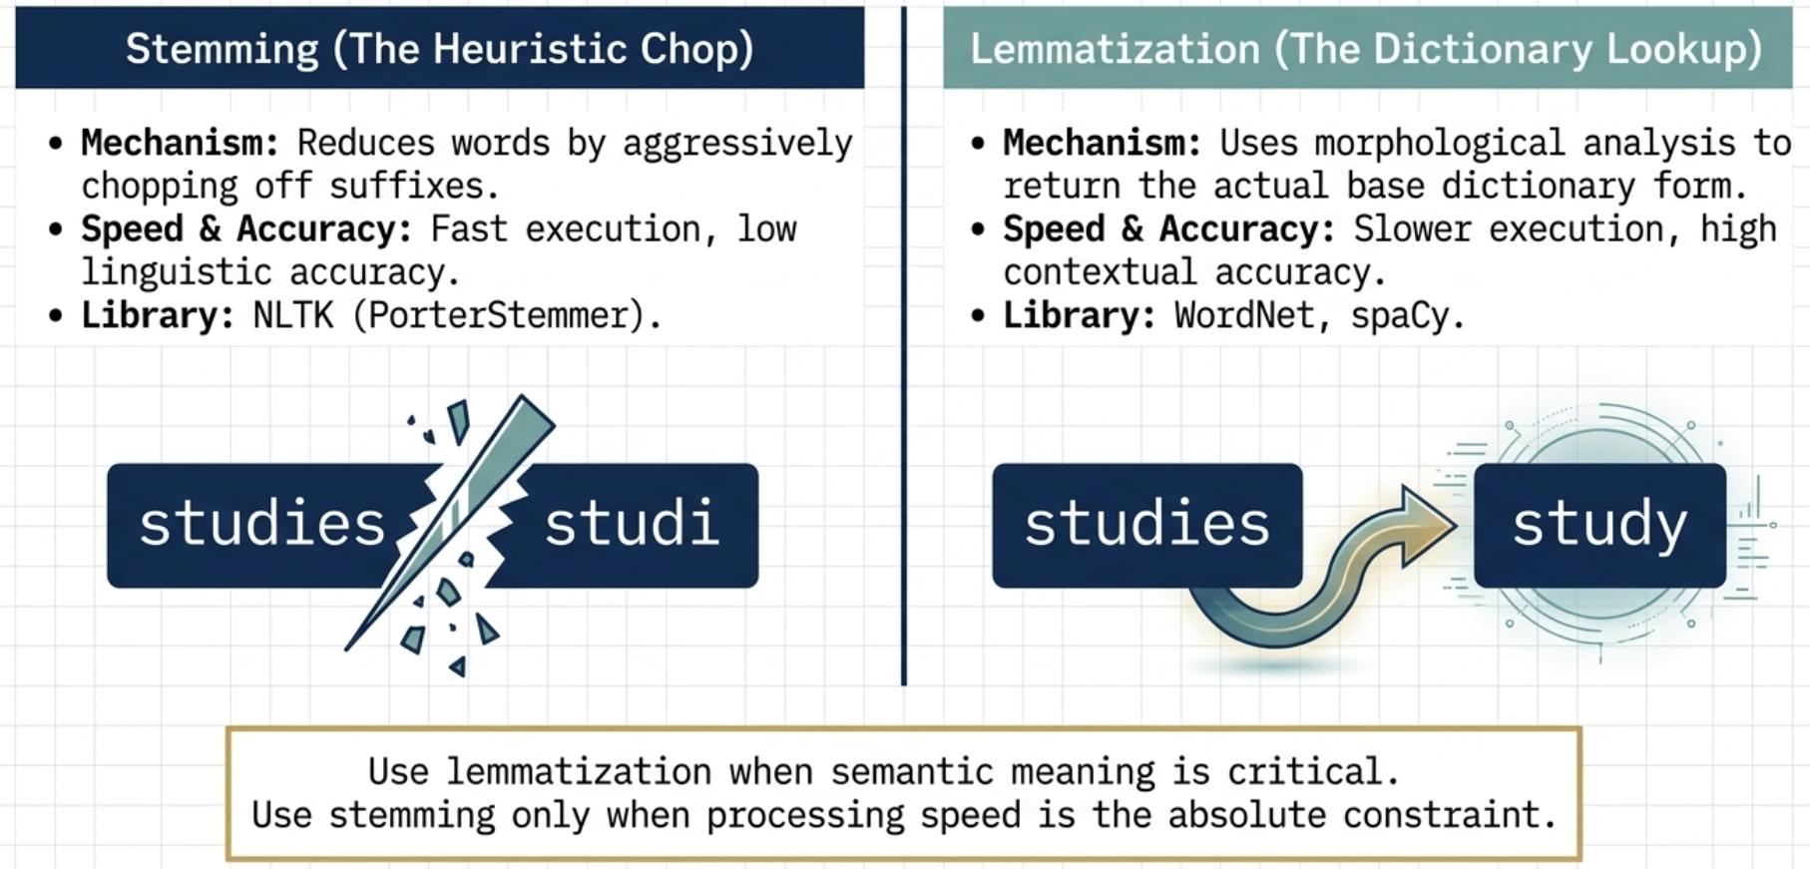
Stemming vs Lemmatization

Slide 11
Stemming Example (Python)
from nltk.stem import PorterStemmer
stemmer = PorterStemmer()
words = ["running", "runs", "easily", "fairly"]
print([stemmer.stem(w) for w in words])
Notes:
Output: ['run', 'run', 'easili', 'fairli']

Slide 12
Lemmatization Example (Python)
from nltk.stem import WordNetLemmatizer
lemmatizer = WordNetLemmatizer()
words = ["running", "ran", "better"]
for w in words:
print(w, '→', lemmatizer.lemmatize(w, pos='v'))
Notes:
Output: running→run; ran→run; better→good

Slide 13
Stemming vs Lemmatization
Feature | Stemming | Lemmatization
Approach | Heuristic | Linguistic
Accuracy | Low | High
Speed | Fast | Slower
Libraries | NLTK, Snowball | WordNet

Slide 14
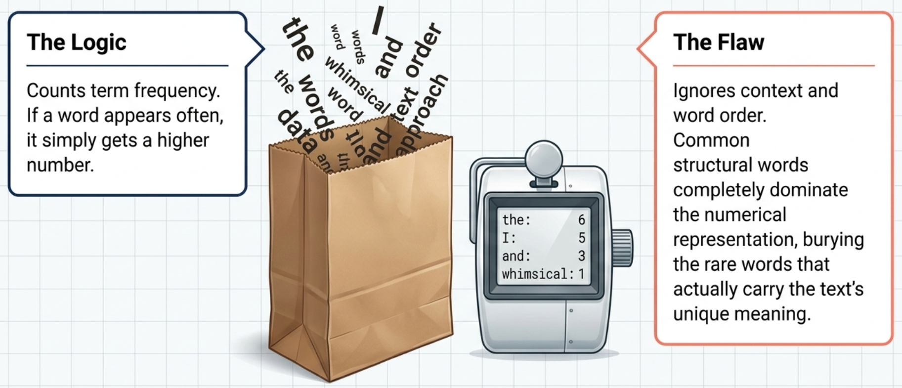
Bag of Words (BoW)

Slide 15
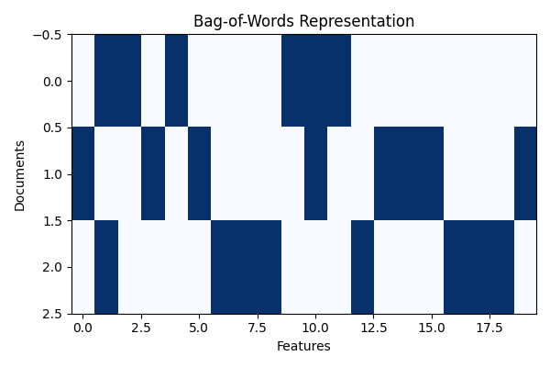
Bag of Words (BoW)
Definition: Represents documents as vectors of word occurrence counts.
X_{ij} = count of word j in document i
Characteristics:
Ignores grammar and word order.
Produces sparse, high-dimensional matrices.

Slide 16
Bag of Words Example (Python)
from sklearn.feature_extraction.text import CountVectorizer
corpus = ["I love data science", "Data science is amazing"]
vec = CountVectorizer()
X = vec.fit_transform(corpus)
print(vec.get_feature_names_out())
print(X.toarray())

Slide 17
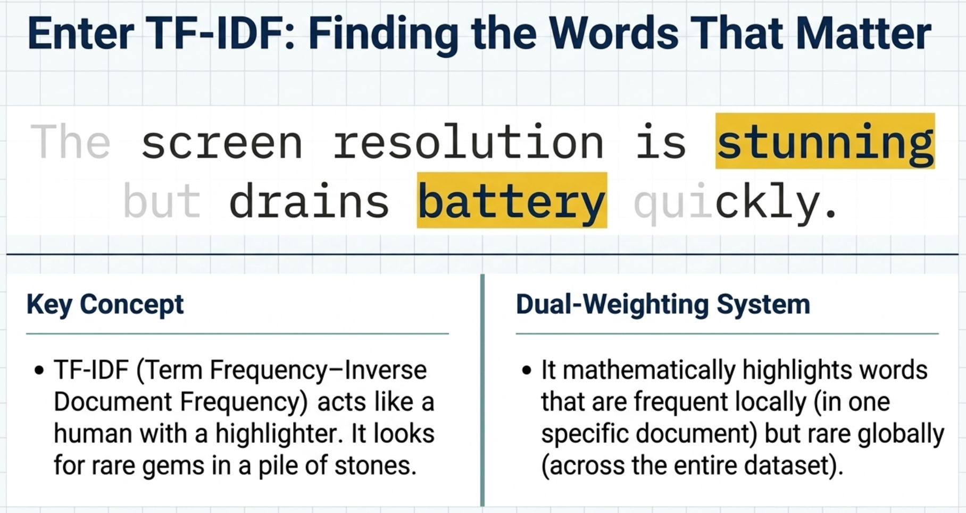

Slide 18
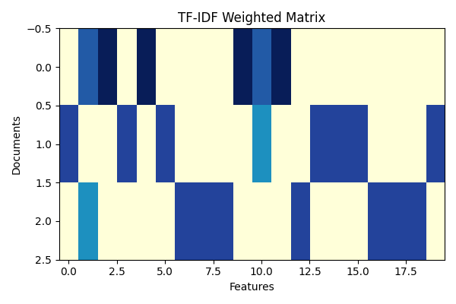
Term Frequency–Inverse Document Frequency (TF–IDF)
Mathematical Formula:
TFIDF_{t,d} = TF_{t,d} × log
N
DF_{t}
where:
TF_{t,d} = Term frequency of term t in document d DF_{t} = Number of documents containing term t N = Total number of documents

Slide 19
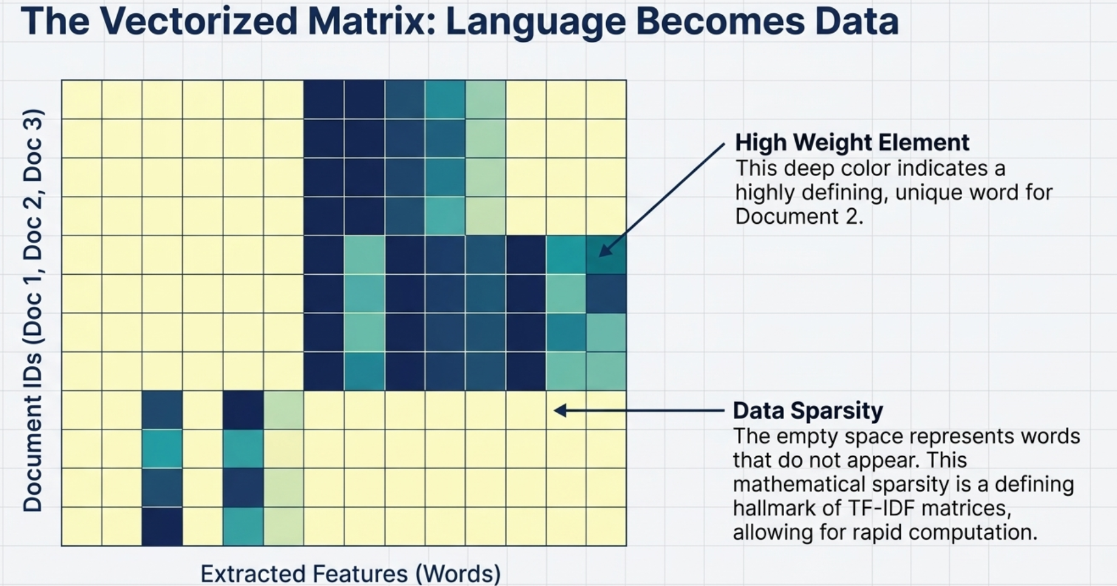

Slide 20
TF-IDF Example (Python)
from sklearn.feature_extraction.text import TfidfVectorizer
corpus = ["I love data science", "Data science is amazing"]
tfidf = TfidfVectorizer()
X = tfidf.fit_transform(corpus)
print(tfidf.get_feature_names_out())
print(X.toarray())

Slide 21
Comparison: BoW vs TF-IDF
Bag of Words counts term frequency.
TF-IDF adjusts weights using inverse document frequency.
TF-IDF highlights rare but important words.

Slide 22
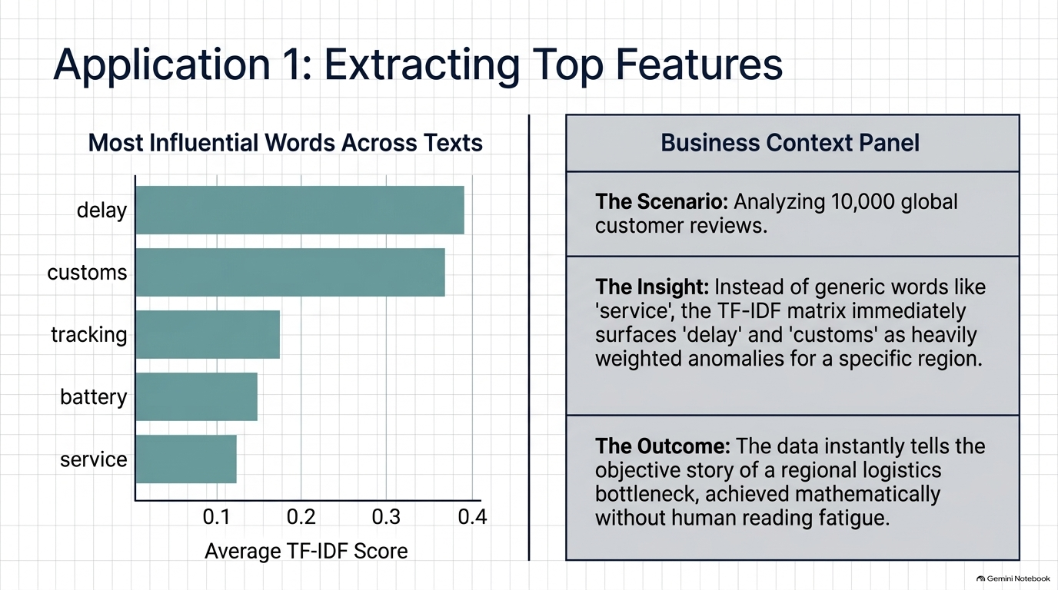

Slide 23
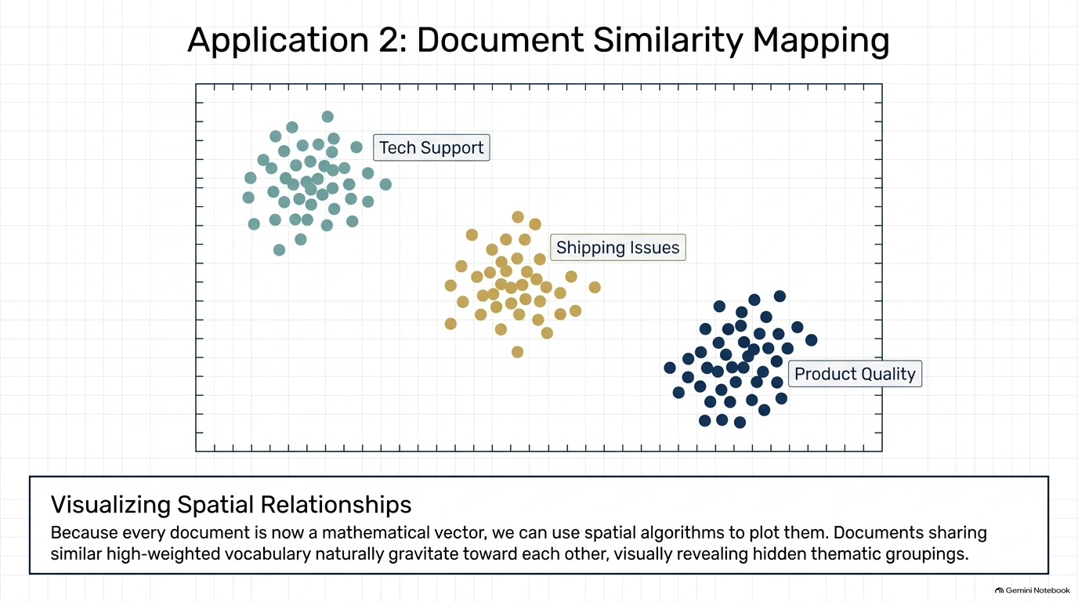

Slide 24
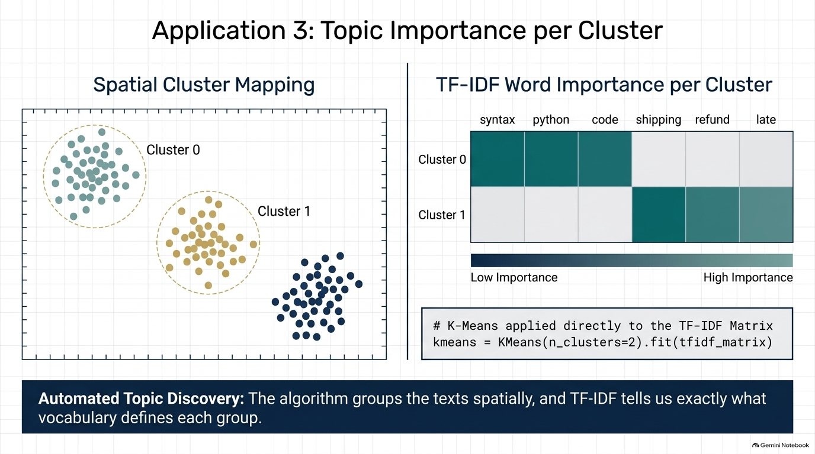

Slide 25
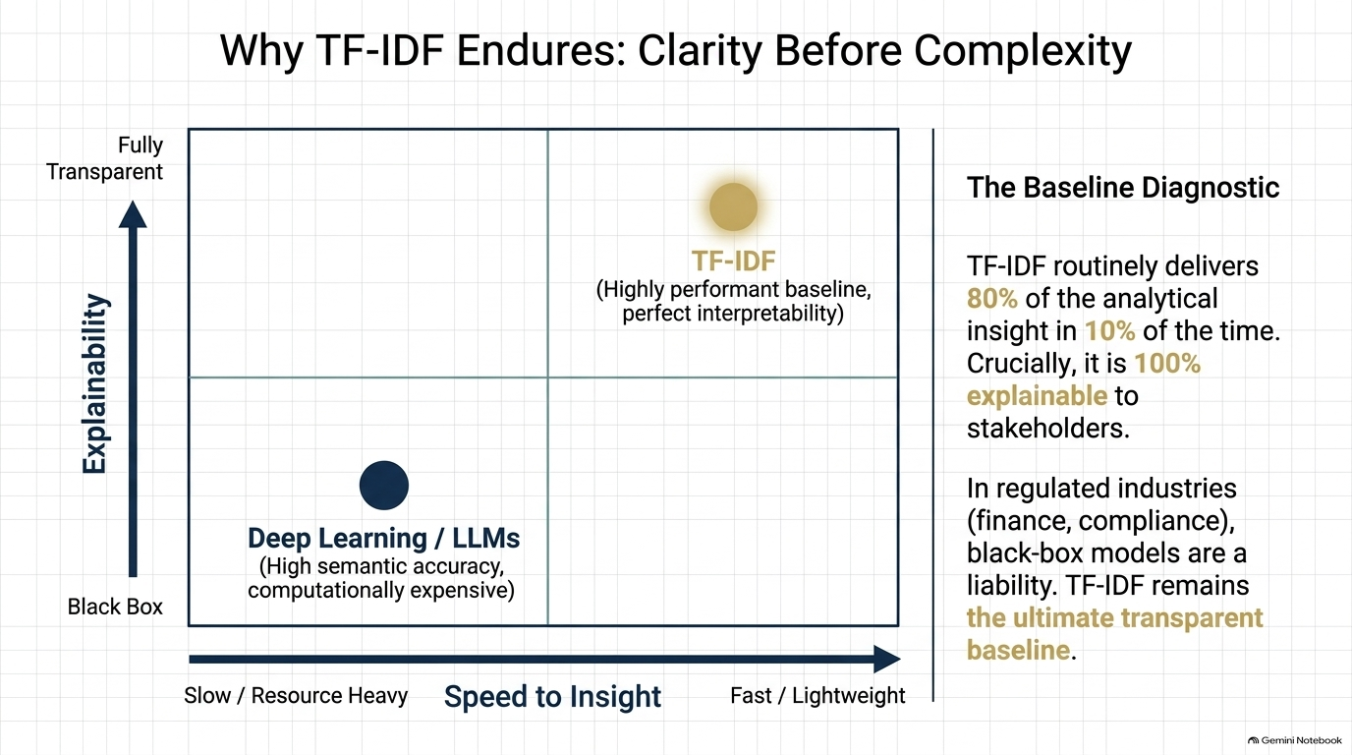

Slide 26
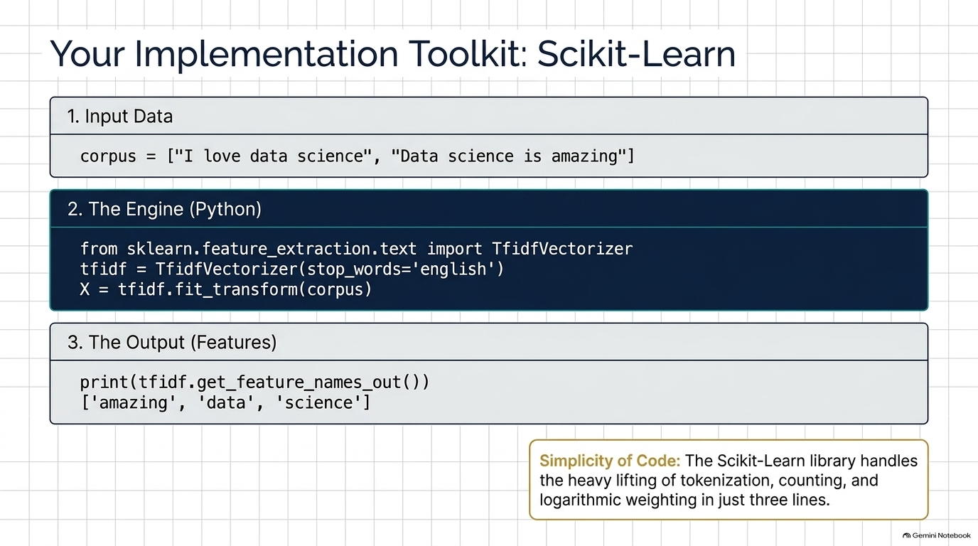

Slide 27
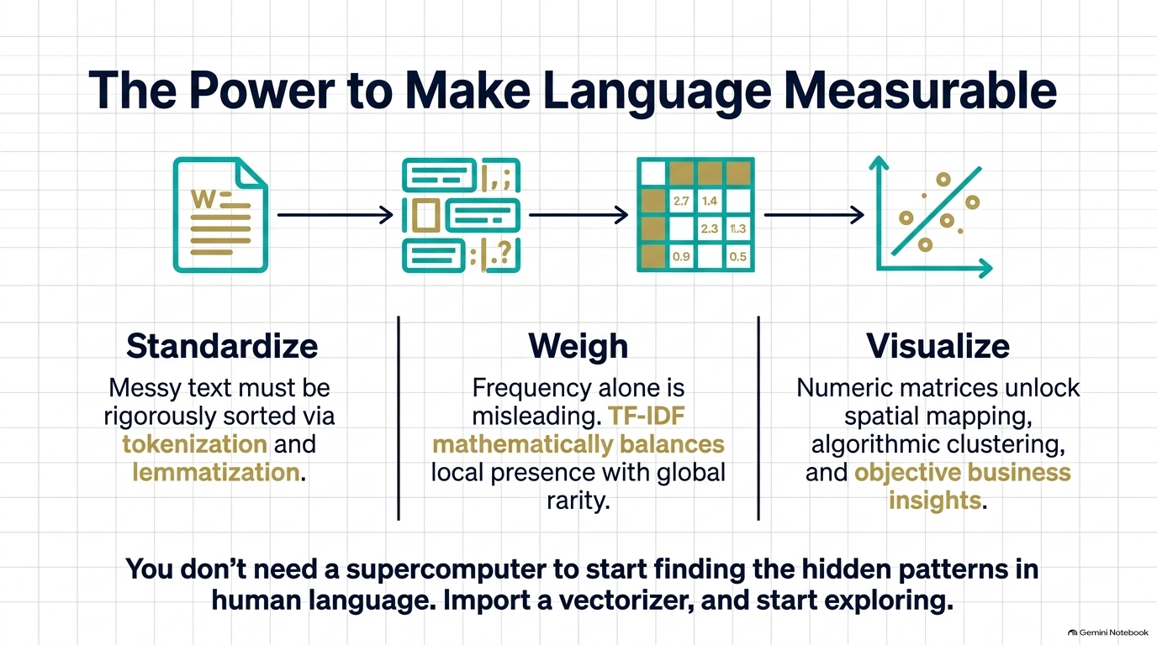

Slide 28
Any Questions ?

