Slide 1
Lec # 16
Course: Data Science Tools & Techniques
Instructor: Dr. Mateen Yaqoob

Slide 2




Big Data - Definition
Some make it 4Vs
Volume
Velocity
Variety
Veracity
Data Size
Data in Motion
Data in many Forms
Data in Doubt
Uncertainty due to data inconsistency & incompleteness, ambiguities, latency, deception, model approximations
Terabytes to exabytes of existing data process
Streaming data, milliseconds to
seconds to respond
Structured, unstructured text, multimedia

Slide 3

Big Data Analysis Pipeline
Major steps in the analysis of big data
Acquisition/ Recording
Extraction/
Cleaning/
Annotation
Integration/
Representation
Analysis/
Modeling
Interpretation/
Visualization
Source: http://www.cra.org/ccc/files/docs/init/bigdatawhitepaper.pdf
Notes:
http://www.cra.org/ccc/files/docs/init/bigdatawhitepaper.pdf

Slide 4
Hadoop
Hadoop is an open-source framework that allows us to store & process large datasets in a parallel & distributed manner.
Hadoop Distributed File System (HDFS) is the primary data storage system used by Hadoop application.
MapReduce is the Hadoop processing unit.
Three main components: HDFS, MapReduce, and Hadoop YARN.
Notes:
Hadoop HDFS - Hadoop Distributed File System (HDFS) is the storage unit of Hadoop.
Hadoop MapReduce - Hadoop MapReduce is the processing unit of Hadoop. This software framework is used to write applications to process vast amounts of data.
Hadoop YARN (Yet Another Resource Negotiator) - Hadoop YARN is a resource management component of Hadoop. It processes and runs data for batch, stream, interactive, and graph processing - all of which are stored in HDFS.

Slide 5
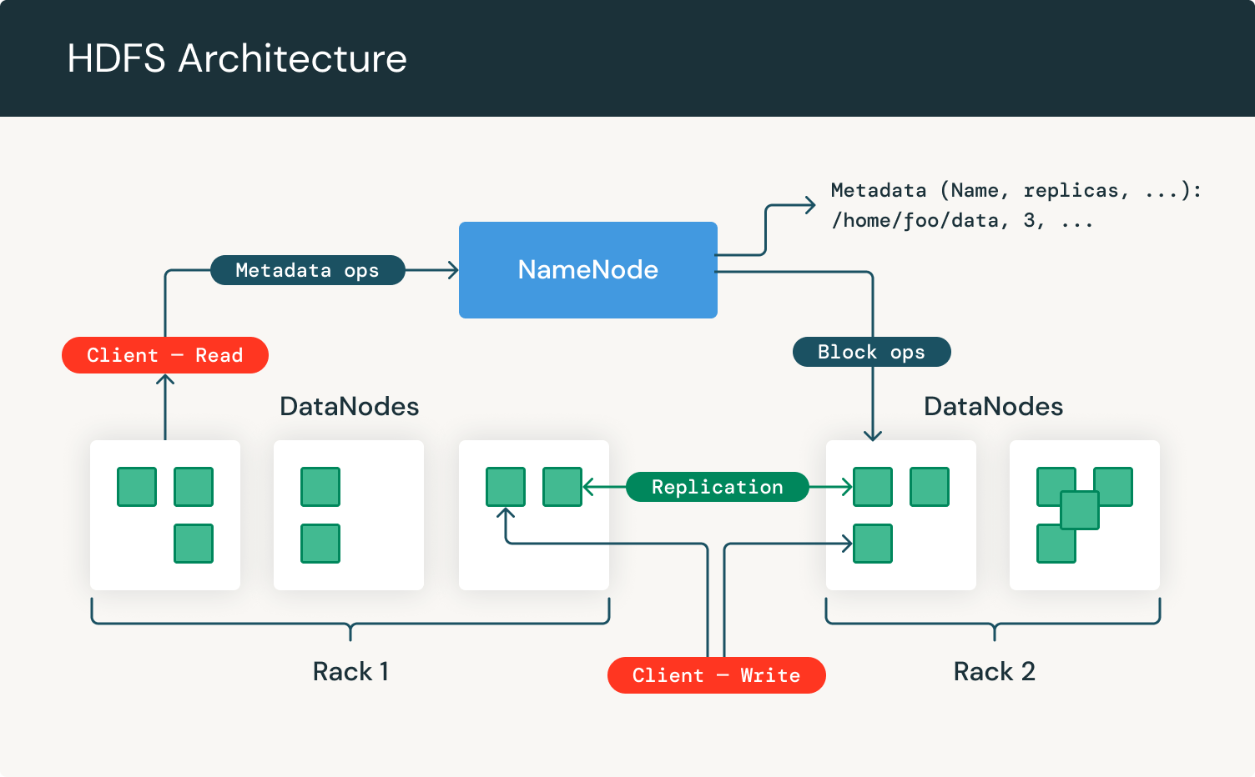
Notes:
HDFS is somewhat similar to the traditional file system (hierarchical). HDFS Client is the one who wants to perform the read/write operations.
Two main components of HDFS are the Name Node (Master Node) and Data Nodes.
The Name Node of HDFS acts as the master server and can manage the files, control a client's access to files, and overseas file operating processes such as renaming, opening, and closing files.
For every node in an HDFS cluster, you will locate a DataNode. These nodes help to control the data storage of their system as they can perform operations on the file systems if the client requests, and also create, replicate, and block files when the NameNode instructs.

Slide 6
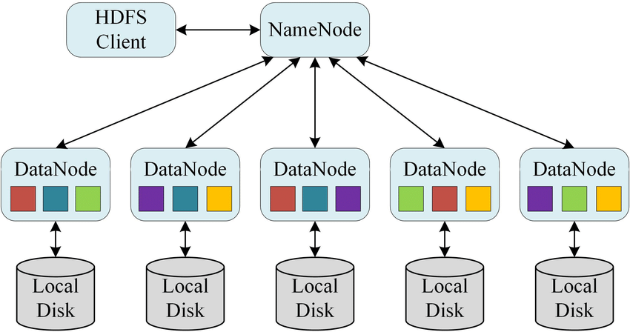
HDFS Storage
HDFS data is stored in something called blocks.
Files are processed and broken down into these blocks, which are then taken and distributed across the cluster - and also replicated for safety.
Notes:
HDFS works on existing hardware. So, there is no need to buy specialized hardware.
These blocks are the smallest unit of data that the file system can store. Files are processed and broken down into these blocks, which are then taken and distributed across the cluster - and also replicated for safety. Typically, each block can be replicated three times.
The Name Node/Master Node divides the file into size of 128 MB (block size). By default size is 128 MB.
The Metadata (Namespace) is stored in Name/Master Node.

Slide 7
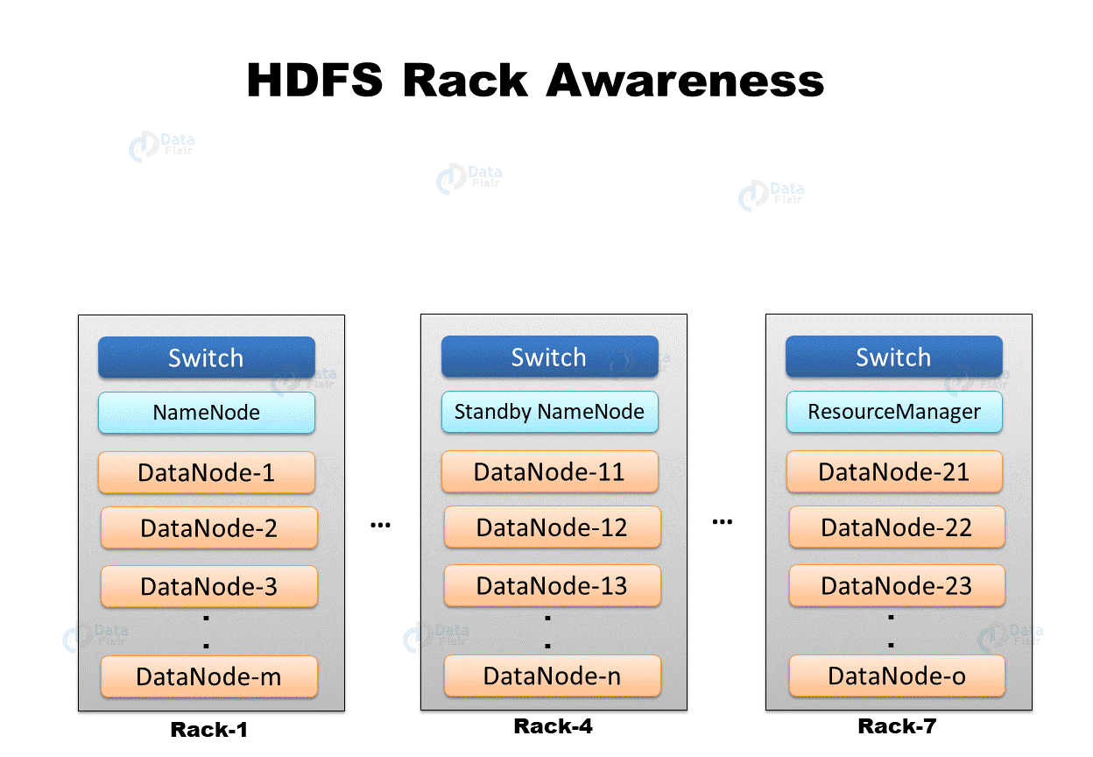

Slide 8
Name/Master Node
Records the metadata (Namespace) of all the files stored in the cluster.
There are two files associated with metadata:
  FsImage: contains the complete state of the file system namespace since the start of the Name Node.
  EditLogs: contains all the recent modifications made to the file system with respect to the most recent FsImage.
Receives reports from all the Data Nodes to ensure that the Data Nodes are alive.

Slide 9
Hadoop Cluster
Hadoop Cluster has three supported modes:
  Local (standalone)
  Pseudo-Distributed
  Fully-Distributed
For installation guide of Hadoop Cluster
  https://hadoop.apache.org/docs/stable/hadoop-project-dist/hadoop-common/SingleCluster.html
Notes:
Local (standalone):
By default, Hadoop is configured to run in a non-distributed mode, as a single Java process.
Pseudo-Distributed:
Hadoop can also be run on a single-node in a pseudo-distributed mode where each Hadoop daemon runs in a separate Java process.
Fully-Distributed:

Slide 10
MapReduce

Slide 11
Big Data
it cannot be stored in one machine
store the data sets on multiple machines
Google File System
it cannot be processed in one machine
parallelize computation on multiple machines
MapReduce

Slide 12
Motivation: Large Scale Data Processing
Want to process lots of data ( > 1 TB)
Want to parallelize across hundreds/thousands of CPUs
Want to make this easy

Slide 13
Motivation: Example
Carnegie Mellon
Processing Web Data on a Single Machine
  20+ billion web pages x 20KB = 400+ terabytes
  One computer can read 30‐35 MB/sec from disk
  ~ four months to read the web
  ~1,000 hard drives just to store the web
  Even more to do something with the data
Takes too long on a single machine, but with 1000 machines?
  < 3 hours to perform on 1000 machines
  But how long to program? What about the overheads?
  Communication, coordination, recovery from machine failure
  Status Reporting, Debugging, Optimization, Locality

Slide 14
MapReduce Working
Map
Grab the relevant data from the source
User function gets called for each chunk of input
Spits out (key, value) pairs
Reduce
Aggregate the results
User function gets called for each unique key with all values corresponding to that key

Slide 15
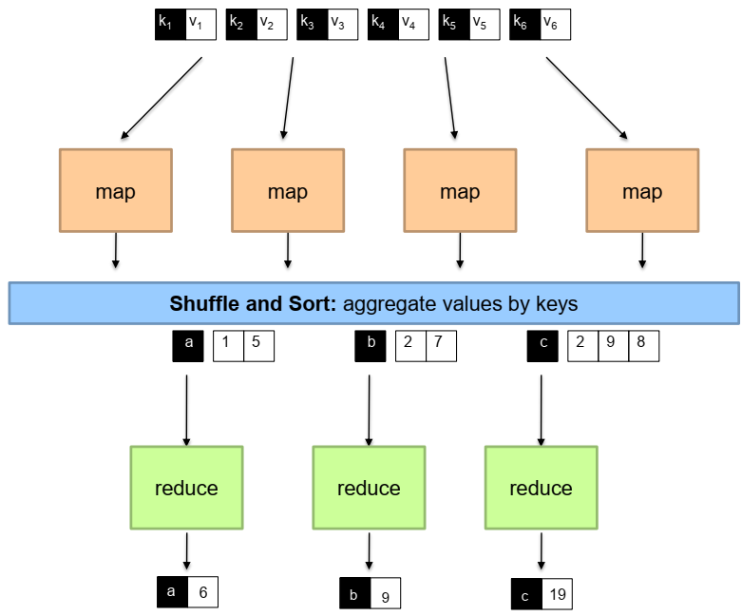

Slide 16


MapReduce Working
Map
  Grab the relevant data from the source (parse into key, value)
  Write it to an intermediate file
Partition
  Partitioning: identify which of R reducers will handle which keys
  Map partitions data to target it to one of R Reduce workers based on a partitioning function (both R and partitioning function user defined)
Shuffle & Sort
  Shuffle: Fetch the relevant partition of the output from all mappers
  Sort by keys (different mappers may have sent data with the same key)
Reduce
  Input is the sorted output of mappers
  Call the user Reduce function per key with the list of values for that key to aggregate the results
Map Worker
Reduce Worker

Slide 17
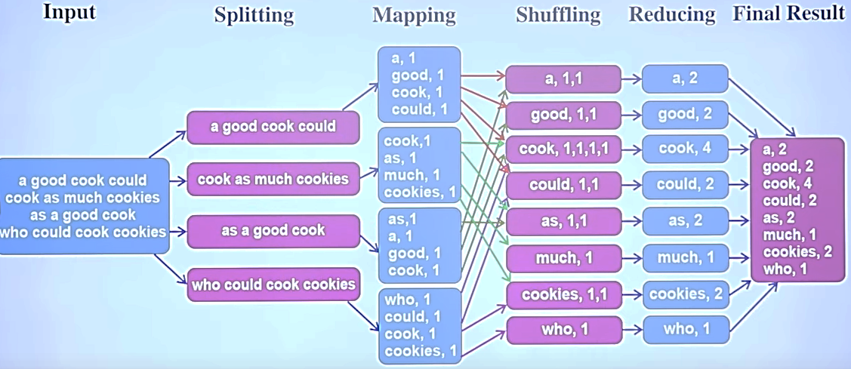
Example

Slide 18
Parallelism
map() functions run in parallel, creating different intermediate values from different input data sets
  The programmer must specify a proper input split (chunk) between mappers to enable parallelism
reduce() functions also run in parallel, each working on a different output key
  Number of reducers is a key parameter which determines MapReduce performance
All values are processed independently
Bottleneck: reduce phase can’t start until map phase is finished.

Slide 19
Data Locality
Master program divides up tasks based on location of data
  Tries to have map() tasks on same machine as physical file data, or at least same rack
map() task inputs are divided into 64 MB blocks same size as Google File System chunks

Slide 20
Handling Fault Tolerance
Although the probability of a machine failure is low, the probability of a machine failing among thousands of machines is common
Worker Failure
  The master sends a heartbeat to each worker node
  If a worker node fails, the master reschedules the tasks handled by the worker
Master Failure
  The whole MapReduce job gets restarted through a different master

Slide 21
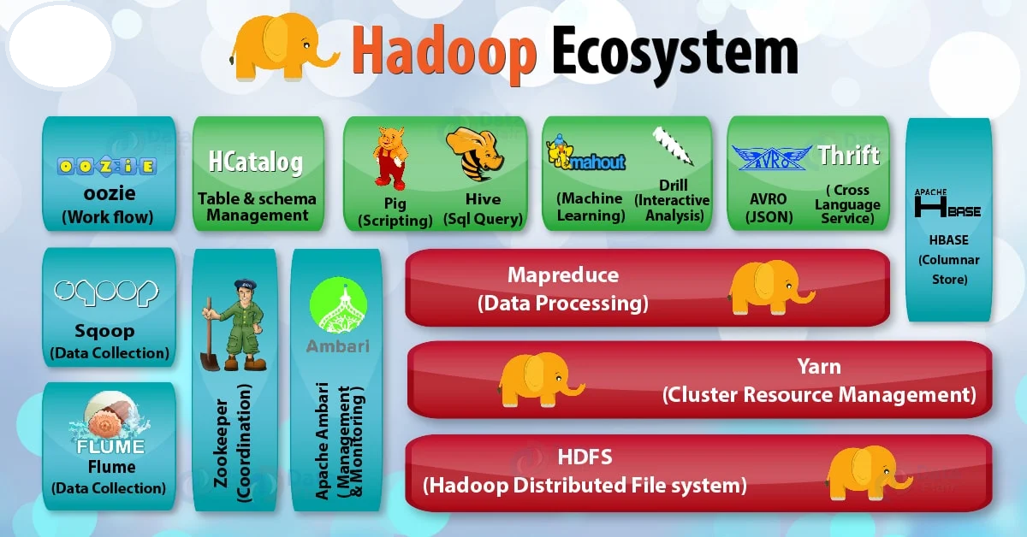

Slide 22
Big Data – Datasets
Structured
  CelebFaces Attributes - 1.2 GB
    Over 200k images of celebrities with 40 binary attribute annotations
Text
  CommonCrawl (AWS) - A corpus of web crawl data composed of over 25 billion web pages.
    Semi-Structured (includes Metadata): 250 TB
  StackOverflow Data (BigQuery) - 182 GB

Slide 23
Home Tasks

Slide 24
Actual Hadoop Flow
http://www.michael-noll.com/tutorials/writing-an-h adoop-mapreduce-program-in-python/
Installation (From the above page)
Running Hadoop On Ubuntu Linux (Single-Node Cluster) – How to set up a pseudo-distributed, single-node Hadoop cluster backed by the Hadoop Distributed File System (HDFS)
Running Hadoop On Ubuntu Linux (Multi-Node Cluster) – How to set up a distributed, multi-node
Hadoop cluster backed by the Hadoop Distributed File System (HDFS)
Minor changes needed due to changes in recent hadoop distribution directory
➢
➢

Slide 25
Open up any tutorial on hadoop and first program you see will be of wordcount
Task: Given a text file, generate a list of words with the number of times each of them appear in the file
Input: Plain text file
Expected Output:
hadoop is a framework written in java hadoop supports parallel processing and is a simple framework
<word, frequency>

Slide 26
Mimicking the Hadoop Flow
Create files “mapper.py” for Map and “reducer.py” for Reduce
Mimic Hadoop using the Linux pipe (|)
cat input.txt | mapper.py | sort | reducer.py
a 2
and 1
framework hadoop in 1 is 2 java 1 parallel | 2 | 2 1
processing simple 1 supports |  | 1 | 1
written |  | 1
hadoop is a framework written in java hadoop supports parallel processing and is a simple framework
cat input.txt | mapper.py | sort | reducer.py

Slide 27
Actual Hadoop Flow
: Snippets from http://www.michael-noll.com/tutorials/writing-an-hadoop-mapreduce-program-in-python/
Copy input to HDFS
$ bin/hadoop dfs -copyFromLocal /tmp/gutenberg /user/hduser/gutenberg
Run the mapper and reducer
$ bin/hadoop jar <path-to-jar>/hadoop-*streaming*.jar \
-file /home/hduser/mapper.py -mapper /home/hduser/mapper.py-file \
/home/hduser/reducer.py -reducer /home/hduser/reducer.py \
-input /user/hduser/gutenberg/* -output /user/hduser/gutenberg-output

Slide 28
Actual Hadoop Flow
: Snippets from http://www.michael-noll.com/tutorials/writing-an-hadoop-mapreduce-program-in-python/
Check the output
$ bin/hadoop dfs -cat /user/hduser/gutenberg-output/part-00000 "(Lo)cra" 1
"1490 1
"1498," 1
"35" 1
"40," 1
"A 2
"AS-IS". | 2
"A_ 1 "Absoluti | 1
[...]
hduser@ubuntu:/usr/local/hadoop$

Slide 29
Any Questions ?

