Slide 1
Lec # 17
Course: Data Science Tools & Techniques
Instructor: Dr. Mateen Yaqoob

Slide 2
Actual Hadoop Flow
http://www.michael-noll.com/tutorials/writing-an-h adoop-mapreduce-program-in-python/
Installation (From the above page)
Running Hadoop On Ubuntu Linux (Single-Node Cluster) – How to set up a pseudo-distributed, single-node Hadoop cluster backed by the Hadoop Distributed File System (HDFS)
Running Hadoop On Ubuntu Linux (Multi-Node Cluster) – How to set up a distributed, multi-node
Hadoop cluster backed by the Hadoop Distributed File System (HDFS)
Minor changes needed due to changes in recent hadoop distribution directory
➢
➢

Slide 3
Open up any tutorial on hadoop and first program you see will be of wordcount
Task: Given a text file, generate a list of words with the number of times each of them appear in the file
Input: Plain text file
Expected Output:
hadoop is a framework written in java hadoop supports parallel processing and is a simple framework
<word, frequency>

Slide 4
Mimicking the Hadoop Flow
Create files “mapper.py” for Map and “reducer.py” for Reduce
Mimic Hadoop using the Linux pipe (|)
cat input.txt | mapper.py | sort | reducer.py
a 2
and 1
framework hadoop in 1 is 2 java 1 parallel | 2 | 2 1
processing simple 1 supports |  | 1 | 1
written |  | 1
hadoop is a framework written in java hadoop supports parallel processing and is a simple framework
cat input.txt | mapper.py | sort | reducer.py

Slide 5
Actual Hadoop Flow
: Snippets from http://www.michael-noll.com/tutorials/writing-an-hadoop-mapreduce-program-in-python/
Copy input to HDFS
$ bin/hadoop dfs -copyFromLocal /tmp/gutenberg /user/hduser/gutenberg
Run the mapper and reducer
$ bin/hadoop jar <path-to-jar>/hadoop-*streaming*.jar \
-file /home/hduser/mapper.py -mapper /home/hduser/mapper.py-file \
/home/hduser/reducer.py -reducer /home/hduser/reducer.py \
-input /user/hduser/gutenberg/* -output /user/hduser/gutenberg-output

Slide 6
Actual Hadoop Flow
: Snippets from http://www.michael-noll.com/tutorials/writing-an-hadoop-mapreduce-program-in-python/
Check the output
$ bin/hadoop dfs -cat /user/hduser/gutenberg-output/part-00000 "(Lo)cra" 1
"1490 1
"1498," 1
"35" 1
"40," 1
"A 2
"AS-IS". | 2
"A_ 1 "Absoluti | 1
[...]
hduser@ubuntu:/usr/local/hadoop$

Slide 7
Big Data and Growth
Where data comes from?
  Internet users generate about 2.5 quintillion bytes of data each day¹
  In 2018, internet users spent 2.8 million years online
    Social media accounts for 33% of the total time spent online
  In 2019, there were 2.3 billion active Facebook users¹
  Twitter users send nearly half a million tweets every minute¹
1 https://bernardmarr.com/how-much-data-do-we-create-every-day-the-mind-blowing-stats-everyone-should-read/

Slide 8
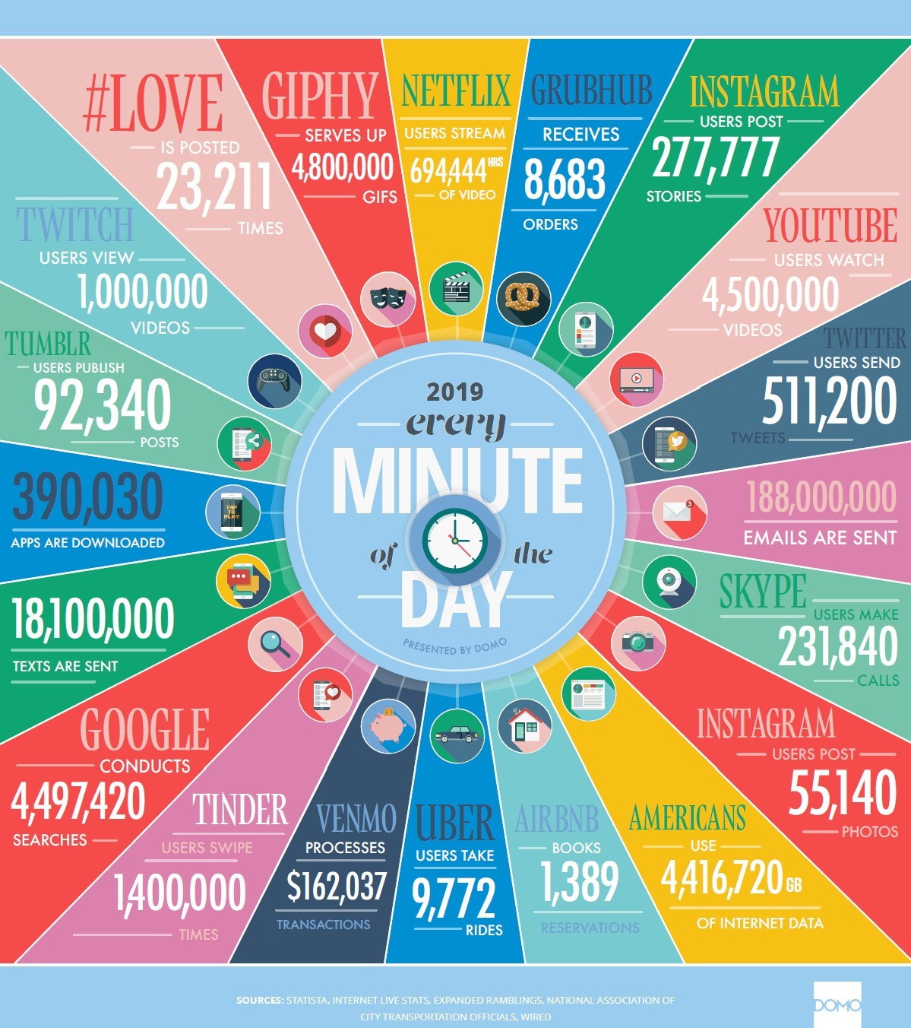
Big Data and Growth

Slide 9
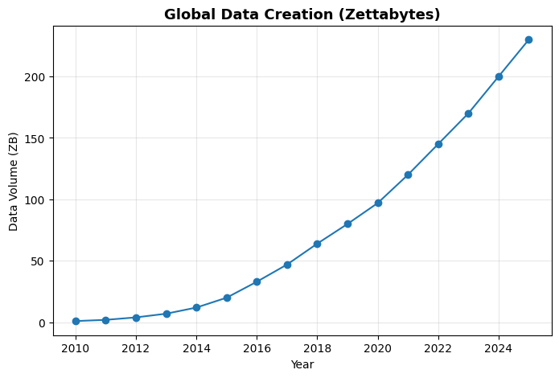
Motivation: Data Explosion
Global data generation is growing exponentially due to social media, IoT, sensors, and multimedia.
Traditional data processing tools cannot handle this scale and diversity.
The need for distributed and parallel data processing frameworks arises

Slide 10
What is Big Data
“Big data”: Datasets whose size is beyond the ability of typical database software tools to capture, store, manage, and analyze
As technology advances over time, the size of datasets that qualify as big data will also increase
The definition varies by sector, depending on the kinds of available software tools and sizes of datasets in a particular industry
With those caveats, big data in many sectors today will range from a few dozen terabytes to multiple petabytes (thousands of terabytes)

Slide 11
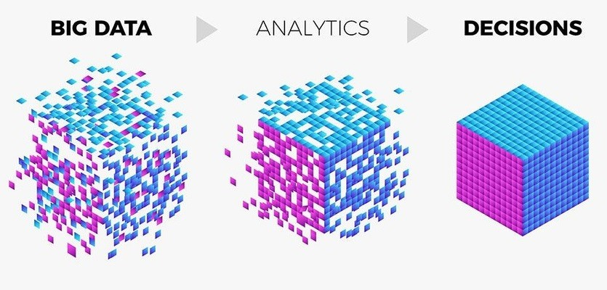
Data Analytics
Data: Set of values of qualitative or quantitative variables
Information: Meaningful or organized data
Data Analytics: The process of examining data in order to draw and communicate useful conclusions about the information it contains
Source: https://enablecomp.com/

Slide 12
Big Data Analytics: Market

Slide 13
Data Analytics: Then and Now
Data Analytics has been around for years
Even in 1950’s, businesses were using basic analytics (manual examination) on data (essentially numbers in a spreadsheet) to uncover insights and trends
New tools and technologies bring speed and efficiency in techniques
Today, businesses analyze data and can identify insights for immediate decisions
The ability to work faster and stay agile gives organizations a competitive edge they did not have before

Slide 14
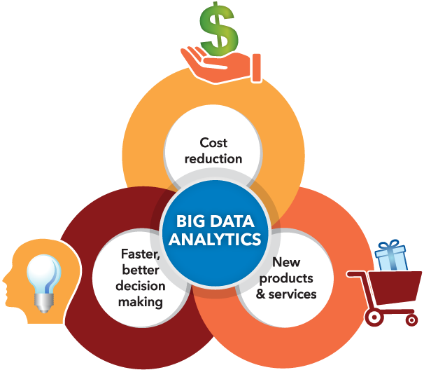
Why is Big Data Analytics Important
Organizations analyze data
to identify new opportunities
to gain insights that lead to smarter business decisions to identify methods for more efficient operations
to maximize larger revenues and higher profits to keeps customers satisfied
Top three factors businesses got the most value in
Cost reduction
Faster, better decision making New products and services

Slide 15
Sources of Big Data

Slide 16
Where big data comes from
1
2
3
Sensors and IoT
Logs and infrastructure
Web and social media
Industrial telemetry, smart meters, wearables, vehicles
Server, network and application logs at cloud scale
Clickstreams, posts, search queries, recommendations
4
5
6
Transactions
Scientific instruments
Health records and imaging
Payments, trading records, point-of-sale and e-commerce events
Telescopes, genomics sequencers, particle detectors
EHRs, medical imaging and clinical sensor streams

Slide 17
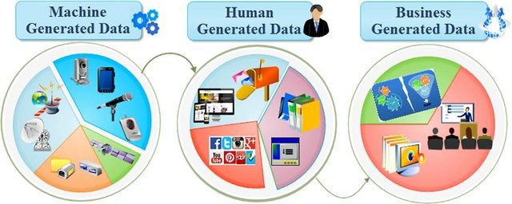
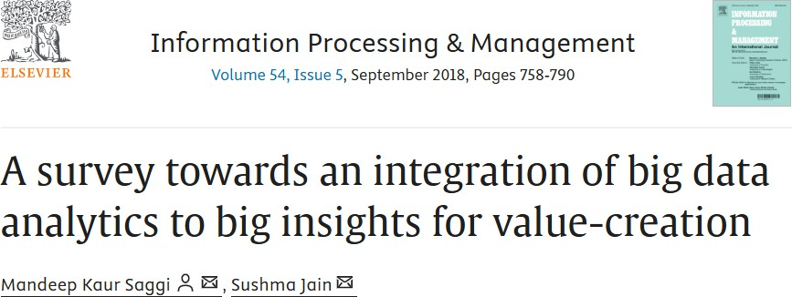
Sources of Big Data

Slide 18
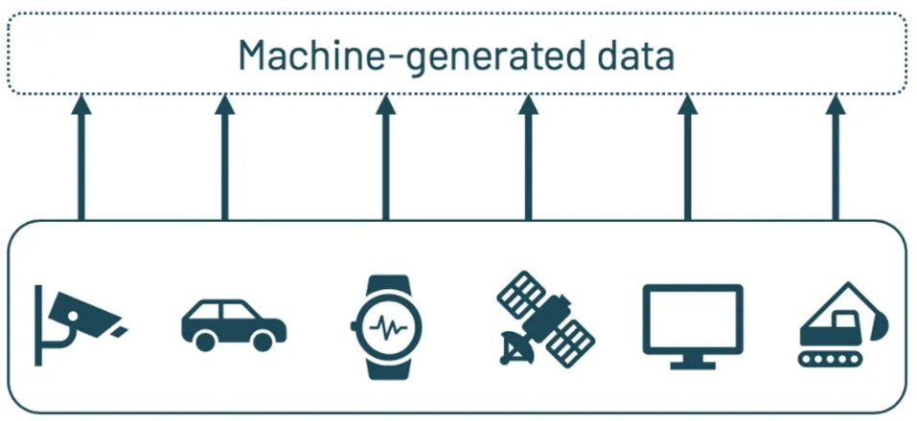
Sources: Machine Generated Data
Biggest source of big data
Temperature sensors, GPS navigator, Satellite imagery, Apps,
Increasing number of smart devices, IoT
A 12-hour flight produces 84TB of data, sensors, temperature, pressure, accelerometer, and turbulence
Smart City, Smart Transportation
Think about the volume of video data collected at the Islamabad Safe City Authority Control Room
Generally, such data is unstructured

Slide 19
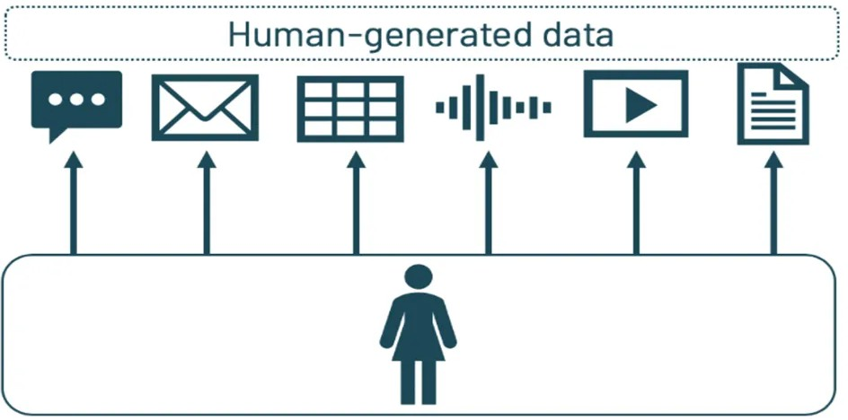

Sources: People Generated Data
Daily facebook data 30+ PB > All US Academic libraries (2 PB) Companies use 12PB/day Twitter data for sentiment analysis on products
Could be used for disaster management, e.g. to identify and measure affected areas and channel resources
Typically unstructured, or at best semi-structured (email headers has somewhat of a structure), except in few cases e.g., filling up a survey form
Generally more text: 500 million tweets per day

Slide 20






Sources: Organization Generated Data
Organization-generated data
Students Data, ESPN Cricinfo, TCS shipment tracking data Governments data, Stock Records, Banks, e-Commerce, Medical Records
Combine Walmart sales data with Twitter sentiment analyses or events to launch a new product
Estimate demands Fraud Detection
Highly Structured Data

Slide 21
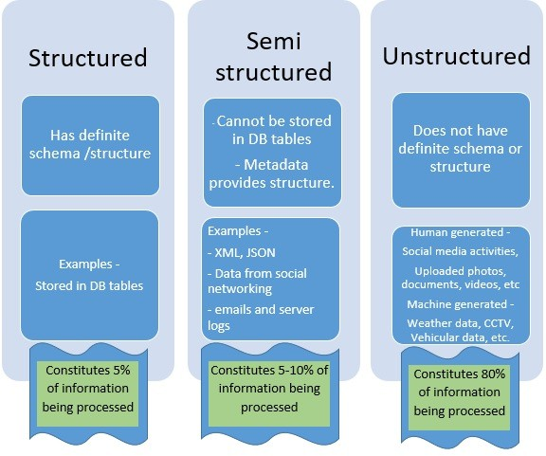
Categories of Data

Slide 22
Types of Data
Relational Data
Text Data Multimedia Data Time Series Data Sequential Data Streams

Slide 23
Types of Data: Text
blogs, webpages, tweets, documents, emails
High dimensionality, vocabulary, information retrieval, natural language processing
Latest search engine for Walmart.com uses text analysis, machine learning and even synonym mining to produce relevant search results.
Walmart says adding semantic search has improved online shoppers completing a purchase by 10% to 15%. “In Wal-Mart terms, that is billions of dollars,”

Slide 24



Types of Data: Multimedia
image, audio, video
‘Fast food and video’ company is training cameras on drive-through lanes to determine what to display on its digital menu board. When the lines are longer, the menu features products that can be served up quickly; when the lines are shorter, the menu features higher-margin items that take longer to prepare

Slide 25
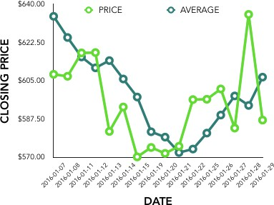
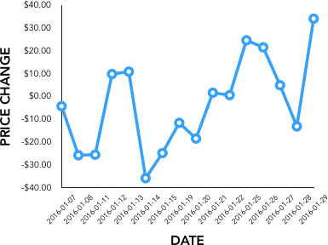
Types of Data: Time Series
Sequence of data points at equally spaced time intervals
Sensor data, Stock market data, Forex rates, Temporal tracking (GPS), Smart Meters Data (AMI)
Understanding the underlying forces and structure of observed data and fit a model to forecast, monitor or control
Economic Forecasting, Sales Forecasting, Stock Market Analysis, Yield Projections, Process and Quality Control, Inventory Studies, Workload Projections, Census Analysis
market momentum
Application of Time Series Analysis in Financial Economics by @Statswork https://link.medium.com/n3FJPzhIadb

Slide 26
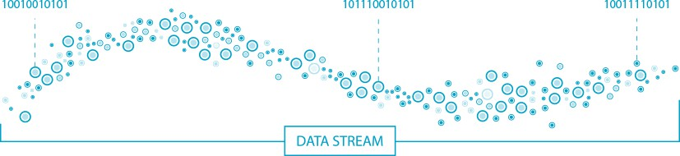
Types of Data: Streams
Real time data
Single pass algorithms/online algorithms Irreversible decisions
Small memory algorithms

Slide 27
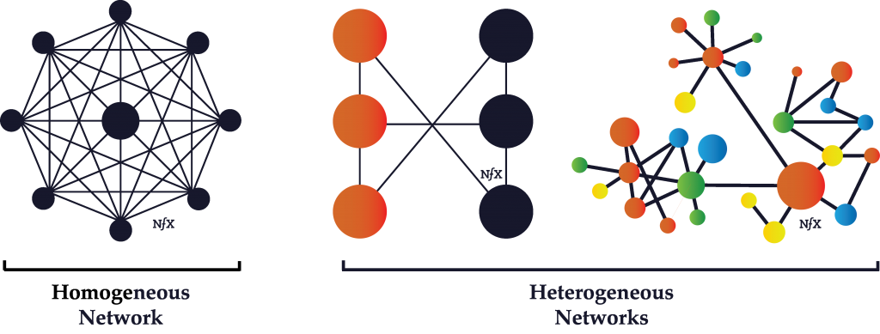
Types of Data: Graphs/Homogeneous Networks
G = (V , E ), data items represented as graphs
Could have similarity on edges
Could have weights on vertices, edges or both
Facebook, webgraph, twitter, co-authorship graphs (bibliometric), citation networks

Slide 28
Big Data: Challenges
Lack of data talent and skills
Speed of data growth
Problems with data quality
Compliance violations
Integration complexity
Security concerns
Notes:
Lack of data talent and skills. Data scientists, data analysts, and data engineers are in short supply—and are some of the most highly sought after (and highly paid) professionals in the IT industry. Lack of big data skills and experience with advanced data tools is one of the primary barriers to realizing value from big data environments.
Speed of data growth. Big data, by nature, is always rapidly changing and increasing. Without a solid infrastructure in place that can handle your processing, storage, network, and security needs, it can become extremely difficult to manage.
Problems with data quality. Data quality directly impacts the quality of decision-making, data analytics, and planning strategies. Raw data is messy and can be difficult to curate. Having big data doesn’t guarantee results unless the data is accurate, relevant, and properly organized for analysis. This can slow down reporting, but if not addressed, you can end up with misleading results and worthless insights.
Compliance violations. Big data contains a lot of sensitive data and information, making it a tricky task to continuously ensure data processing and storage meet data privacy and regulatory requirements, such as data localization and data residency laws.
Integration complexity. Most companies work with data siloed across various systems and applications across the organization. Integrating disparate data sources and making data accessible for business users is complex, but vital, if you hope to realize any value from your big data.
Security concerns. Big data contains valuable business and customer information, making big data stores high-value targets for attackers. Since these datasets are varied and complex, it can be harder to implement comprehensive strategies and policies to protect them.

Slide 29









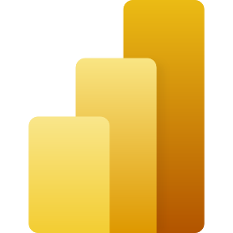





Tools for Big Data
Data Storage and Management
  HDFS, Apache Hbase, Cassandra, MongoDB, Amazon S3
Processing Frameworks
  MapReduce, Spark, Flink, Storm, Google Dataflow
Data Ingestion and Integration
  Kafka, NiFi, Flume, Sqoop
Data Querying and Warehousing
  Hive, Presto, Trino, BigQuery, Snowflake
Big Data Analytics and ML
  Spark MLlib, H2O.ai, Mahout, TensorFlow on Spark
Data Visualization
  Tableau, Power BI, Apache Superset, Grafana
Cloud Big Data Platforms
  AWS Big Data Suite, GCP, Azure, Databricks
Ecosystem Add-ons
  Delta Lake, Apache Iceberg, Airflow, Kubeflow, MLflow
Notes:
1. Data Storage and Management Tools
ToolDescriptionKey FeaturesHDFS (Hadoop Distributed File System)Distributed file system for storing massive datasets.Fault-tolerant, scalable, replication-based.Apache HBaseNoSQL database built on HDFS.Real-time read/write access to large data tables.CassandraDistributed NoSQL database.High availability, decentralized, scalable.MongoDBDocument-based NoSQL database.JSON-like data storage, flexible schema.Amazon S3Cloud-based storage (AWS).Highly durable, integrated with AWS analytics tools.
⚙️ 2. Big Data Processing Frameworks
ToolDescriptionKey FeaturesApache Hadoop (MapReduce)Batch processing framework.Processes large datasets in parallel across clusters.Apache SparkIn-memory processing engine.Faster than Hadoop, supports batch, streaming, ML, and graph processing.Apache FlinkReal-time and batch processing.Low-latency, stateful computations.Apache StormStream processing system.Real-time computation on unbounded data streams.Google Dataflow / Apache BeamUnified model for batch + streaming.Portable pipelines, supports multiple runners (Spark, Flink).
🔄 3. Data Ingestion and Integration Tools
ToolDescriptionKey FeaturesApache KafkaDistributed messaging and streaming platform.Handles real-time data feeds, durable, scalable.Apache NiFiDataflow automation tool.Visual interface for moving and transforming data.FlumeFor collecting and moving log data.Integrates with Hadoop ecosystem.SqoopTransfers data between Hadoop and RDBMS.Supports parallel import/export.
🧮 4. Data Querying and Warehousing Tools
ToolDescriptionKey FeaturesApache HiveSQL-like querying on Hadoop.Converts SQL queries into MapReduce/Spark jobs.Presto / TrinoDistributed SQL query engine.Interactive analytics over heterogeneous sources.ImpalaLow-latency SQL queries on HDFS data.Integrates with Cloudera ecosystem.Google BigQueryServerless data warehouse (cloud).Handles petabyte-scale analytics using SQL.SnowflakeCloud-based warehouse platform.Scalable storage-compute separation.
📊 5. Big Data Analytics and Machine Learning Tools
ToolDescriptionKey FeaturesSpark MLlibMachine learning library for Spark.Distributed ML algorithms (classification, clustering, etc.).H2O.aiOpen-source ML platform.AutoML, scalable deep learning, integration with Spark.TensorFlow on SparkDistributed deep learning on clusters.GPU + Spark integration.MahoutScalable ML on Hadoop/Spark.Focused on recommendation and clustering.
🌐 6. Data Visualization and BI Tools
ToolDescriptionKey FeaturesTableau / Power BIInteractive dashboards and visual analytics.Connects to Big Data sources (Hive, Spark).Apache SupersetOpen-source visualization tool.Lightweight, SQL-based dashboards.GrafanaTime-series visualization.Used with real-time data pipelines.
☁️ 7. Cloud-Based Big Data Platforms
PlatformProviderKey ServicesAWS Big Data SuiteAmazonEMR (Hadoop/Spark), Redshift, Kinesis, Glue, S3Google Cloud Platform (GCP)GoogleBigQuery, Dataflow, Dataproc, Pub/SubMicrosoft AzureMicrosoftHDInsight, Synapse Analytics, Azure DatabricksDatabricksIndependent (on multi-cloud)Unified analytics for Spark and ML workloads.
🧠 8. Emerging Tools and Ecosystem Add-ons
ToolFunctionDelta Lake / Apache IcebergACID transactions on data lakesAirflow / OozieWorkflow orchestration for Big Data pipelinesKubeflow / MLflowMLOps and model lifecycle management in Big DataElastic Stack (ELK)Search and analytics for log/text data

Slide 30
Data Analytics: Process and Tasks

Slide 31
From Big Data to Analytics
Data → Storage → Processing → Analytics → Insight
Data flows through ingestion, storage (HDFS, NoSQL), processing (Spark, Hadoop), and analysis (MLlib, Power BI) for decision-making.

Slide 32
What is Big Data Analytics?
The process of examining large and varied datasets to uncover hidden patterns, correlations, market trends, and insights.
Key aspects:
  5Vs of Big Data
  Distributed computing and ML
  Transforming raw data into actionable intelligence

Slide 33
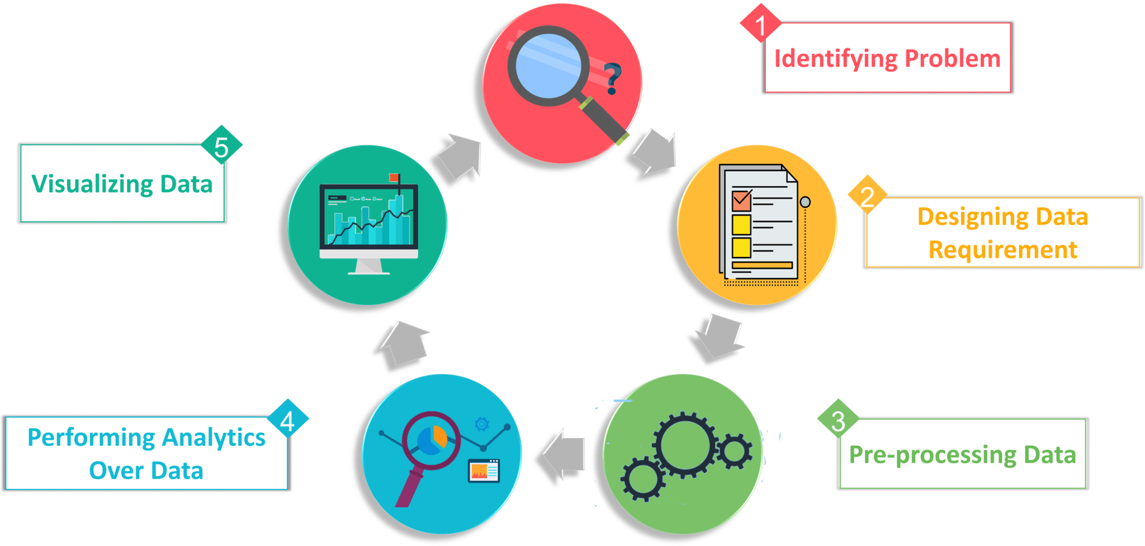
The Analytics Process

Slide 34
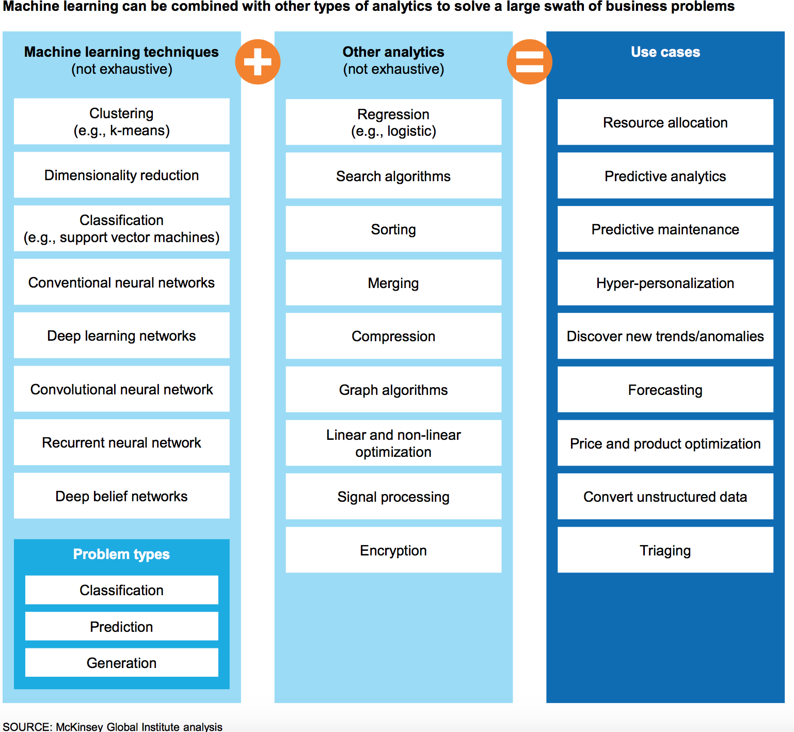
Data Analytics Tasks and Methods

Slide 35
Map of open research directions
1
2
3
Efficient learning
Federated analytics
Explainable analytics
Scaling distributed training without saturating networks
Privacy, heterogeneity and robustness across devices
Explanations that scale to billions of records
4
5
6
Edge and streaming
Data systems for AI
Sustainable analytics
Adaptive analytics under concept drift and tight budgets
Curation, indexing and pipelines for foundation models
Energy-aware scheduling and cost-efficient clusters

Slide 36
Any Questions ?

