Slide 1
Lecture # 9
Course: Data Science Tools & Techniques
Instructor: Dr. Mateen Yaqoob

Slide 2
DATA ENGINEERING
compute: code, python, R, julia, spark, hadoop
storage/database: git, SQL, NoSQL, HBase, disk, memory
devops: AWS, docker, mesos, repeatability
product: database, web, API, viz, UI, story
•
•
•
Different at different scales....

Slide 3
What kind of data storage do you need?
•
memory
disk: what if we do not fit?
cluster: what if we still do not fit? cluster: what if we need/can use parts? What if we MUST bring compute to disk?
•
•
•
•

Slide 4
What kind of data access do you need?
•
relational: pandas, SQL: Postgres, sqlite, Hbase,
VoltDB
document oriented: MongoDB, CouchDB key1value: Riak, Redis, Memcached graph oriented: Neo4J
•
•
•

Slide 5
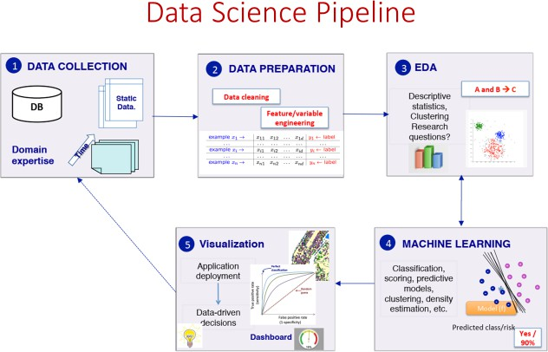

Slide 6

What is Machine Learning?

Slide 7
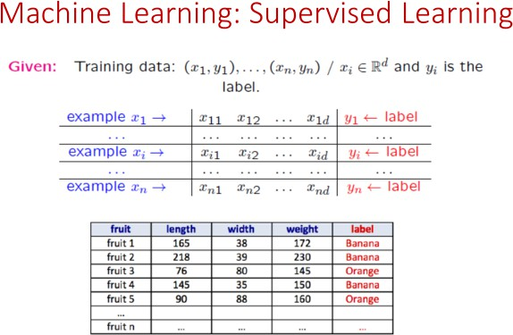

Slide 8
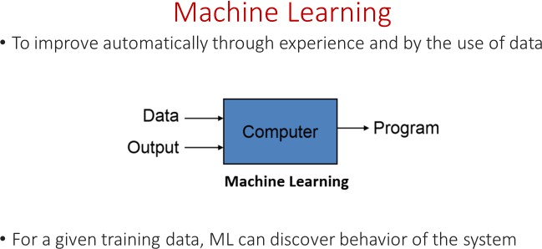

Slide 9
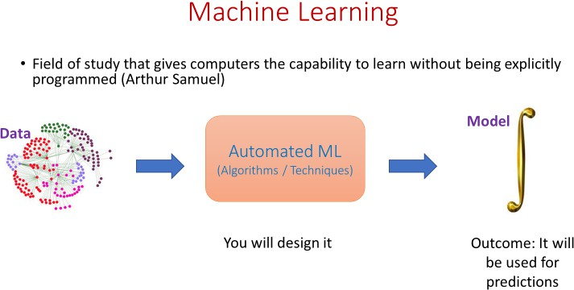

Slide 10
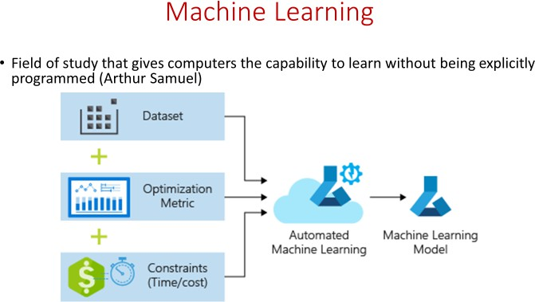

Slide 11
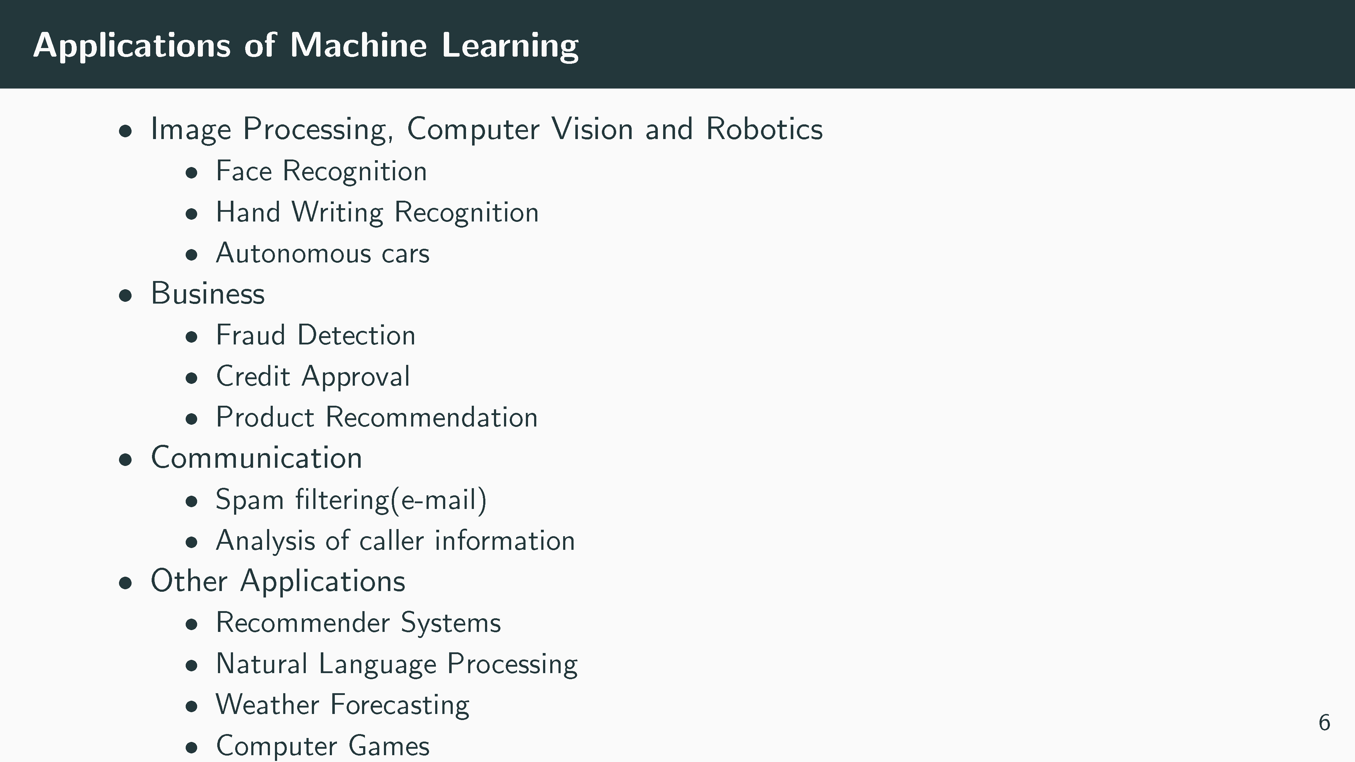

Slide 13
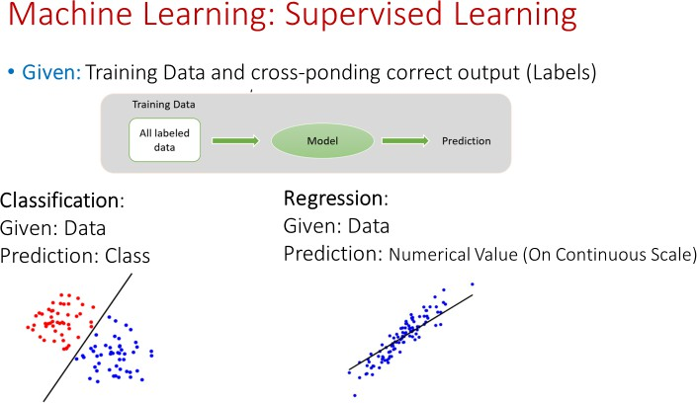

Slide 14
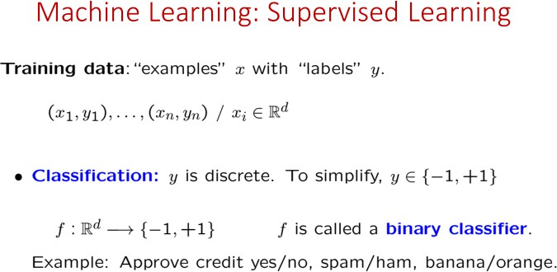

Slide 15
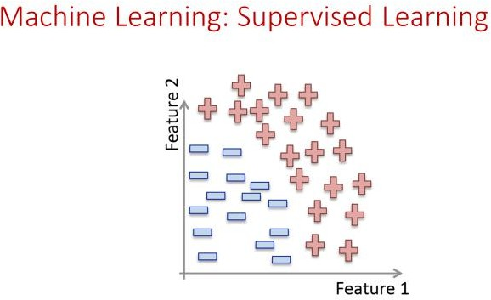

Slide 16
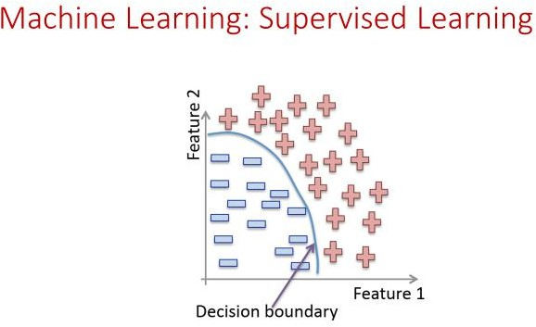

Slide 17
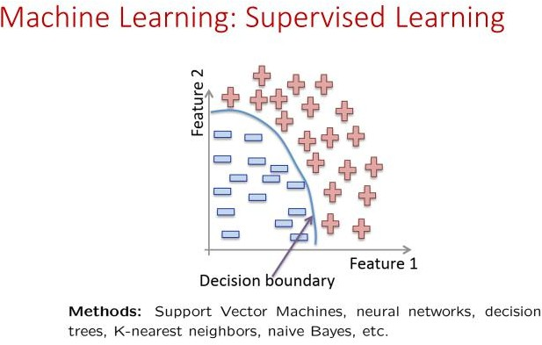

Slide 18
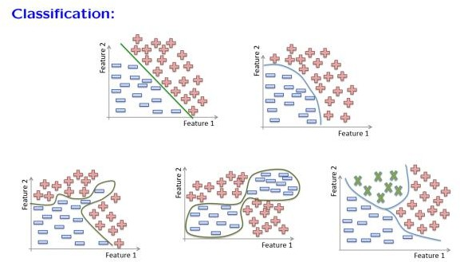

Slide 19
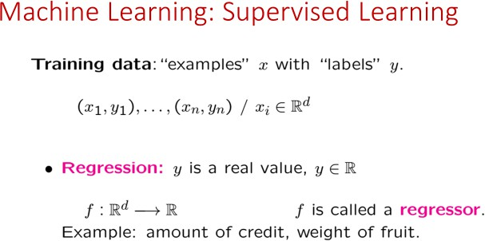

Slide 20
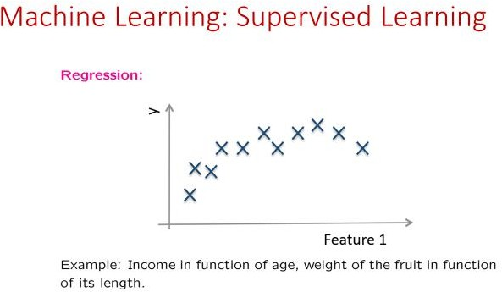

Slide 21
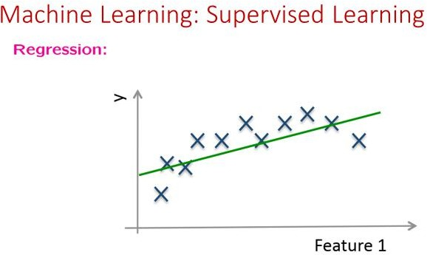

Slide 22
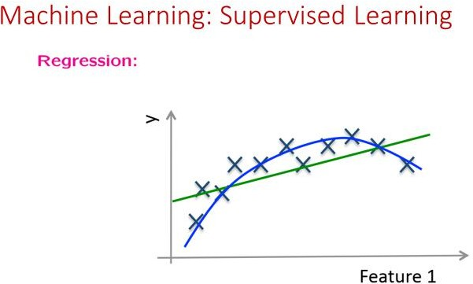

Slide 23
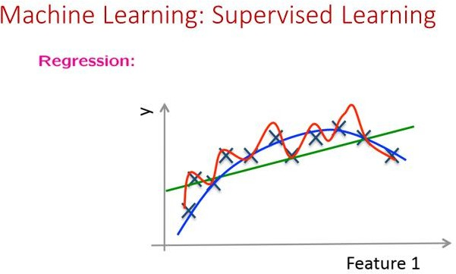

Slide 24
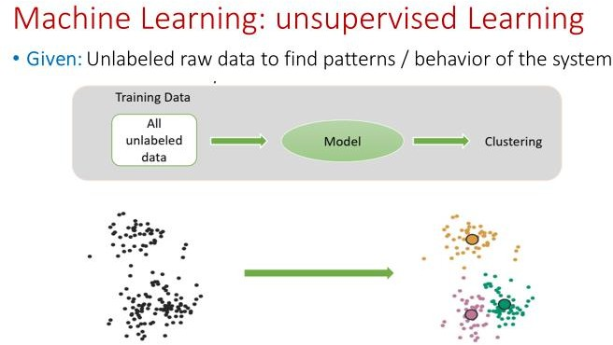

Slide 25
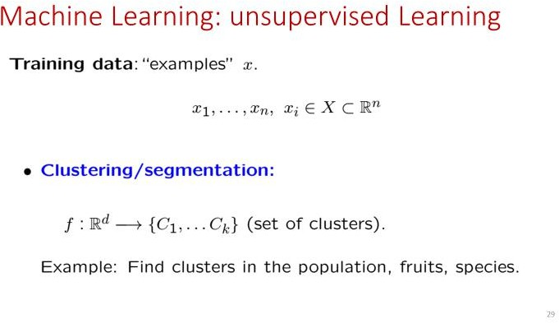

Slide 26
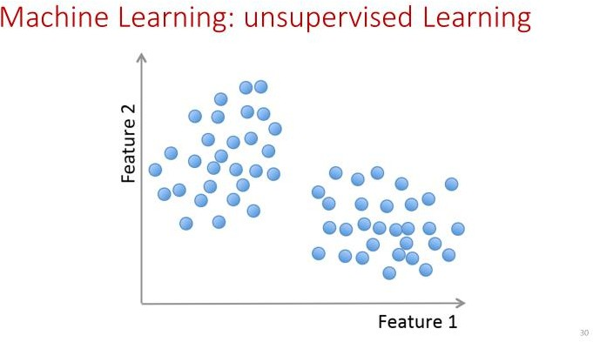

Slide 27
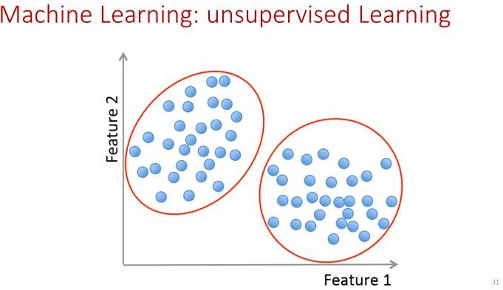

Slide 28


