Slide 1
Week # 1
Course: Data Science Tools & Techniques
Instructor: Dr. Mateen Yaqoob

Slide 2
About me
    Ph.D. from HITEC University Taxila (2024).
    Specialization: Big Data and Distributed Computing
    Thesis title: “Federated Learning for Healthcare Systems”
    Have teaching experience of 13 + years.

Slide 3
Contact Information
Contact Information:
  Office: 212-D (2ND Floor, Block D)
  Email: mateen.yaqoob@isb.nu.edu.pk
  Research Interests / R&D FYPs:
        Cloud Computing
        Big Data Analytics
        Data Science
        Federated Learning

Slide 4
Course Overview
This course covers the following main concepts
  Data Extraction, Data Quality
  Data Scrubbing and pre-processing stages
  Basic Descriptive & Exploratory Data Analysis
  Python Data Science and Data Wrangling
  Data Storage and Exploration
  Data Modelling
  Model Evaluation
  Big Data Processing Tools
  Recent Trends in Data Science, Ethical Issues, Research Opportunities

Slide 5
Recommended Material
Python for Data Analysis, 1st Edition, William McKinney
Data Science from Scratch, 1st Edition, Joel Grus
Introduction to Data Science. A Python Approach to Concepts, Techniques and Applications, 2nd Edition, Laura Igual.

Slide 6
Course Coordination
Lecture slides and other material will be shared on Google Classroom:
The class code is:
jsp2vapt

Slide 7
Grading Policy
Grading policy: Absolute grading
Assignments | 4 | 8%
Project | 1 | 15%
Quizzes | 4 | 7%
Sessional-I | 1 | 10%
Sessional-II | 1 | 15%
Final Term Exam | 1 | 45%

Slide 8
What Is Data?
Data are recorded observations, measurements, transactions, signals, text, images, events, or other representations.
Structured: tables, databases, spreadsheets.
Semi-structured: JSON, XML, logs.
Unstructured: text, images, audio, video.
Modern systems generate data continuously and at unprecedented scale.
5

Slide 9

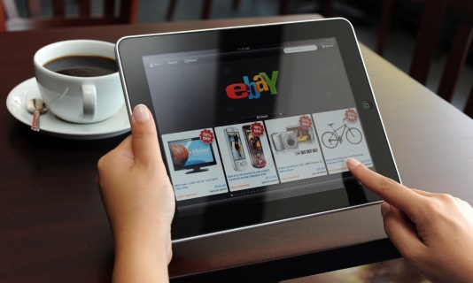
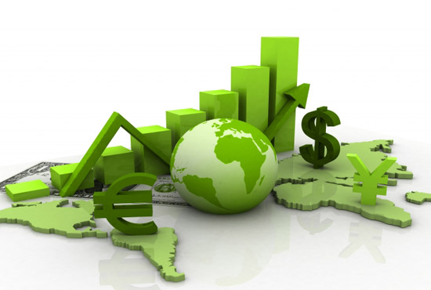

Data All Around
Lots of data is being collected and warehoused
  Web data, e-commerce
  Financial transactions, bank/credit transactions
  Online trading and purchasing
  Social Network

Slide 10
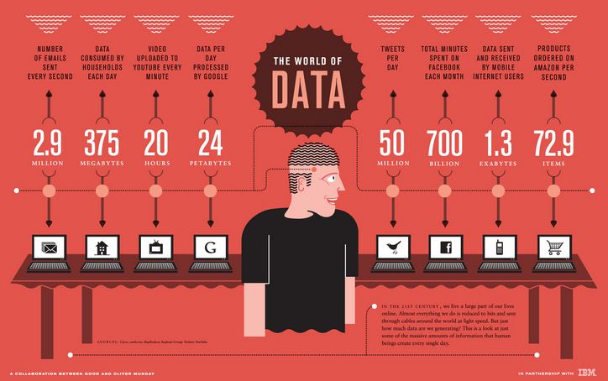
How Much Data Do We have?
Google processes 20 PB a day
Facebook has 60 TB of daily logs
eBay has 6.5 PB of user data + 50 TB/day (5/2009)
1000 genomes project: 200 TB
Cost of 1 TB of disk: $35
Time to read 1 TB disk: 3 hrs (100 MB/s)

Slide 11
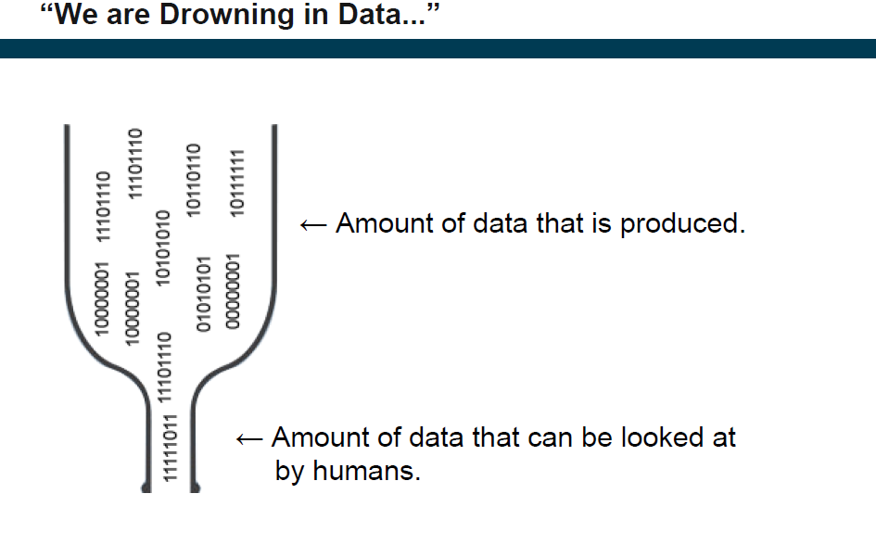

Slide 12
Big Data
  Big Data is any data that is expensive to manage and hard to extract value from
  Volume
      The size of the data
  Velocity
      The latency of data processing relative to the growing demand for interactivity
  Variety and Complexity
      The diversity of sources, formats, quality, structures.

Slide 13
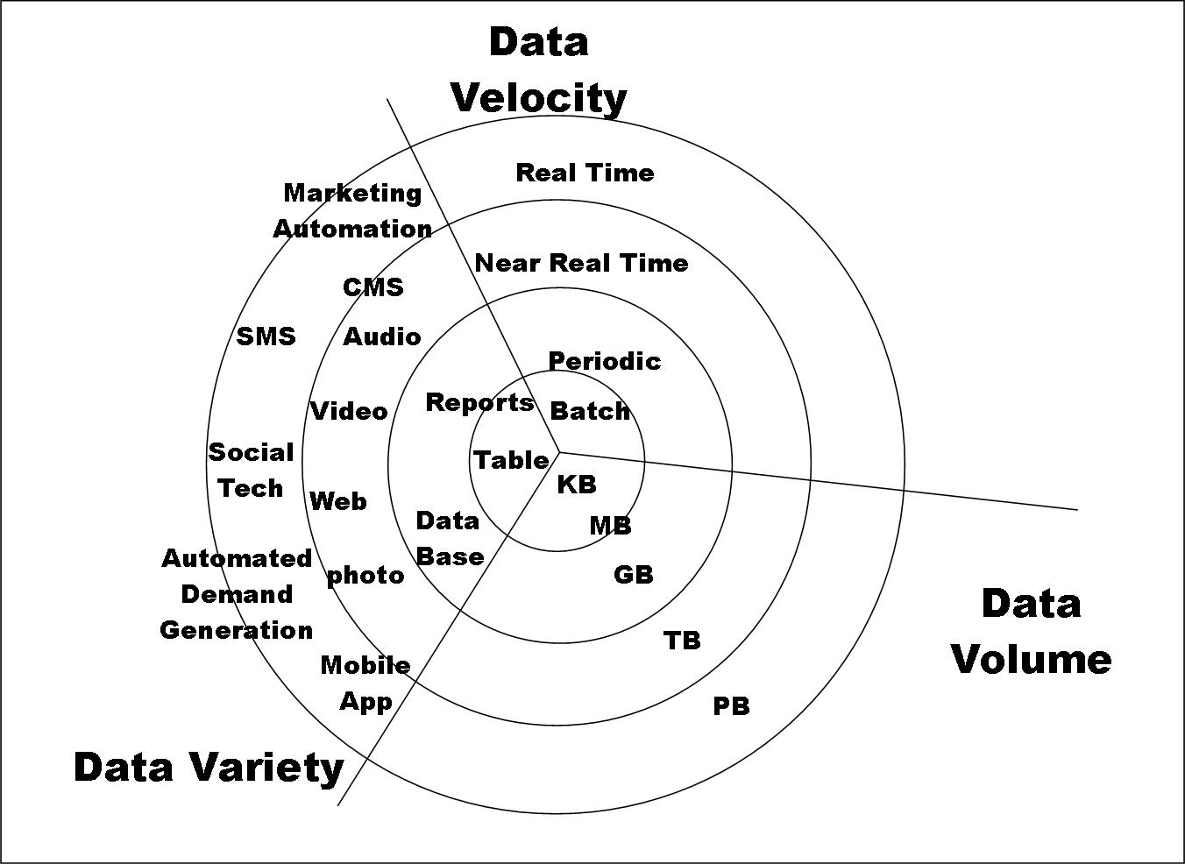
Big Data

Slide 14
Types of Data We Have
Relational Data (Tables/Transaction/Legacy Data)
Text Data (Web)
Semi-structured Data (XML)
Graph Data
Social Network, Semantic Web (RDF), …
Streaming Data

Slide 15
What To Do With These Data?
Aggregation and Statistics
  Data warehousing and OLAP
Indexing, Searching, and Querying
  Keyword based search
  Pattern matching (XML/RDF)
Knowledge discovery
  Data Mining
  Statistical Modeling

Slide 16
Big Data and Data Science
“… the most attractive job in the next 10 years will be statisticians,” Hal Varian, Google Chief Economist
The U.S. will need 140,000-190,000 predictive analysts and 1.5 million managers/analysts by 2018. McKinsey Global Institute’s June 2011
New Data Science institutes being created or repurposed
New degree programs, courses, boot-camps

Slide 17
What is Data Science?
An area that manages, manipulates, extracts, and interprets knowledge from tremendous amount of data
Data science (DS) is a multidisciplinary field of study with goal to address the challenges in big data
Data science principles apply to all data – big and small

Slide 18
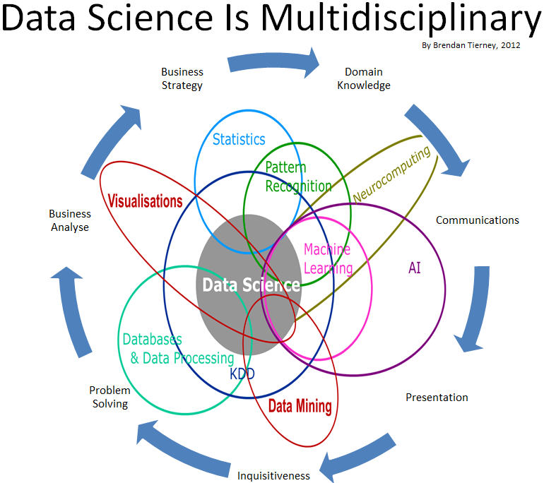

Slide 19
What is Data Science?
Theories and techniques from many fields and disciplines are used to investigate and analyze a large amount of data to help decision makers in many industries such as science, engineering, economics, politics, finance, and education
  Computer Science
    Pattern recognition, visualization, data warehousing, High performance computing, Databases, AI
  Mathematics
    Mathematical Modeling
  Statistics
    Statistical and Stochastic modeling, Probability.

Slide 20
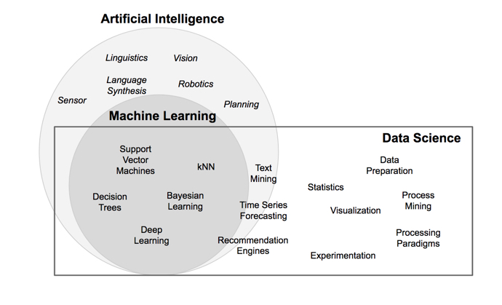
What is Data Science?

Slide 21
Data Science – Example
As a large retailer, Target tracks your purchases and interactions, both online and instore. And it uses the data to predictively model which of its customers are going to be parent, to better market baby-related purchases to them.
Facebook asks you to list your hometown and your current location, to make it easier for your friends to find and connect with you. But it also analyzes these locations to identify global migration patterns and where the fanbases of different football teams live.

Slide 22
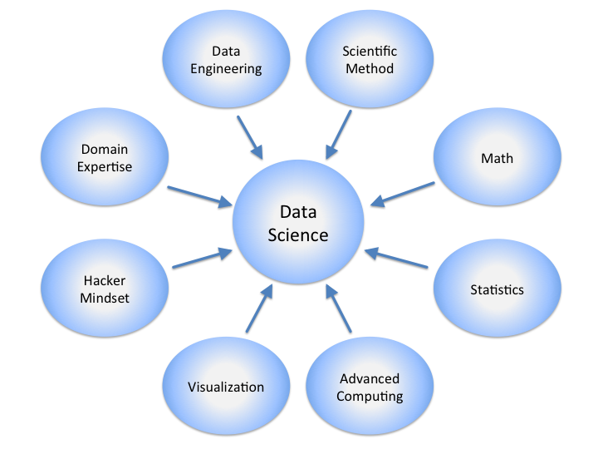
Data Science

