Slide 1
Week # 1
Course: Data Science Tools & Techniques
Instructor: Dr. Mateen Yaqoob

Slide 2
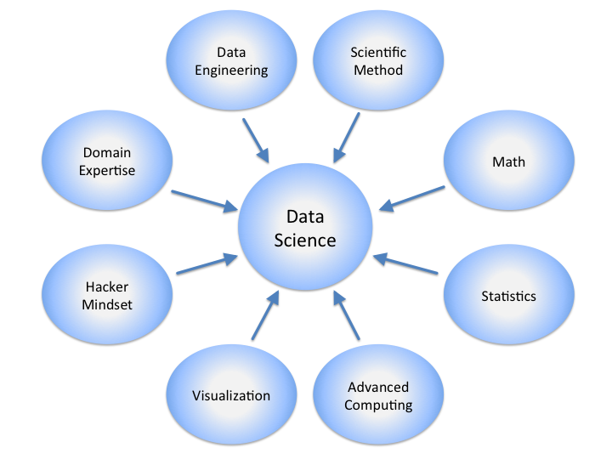
Data Science

Slide 3
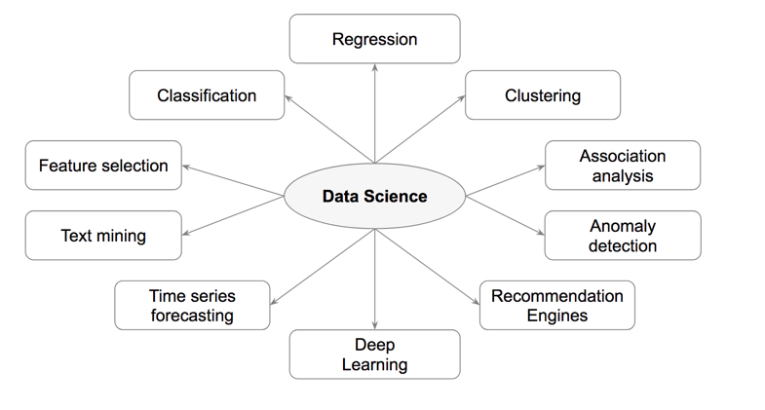
Tasks in Data Science

Slide 4
Data Science Tasks

Slide 5
Tasks | Description | Algorithms | Examples
Classification | Predict if a data point belongs to one of predefined classes. The prediction will be based on learning from known data set. | Decision Trees, Neural networks, Bayesian models, Induction rules, K nearest neighbors | Bucketing new customers into one of known customer groups.
Regression | Predict the numeric target label of a data point. The prediction will be based on learning from known data set. | Linear regression, Logistic regression | Predicting unemployment rate for next year. Estimating insurance premium.
Anomaly detection | Predict if a data point is an outlier compared to other data points in the data set. | Distance based; Density based | Fraud transaction detection in credit cards. Network intrusion detection.
Time series | Predict if the value of the target variable for future time frame based on history values. | Exponential smoothing, ARIMA, regression | Sales forecasting, production forecasting, virtually any growth phenomenon that needs to be extrapolated
Clustering | Identify natural clusters within the data set based on inherit properties within the data set. | K means, density-based clustering - DBSCAN | Finding customer segments in a company based on transaction, web and customer call data.
Association analysis | Identify relationships within an itemset based on transaction data. | FP Growth, Apriori | Find cross selling opportunities for a retailor based on transaction purchase history.

Slide 6
Data Science Technologies and Techniques
Data science tasks are generally divided into two major categories.
Prediction Methods
  Use some variables to predict unknown or future values of other variables. The attribute to be predicted is target or dependent variable, while the attributes used for making the prediction are know as the explanatory or independent variables
Description Methods
  Find human-interpretable patterns (correlations, association, trends, clusters and anomalies) that describe the underlying relationships in the data

Slide 7
Data Science Technologies and Techniques
Classification [Predictive]
Clustering [Descriptive]
Association Rule Discovery [Descriptive]
Sequential Pattern Discovery (spatial temporal data) [Descriptive]
Regression [Predictive]
Deviation/ Anomaly Detection [Predictive]

Slide 8

Data Scientists
Data Scientist
  The Most Attractive Job of the 21st Century
They find stories, extract knowledge. They are not reporters

Slide 9
What do Data Scientists do?
National Security
Cyber Security
Business Analytics
Engineering
Healthcare
And more ….

Slide 10
Concentration in Data Science
Mathematics and Applied Mathematics
Applied Statistics/Data Analysis
Programming Skills (R, Python, Julia, SQL)
Data Mining
Data Base Storage and Management
Machine Learning and discovery

Slide 11
Motivating Challenges of Data Science
Scalability
High Dimensionality
Complex and Heterogeneous Data
Data Ownership and Distribution
Privacy Preservation
Streaming Data
Data Quality

Slide 12
Why Data Science Now?
Digital transformation has made data a core organizational asset.
Cloud platforms make large-scale storage and computing accessible.
Open-source ecosystems reduce barriers to experimentation.
Machine learning enables prediction, recommendation, detection, and automation.
Streaming and IoT create continuously arriving data.
Generative AI is expanding the ways data can be queried, transformed, and analyzed.
15

Slide 13
The Data Explosion
Every application, device, transaction, sensor, and interaction can generate data.
Volume is only one dimension: velocity, variety, veracity, and value also matter.
More data does not automatically mean better decisions.
The challenge has shifted from data scarcity toward trustworthy data utilization.
16

Slide 14
Where Is Data Science Used?
Healthcare: diagnosis support, risk prediction, medical imaging, resource planning.
Finance: fraud detection, credit risk, forecasting, algorithmic decision support.
Retail: recommendation, demand forecasting, customer segmentation.
Manufacturing: predictive maintenance and quality control.
Cybersecurity: anomaly detection, threat intelligence, behavioral analytics.
Public sector: planning, service delivery, and policy analysis.
19

Slide 15
Data Science Life Cycle
Section

Slide 16
Data Science Life Cycle — Key Points
An end-to-end framework for solving data-driven problems.
Typical stages: problem understanding → data acquisition → understanding → preparation → EDA → features → modeling → evaluation → deployment → monitoring.
Stages overlap and are revisited.
The lifecycle is a feedback system, not a one-way pipeline.
25

Slide 17
Stage 1 — Problem / Research Understanding
Clarify the decision, user, stakeholder, or research question.
Define success before selecting a model.
Identify constraints: latency, cost, privacy, interpretability, safety, and resources.
Translate the objective into measurable outcomes.
Example: 'reduce churn' is not yet a well-defined ML task.
26

Slide 18
Stage 2 — Data Acquisition
Identify relevant internal and external sources.
Sources: databases, APIs, files, sensors, logs, surveys, public datasets, streams.
Check provenance, licensing, consent, access rights, and collection procedures.
Sampling decisions can determine the quality and representativeness of the final model.
27

Slide 19
Stage 3 — Data Understanding
Inspect schema, distributions, data types, ranges, duplicates, missingness, and relationships.
Understand how variables were generated.
Identify potential leakage and target definition problems.
Document assumptions and data provenance.
EDA begins here and continues throughout the project.
28

Slide 20
Stage 4 — Data Cleaning
Handle missing, duplicated, inconsistent, invalid, or noisy records.
Standardize formats and units.
Resolve inconsistent categories and identifiers.
Detect outliers using domain-aware methods.
Cleaning decisions can change the meaning of the dataset—document them.
29

Slide 21
Stage 5 — Exploratory Data Analysis
Use descriptive statistics and visualization to understand the data.
Study distributions, correlations, group differences, trends, and anomalies.
Look for imbalance and suspicious patterns.
EDA should generate hypotheses, not merely produce attractive charts.
Always separate exploration from final confirmatory claims where appropriate.
30

Slide 22
Stage 6 — Feature Engineering
Transform raw variables into representations useful for analysis or modeling.
Examples: scaling, encoding, aggregation, time-based features, text representations.
Feature engineering uses domain knowledge as well as algorithms.
A good feature can simplify a difficult learning problem.
Avoid leakage: features must be available at prediction time.
31

Slide 23
Stage 7 — Modeling
Select a baseline before complex models.
Choose methods based on task, data, constraints, and assumptions.
Examples: linear/logistic regression, trees, ensembles, clustering, neural networks.
Use reproducible training and validation procedures.
Model complexity should be justified by measurable benefit.
32

Slide 24
Stage 8 — Evaluation
Choose metrics aligned with the real objective.
Classification: precision, recall, F1, ROC-AUC, PR-AUC, calibration.
Regression: MAE, RMSE, R², and domain-specific error measures.
Compare against meaningful baselines.
Evaluate robustness, fairness, leakage, and generalization—not only headline accuracy.
33

Slide 25
Stage 9 — Deployment
Turn an analysis/model into a usable service, application, report, or decision workflow.
Deployment may be batch, real-time, edge, cloud, or embedded.
Consider latency, scalability, cost, security, reliability, and versioning.
Deployment is where technical work meets operational reality.
34

Slide 26
Stage 10 — Monitoring & Maintenance
Monitor data quality, drift, performance, latency, failures, and resource use.
Real-world data can change after deployment.
Retraining policies should be defined before failures become costly.
Track model and data versions.
Monitoring closes the loop and feeds the next iteration.
35

Slide 27
Why the Lifecycle Is Iterative
New data can reveal a flawed assumption.
EDA may show that the target is poorly defined.
Evaluation may expose leakage or subgroup failures.
Deployment can reveal latency or usability constraints.
Feedback creates a new cycle of improvement.
36

Slide 28
Data Science Is Not Linear
Problem definition ↔ data understanding.
EDA ↔ feature engineering.
Modeling ↔ evaluation.
Deployment ↔ monitoring.
Monitoring ↔ new data and problem reformulation.
The ability to iterate is a core professional skill.
37

Slide 29
Where Tools Fit in the Lifecycle
Python/SQL: data access, transformation, analysis.
Pandas/NumPy: structured data manipulation and numerical computing.
Visualization libraries: EDA and communication.
Scikit-learn / ML frameworks: modeling.
Spark: distributed processing.
Kafka: streaming data pipelines.
Cloud platforms and MLOps tools: deployment, orchestration, monitoring.
39

