Slide 1
Week # 2
Course: Data Science Tools & Techniques
Instructor: Dr. Mateen Yaqoob

Slide 2
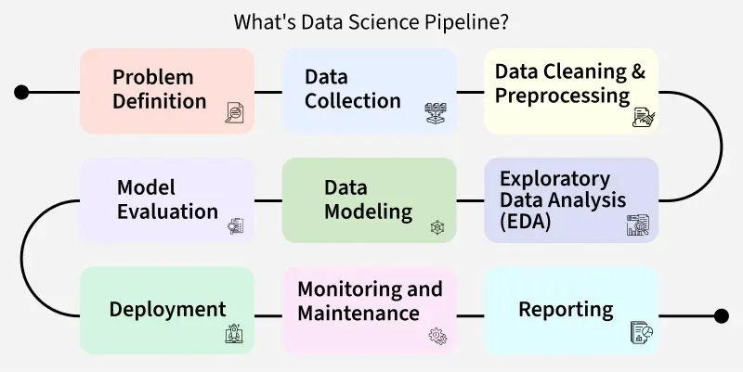

Slide 3
Data and Types of Data

Slide 4
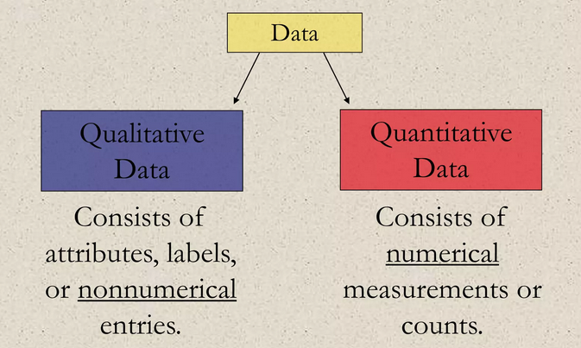
Types of Data
Data sets can consist of two types of data
  Qualitative Data
  Quantitative Data

Slide 5
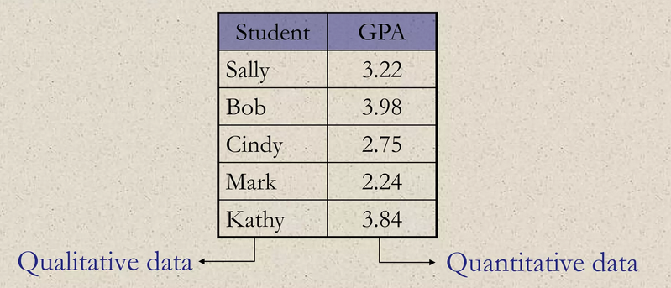
  Qualitative Data & Quantitative Data
Example:
  The grade point average of five students are listed in the table. Which data are qualitative and which are quantitative?

Slide 6

Levels of Measurement
The level of measurement determines which satatistical calculations are meaningful.
The four levels of measurement are
  Nominal
  Ordinal
  Interval
  Ratio

Slide 7
Data Objects
Data sets are made up of data objects.
A data object represents an entity.
Examples:
  sales database: customers, store items, sales
  medical database: patients, treatments
  university database: students, professors, courses
Also called samples , examples, instances, data points, objects, tuples.
Data objects are described by attributes.
Database rows -> data objects; columns ->attributes.

Slide 8
Attributes
Attribute (or dimensions, features, variables): a data field, representing a characteristic or feature of a data object.
  E.g., customer _ID, name, address
Types:
  Nominal
  Binary
  Numeric: quantitative
    Interval-scaled
    Ratio-scaled

Slide 9
Attribute Types
Nominal: categories, states, or “names of things”
  Hair_color = {auburn, black, blond, brown, grey, red, white}
  marital status, occupation, ID numbers, zip codes
Binary
  Nominal attribute with only 2 states (0 and 1)
  Symmetric binary: both outcomes equally important
    e.g., gender
  Asymmetric binary: outcomes not equally important.
    e.g., medical test (positive vs. negative)
    Convention: assign 1 to most important outcome (e.g., HIV positive)
Ordinal
  Values have a meaningful order (ranking) but magnitude between successive values is not known.
  Size = {small, medium, large}, grades, army rankings

Slide 10
Numeric Attribute Types
Quantity (integer or real-valued)
Interval
    Measured on a scale of equal-sized units
    Values have order
      E.g., temperature in C˚or F˚, calendar dates
    No true zero-point
Ratio
    Inherent zero-point
    We can speak of values as being an order of magnitude larger than the unit of measurement (10 K˚ is twice as high as 5 K˚).
      e.g., temperature in Kelvin, length, counts, monetary quantities

Slide 11
Discrete vs. Continuous Attributes
Discrete Attribute
  Has only a finite set of values
    E.g., zip codes, profession, or the set of words in a collection of documents
  Sometimes, represented as integer variables
  Note: Binary attributes are a special case of discrete attributes
Continuous Attribute
  Has real numbers as attribute values
    E.g., temperature, height, or weight
  Practically, real values can only be measured and represented using a finite number of digits
  Continuous attributes are typically represented as floating-point variables

Slide 12
Important Characteristics of Structured Data
Dimensionality
  Curse of dimensionality
Sparsity
  Only presence counts
Resolution
  Patterns depend on the scale
Distribution
  Centrality and dispersion

Slide 13
Dimensionality
The dimensionality of a data set is the number of attributes that the objects in the data set possess.
Analyzing data with a small number of dimensions tends to be qualitatively different from analyzing moderate or high-dimensional data.
Indeed, the difficulties associated with the analysis of high-dimensional data are sometimes referred to as the curse of dimensionality.
Because of this, an important motivation in preprocessing the data is dimensionality reduction.

Slide 14
Sparsity
A special case of skewed data is sparsity.
For sparse binary, count or continuous data, most attributes of an object have values of 0.
In many cases, fewer than 1% of the values are non-zero. In practical terms, sparsity is an advantage because usually only the non-zero values need to be stored and manipulated.
This results in significant savings with respect to computation time and storage

Slide 15
Resolution
It is frequently possible to obtain data at different levels of resolution, and often the properties of the data are different at different resolutions.
For instance, the surface of the Earth seems very uneven at a resolution of a few meters, but is relatively smooth at a resolution of tens of kilometers.
The patterns in the data also depend on the level of resolution.
If the resolution is too fine, a pattern may not be visible or may be buried in noise; if the resolution is too coarse, the pattern can disappear.
For example, variations in atmospheric pressure on a scale of hours reflect the movement of storms and other weather systems.
On a scale of months, such phenomena are not detectable.

Slide 16
Distribution
The distribution of a data set is the frequency of occurrence of various values or sets of values for the attributes comprising data objects.
Equivalently, the distribution of a data set can be considered as a description of the concentration of objects in various regions of the data space.

Slide 17
Types of Data Sets
Record
  Relational records
  Data matrix, e.g., numerical matrix, crosstabs
  Document data: text documents: term-frequency vector
  Transaction data
Graph and network
  World Wide Web
  Social or information networks
  Molecular Structures
Ordered
  Video data: sequence of images
  Temporal data: time-series
  Sequential Data: transaction sequences
  Genetic sequence data
Spatial, image and multimedia:
  Spatial data: maps
  Image data:
  Video data:

Slide 18
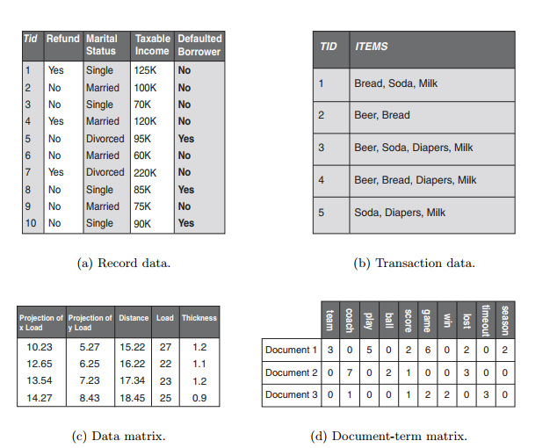
Record Data

Slide 19
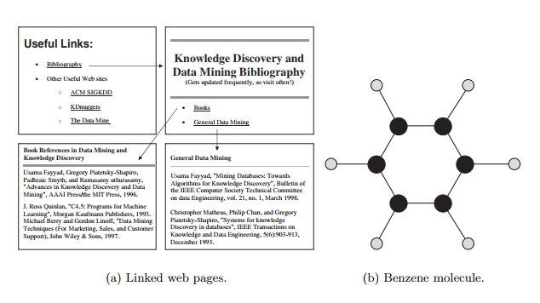
Graph and networks

Slide 20
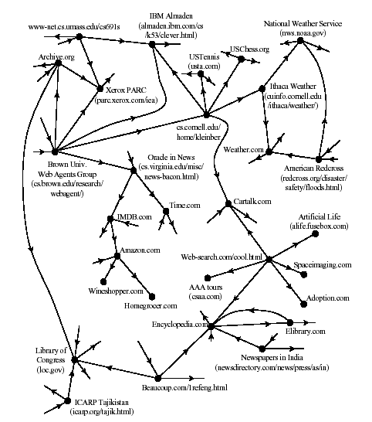
Graph and network : World Wide Web

Slide 21
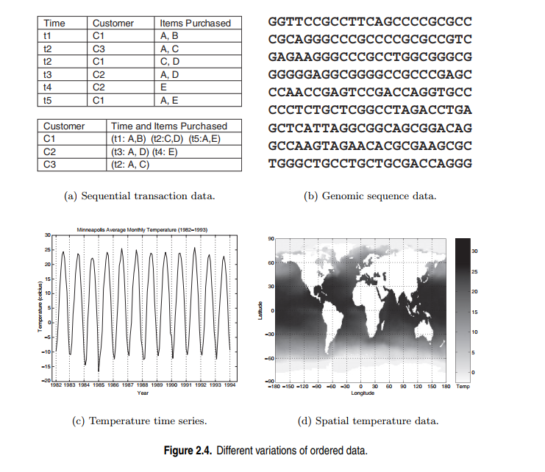
Ordered Data

Slide 22
Data Quality
What kinds of data quality problems?
How can we detect problems with the data?
What can we do about these problems?
Examples of data quality problems:
  Noise and outliers
  missing values
  duplicate data

Slide 23
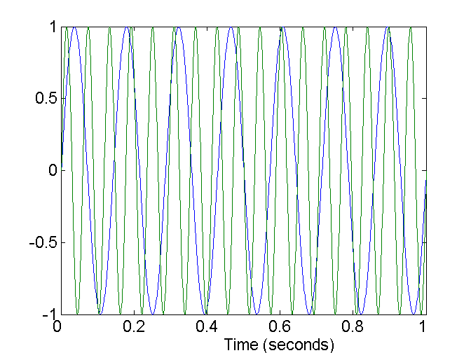
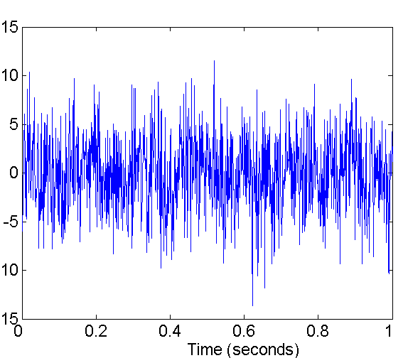
Noise
Noise refers to modification of original values
  Examples: distortion of a person’s voice when talking on a poor phone and “snow” on television screen
Two Sine Waves
Two Sine Waves + Noise

Slide 24
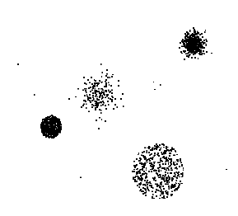
Outliers
Outliers are data objects with characteristics that are considerably different than most of the other data objects in the data set

Slide 25
Missing Values
Reasons for missing values
  Information is not collected
  (e.g., people decline to give their age and weight)
  Attributes may not be applicable to all cases
  (e.g., annual income is not applicable to children)
Handling missing values
  Eliminate Data Objects
  Estimate Missing Values
  Ignore the Missing Value During Analysis
  Replace with all possible values (weighted by their probabilities)

Slide 26
Duplicate Data
Data set may include data objects that are duplicates, or almost duplicates of one another
  Major issue when merging data from heterogenous sources
Examples:
  Same person with multiple email addresses
Data cleaning
  Process of dealing with duplicate data issues

Slide 27
Data Preprocessing
Aggregation
Sampling
Dimensionality Reduction
Feature subset selection
Feature creation
Discretization and Binarization
Attribute Transformation

Slide 28
Aggregation
Sometimes “Less is more”, this is the case with aggregation
Combining two or more attributes (or objects) into a single attribute (or object)
Purpose
  Data reduction
    Reduce the number of attributes or objects
  Change of scale
    Cities aggregated into regions, states, countries, etc
  More “stable” data
    Aggregated data tends to have less variability

Slide 29
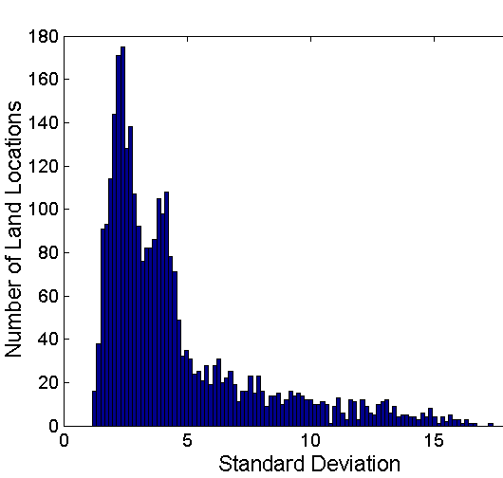
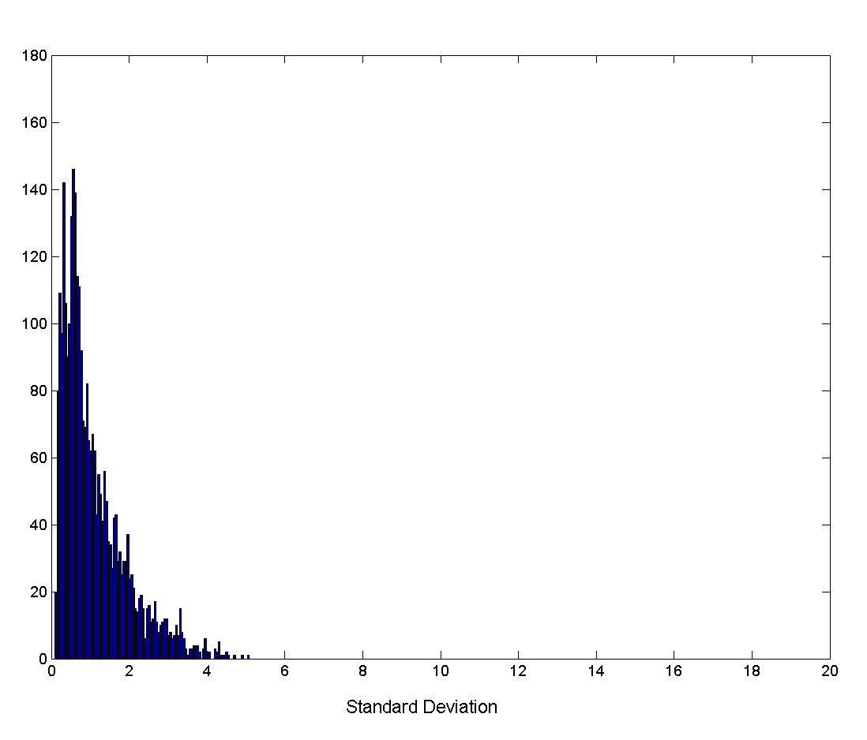
Aggregation
Variation of Precipitation in Australia
Standard Deviation of Average Monthly Precipitation
Standard Deviation of Average Yearly Precipitation

Slide 30
Sampling
Sampling is the main technique employed for data selection.
  It is often used for both the preliminary investigation of the data and the final data analysis.
Statisticians sample because obtaining the entire set of data of interest is too expensive or time consuming.
Sampling is used in data mining because processing the entire set of data of interest is too expensive or time consuming.

Slide 31
Sampling …
The key principle for effective sampling is the following:
  using a sample will work almost as well as using the entire data sets, if the sample is representative
  A sample is representative if it has approximately the same property (of interest) as the original set of data

Slide 32
Types of Sampling
Simple Random Sampling
  There is an equal probability of selecting any particular item
Sampling without replacement
  As each item is selected, it is removed from the population
Sampling with replacement
  Objects are not removed from the population as they are selected for the sample.
    In sampling with replacement, the same object can be picked up more than once
Stratified sampling
  Split the data into several partitions; then draw random samples from each partition

Slide 33

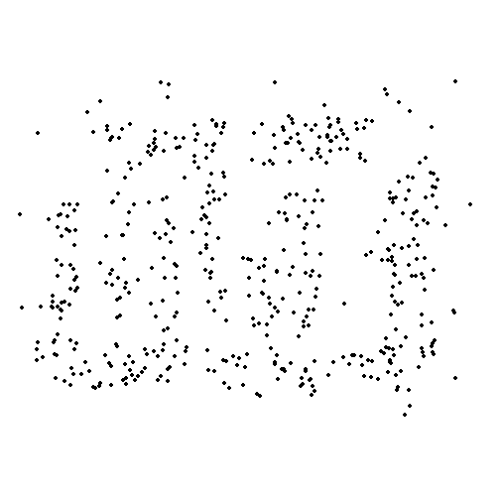
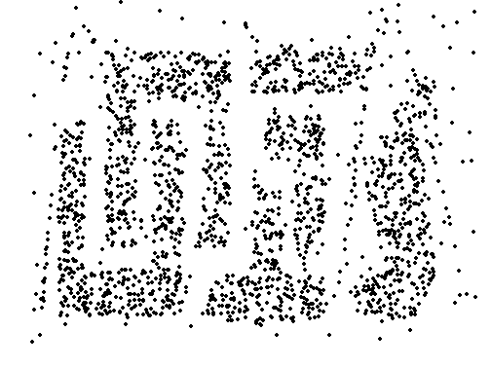
Sample Size
8000 points 2000 Points 500 Points

Slide 34
Dimensionality Reduction
Data sets can have a large number of features.
Consider a set of documents, where each document is represented by a vector whose components are the frequencies with which each word occurs in the document. In such cases, there are typically thousands or tens of thousands of attributes (components), one for each word in the vocabulary
There are a variety of benefits to dimensionality reduction.
A key benefit is that many data mining algorithms work better if the dimensionality—the number of attributes in the data—is lower.

Slide 35
Curse of Dimensionality
The curse of dimensionality refers to the phenomenon that many types of data analysis become significantly harder as the dimensionality of the data increases.
Specifically, as dimensionality increases, the data becomes increasingly sparse in the space that it occupies.
Thus, the data objects we observe are quite possibly not a representative sample of all possible objects.
For classification, this can mean that there are not enough data objects to allow the creation of a model that reliably assigns a class to all possible objects.
For clustering, the differences in density and in the distances between points, which are critical for clustering, become less meaningful.

Slide 36
Dimensionality Reduction
Purpose:
  Avoid curse of dimensionality
  Reduce amount of time and memory required by data mining algorithms
  Allow data to be more easily visualized
  May help to eliminate irrelevant features or reduce noise
Techniques
  Principle Component Analysis
  Singular Value Decomposition
  Others: supervised and non-linear techniques

Slide 37
Dimensionality Reduction: PCA
Goal is to find a projection that captures the largest amount of variation in data
Principal component analysis, or PCA, is a dimensionality reduction method that is often used to reduce the dimensionality of large data sets, by transforming a large set of variables into a smaller one that still contains most of the information in the large set.
x₂
e
x₁

Slide 38
Dimensionality Reduction: PCA

