Slide 1
Week # 2
Course: Data Science Tools & Techniques
Instructor: Dr. Mateen Yaqoob

Slide 2
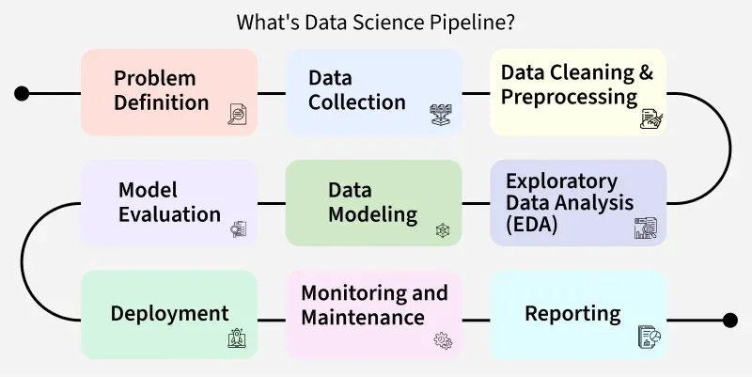

Slide 3
What is Data Extraction?
Definition: Process of retrieving data from various sources and converting it into a usable format.
Key concept: "Data extraction involves extracting data from homogeneous or heterogeneous sources"
Why it matters:
  Raw data exists in multiple formats across disparate systems
  Extraction is the first step in ETL (Extract, Transform, Load)
  Quality of extraction determines quality of analysis

Slide 4
The Data Extraction Landscape
Sources of Data:
  Databases - Structured relational data
  APIs - Web services, RESTful APIs
  Files - CSV, JSON, XML, Excel, PDF
  Web Scraping - HTML pages
  Sensors & IoT - Streaming data
  Logs & Social Media - Unstructured text
Challenges:
  Different formats (CSV, JSON, XML, DB tables)
  Different structures (structured vs. unstructured)
  Data redundancy, inconsistency, duplication

Slide 5
Data Format Taxonomy
Structured: Fixed schema, rows & columns, relational
  Examples: SQL Databases, CSV, Excel
Semi-Structured: Flexible schema, hierarchical, self-describing
  Examples: JSON, XML, HTML, YAML
Unstructured: No predefined structure
  Examples: Text, Images, Audio, Video
Key Insight: Extraction techniques vary significantly across these categories

Slide 6
Querying CSV with Python - Pandas
import pandas as pd
df = pd.read_csv('data.csv')
df_filtered = df[df['age'] > 30]
df_subset = df[['name', 'salary']]
avg_salary = df.groupby('department')['salary'].mean()
df.query('age > 25 and salary > 70000')

Slide 7
Querying Excel Files
import pandas as pd
df = pd.read_excel('data.xlsx', sheet_name='Sales')
all_sheets = pd.read_excel('data.xlsx', sheet_name=None)
q1 = df[df['Quarter'] == 'Q1']
q1_sales = q1['Revenue'].sum()
with pd.ExcelWriter('output.xlsx') as writer:
df.to_excel(writer, sheet_name='Data', index=False)

Slide 8
Data Extraction Paradigms
Data Formats Taxonomy
• Structured: Fixed schemas, relational models (CSV, SQL databases).
• Semi-Structured: Self-describing schema, nested objects (JSON, XML, YAML).
• Unstructured: Free text, binary formats, documents (PDF, Docx, HTML).
• Binary Storage: Optimized binary serialization (Parquet, ORC, Avro).
Extraction Considerations
• Schema Enforcement: Read schema-on-write vs. schema-on-read.
• Memory Efficiency: Chunking, streaming, and lazy evaluation.
• Serialization Overhead: CPU cost of parsing string vs binary data.
• Data Integrity: Validation, missing value handling, character encodings.

Slide 9
Row vs. Columnar File Formats
Row-Oriented (CSV / Excel)
• Format: Human-readable plain text / XML compressed.
• Best Use Case: Small datasets, manual inspection, row inserts.
• Bottlenecks: Full file must be scanned to query specific columns.
• Memory: High overhead during parsing in Pandas/Python.
Columnar Storage (Parquet / Feather)
• Format: Binary columnar compression (Snappy / ZSTD).
• Best Use Case: Large-scale OLAP analytics and feature extraction.
• Performance: Column projection pushdown (only load needed columns).
• I/O Efficiency: Predicate pushdown filters data at metadata level.

Slide 10
Semi-Structured Data (JSON / XML)
JSON & JSONL Extraction
• Hierarchical, key-value data structures.
• Querying Tools: jsonpath-ng, Pandas json_normalize().
• JSONL (JSON Lines): Enables line-by-line streaming for multi-gigabyte files.
• Schema drift handling: Optional keys and varying nested depth.
XML & HTML Extraction
• Tree-structured markup with explicit tagging.
• Querying Tools: XPath expressions, lxml, BeautifulSoup.
• Navigation: ElementTree traversal, parent/child/sibling nodes.
• Namespace Handling: Registering and parsing XML namespaces.

Slide 11
Web Data Extraction: APIs & Web Scraping
RESTful APIs
• HTTP Protocols: GET/POST with Authentication headers.
• Rate Limiting & Pagination: Handling tokens, offsets, cursor-based pagination.
• Robustness: Implementing retry logic with exponential backoff.
• Libraries: httpx (async API extraction), requests.
Web Scraping (HTML Parsing)
• Static Pages: requests + BeautifulSoup4 with CSS selectors / XPath.
• Dynamic Rendering: Headless browser execution (Playwright, Selenium).
• Best Practices: Respect robots.txt, avoid IP blocking via proxy rotation.
• Content Extraction: Parsing tabular tags directly into dataframes.

Slide 12
Querying Unstructured Documents
PDF & Document Processing
• Text Extraction: pdfplumber, PyPDF2, pypdf.
• Table Extraction from PDFs: pdfplumber bounding boxes / camelot.
• OCR: pytesseract for scanned images/PDFs.
• Document Layout Parsing: Structural layout analysis (headers, captions).
RegEx & Pattern Matching
• Extracting entities (Emails, IP addresses, Currency, Dates) from raw text.
• Named Entity Recognition (NER): SpaCy / NLTK for structured entity extraction.
• String Normalization: Unicode clean-up, tokenization, whitespace removal.
• Unstructured to Structured pipeline.

Slide 14
Feature Subset Selection
Another way to reduce dimensionality of data
Redundant features
  duplicate much or all of the information contained in one or more other attributes
  Example: purchase price of a product and the amount of sales tax paid
Irrelevant features
  contain no information that is useful for the data mining task at hand
  Example: students' ID is often irrelevant to the task of predicting students' GPA

Slide 15
Feature Subset Selection
Techniques:
  Brute-force approach:
    Try all possible feature subsets as input to data mining algorithm
  Embedded approaches:
    Feature selection occurs naturally as part of the data mining algorithm
  Filter approaches:
    Features are selected before data mining algorithm is run
  Wrapper approaches:
    Use the data mining algorithm as a black box to find best subset of attributes

Slide 16
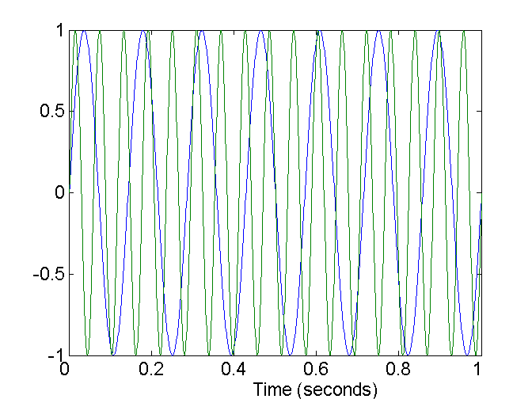
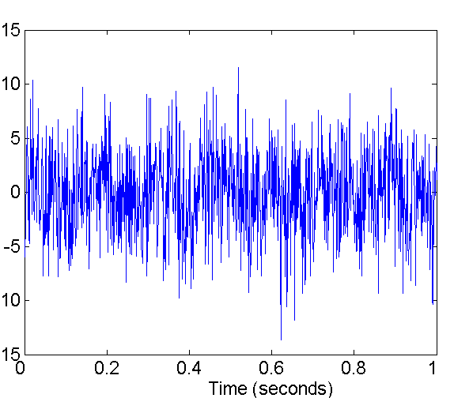
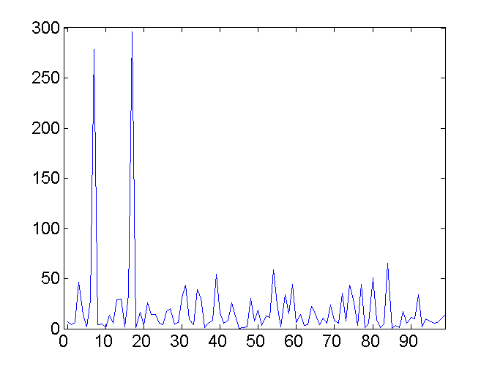
Mapping Data to a New Space
Fourier transform
Wavelet transform
Two Sine Waves
Two Sine Waves + Noise
Frequency

Slide 17
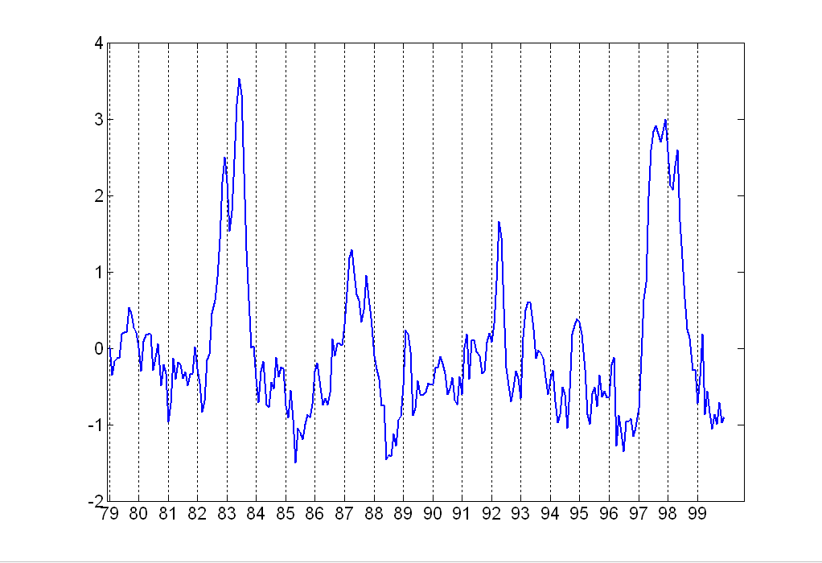
Attribute Transformation
A function that maps the entire set of values of a given attribute to a new set of replacement values such that each old value can be identified with one of the new values
  Simple functions: x^{k}, log(x), e^{x}, |x|
  Standardization and Normalization
Notes:
Standardization: In statistics it refers to subtracting off the means and dividing by the standard deviation. (to make an entire set of values have a Particular property eg. Mean 0 and SD.
2. Normalization: (interchangav)It refers to various techniques to adjust to differences among attributes in terms of frequency of occurrence, mean, variance, range etc
normalization and standardization terms are normally used interchangeably.

Slide 18
Similarity and Dissimilarity
Are important for number of data science techniques such as
  Clustering
  Nearest neighbor classification
  Anomaly detection
In some cases, original dataset is not needed once the similarity and dissimilarity have been computed
Means transforming the data to a similarity (dissimilarity) space and then performing the analysis

Slide 19
Best Practices for Data Extraction
Validate and clean data during extraction
Handle exceptions and errors
Use efficient querying and indexing strategies

Slide 20


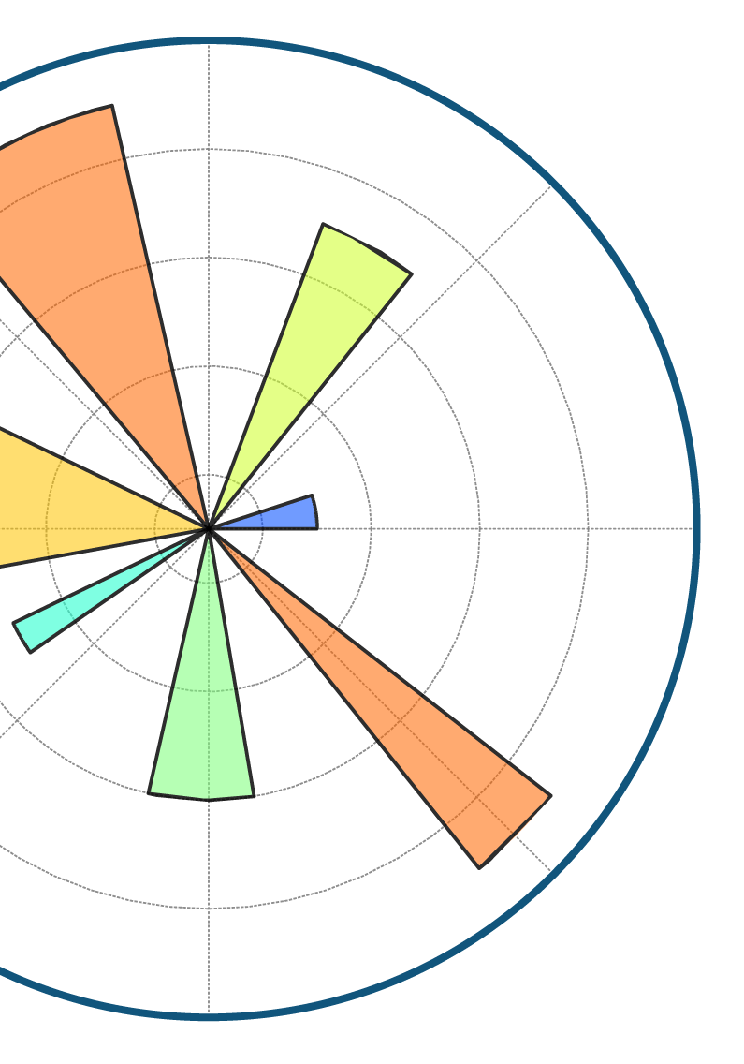




Slide 21


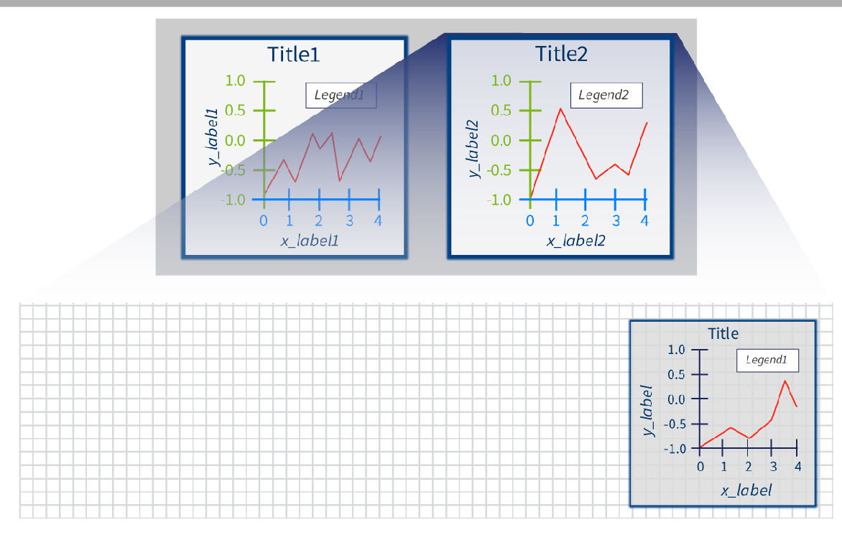
















Slide 22





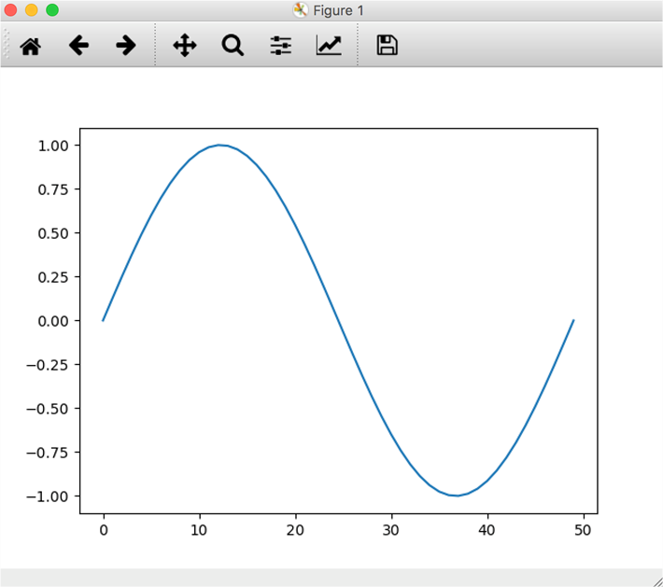

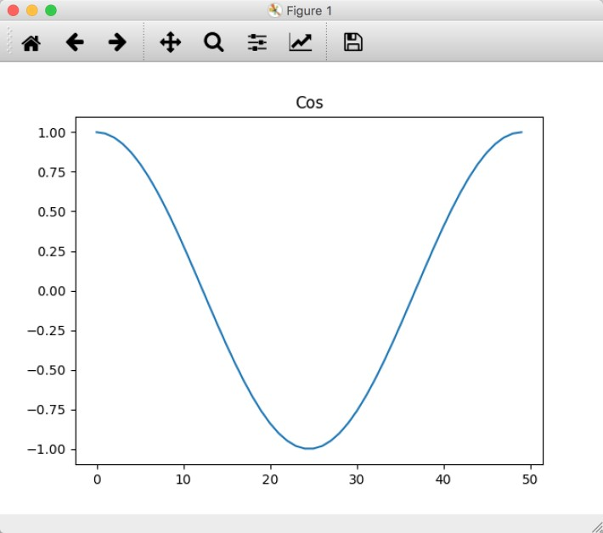
>>> import matplotlib.pyplot as plt
>>> import numpy as np
>>> t = np.linspace(0,2*np.pi,
...
>>> x = np.sin(t)
>>> y = np.cos(t)
50)
# Now create a figure
>>> plt.figure()
# and plot x inside it
>>> plt.plot(x)
# Now create a new figure
>>> plt.figure()
# and plot y inside it...
>>> plt.plot(y)
# ...and add a title
>>> plt.title("Cos")

Slide 23

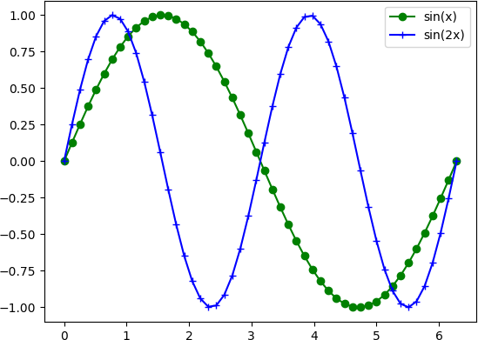


>>> x = np.linspace(0, 2*np.pi, 50)
>>> y1 = np.sin(x)
>>> y2 = np.sin(2*x)
>>> plt.figure() # Create figure
>>> plt.plot(y1)
>>> plt.plot(x, y1)
# red dot-dash circle
>>> plt.plot(x, y1, 'r-o')
# red marker only circle
>>> plt.plot(x, y1, 'ro')
>>> plt.plot(x, y1, 'g-o',
... x, y2, 'b-+')
>>> plt.legend(['sin(x)',
... 'sin(2x)'])
Symbol | Color
b | Blue
g | Green
r | Red
c | Cyan
m | Magenta
y | Yellow
k | Black
w | White
Symbol | Marker
. | Point
o | Circle
< > ^ v | Triangles
8 | Octagon
s | Square
* | Star
+ | Plus
 | …and more

Slide 24


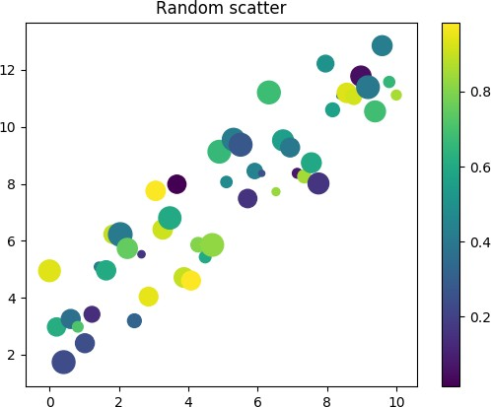
>>> | N = 50 # no. of points
>>> | x = np.linspace(0, 10, N)
>>> | from numpy.random \
... | import rand
>>> | e = rand(N)*5.0 # noise
>>> | y1 = x + e
>>> | areas = rand(N)*300
>>> | plt.scatter(x, y1, s=areas)
>>> | colors = rand(N)
>>> | plt.scatter(x, y1, s=areas,
... | c=colors)
>>> | plt.colorbar()
>>> | plt.title("Random scatter")

Slide 25

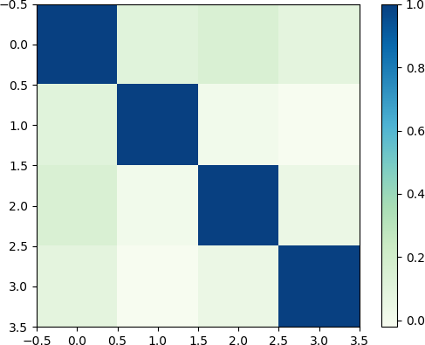
>>> # Create some data
>>> e1 = rand(100)
>>> e2 = rand(100)*2
>>> e3 = rand(100)*10
>>> e4 = rand(100)*100
>>> corrmatrix = \
... np.corrcoef([e1, e2,
... e3, e4])
>>> # Plot corr matrix as image
>>> plt.imshow(corrmatrix,
...
...
interpolation='none', cmap='GnBu')
>>> plt.colorbar()

Slide 26

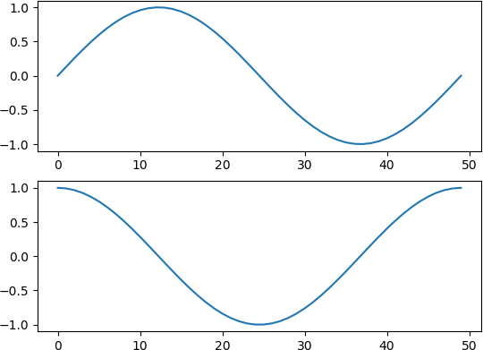







subplot
>>> t = np.linspace(0, 2*np.pi)
>>> x = np.sin(t)
>>> y = np.cos(t)
# To divide the plotting area
>>> plt.subplot(2, 1, 1)
>>> plt.plot(x)
# Now activate a new plot # area.
>>> plt.subplot(2, 1, 2)
>>> plt.plot(y)

Slide 27

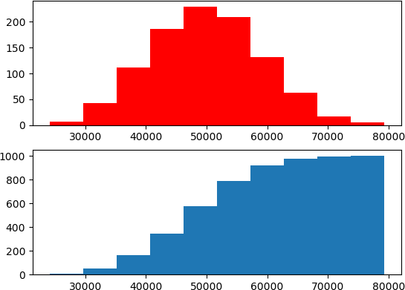
>>> # Create array of data
>>> from numpy.random import \
... randint
>>> data = randint(10000,
... size=(10,1000))
>>> # Approx norm distribution
>>> x = np.sum(data, axis=0)
>>> # Set up for stacked plots
>>> plt.subplot(2,1,1)
>>> plt.hist(x, color='r')
>>> # Plot cumulative dist
>>> plt.subplot(2,1,2)
>>> plt.hist(x, cumulative=True)
>>> # For multiple histograms:
>>> plt.hist([d1, d2, …])

Slide 28



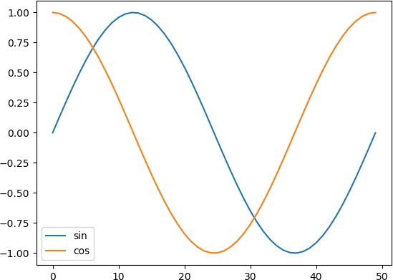
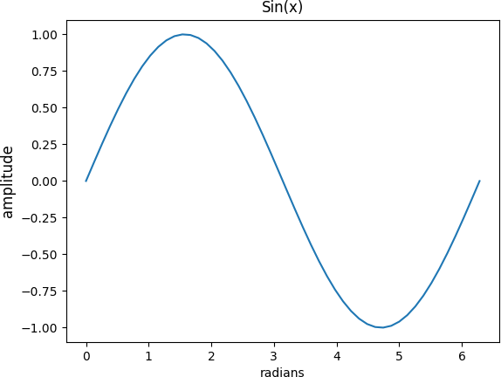
# Add labels in plot command.
>>> plt.plot(np.sin(t),
... label='sin')
>>> plt.plot(np.cos(t),
... label='cos')
>>> plt.legend()
>>> plt.plot(t, np.sin(t))
>>> plt.xlabel('radians')
# Keywords set text properties.
>>> plt.ylabel('amplitude',
... fontsize='large')
>>> plt.title('Sin(x)')

Slide 29



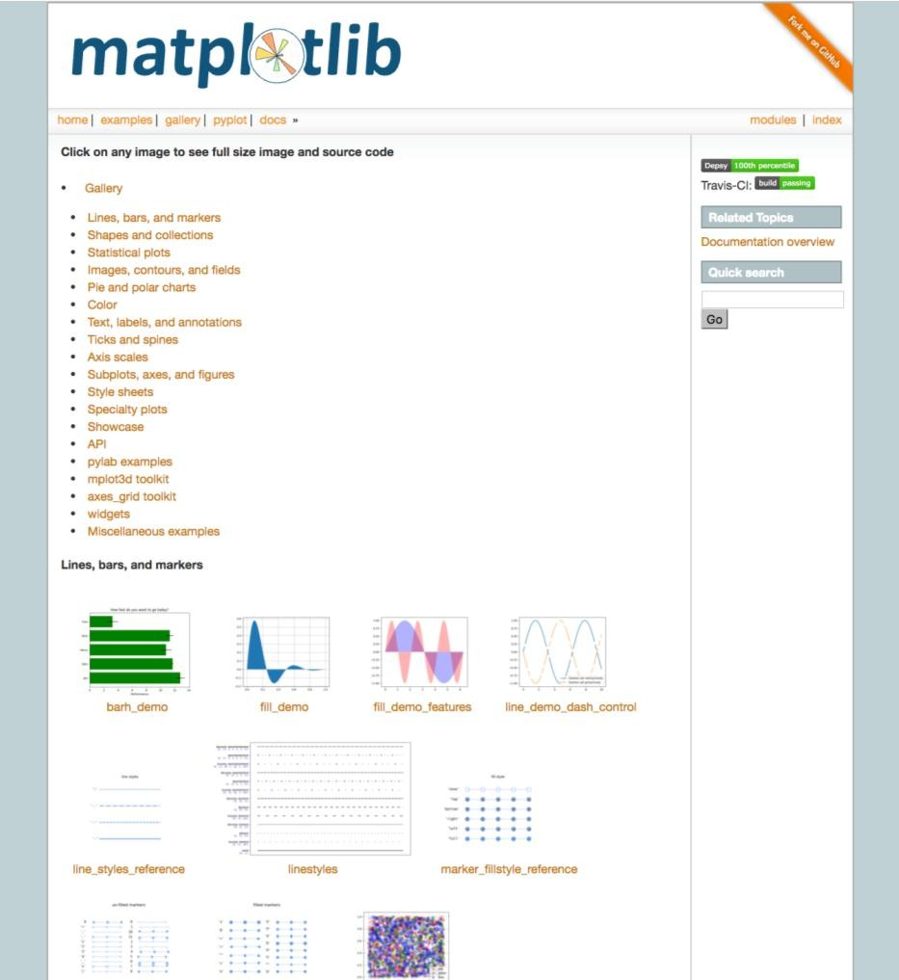
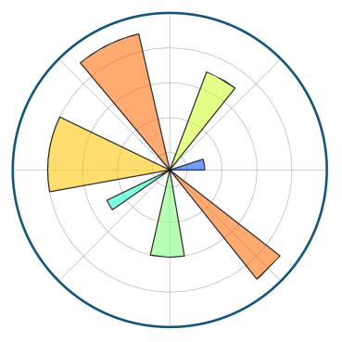





•
•
•
•

Slide 30











