Slide 1
Week # 3
Course: Data Science Tools & Techniques
Instructor: Dr. Mateen Yaqoob

Slide 2
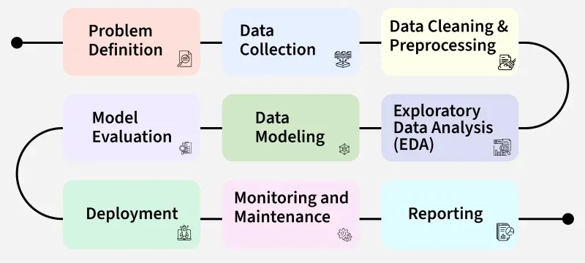

Slide 3
Data Preparation
One of the first tasks when analyzing data is to collect and prepare the data in a format appropriate for analysis of the samples.
  Obtaining the data
  Parsing the data
  Cleaning the data
  Building data structures
Notes:
1. Obtaining the data: Data can be read directly from a file or they might be obtained
by scraping the web.
2. Parsing the data: The right parsing procedure depends on what format the data
are in: plain text, fixed columns, CSV, XML, HTML, etc.
3. Cleaning the data: Survey responses and other data files are almost always incomplete. Sometimes, there are multiple codes for things such as, not asked, did
not know, and declined to answer. And there are almost always errors. A simple
strategy is to remove or ignore incomplete records.
4. Building data structures: Once you read the data, it is necessary to store them in
a data structure that lends itself to the analysis we are interested in. If the data fit
into the memory, building a data structure is usually the way to go. If not, usually
a database is built, which is an out-of-memory data structure. Most databases
provide a mapping from keys to values, so they serve as dictionaries.

Slide 4
ID | Name | Age | Gender | Income (PKR)
1 | Ali | 25 | M | 50,000
2 | Sara |  | Female | 60000
3 | Ahmed | 250 | Male | -20000
4 | Sara | 30 | F | 60000
5 | John | 28 | MALE | 45,000
6 | Maryam | 35 | female | 70,000
7 | Ayesha | 29 | F | 75,000
8 | Kamran | 40 | M | ?
9 | Ali | 25 | Male | 50,000
10 | Bilal | -5 | M | 55,000
11 | Sana | 32 | F | 62,000
12 | John | 28 | M | 45,000
13 | Usman | 31 | Male | 61,500
14 | Fatima | 200 | F | 72,000
15 | Zainab | 27 | female | null
16 | Ahmed | 36 | Male | 68,000
17 | Rehan | 29 | M | 58,000
18 | Sara | 30 | Female | 60,000
19 | Ali | 25 | M | 50,000
20 | Maria |  | F | 80,000

Slide 5
Example: The Adult Dataset
Hosted on the UCI’s Machine Learning Repository (https://archive.ics.uci.edu/ml/datasets/Adult)
It contains approximately 32,000 observations concerning different financial parameters related to the US population: age, sex, marital, country, income (Boolean variable: whether the person makes more than $50,000 per annum), education (the highest level of education achieved by the individual), occupation, capital gain, etc.
We can explore the data by asking questions like: “Are men more likely to become high-income professionals than women, i.e., to receive an income of over $50,000 per annum?”

Slide 6
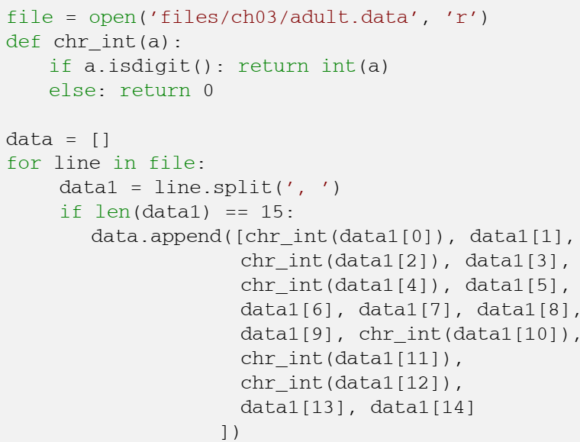
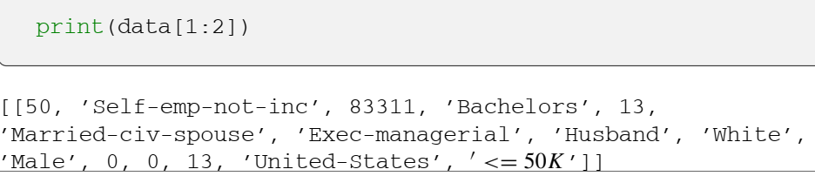
Let’s read the data and check the data we obtain

Slide 7
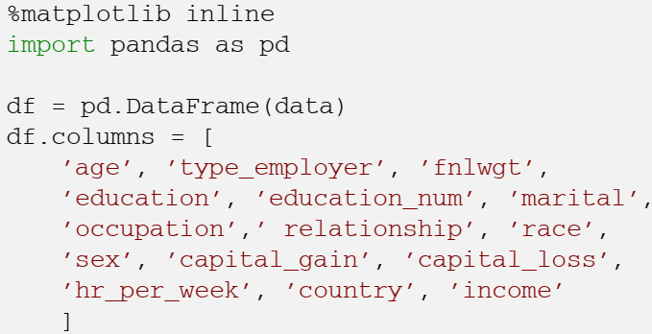
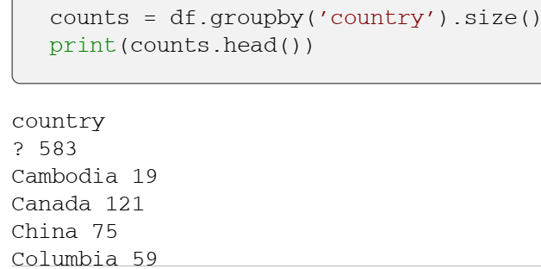
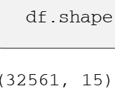
Notes:
One of the easiest ways to manage data in Python is by using the DataFrame structure, defined in the Pandas library, which is a two-dimensional, size-mutable, potentially heterogeneous tabular data structure with labeled axes:
The command shape gives exactly the number of data samples (in rows, in this case) and features (in columns): Thus, we can see that our dataset contains 32,561 data records with 15 features each. Let us count the number of items per country: The first row shows the number of samples with unknown country, followed by the number of samples corresponding to the firsts countries in the dataset.

Slide 8
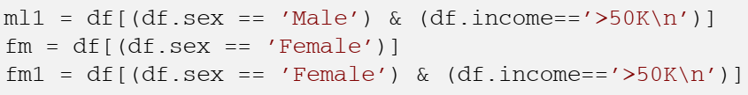
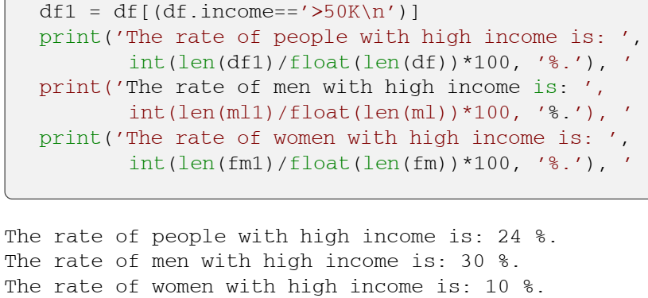
Notes:
Let us split people according to their gender into two groups: men and women .
If we focus on high-income professionals separated by sex, we can do:
The data in general can be categorical or quantitative. For categorical data, a simple tabulation of the frequency of each category is the best non-graphical exploration for data analysis. For example, we can ask ourselves what is the proportion of highincome professionals in our database:

Slide 9
Adult Dataset Description
File | Size | Purpose | Contains | Used for ML?
adult.data | 3.8 MB | Training data | ~32,561 records with 14 features + income target | Yes
adult.test | 1.9 MB | Test data | ~16,281 records with 14 features + income target | Yes
adult.names | 5.1 KB | Dataset documentation | Attribute descriptions, possible values, missing-value information, dataset background | Reference
old.adult.names | 4.2 KB | Older documentation | Earlier version of the dataset description/metadata | Usually no
Index | 140 Bytes | Repository/index information | File/index metadata | No

Slide 10
Data Scrubbing
Data scrubbing (or data cleaning) is the process of detecting, correcting, or removing corrupt or inaccurate records from a dataset.
Goals:
  Improve data quality and reliability
  Ensure consistency and accuracy
  Prepare data for analysis

Slide 11
Importance of Data Cleaning
Data Quality: Clean data ensures more accurate and reliable results.
Efficiency: Reduces processing time and storage needs.
Example: Impact of dirty data in predictive modeling.

Slide 12
Common Issues
Missing Values: Data points that are not recorded.
Inconsistent Data: Different formats or units (e.g., "US" vs. "USA").
Outliers: Values that are significantly different from others.
Duplicates: Multiple entries of the same data point.
Incorrect Data Types: Numeric data stored as text, etc.

