Slide 1
Week # 3
Course: Data Science Tools & Techniques
Instructor: Dr. Mateen Yaqoob

Slide 2
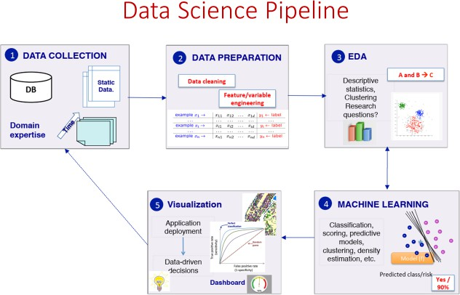

Slide 3
Step-1: Data Collection
Gathering raw data from multiple sources.
Sources:
  Databases (SQL, NoSQL).
  APIs (Twitter API, Weather API).
  Files (CSV, JSON, Excel).
  Streaming data (IoT sensors, stock markets).
Example Datasets:
  UCI Adult Dataset (demographic data).
  Kaggle Titanic Dataset (passenger survivaldata).
Programming:
  pandas.read_csv("file.csv")
  requests.get("api_url")

Slide 4
Step-2: Data Preparation
Data Cleaning (remove missing, duplicates, errors).
Feature Engineering (create new variables).
Data Transformation (scaling, encoding).
Example:
df['Age'].fillna(df['Age'].median(), inplace=True)
df['Sex'] = df['Sex'].map({'male':0, 'female':1})

Slide 5
Data Wrangling
The process of cleaning, restructuring, and enriching raw data into a desired format for better decision-making and analysis.
Why?
  Raw data is messy, inconsistent, and incomplete.
  Ensures data quality, consistency, and usability.

Slide 6
Steps in Data Wrangling
Data Discovery – Understanding sources and structure.
Data Cleaning – Handling missing values, duplicates, errors.
Data Structuring – Reshaping datasets (wide ↔ long format).
Data Enrichment – Adding external/derived features.
Validation – Ensuring correctness and consistency.
Publishing – Making it ready for analysis/ML models.

Slide 7
Tools for Data Wrangling
Pandas → Handling missing values, reshaping, merging, groupby.
NumPy → Efficient numerical operations.
Dask → Parallel/distributed data wrangling for large datasets.
PySpark → Scalable data wrangling on big data.
Apache Spark (PySpark, SparkR) → Distributed large-scale wrangling.
Hadoop → Preprocessing raw unstructured data.
Databricks → Unified environment for wrangling + ML.

Slide 8
Examples
Handling Missing Data
  Example: Replace NaN in Age with mean/median.
Removing Duplicates
  Example: Duplicate customer IDs removed from database.
Standardizing Formats
  Example: Convert "12-05-25" → "2025-05-12".
Encoding Categorical Variables
  Example: Male/Female → 0/1.
Merging Datasets
  Example: Joining Sales.csv with Customer.csv.
Outlier Treatment
  Example: Replace extreme income values with capped values.

Slide 9
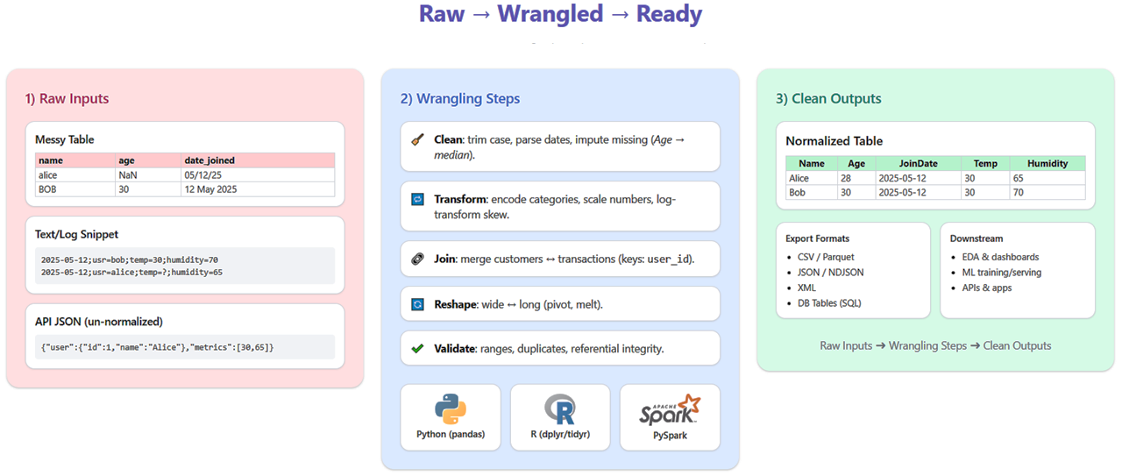
Example

Slide 10
Data Filtering
Data filtering is the process of selecting a subset of data based on specific conditions or criteria.
Purpose:
  Remove irrelevant or unnecessary data
  Focus on specific data points for analysis
  Improve data quality and relevance

Slide 11
Types
Basic Filtering: Simple conditions (e.g., filter by value, range, or category)
Advanced Filtering: Multiple conditions and complex queries (e.g., filtering based on multiple columns or logical operators)
Date and Time Filtering: Selecting data within specific time frames or periods.
Text-Based Filtering: Filtering based on specific keywords, patterns, or text length.
Statistical Filtering: Filtering based on statistical properties (e.g., mean, standard deviation, quantiles).

Slide 12
Basic Filtering Technique
Condition-Based Filtering: Using simple conditions to filter data.
Example: Filtering data where the value in a column is greater than a certain threshold.
import pandas as pd
# Load dataset
df = pd.read_csv('data.csv')
# Filter data where column value is greater than 50
filtered_df = df[df['column_name'] > 50]

Slide 13
Advance Filtering Technique
Multiple Conditions: Using logical operators (& |) to combine multiple conditions.
Filter Based on Multiple Columns
  Example: Filtering data where the value in column1 is greater than 50 and the value in column2 is 'Yes'.
import pandas as pd
# Load dataset
df = pd.read_csv('data.csv')
# Filter data with multiple conditions
filtered_df = df[(df['column1'] > 50) & (df['column2'] == 'Yes')]

Slide 14
Data Preprocessing
Garbage In, Garbage Out
Common Data Quality Issues
Real-world data is incomplete, noisy, and inconsistent
Model quality is bounded above by input data quality
Preprocessing improves accuracy, reduces training time
Ensures compatibility with algorithmic assumptions (e.g., scale, distribution)
Reduces risk of biased or misleading conclusions
Missing values
Null / NaN entries, blank fields
Noise & outliers
Measurement errors, extreme values
Inconsistency
Mismatched units, formats, categories
Duplicates
Repeated records inflating patterns
Imbalanced classes
Skewed target distributions

Slide 15
Steps in Data Preprocessing
1
2
3
4
Data Cleaning
Data Transformation
Data Reduction
Data Integration
Handle missing values, remove duplicates, fix noisy/erroneous entries
Normalize / standardize, encode categoricals, discretize continuous vars
Reduce volume while preserving structure (sampling, aggregation, PCA)
Combine multiple sources into a coherent, conflict-free dataset
Common Tools
pandas
scikit-learn
OpenRefine
PyOD / IsolationForest
isna(), fillna(), drop_duplicates()
SimpleImputer, StandardScaler, OneHotEncoder
GUI-based cleaning of messy data
Outlier & anomaly detection

Slide 16
Preprocessing with pandas & scikit-learn
import pandas as pd
from sklearn.impute import SimpleImputer
from sklearn.preprocessing import StandardScaler, OneHotEncoder
from sklearn.compose import ColumnTransformer
from sklearn.pipeline import Pipeline
df = pd.read_csv("patients.csv")
df.drop_duplicates(inplace=True)
num_cols = ["age", "bmi", "glucose"]
cat_cols = ["gender", "region"]
num_pipe = Pipeline([
("impute", SimpleImputer(strategy="median")),
("scale", StandardScaler())
])
cat_pipe = Pipeline([
("impute", SimpleImputer(strategy="most_frequent")),
("encode", OneHotEncoder(handle_unknown="ignore"))
])
preprocessor = ColumnTransformer([
("num", num_pipe, num_cols),
("cat", cat_pipe, cat_cols)
])
X_clean = preprocessor.fit_transform(df)

Slide 17
Data Transformation
Normalization:
  Scaling features to a specific range (e.g., [0, 1] or [-1, 1])
Standardization:
  Scaling features to have a mean of 0 and a standard deviation of 1
Encoding Categorical Variables:
  One-hot encoding, Label encoding
Notes:
One-hot encoding is a technique used in data preprocessing to convert categorical data into a numerical format that machine learning algorithms can use. This is particularly useful when dealing with categorical variables that do not have an inherent order.
How One-Hot Encoding Works:
Categorical Data:
Suppose you have a categorical feature (column) called "Color" with three possible values: "Red", "Blue", and "Green".
Transforming into One-Hot Encoding:
One-hot encoding converts this single categorical feature into multiple binary features, where each category becomes a new column.
For example:
Original Data:
ColorRedBlueGreenBlueRed
One-Hot Encoded Data:
Color_RedColor_BlueColor_Green100010001010100
Each original category ("Red", "Blue", "Green") is represented as a binary vector, with "1" indicating the presence of that category in the original data, and "0" indicating its absence.
When to Use One-Hot Encoding?
When dealing with categorical variables that have no intrinsic ordering (e.g., color, city names, etc.).
When the number of categories is relatively small. For very large numbers of categories, other techniques like target encoding or embedding might be more suitable.

Slide 18
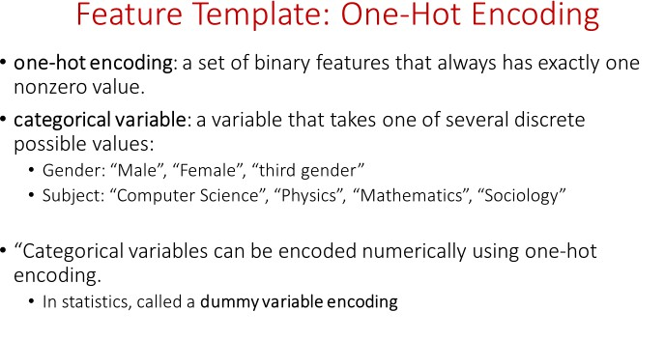

Slide 19
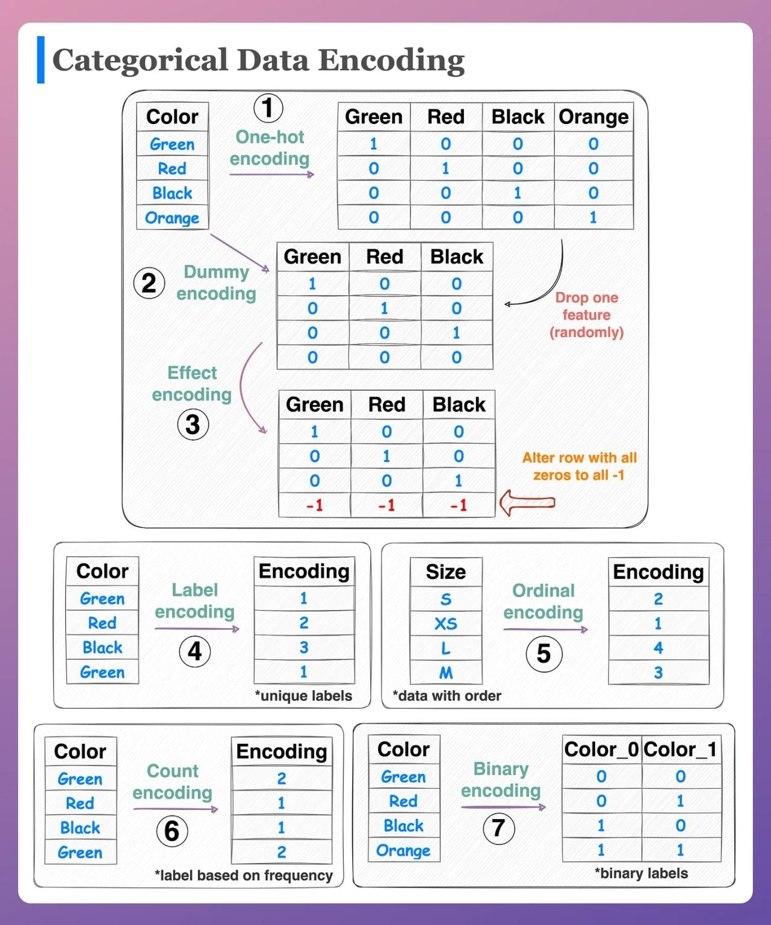

Slide 20
Feature Engineering
Using domain knowledge to construct new variables that make patterns easier for a model to learn.
Feature Selection
Feature Extraction
Feature Construction
Feature Encoding
Filter (correlation, chi-square), Wrapper (RFE), Embedded (Lasso, tree importances)
PCA, autoencoders, text embeddings — compress raw inputs into compact representations
Ratios, interaction terms, date-part extraction, aggregations, domain formulas
One-hot, label, target/mean encoding, binning, log/Box-Cox transforms
Tools
Key Reading
Featuretools
Automated feature synthesis (deep feature synthesis / DFS)
tsfresh
Automatic feature extraction from time series
category_encoders (Python)
Target, WOE, hashing, ordinal encoders
Zheng & Casari, “Feature Engineering for Machine Learning”, O’Reilly, 2018
Kanter & Veeramachaneni, “Deep Feature Synthesis”, IEEE DSAA, 2015 — basis for Featuretools

Slide 21
Constructing New Features
import pandas as pd
import numpy as np
df["bmi"] = df["weight_kg"] / (df["height_m"] ** 2)
df["age_bucket"] = pd.cut(df["age"], bins=[0,18,35,60,100],
labels=["teen","adult","mid","senior"])
df["order_date"] = pd.to_datetime(df["order_date"])
df["order_month"] = df["order_date"].dt.month
df["is_weekend"] = df["order_date"].dt.dayofweek >= 5
df["log_income"] = np.log1p(df["income"])
# Automated feature synthesis with Featuretools
import featuretools as ft
es = ft.EntitySet(id="orders")
es = es.add_dataframe(dataframe_name="orders", dataframe=df,
index="order_id", time_index="order_date")
features, feature_defs = ft.dfs(entityset=es,
target_dataframe_name="orders",
max_depth=2)

Slide 22
Data Integration: Merging & Resolving Conflicts
Merge Strategies
Resolving Conflicts
Inner / Outer / Left / Right join
Value conflicts
Combine tables on shared keys (SQL JOIN, pandas.merge)
Same entity, different values (e.g., two ages for one patient) → rule-based or trust-score resolution
Concatenation
Unit / format mismatch
Stack datasets with the same schema (pandas.concat)
Convert to a common unit & format (kg vs lb, date formats) before merging
Entity resolution / record linkage
Duplicate entities
Match records referring to the same real-world entity across sources
Fuzzy matching (Levenshtein, Jaro-Winkler) to detect near-duplicate records
Schema matching
Structural conflicts
Align differing column names, types, and units before merging
Different schemas for the same concept — harmonize via a canonical data model

Slide 23
Merging Datasets in pandas
import pandas as pd
patients = pd.read_csv("patients.csv") # source A
labs = pd.read_csv("lab_results.csv") # source B
# 1. Harmonize keys/units before merge
labs["patient_id"] = labs["pid"].astype(str)
labs["glucose_mgdl"] = labs["glucose_mmol"] * 18.0
# 2. Merge on common key
merged = patients.merge(labs, on="patient_id", how="left")
# 3. Resolve value conflicts: prefer most recent record
merged = (merged.sort_values("test_date")
.drop_duplicates("patient_id", keep="last"))
# 4. Fuzzy match near-duplicate names across sources
from rapidfuzz import fuzz
score = fuzz.token_sort_ratio("Jon Smith", "John Smith") # 90+
Key Reading
Doan, Halevy & Ives, “Principles of Data Integration”, Morgan Kaufmann, 2012 — the standard textbook reference
Elmagarmid, Ipeirotis & Verykios, “Duplicate Record Detection: A Survey”, IEEE TKDE, 2007
Dong & Srivastava, “Big Data Integration”, Synthesis Lectures on Data Management, 2015 — covers conflict/truth resolution at scale

Slide 24
Dimensionality Reduction
Reduce the number of features while preserving structure — fights the curse of dimensionality, speeds up training, and enables visualization.
PCA
t-SNE
UMAP
Autoencoders
LDA
Linear projection onto orthogonal directions of maximum variance
Nonlinear embedding preserving local neighborhood structure; great for visualization
Faster nonlinear embedding; preserves local + more global structure than t-SNE
Neural nets that learn compressed latent representations
Supervised projection maximizing class separability
Tools
Key Reading
scikit-learn — PCA, TruncatedSVD, LDA
openTSNE / sklearn.manifold — t-SNE
umap-learn — UMAP embeddings
van der Maaten & Hinton, “Visualizing Data using t-SNE”, JMLR, 2008
McInnes, Healy & Melville, “UMAP”, arXiv:1802.03426, 2018
Notes:
PCA (Principal Component Analysis)
What it does: Finds new axes (principal components) that are linear combinations of your original features, ordered by how much variance they capture. The first component captures the most variance, the second the next most (orthogonal to the first), and so on.
Key traits:
Linear method — only captures straight-line relationships
Fast, deterministic, and easy to interpret (components are just weighted sums of original features)
Preserves global structure well, but can miss nonlinear patterns (e.g., a spiral or manifold)
Widely used for compression, noise reduction, and as a preprocessing step before other algorithms
When to use: Quick dimensionality reduction, removing multicollinearity, speeding up downstream models, or when you need components that generalize to new data (via transform()).
t-SNE (t-Distributed Stochastic Neighbor Embedding)
What it does: A nonlinear technique that converts similarities between points into probabilities, then arranges points in 2D/3D so that similar points (in high-dimensional space) stay close together.
Key traits:
Excellent at revealing local clusters and structure
Distances between clusters and cluster sizes in the output are not meaningful — only relative neighborhoods are
Computationally expensive, doesn't scale well to huge datasets
No simple transform() for new data — usually refit from scratch
Very sensitive to the perplexity hyperparameter
When to use: Visualizing high-dimensional data (e.g., embeddings, gene expression, image features) to spot clusters — not for feeding into another model.
UMAP (Uniform Manifold Approximation and Projection)
What it does: Similar goal to t-SNE (nonlinear embedding for visualization), but based on manifold learning and topological data analysis. It builds a graph representing the data's structure, then optimizes a low-dimensional layout to match it.
Key traits:
Faster than t-SNE, scales to larger datasets
Better preserves both local and more of the global structure than t-SNE
Supports transforming new/unseen data (unlike vanilla t-SNE)
Also sensitive to hyperparameters (n_neighbors, min_dist)
When to use: Same use case as t-SNE (visualization, clustering exploration) but preferred when speed matters or you need to embed new points later.
LDA (Linear Discriminant Analysis)
What it does: Unlike PCA, t-SNE, and UMAP (which are unsupervised), LDA is supervised — it uses class labels to find axes that maximize separation between classes while minimizing variance within each class.
Key traits:
Linear, like PCA, but optimizes for class discrimination rather than overall variance
Number of components is capped at (number of classes − 1)
Can double as a classifier itself, not just a dimensionality reduction tool
Assumes classes are roughly Gaussian with equal covariance — violated often in practice, which can hurt performance
When to use: When you have labeled data and want a reduced feature space that's specifically good for classification, or as a lightweight classifier baseline.
Autoencoders
What it does: A neural network trained to reconstruct its own input. It has a "bottleneck" hidden layer (the latent space) that's smaller than the input, forcing the network to learn a compressed representation.
Key traits:
Fully nonlinear (thanks to activation functions), so it can capture complex relationships PCA can't
Needs more data and compute to train well than PCA
Variants: denoising autoencoders (robust to noise), variational autoencoders/VAEs (generative, produce a smooth latent space), sparse autoencoders (encourage sparsity in the latent code)
The encoder half can be reused to transform new data efficiently after training
When to use: Large datasets, complex nonlinear structure, or when you want a reduction technique that can also generate/reconstruct data (unlike PCA/t-SNE/UMAP/LDA).

Slide 25
Step-3: EDA
Understand patterns, distributions, and relationships.
Techniques:
  Descriptive statistics (mean, median, std).
  Visualization (histograms, scatter plots, heatmaps).
  Clustering (group patterns).

Slide 26
Exploratory Data Analysis (EDA)
Understand structure, spot anomalies, test assumptions, and form hypotheses — before modeling.
Univariate
Bivariate / Multivariate
Missing-value analysis
Distribution & outlier checks
Histograms, box plots, value counts, summary statistics (mean, median, skew)
Correlation heatmaps, scatter matrices, group-by comparisons
Missingness patterns, heatmaps (missingno)
Q-Q plots, z-scores, IQR-based outlier flags
Tools
Key Reading
pandas-profiling / ydata-profiling
One-line automated EDA reports
Sweetviz
Fast comparative EDA reports
matplotlib, seaborn, plotly
Custom statistical visualizations
John Tukey, “Exploratory Data Analysis”, Addison-Wesley, 1977 — the foundational text that coined EDA
Wickham & Grolemund, “R for Data Science”, O’Reilly, 2017 — modern EDA workflow, ch. 7

Slide 27
Step-4: Machine Learning
Build predictive models.
Techniques:
  Classification (Logistic Regression, SVM).
  Regression (Linear Regression).
  Clustering (KMeans).

Slide 28
Step-5: Visualization & Deployment
Present results & deploy models.
Techniques:
  Dashboards (Tableau, Power BI, Plotly Dash).
  Web Apps (Streamlit, Flask).
  Model APIs (FastAPI, TensorFlow Serving).

