Slide 1
Lecture # 7
Course: Data Science Tools & Techniques
Instructor: Dr. Mateen Yaqoob

Slide 2
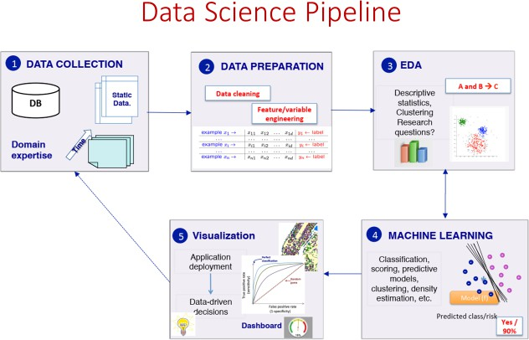

Slide 3
Discover patterns in data
Why is it important to find patterns?
What counts as a pattern?
What techniques can we use to find patterns?
When can such techniques be used?
How should the results be interpreted?

Slide 4
Data analysis template
Exploratory Data Analysis
  Summary of the data
  Accidental and unexpected patterns
Data Screening
  check for statistical glitches

Slide 5
The role of EDA
Exploratory Data Analysis
Explore a data set
Use methods that help you understand the data
  to help you understand the events that generated the data
  to help you see what happened, sometimes in spite of your expectations

Slide 6
Simple example
Class attendance and language learning
Bob: 10 classes; 100 words
Carol: 15 classes 150 words
Dave: 12 classes; 120 words
Ann: 17 classes; 170 words
Steve: 13 classes; 95 words

Slide 7
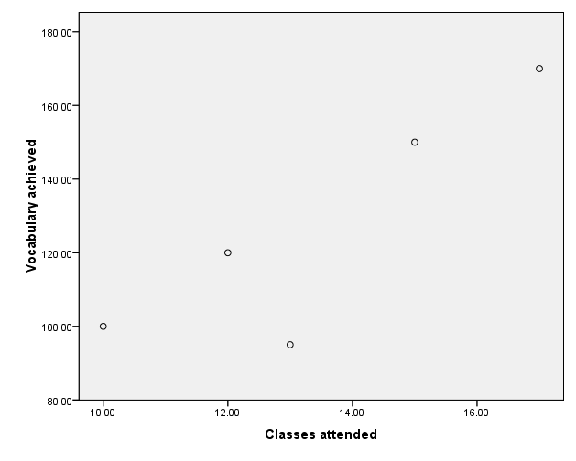

Slide 9
Recognising patterns
EDA supplies statistical techniques
that work in combination with a very powerful pattern recognition device…
Ways to tabulate, summarise, display, reduce …data

Slide 10
Data Analysis (DA)
DA can't be done mechanically
Often there has to be a "creative" element
Conventional DA is in a sense idealistic
Trade-off between
  "ideal" experimentation v. ecological validity
Sometimes questions are tentative
We need data analysis skills that allow data to speak to us despite our expectation

Slide 11
More interesting example
NameVoyager
NameMapper

Slide 12
NameVoyager
Variable Method used to represent
Time horizontal axis
No. / billion babies vertical axis
Sex colour hue
Rank in 2007 colour saturation
Name label
Detail pop-up, click thru

Slide 13
Confirmatory vs. exploratory data analysis
Confirmatory data
analysis
Exploratory data
analysis
tests a hypothesis
settles questions
(Inferential statistics)
finds a good description
raises new questions
(Descriptive statistics)

Slide 14
What is data?
A bunch of numbers (usually)
Each number summarises some property or event of interest
  e.g. 18
  Age, Beck Depression Inventory (BDI) score, Income in £’000s
Data: lots of numbers
  e.g. 18, 24, 43, 22, 37, …
Is there a pattern?

Slide 15
Data reduction – fewer numbers
Summarise proportion
  27 / 48 children in class A are boys
  16 / 23 children in class B are boys
  Re-presented: 56% of class A, 69% of class B are boys
Summarise change
  Before: 112, 134, 121, 97
  After: 116, 132, 140, 108
  Re-presented
  Change: 4, -2, 19, 11

Slide 16
Class-Activity
ID | Age | Sex | Education | Marital-Status | Hours-per-Week | Income
1 | 25 | Male | Bachelors | Never-married | 40 | <=50K
2 | 38 | Male | HS-grad | Married-civ-spouse | 50 | >50K
3 | 28 | Female | Masters | Never-married | 45 | >50K
4 | 52 | Male | HS-grad | Married-civ-spouse | 60 | >50K
5 | 45 | Female | Bachelors | Divorced | 30 | <=50K
6 | 36 | Male | Some-college | Married-civ-spouse | 55 | >50K
7 | 61 | Male | HS-grad | Married-civ-spouse | 20 | <=50K
8 | 29 | Female | Assoc-acdm | Never-married | 40 | <=50K
9 | 34 | Male | Bachelors | Married-civ-spouse | 70 | >50K
10 | 41 | Female | HS-grad | Married-civ-spouse | 45 | >50K
11 | 23 | Male | HS-grad | Never-married | 15 | <=50K
12 | 55 | Female | Doctorate | Married-civ-spouse | 60 | >50K
Notes:
How many males vs. females are in the dataset?
What is the most common education level?
Which income group (<=50K or >50K) works longer hours on average?
Identify inconsistencies or missing values. How would you fix them?
Do you notice any relationship between education and income?
Which 2 features might be most predictive of income?

Slide 17
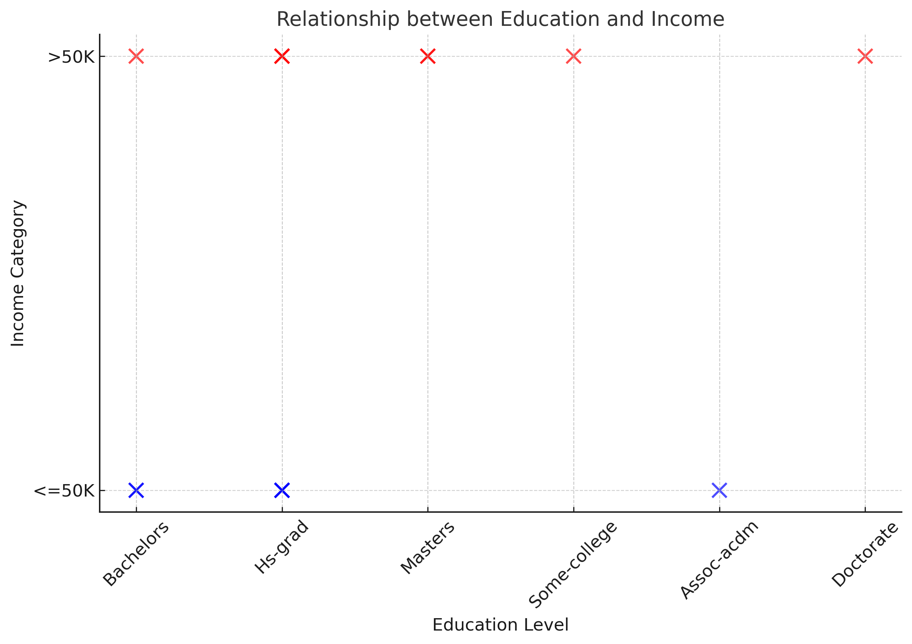

Slide 18
Revealing patterns
Raw data is hard to understand
EDA provides ways of presenting data that make the data easier to understand
Notes:
…
e.g. table of raw data
…
a representation that the eye finds congenial is of more practical use

Slide 19
Date | Source compound | Extraction method | Weight observed
29.11.93 | NO | hot iron | 2.30143
5.12.93 | NO | hot iron | 2.29816
6.12.93 | NO | hot iron | 2.30182
8.12.93 | NO | hot iron | 2.29890
12.12.93 | Air | hot iron | 2.31017
14.12.93 | Air | hot iron | 2.30986
19.12.93 | Air | hot iron | 2.31010
22.12.93 | Air | hot iron | 2.31001
26.12.93 | N₂O | hot iron | 2.29889
28.12.93 | N₂O | hot iron | 2.29940
9.1.94 | NH₄NO₂ | hot iron | 2.29849
13.1.94 | NH₄NO₂ | hot iron | 2.29889
27.1.94 | Air | ferrous hydrate | 2.31024
30.1.94 | Air | ferrous hydrate | 2.31030
1.2.94 | Air | ferrous hydrate | 2.31028

Slide 20
Box & whisker plot

Slide 21
dot plot

Slide 22
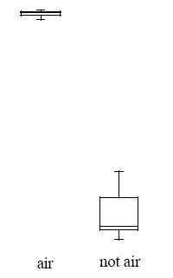
Two separate box & whisker plots

Slide 23

Interpreting EDA
Multiplicity

Slide 24
Technique
Find a graph that shows clearly that the data can be divided into different groups
Appropriate representation depends on your practical goal

Slide 25
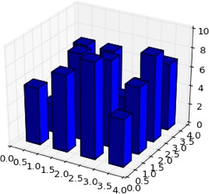
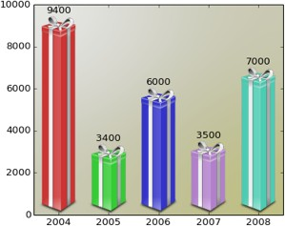
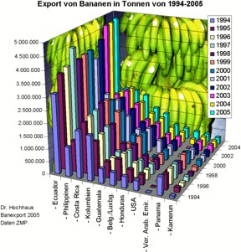
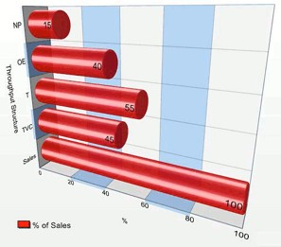
Don’t!
matplotlib gallery
Excel Charts Blog

Slide 26
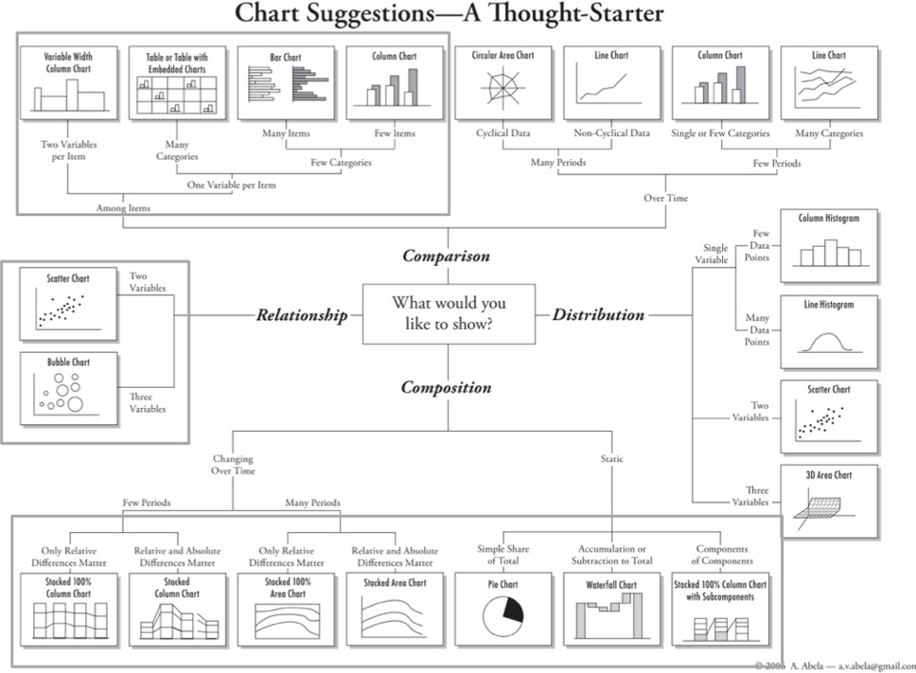
http://extremepresentation.typepad.com/blog/files/choosing_a_good_chart.pdf

Slide 27
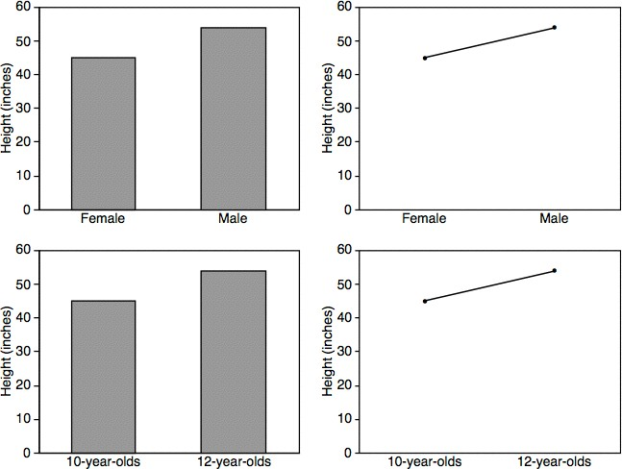
Bars vs. Lines
Zacks 1999

Slide 28
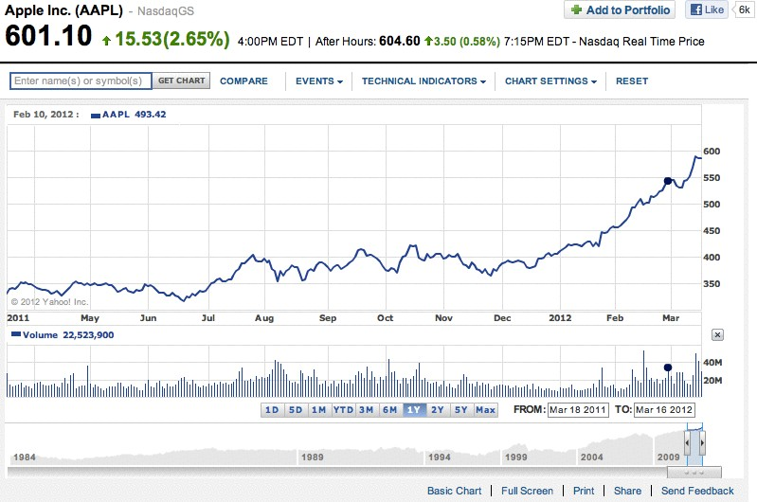
Yahoo! Finance

Slide 29
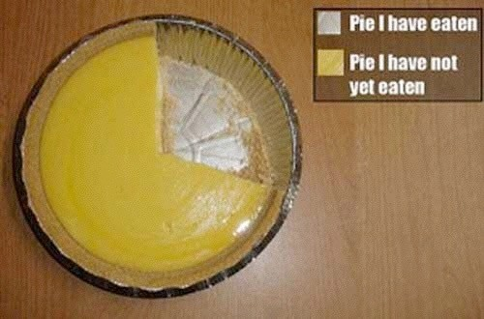
Pie Charts

Slide 30
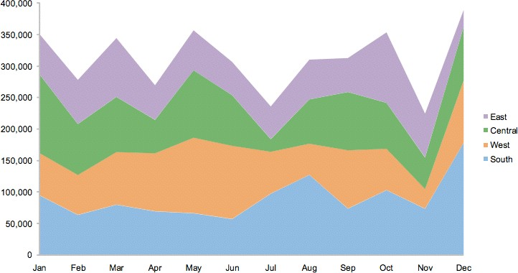
Stacked Area Chart
S. Few

Slide 31
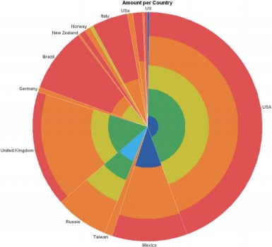
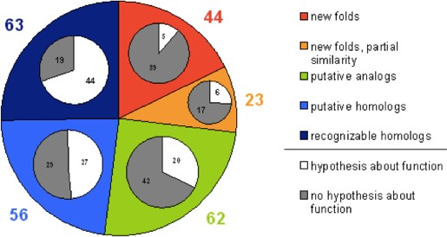
Don’t!

Slide 32
Correlations

Slide 33
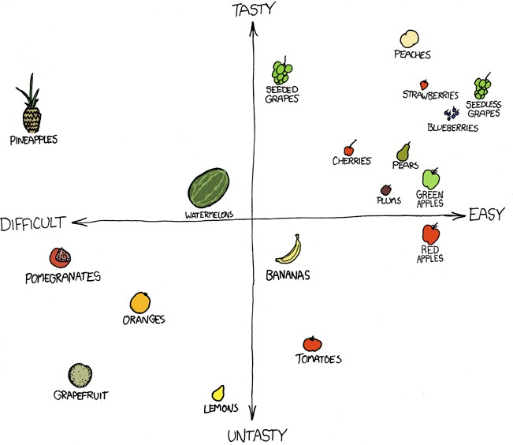
Scatterplots
http://xkcd.com/388/

Slide 34
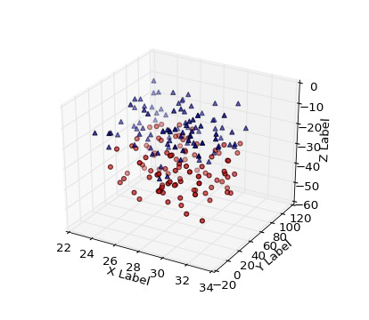
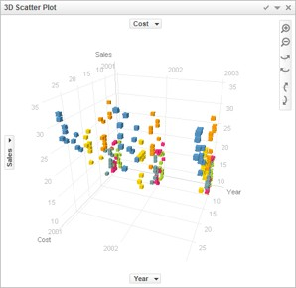
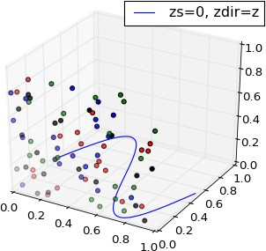
Don’t!
matplot3d tutorial

Slide 35
Distributions

Slide 36
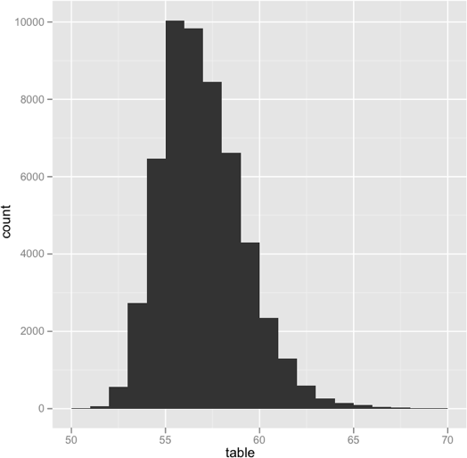
Histogram
ggplot2

Slide 37
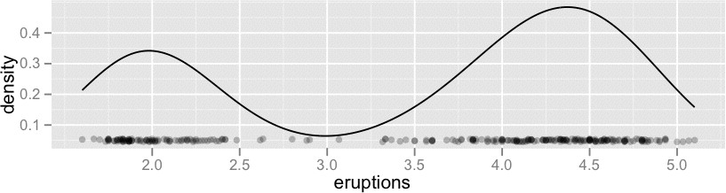
Density Plots

Slide 38
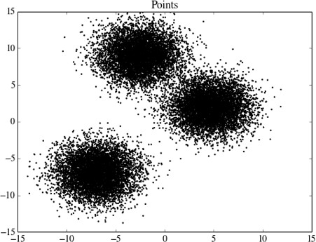
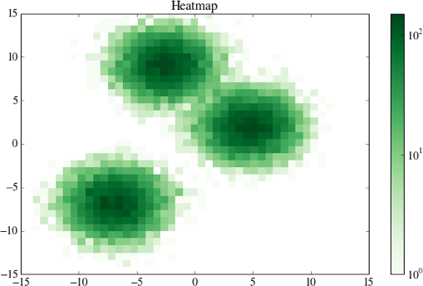
2D Density Plots

Slide 39
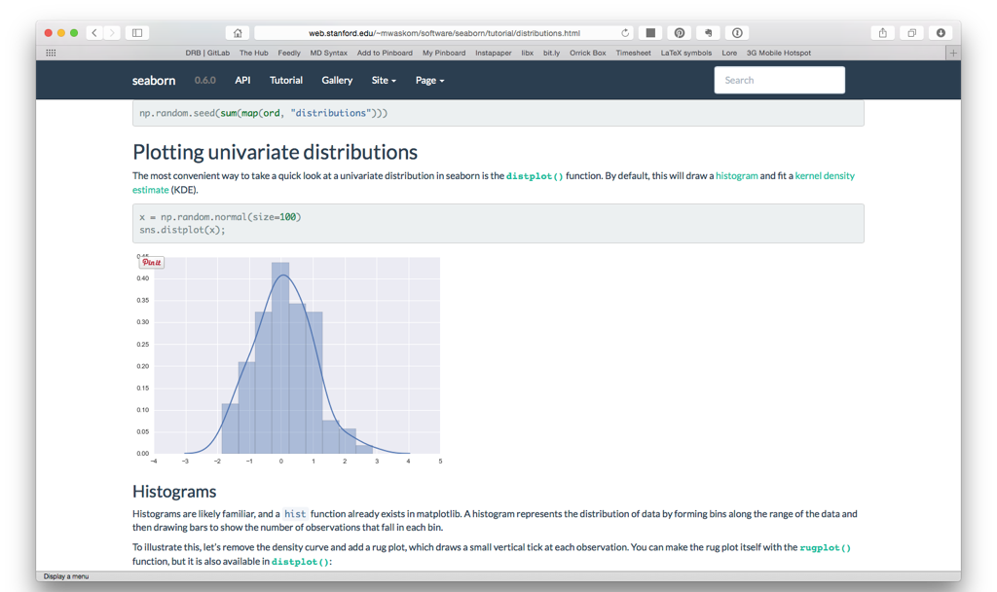
Seaborn Tutorial

Slide 40
Design Exercise
Hands-On Exercise

Slide 41
How do you feel about doing science?
Table
Interest | Before | After
Excited | 19 | 38
Kind of interested | 25 | 30
OK | 40 | 14
Not great | 5 | 6
Bored | 11 | 12
Data courtesy of Cole Nussbaumer

Slide 42
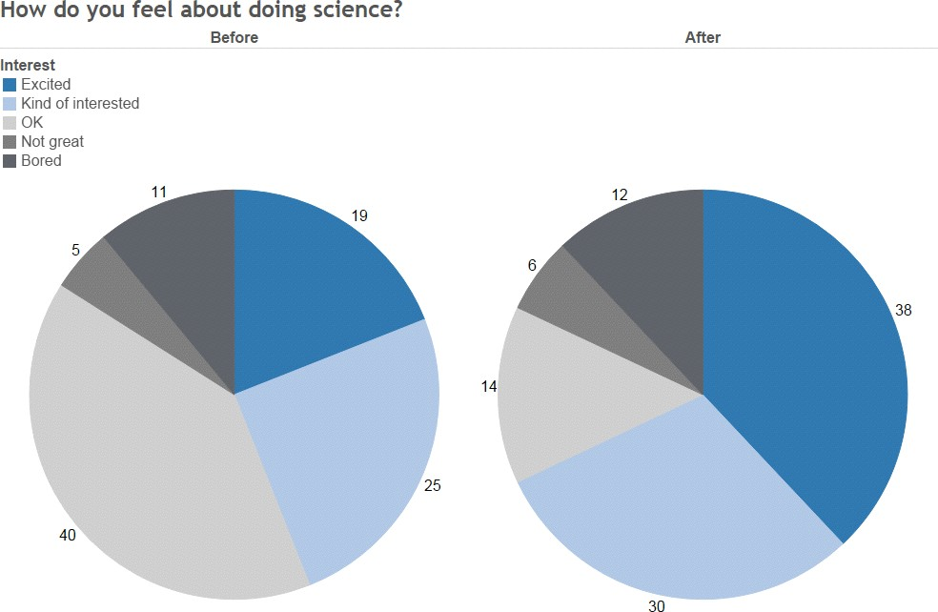

Slide 43
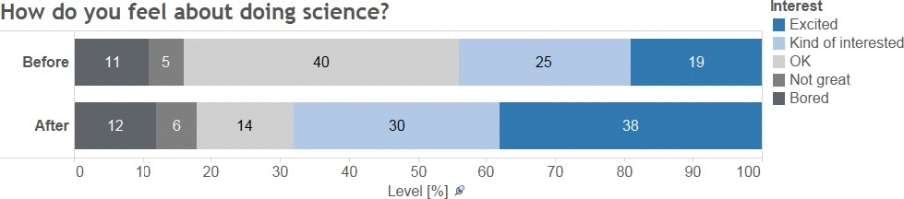

Slide 44
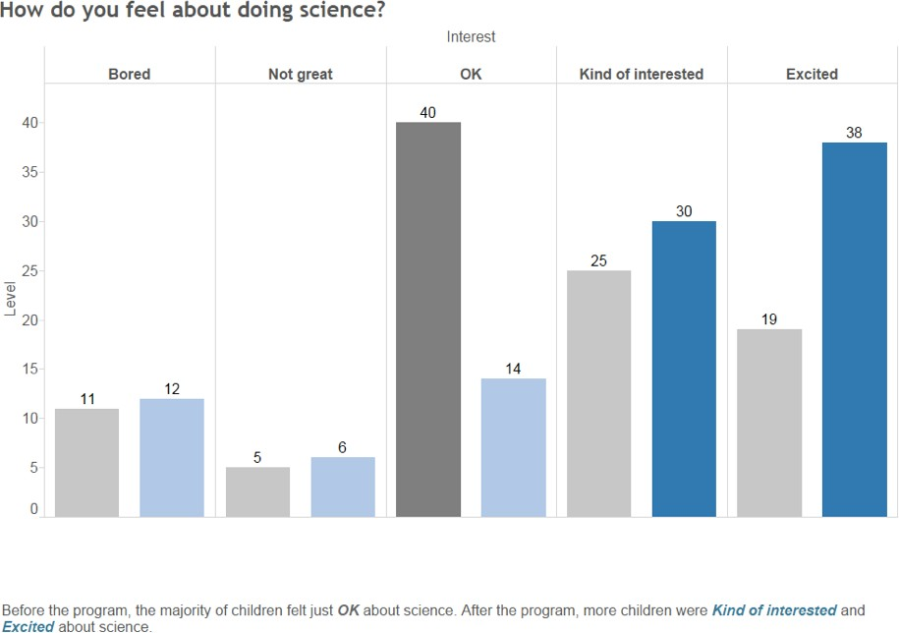

Slide 45
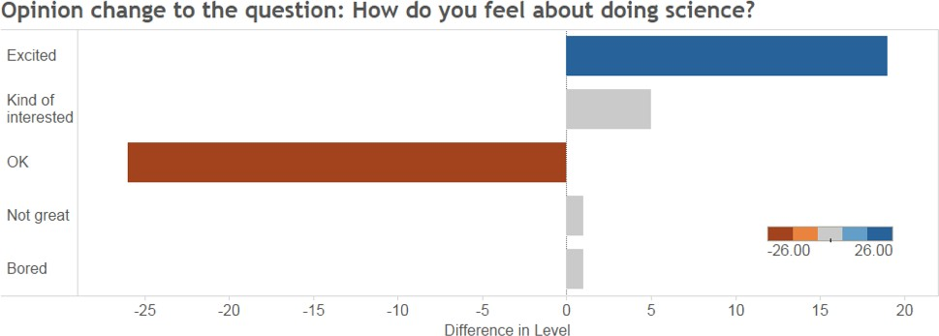

Slide 46
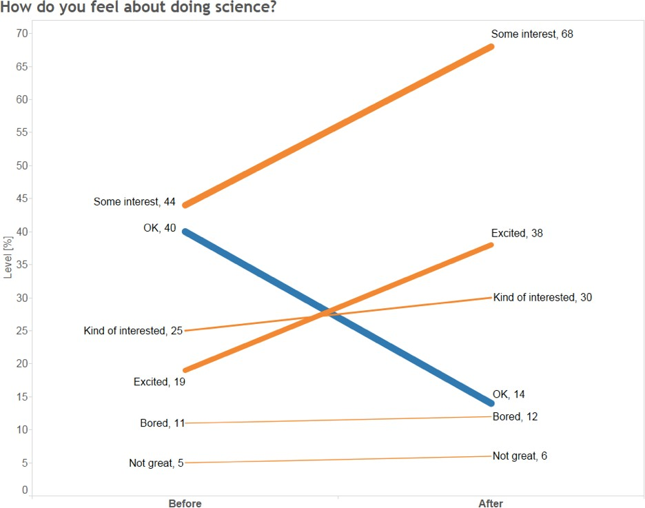

Slide 47
Interpreting EDA
Summarise the results
Discover unanticipated results
  new line of research, new experiment
  qualify conclusion from the present study
Generate hypotheses
Check assumptions
  qualify conclusion from the present study
  address anomalies
NOT (or, rarely) a definitive conclusion

