Slide 1
Lecture # 8
Course: Data Science Tools & Techniques
Instructor: Dr. Mateen Yaqoob

Slide 2
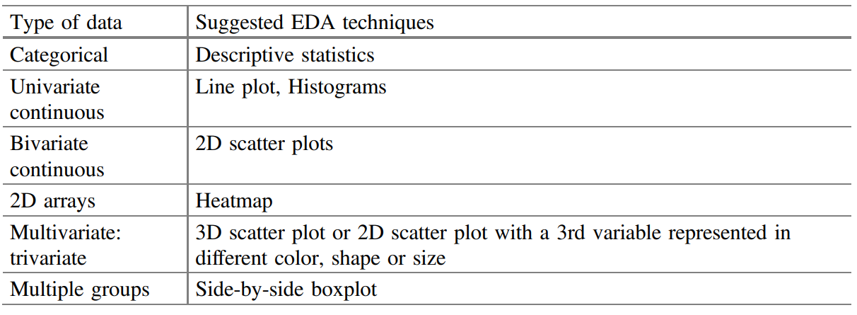
EDA techniques based on type of data

Slide 3
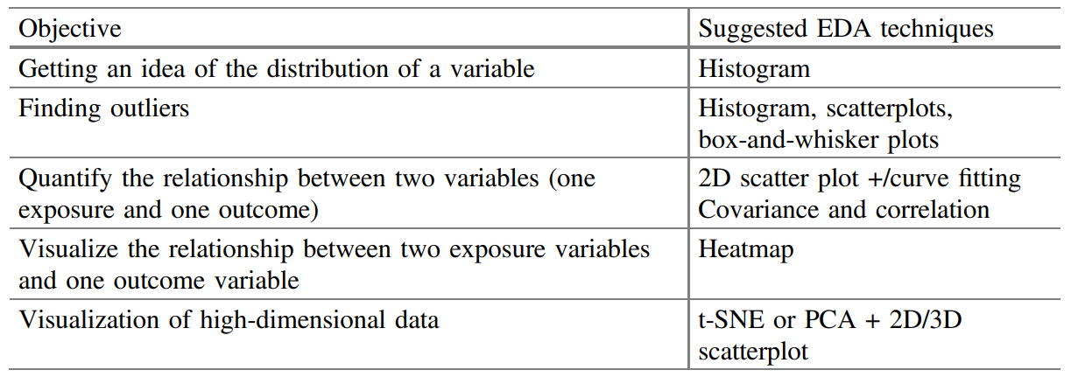
EDA techniques depending on an objective
Notes:
t-SNE t-distributed stochastic neighbor embedding, PCA Principal component analysis

Slide 4
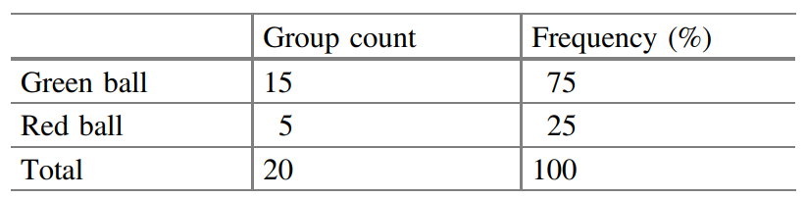
Non-Graphical EDA
Univariate
  Tabulation of Data

Slide 5
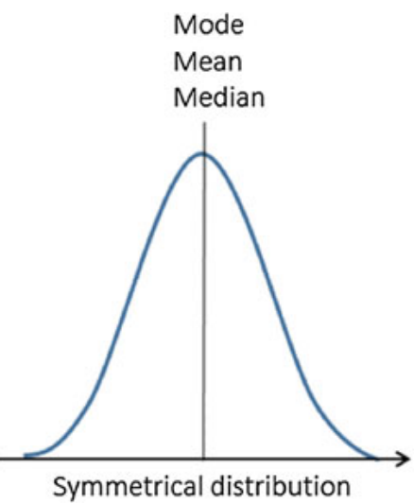
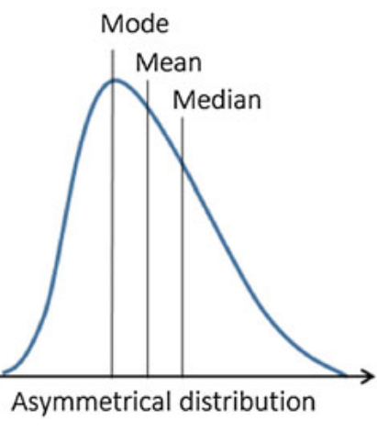
Non-Graphical EDA
Univariate
  Central tendency parameters = Mode, Mean, Median

Slide 6
Non-Graphical EDA
Univariate
  Spread of Data = variance, standard deviation, interquartile range, maximum and minimum value.
Multivariate
  Covariance and Correlation

Slide 7
After EDA
Data warehousing is required to support long-term storage, scalability, and efficient processing of data.
Notes:
Centralized Storage for Large Datasets
EDA typically works with subsets of data or exploratory samples. However, organizations often deal with massive amounts of data from various sources.
Data Warehouses provide a structured, centralized place to store cleaned, historical, and structured data for querying.
Data Lakes offer flexible storage for raw, semi-structured, and unstructured data that may not be fully explored during EDA but is crucial for future use in data science and machine learning.
2. Preservation of Raw and Processed Data
EDA involves cleaning and preprocessing data for analysis, but some insights or raw data might not be fully used initially.
Data Warehouses store processed data in a consistent, structured form that can be readily accessed for analysis, reporting, and dashboards.
Data Lakes allow for the storage of raw data (before processing) for future explorations, advanced analytics, or use in machine learning models.
3. Supporting Future Analysis and Reusability
After EDA, you may want to revisit the data for deeper, more complex queries, or include additional data sources. Warehousing and lakes provide scalable storage that allows re-analysis, data re-integration, or merging with external datasets.
Data Warehouses ensure that preprocessed data is available for fast querying in future BI applications or for operational decision-making.
Data Lakes allow analysts and data scientists to revisit raw data, discover new patterns, or run experiments using historical data that wasn't part of the EDA.
4. Scalability and Performance
EDA might expose the need to run more advanced queries or aggregate large-scale data over long periods. Data warehouses are optimized for query performance over large, structured datasets.
For data that needs more intensive computation or experimentation (e.g., log analysis, IoT data, or unstructured data like images and videos), data lakes provide scalable storage and the flexibility to perform complex data processing tasks.

Slide 8
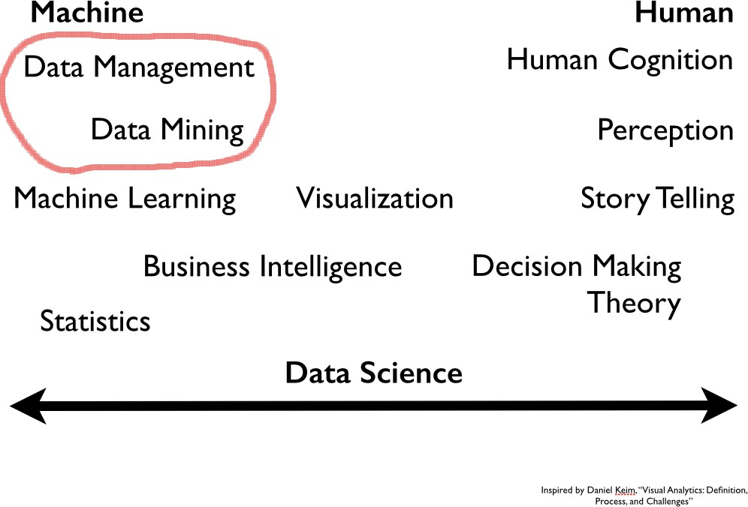

Slide 9
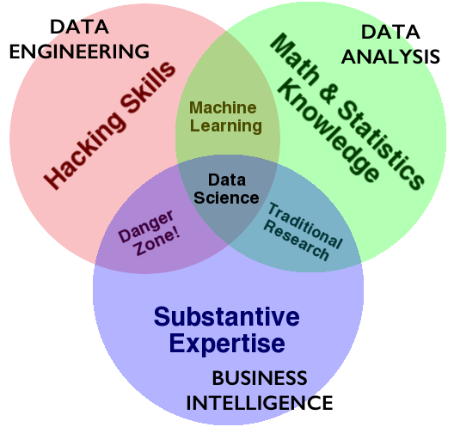

Slide 10
DATA ENGINEERING
compute: code, python, R, julia, spark, hadoop
storage/database: git, SQL, NoSQL, HBase, disk, memory
devops: AWS, docker, mesos, repeatability
product: database, web, API, viz, UI, story
•
•
•
Different at different scales....

Slide 11
What kind of data storage do you need?
•
memory
disk: what if we do not fit?
cluster: what if we still do not fit? cluster: what if we need/can use parts? What if we MUST bring compute to disk?
•
•
•
•

Slide 12
What kind of data access do you need?
•
relational: pandas, SQL: Postgres, sqlite, Hbase,
VoltDB
document oriented: MongoDB, CouchDB key1value: Riak, Redis, Memcached graph oriented: Neo4J
•
•
•

Slide 13
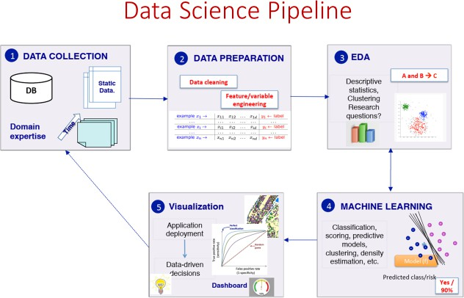

Slide 14

What is Machine Learning?

Slide 15
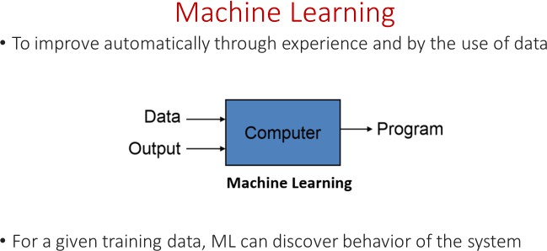

Slide 16
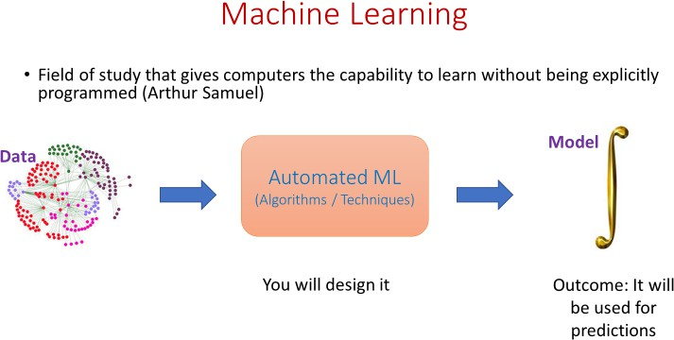

Slide 17
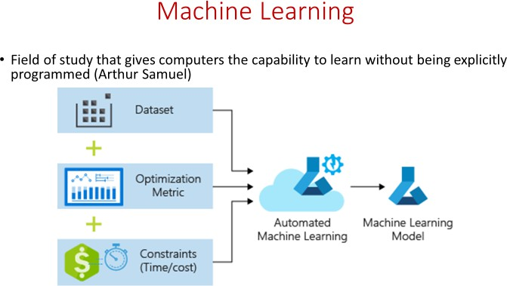

Slide 18
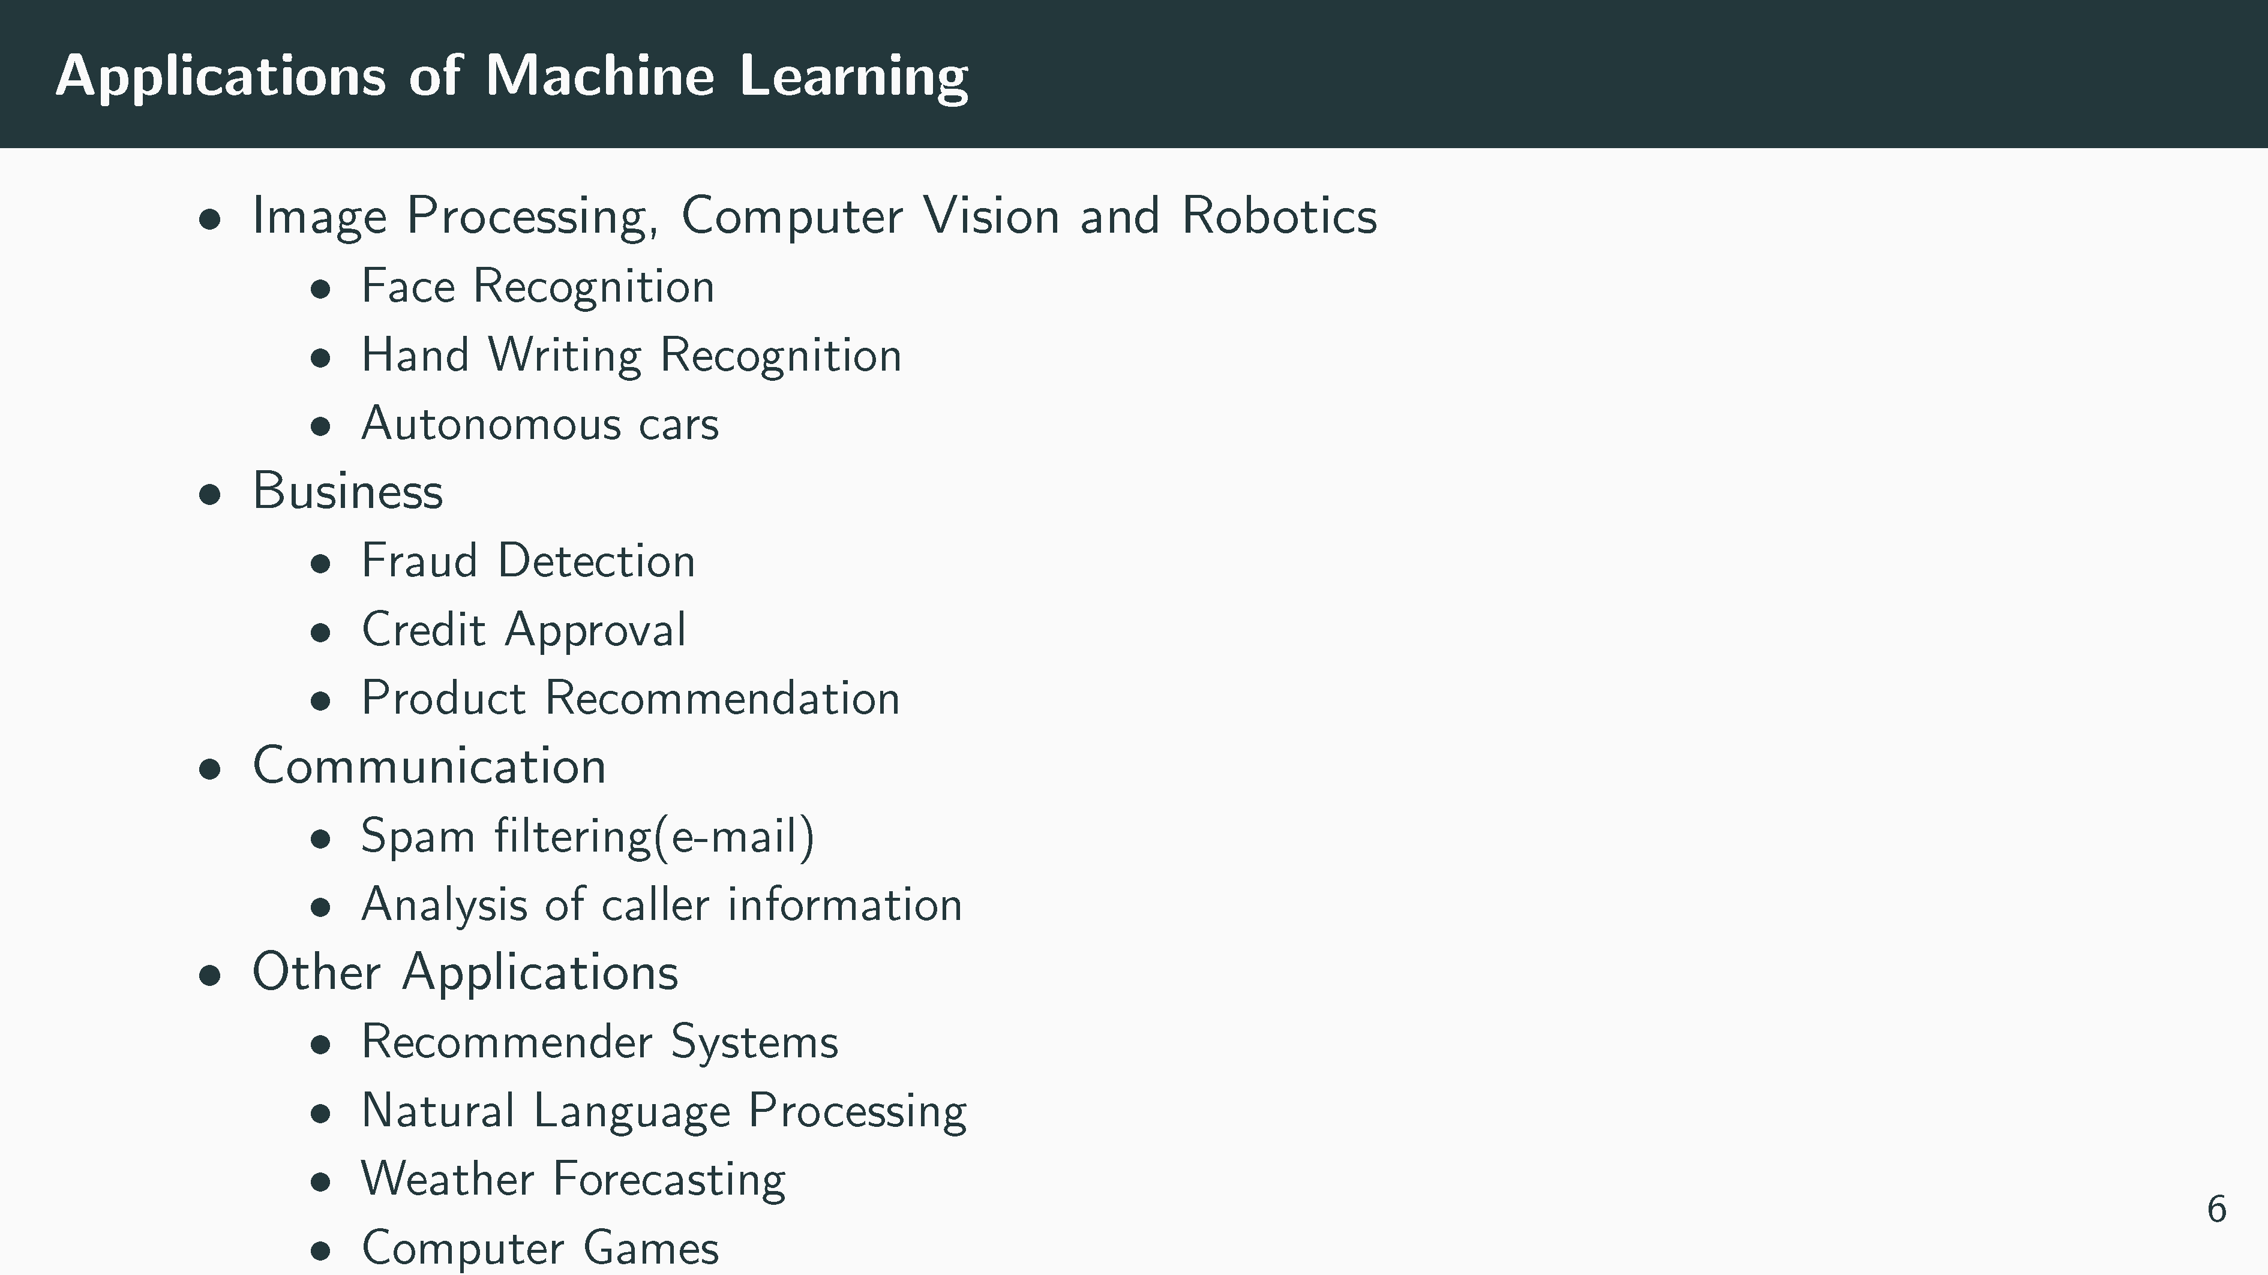

Slide 19
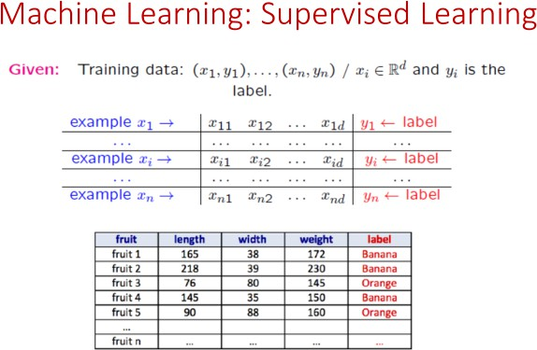

Slide 20
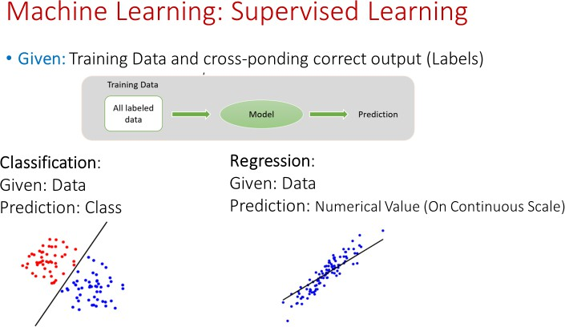

Slide 21
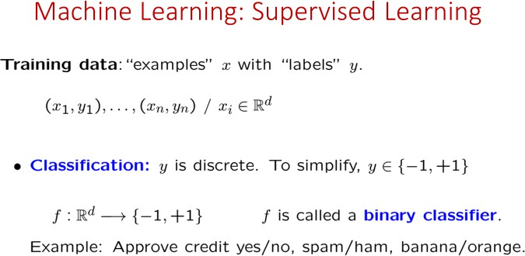

Slide 22
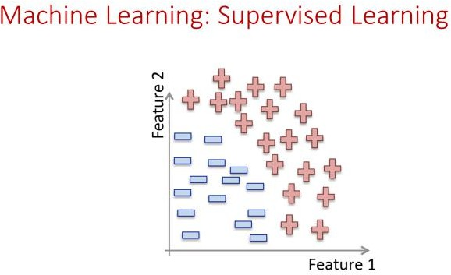

Slide 23
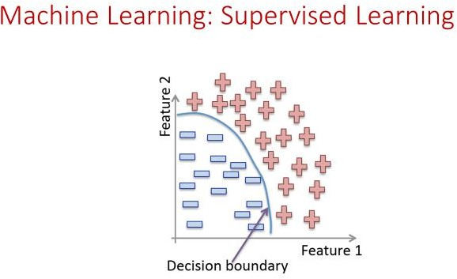

Slide 24
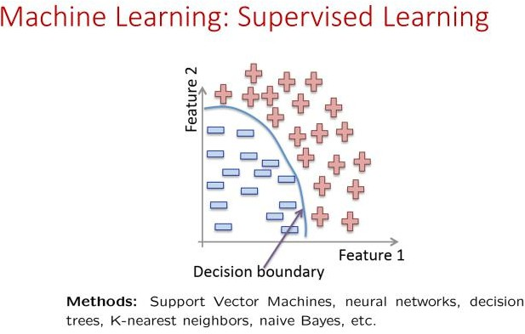

Slide 25
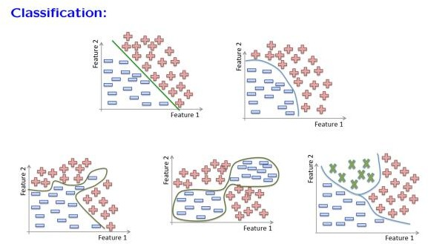

Slide 26
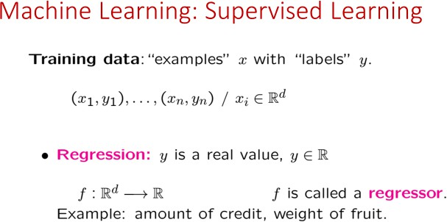

Slide 27
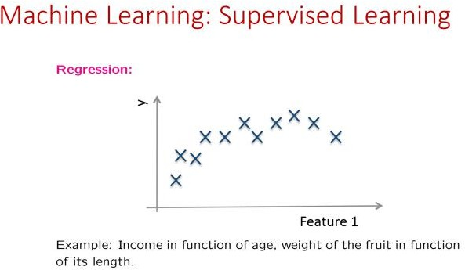

Slide 28
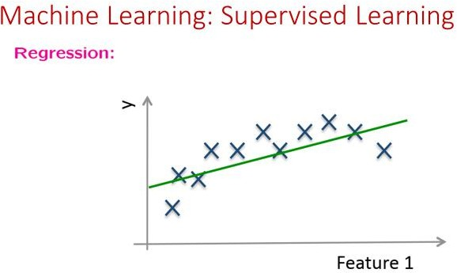

Slide 29
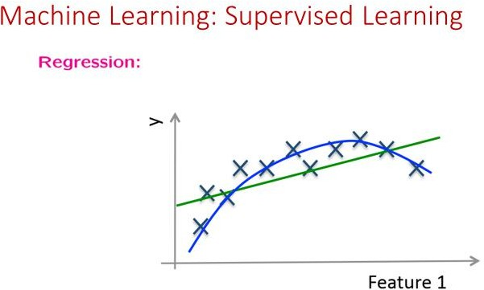

Slide 30
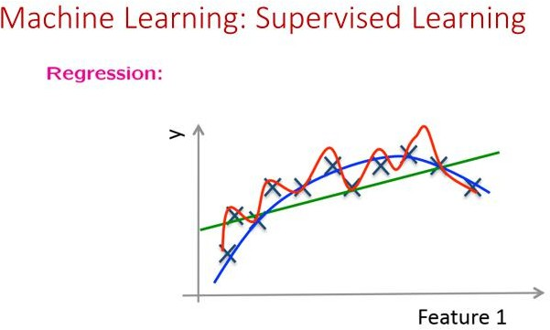

Slide 31
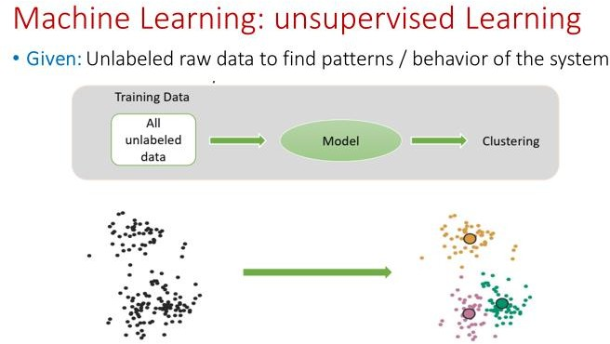

Slide 32
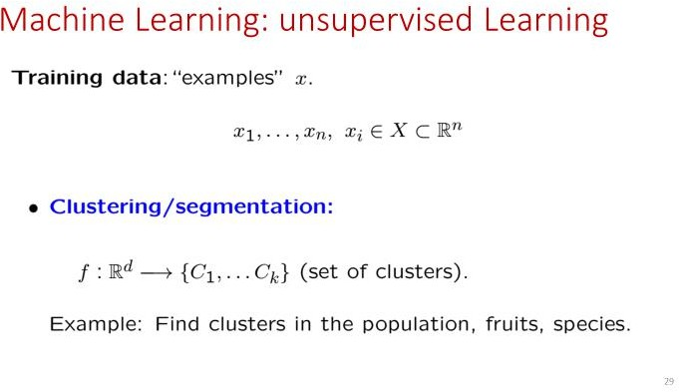

Slide 33
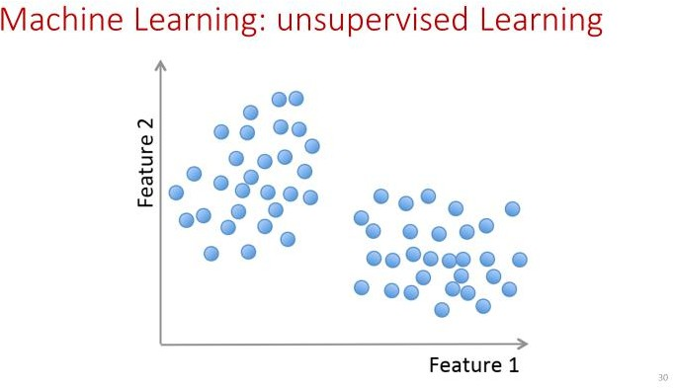

Slide 34
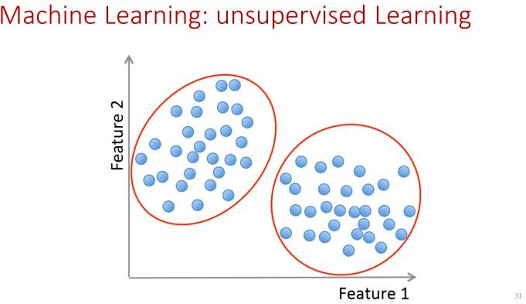

Slide 35


