Slide 1
∇
Mathematical Foundations
for Data Science & Computational Intelligence
Mohsin Raza · Fall 2026

Slide 2
Σ
Today's Agenda
1
Welcome
3 min
2
Course Logistics
7 min
3
Why Math Matters — Three Hooks
20 min
4
AI Problem Types
18 min
5
Notation Reference
8 min
6
Semester Roadmap
10 min
7
Diagnostic
7 min
8
Wrap-up & Q&A
7 min

Slide 3
How This Course Runs
✦
No Lab Sessions
Classroom is lecture and discussion — no in-class hands-on computing required.
✦
Self-Paced Colab Notebooks
Short notebooks shared each module via link/QR code. Free, no install, do them whenever suits you.
✦
Peer TA Support
A peer TA monitors an async forum/chat for questions on notebooks and coursework.
Assessment includes quizzes, assignments, a project, two sessional exams, and a final. Exact weighting is being finalized with the department this week.

Slide 4
Textbooks — All Free
Mathematics for Machine Learning
The Elements of Statistical Learning
Deep Learning: Foundations and Concepts
Deisenroth, Faisal, Ong
Hastie, Tibshirani, Friedman
C. Bishop, H. Bishop
mml-book.com
Free PDF (Stanford)
bishopbook.com
Think DSP
Intro to Applied Linear Algebra
Allen B. Downey
Boyd, Vandenberghe
greenteapress.com
web.stanford.edu

Slide 5
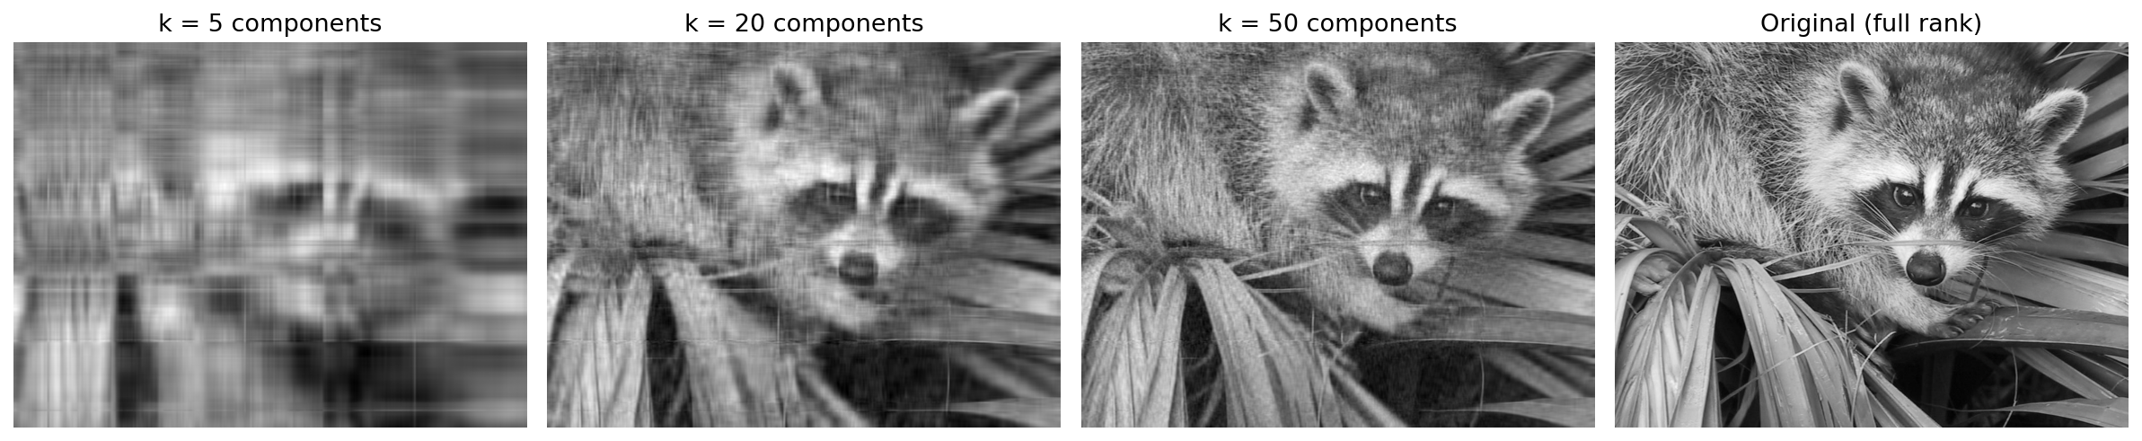
Why Does Data Have Structure?
768 dimensions → recognizable in just 50 components

Slide 6
Can You Trust Your Intuition?
A disease affects 1% of a population. A test for it is 99% accurate. You test positive. What's the chance you actually have the disease?
1%
99%
~50%
Disease prevalence
Test accuracy
Real answer

Slide 7
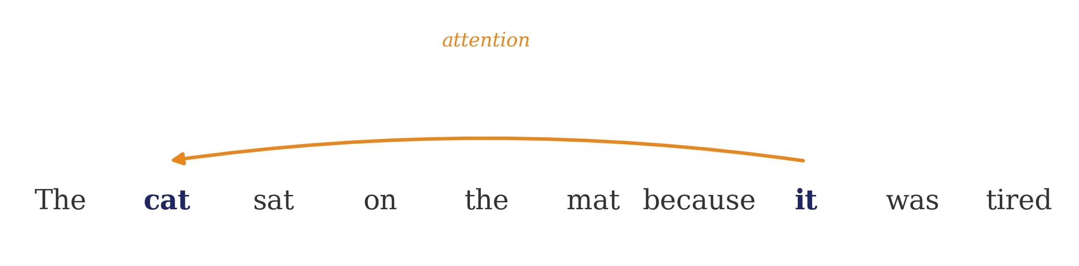
What Powers ChatGPT?
Literally vectors, matrices, and probability — the last module ties it all together

Slide 8
AI Problem Types
Supervised
Unsupervised
Reinforcement
Labeled examples — learning a mapping from input to output.
No labels — finding structure in the data itself.
An agent learns from rewards and penalties through interaction.
EXAMPLE
EXAMPLE
EXAMPLE
Email → spam or not. House features → price.
Customer segmentation. The compression demo you just saw.
Game-playing AI, robotics.

Slide 9
Notation Reference
Symbol | Meaning | Example
v (bold, lowercase) | Vector | v = (5, 2)
A (bold, uppercase) | Matrix | A = [[2,1],[3,4]]
Aᵀ | Transpose | rows ↔ columns
Σ | Summation | Σ xi over a set of terms
∇f | Gradient | direction of steepest ascent
f: ℝⁿ → ℝᵐ | Function mapping | n inputs → m outputs

Slide 10
Semester Roadmap
1
2
3
4
Intro & Diagnostic
Linear Algebra I
Decompositions (SVD)
Systems & Projections
5
6
7
8
Multivariable Calc
Probability & Clustering
Regression & Stats
Optimization
9
10
11
Information Theory
Fourier Methods
Bridge to Modern AI

Slide 11

Quick Diagnostic — Ungraded
10–15 minutes, whenever suits you in the next 48 hours
No account needed — just click and go
You'll see your own results immediately — that's for you, not graded
Helps calibrate the early review material to where this class is starting from
forms.gle/UoxXLxAQ7kBtEvLx7

Slide 12
Next Session
Linear Algebra Foundations
Questions?
∫

Slide 13
Backup — Bayes' Theorem Worked Out
Out of 10,000 people:
 | Has disease (100) | No disease (9,900)
Tests positive | 99 (true positive) | 99 (false positive)
Tests negative | 1 (false negative) | 9,801 (true negative)
P(disease | positive) = 99 / (99 + 99) = ~50%
Total positives (198) split almost evenly between real and false positives — because the healthy population (9,900) is so much larger than the sick population (100), even a small false-positive rate produces a lot of false alarms.

Slide 14
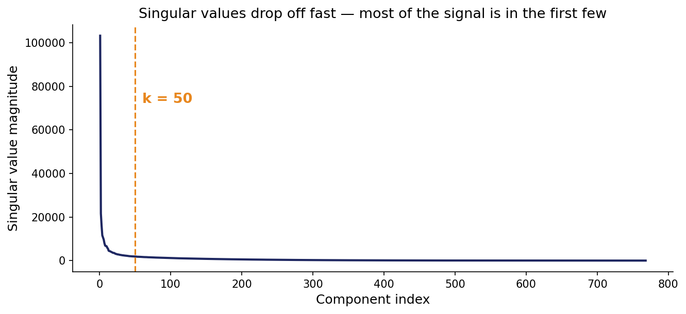
Backup — Why Does k = 50 Work?
First 50 components capture 98.4% of the image's total signal

Slide 15
Backup — Inside Self-Attention
Attention(Q, K, V) = softmax( QK^{T} / √d ) V
Q (Query)
"What am I looking for?" — a vector per word
K (Key)
"What do I contain?" — a vector per word
V (Value)
"What do I actually pass along?" — a vector per word
QK^{T}
How well each word's query matches every other word's key — just a matrix product
softmax( · )
Turns those match scores into probability weights — same softmax used in classification

